Slide 1
PHYSICS
The study of energy and matter and how they interact

Slide 2
Motion is observed when there is a change in distance between an object and a point in space. Motion is a result of a change in energy of an object.
Motion can be measure by the distance an object travels in a specific amount of time. (velocity)
Calculations can be done with the equation:
v = ^{d} / _{t} the base units are meters/second

Slide 3
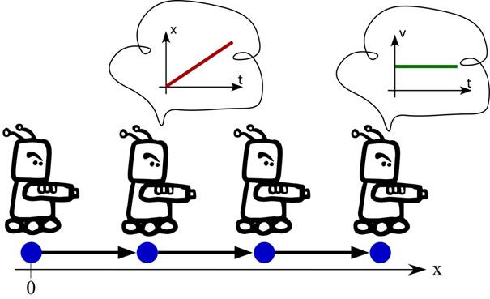
Uniform motion
When an object is traveling in a straight line at a constant speed.

Slide 4
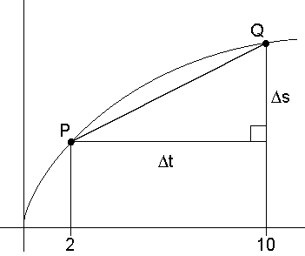
Average velocity
V_{avg} be calculated by using the total displacement and total time of motion.

Slide 5
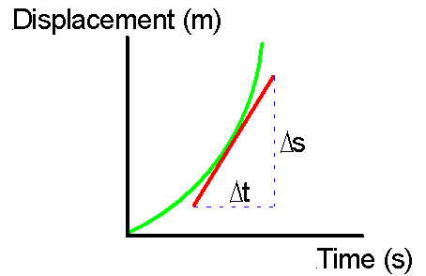
Instantaneous velocity
The speed of an object at any one point in time.

Slide 6
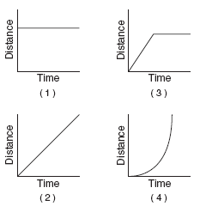
Graphing
Motion can also be demonstrated by graphing.
Using a table of distances and corresponding times we can make a
graph showing motion.
Uniform motion
produces a straight
line of best fit on a
distance – time graph.

Slide 7
Graphing Motion
Graph A
Graph B
Graph C
Distance
(m)
Distance
(m)
Distance
(m)
Time
(s)
Time
(s)
Time
(s)
All graphs represent uniform motion.
Graph A is an object traveling away (positive velocity)
Graph B is an object traveling towards or backwards (negative velocity)
Graph C is an object at rest.

Slide 8
Slope
on a distance-time graph can be found for the line of best fit.
The slope is rise divided by run; or distance divided by time. (speed).
Find slope between two chosen points on the line of best fit.
Slope = ^{rise}/_{run}
Slope = ^{d2 – d1}/ _{t2 – t1}

Slide 9
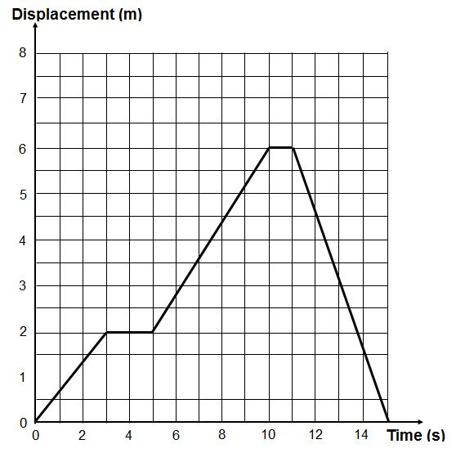
Create a story for the graph here.
Include velovities.

