Slide 1
1.2 Discovery Through Technology
Imagination, and improvements in observation instruments and tools, advanced Ancient Astronomy into a more precise scientific understanding of the heavens.

Slide 2
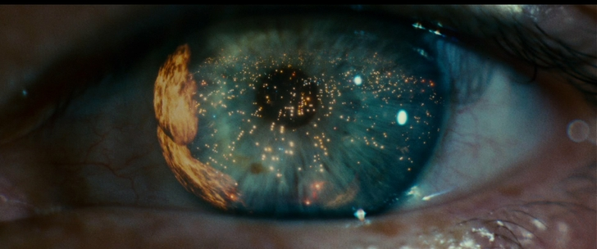
Looking with the naked eye
The earliest astronomers used several tools to chart the position of objects in the sky and to predict where the sun, moon, and certain stars would move. With the heavens serving as both timekeeper and navigational aid, such knowledge was of much more than scholarly interest.

Slide 3
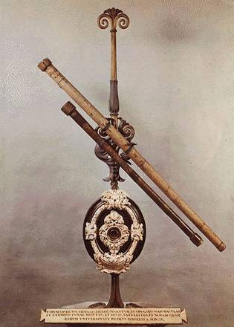
Early Telescope
Before 1609, when Galileo began using a brand new invention called the telescope, humankind's perception of the cosmos was limited to what could be seen with the naked eye. It was natural to perceive Earth as the center of the universe, with a transparent, starry sphere rotating around it.

Slide 4
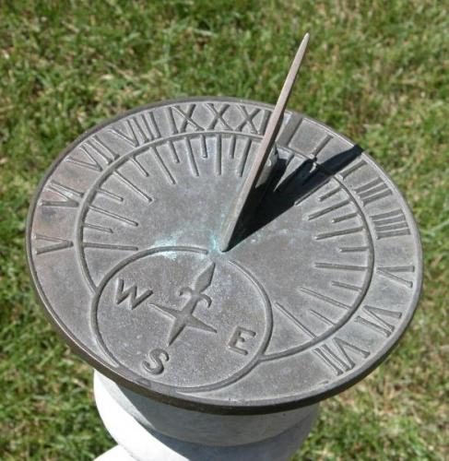
Sundial
A sundial works by casting a shadow in different positions, at different times of the day. The must be aligned withy the celestial north.

Slide 5
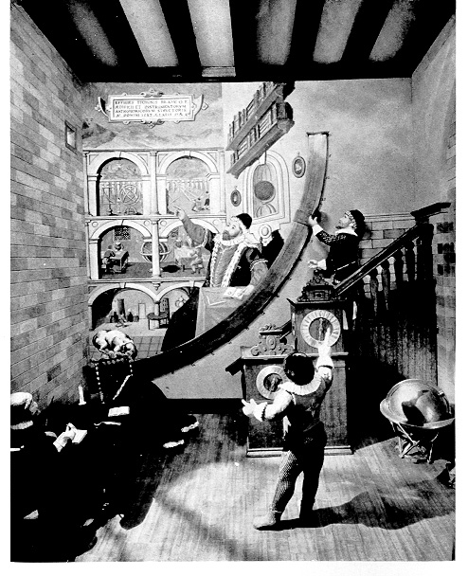
Quadrant
Tycho Brahe was an observation genius in astronomy before the age of the telescope. The mural, or Tychonian quadrant was actually a very large brass quadrant, affixed to a wall. Its radius measured almost two meters and was graduated in tens of seconds. Sightings were taken along the quadrant through the small window in the opposing wall, to which Tycho points. The clock shown at the bottom right, accurate to seconds, allowed the observers to note the precise moment of observation.

Slide 6
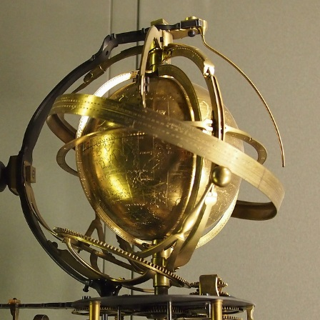
Armillery Sphere
was used to locate celestial objects As measuring devices became more and more precise, old notions about the universe began to crumble. For example, Brahe's measurements--even though they were made
with the naked eye--were fine enough to reveal that comets move through the same region of space as the planets. That destroyed the idea that planets occupied a special place that no other object could penetrate.

Slide 7
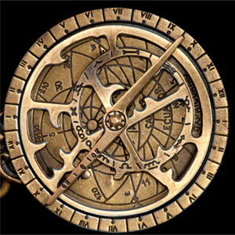
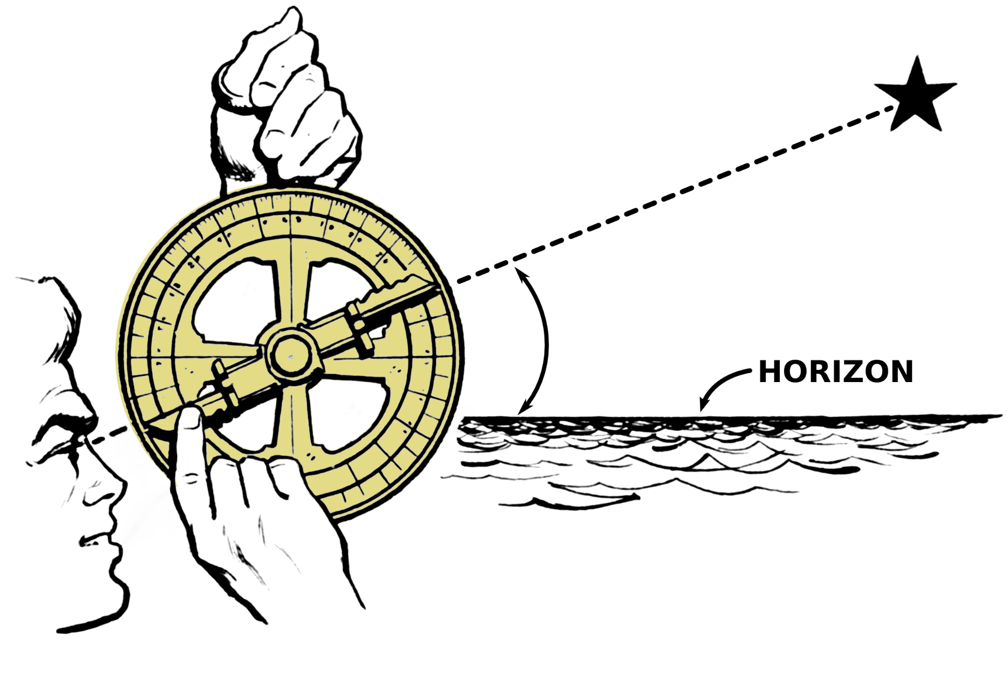
Astrolabe

Slide 8
Astrolabe
The astrolabe is the instrument used to observe the stars and determine their position on the horizon. It had two parts. The back had a moveable sighting arm and a scale for measuring altitude, while the front had a map of the heavens that helped to calculate the future position of objects. With this device, astronomers and others could predict when the sun and certain bright stars would rise or set on any given day. Ipparch invented the astrolabe in the 2nd century B.C. Ptolemy used the astrolabe as a type of geographical map. They were later used to tell time. In the Middle Ages the astrolabe was the main instrument for navigation later to be replaced by the sextant. At the beginning of the 20th century the prismatic astrolabe appeared, enabling the rays of a celestial body to be reflected onto a mercury surface to determine the point in time that it reached a certain height on the horizon.

Slide 9
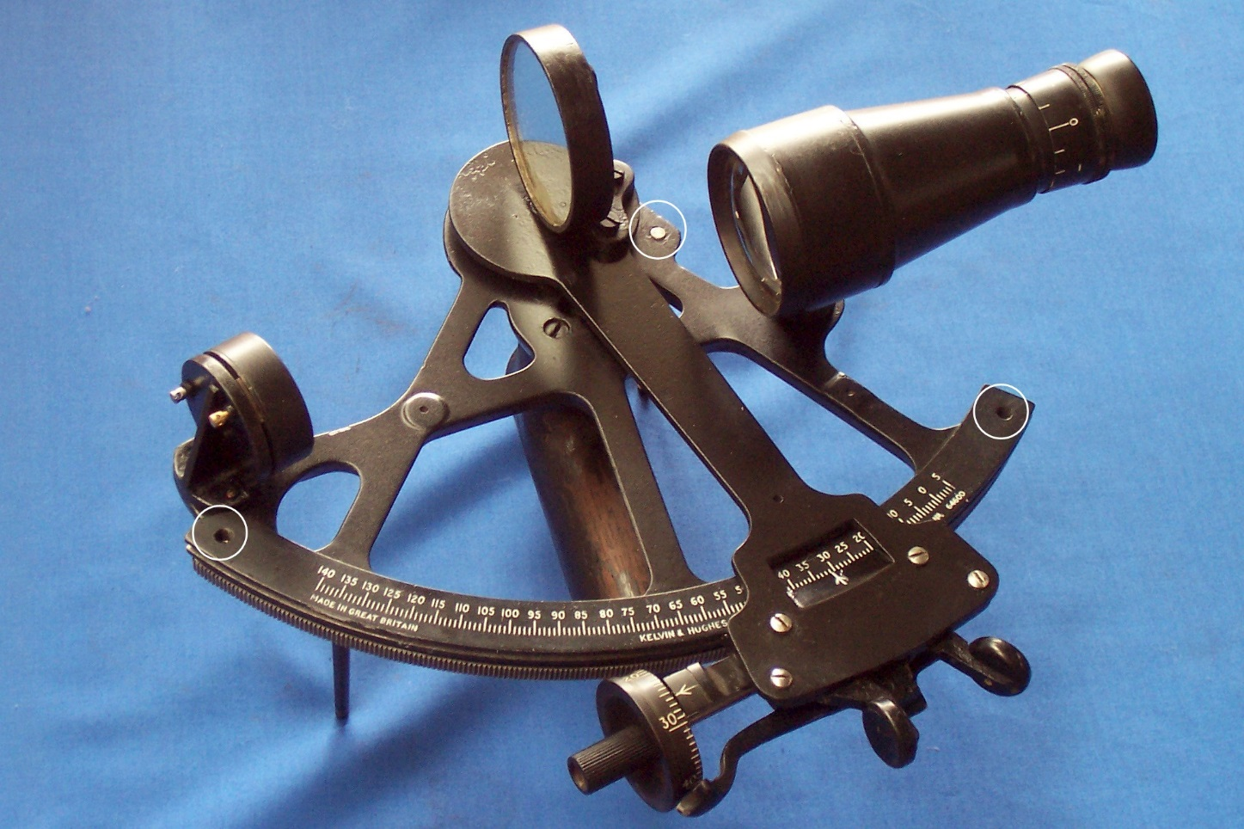
Sextant
A sextant is a tool for measuring the angular altitude of a star above the horizon, which was usually the sun. Primarily, they were used for navigation. This instrument can be used to measure the height of a celestial body from aircraft, spacecraft or the ship's deck. The main types are the sextant used for ships and the bubble sextant used only on aircraft.
Click the pic

Slide 10
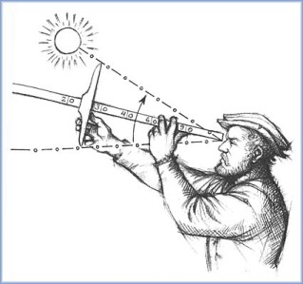
Cross-staff
The cross-staff was made up of a straight staff, marked with graduated scales, with a closefitting, sliding crosspiece. The navigator rested the staff on his cheekbone and lined up one end of the moving crosspiece with the horizon and the other end with the bottom of the pole star, or the sun at midday.
The position of the cross
piece on the staff gave the
reading of altitude.

Slide 11
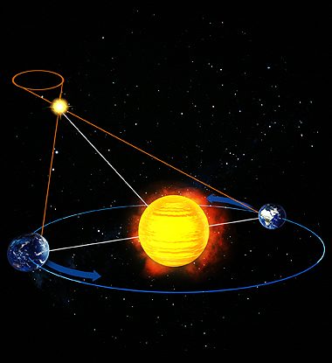
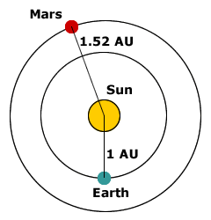
Astronomical Units (AU)
The astronomical unit is used for measuring 'local' distances in the solar system. It is equal to the distance from the center of the Sun to the center of the Earth
(approximately 149,599,000 kms).

Slide 12
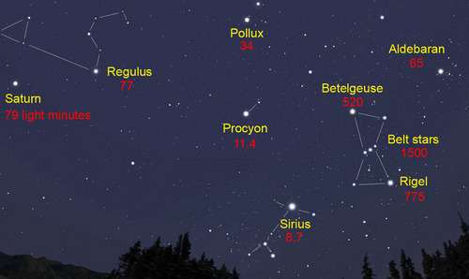
Light-Year
A light-year is equal to the distance light travels in 1 year (approximately 9.5 trillion kms). It is used for longer distances - to stars and galaxies. The distance to our nearest star, Proxima Centauri is a little over 4 light years.

Slide 13
Looking Into The Past
When you view an object in the sky you are seeing it as it was in the past. It has taken the light a very long time to reach the Earth. Light from the Sun takes about 500 seconds (8.3 min) minutes to reach the Earth, whereas light from Pluto takes about 5.5 hours. The farther away, the longer light takes to reach the Earth. Light from the stars in the center of the universe takes about 25,000 years to reach the Earth. The Hubble telescope is capturing light from 12 billion years ago.

Slide 14
Homework
P. 383 # 1-7

