Slide 1
1.3.
The Distribution of Matter in Space

Slide 2
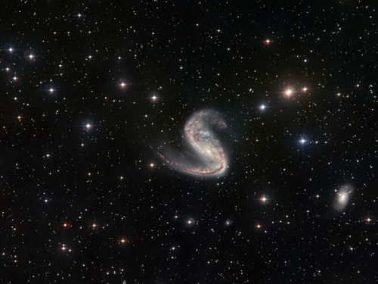
A star is a hot, glowing ball of gas (mainly hydrogen) that gives off light energy. Stars vary in their characteristics. Very hot stars look blue, while cooler stars look red.
In the 1920's, Ejnar Hertzsprung and Henry Norris Russell compared the surface temperature of stars with its brightness (luminosity). Stars fall into distinct groupings.

Slide 3
They graphed their data to show the relationship between brightness and temperature of stars was not random. p. 385

Slide 4
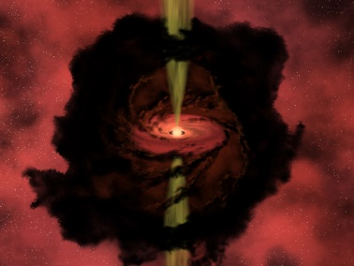
Birth of Stars
Stars form in regions of space where there are huge accumulations of gas and dust called nebulae. Interstellar matter, which makes up part of the nebulae, originated from exploding stars. The process of 'star-building' is known as fusion, which releases great amounts of energy and radiation. A detailed explanation is provided on p. 386 in the textbook.

Slide 5
Lifecycle of a Star

Slide 6
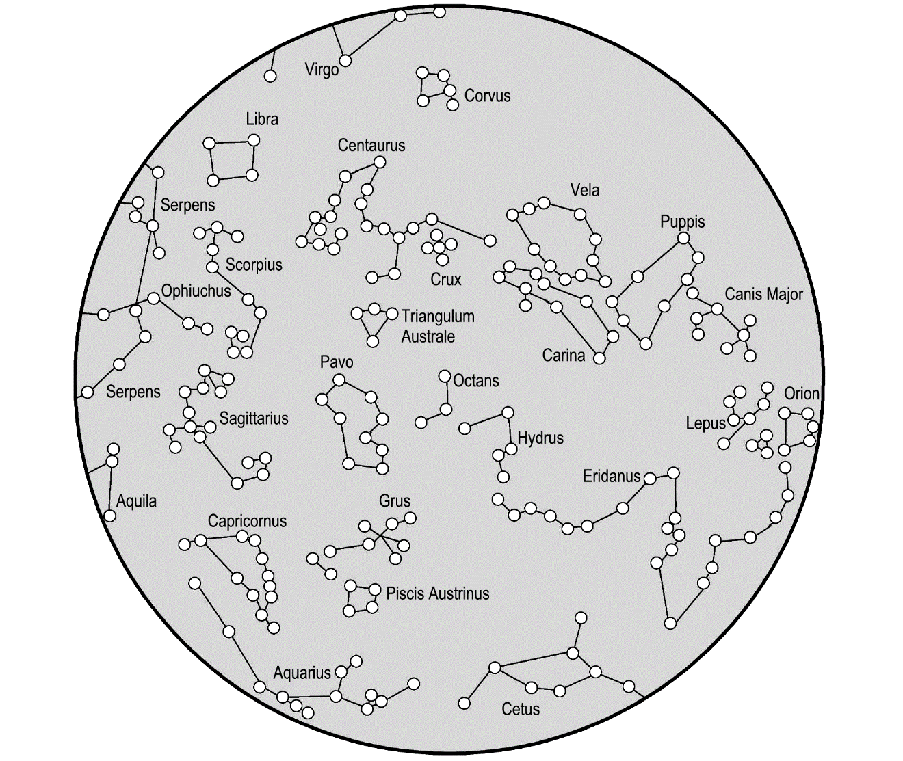
Star Groups
Constellations are the groupings of stars we see as patterns in the night sky. There are 88 constellations
and many are
explained in
Greek Mythology.

Slide 7
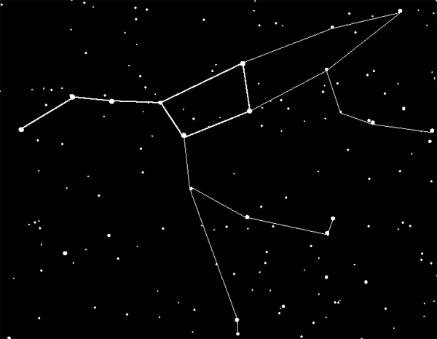
Asterisms
are also groupings of stars but are not officially recognized as constellations.

Slide 8
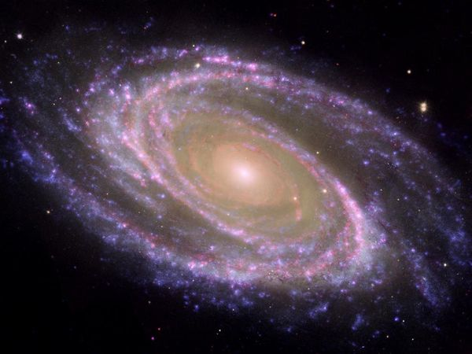
Galaxies
A galaxy is a grouping of millions or billions of stars, gas and dust. It is held together by gravity. The Milky Way Galaxy is the galaxy our solar system is a part of. It is shaped like a flattened pinwheel, with arms spiraling out from the center.

Slide 9
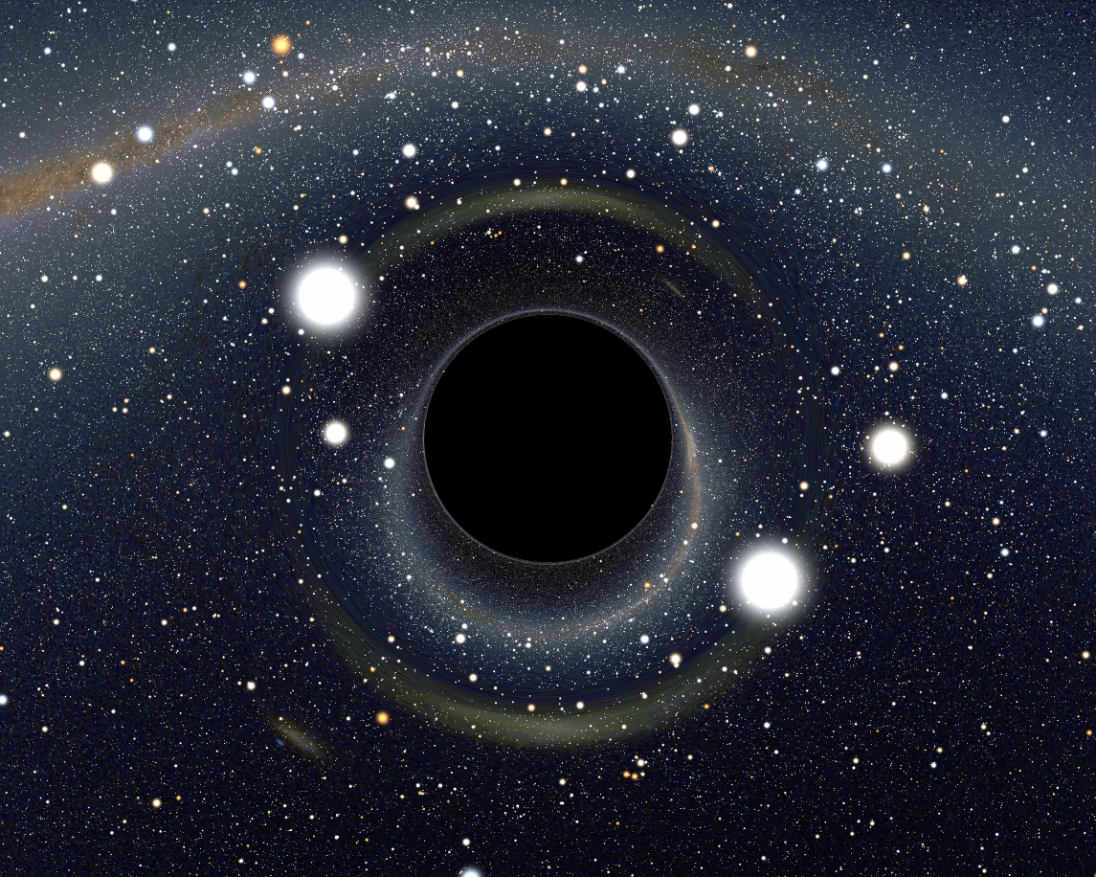
Black holes
are actually invisible to telescopes. Their existence is only known by an indirect method
when celestial material comes close to a black hole it becomes very hot and very bright

Slide 10
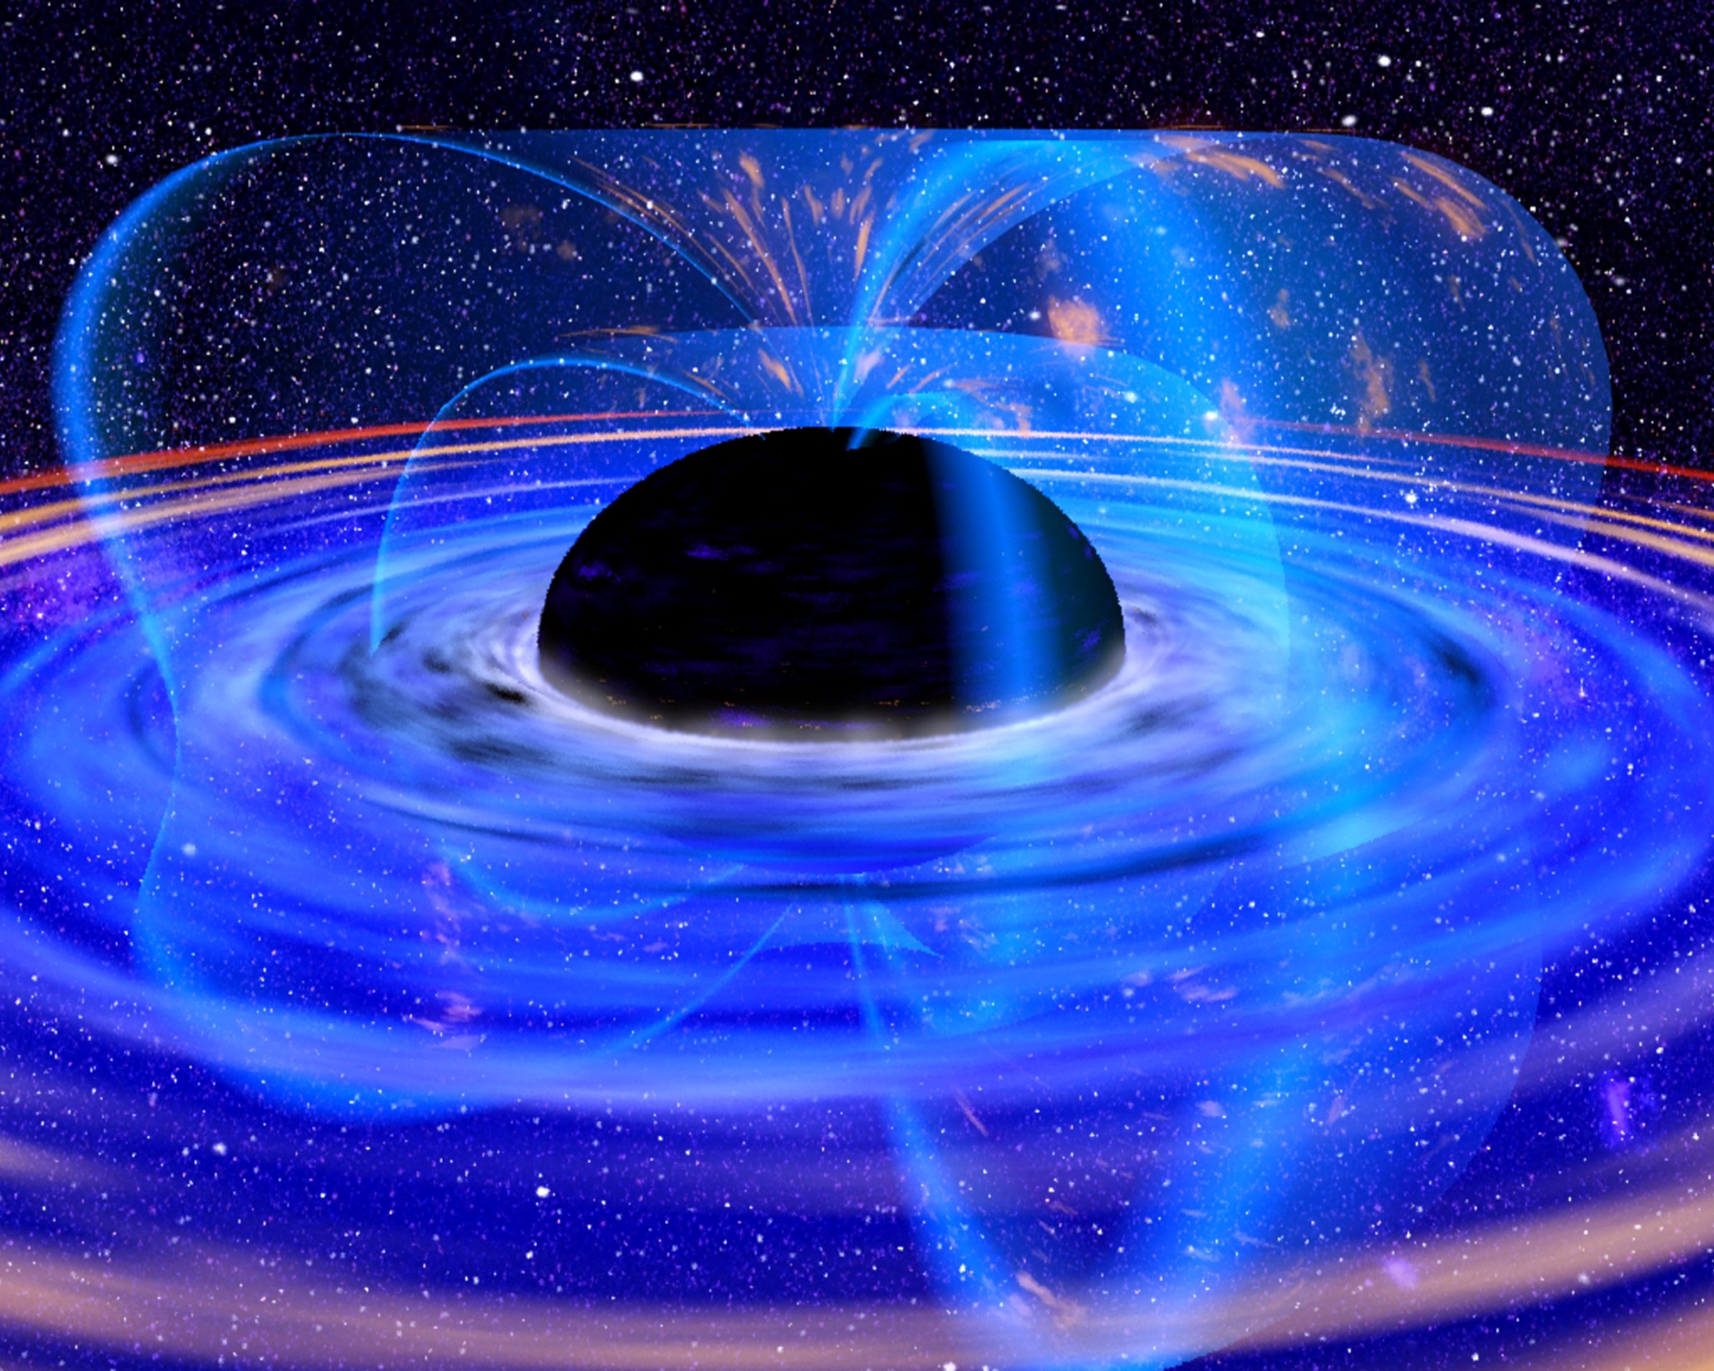
Homework → P. 391 # 1-8

