Slide 1
Energy and Work

Slide 2
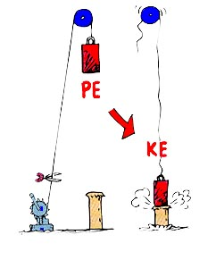
Energy
Energy is the ability to do work.
There are two main types of energy; kinetic and potential.
Kinetic energy (E_{k}) is the energy of an object due to it’s motion.
Potential energy (E_{p}) is the energy of an object due to it’s position or state.

Slide 3
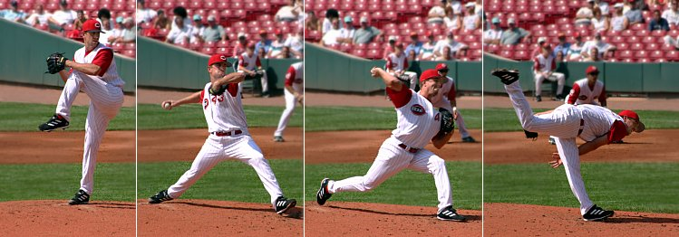
work
The work done on an object is theoretically equal to the energy converted.
A baseball pitcher does positive work on the ball by applying a force to it over the distance it moves while in his grip.
W = F x d
d = vΔt
&
F = ma
W = ΔE

Slide 4
Energy can be found in many forms:
Gravitational energy Heat energy
Chemical energy Mechanical energy
Magnetic energy Sound energy
Electrical energy etc.

Slide 5
Scientists
Scientists through history have become known for their developments in energy conversions:
Lavoisier found a mathematical relationship between chemicals and heat.
Volta converted chemical energy to electrical energy.
Oersted found it is possible to convert electrical energy to magnetism.
Faraday showed magnetism can be converted back to electricity. (generators)
Seebeck discovered how to convert heat to electricity.
Edison was able to convert electricity to light energy.
Joule was one of the first scientists to show that heat can be converted to work.

Slide 6
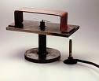
Oersted
Faraday
Seebeck
Volta

Slide 7
Calculating energy change
The most common form of energy change is due to gravity.
Weight is the force acting on an object due to gravity.
Mass is a measure of the amount of matter in an object. Mass and weight may be related, but they are very different properties.
On earth (at sea level) the effect due to gravity is 9.81m/s². All bodies in space produce a unique gravitational effect on other bodies. The gravity of the moon is about one sixth of the earth’s gravity.

Slide 8
gravitational potential energy → E_{g} = mgh
The formula for calculating gravitational potential energy is: E_{g} = mgh
m is mass
g is gravitational constant
h is height above the ground.
The units for E_{g} are kg○m²/s² .
This is also known as a Joule (J).
Notice in F = ma
m → mass
a → acceleration

Slide 9
Practice Problem #1
A weightlifter lifts a barbell a vertical distance of 2.40m If the average force required to lift the barbell is 2.00 x 10³ N how much work is done by the weightlifter on the barbell?

Slide 10
Practice Problem #2
A weightlifter does 4.80 x 10³ J of work in lifting a barbell. How much energy is gained by the barbell?

