Slide 1
1.5. Describing the Position of Objects in Space
Altitude and Azimuth are calculated from the observer's position.

Slide 2
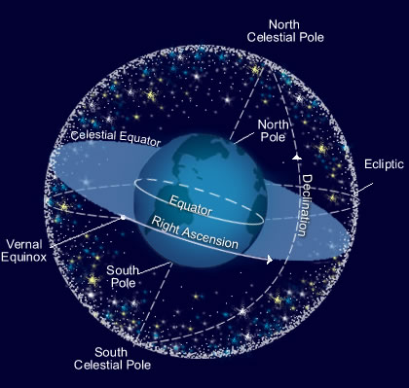
The Celestial Sphere
The stars can be imagined to be points of light on a sphere which rotates about the Earth. Projecting the Earth's poles and equator out onto this imaginary sphere provides a framework for celestial measurement.

Slide 3
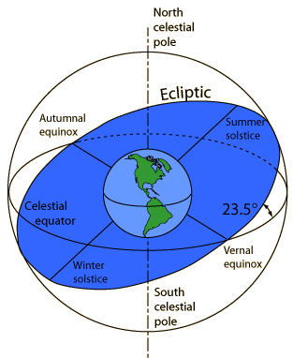
The Ecliptic
The apparent path of the Sun's motion on the celestial sphere as seen from Earth is called the ecliptic.
The ecliptic plane is tilted 23.5° with respect to the plane of the celestial equator since the Earth's spin axis is tilted 23.5° with respect to its orbit around the sun.
The ecliptic plane intersects the celestial equatorial plane along the line between the equinoxes.

Slide 4
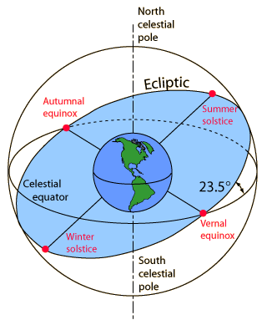
Equinoxes and Solstices
The points where the ecliptic crosses the equatorial plane of the celestial sphere are called equinoxes. On those dates there are 12 hours each of daylight and dark.
The most northern excursion of the sun is called the summer solstice and will have the longest amount of daylight.
The winter solstice opposite it is the shortest period of daylight.

Slide 5
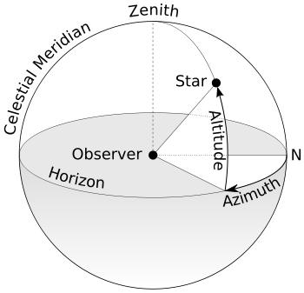
Altitude
Altitude gives you the "how above the horizon it is"; the point straight overhead has an altitude of +90 degrees; straight underneath, an altitude of -90 degrees. Points on the horizon have 0 degree altitudes. An object halfway up in the sky has an altitude of 45 degrees.

Slide 6
Azimuth
Azimuth determines "which compass direction it can be found in the sky." An azimuth of zero degrees puts the object in the North. An azimuth of 90 degrees puts the object in the East. An azimuth of 180 degrees puts the object in the South, and one of 270 degrees puts the object in the west.

Slide 7
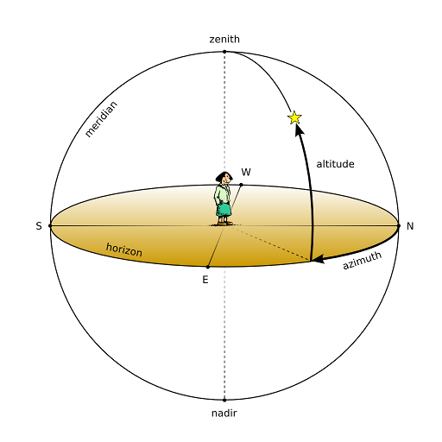
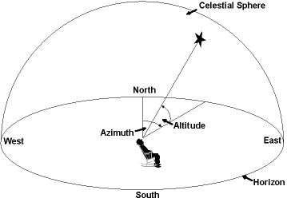
Zenith
Zenith is the position in the sky directly overhead.

Slide 8
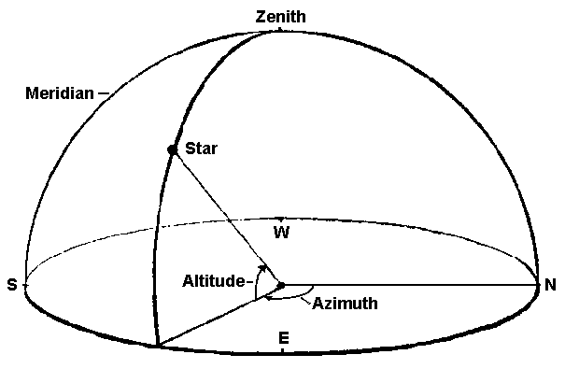
Thus, if Guide tells you that a star that is at altitude 40 degrees, azimuth 110 degrees, look a little South of due East, a little less than half of the way from the horizon to the zenith.
90⁰
40⁰
270⁰
180⁰
0⁰
110⁰
0⁰
90⁰

Slide 9
Homework
1.5 Object position in space
P. 405 # 1-7

