Slide 1
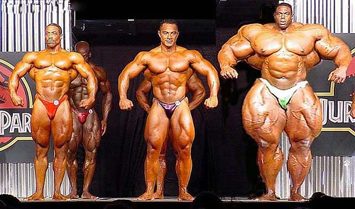
Movement and Muscle Tissue
10.1

Slide 2
Types of Muscles
Skeletal
  Aka Muscle Fibres
  Striated (have bands of light & dark tissue) and tubular
  Many nuclei
  Voluntary contraction
  Attached to bones of skeleton

Slide 3
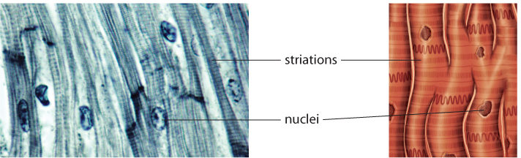
Types of Muscles
Cardiac
  Striated, tubular, and branched
  One nucleus
  Involuntary contraction
  Found only in the heart

Slide 4
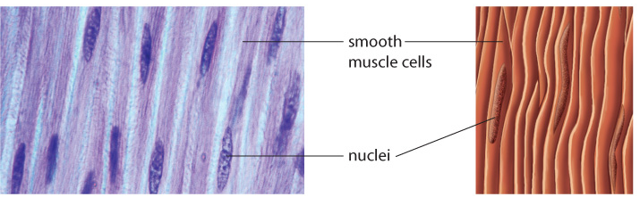
Types of Muscles
Smooth
  Non-striated
  One nucleus
  Involuntary contraction
  Found in walls of internal organs
  Slow to contract, but can sustain prolonged contractions
  Not easily fatigued

Slide 5
Cooperation of Skeletal Muscles
Muscles can only pull, they can not push
It takes at least one pair of muscles to move a body part
  Eg.) Biceps and Triceps

Slide 6
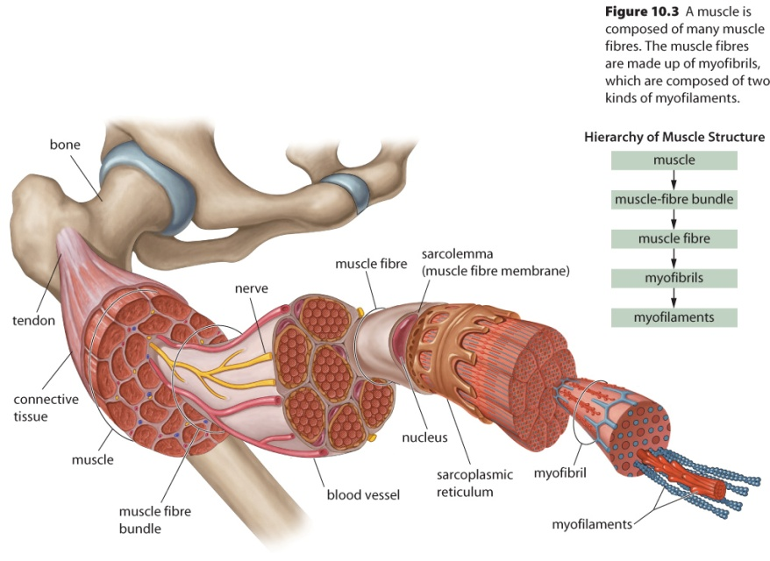
Anatomy of a Muscle
Muscle fibres can be 20 cm long and are organized into many larger bundles
Connective tissue surrounds each fibre, bundle, and the entire muscle
Blood vessels and nerves run between bundles

Slide 7
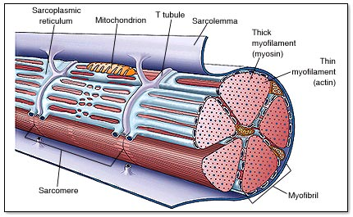
Muscle Fibre Continued:
Within a muscle fibre:
  Myofibrils → cylindrical subunits made of myofilaments
  Myofilaments → contain protein structures responsible for muscle contraction
  ~300 mitochondria
  Other organelles (common to most cells, but may have a different name – see Table 10.1, pg 336)

Slide 8
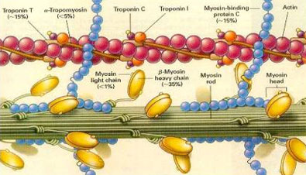
Mechanism of Muscle Fibre Contractions
2 types of myofilaments
  Actin myofilament
    2 bead-like strands of protein wrapped around each other
  Myosin myofilament
    10X longer than an actin myofilament – a long rod with a double-headed globular region at one end

Slide 9
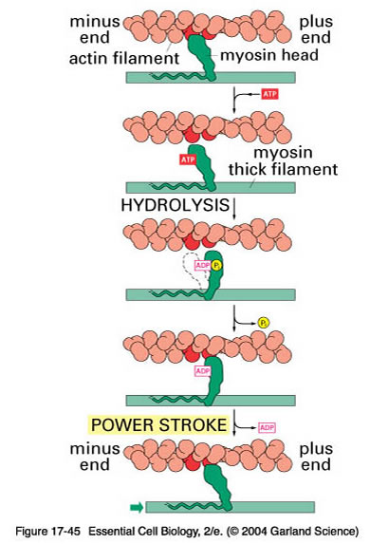
Contraction of Muscle
  Heads of myosin move first
  Attached to actin, pulls the actin along
  Multiple myosin heads ‘walk’ along the actin → each step requires a molecule of ATP to reposition the myosin
    Sliding filament model

Slide 10
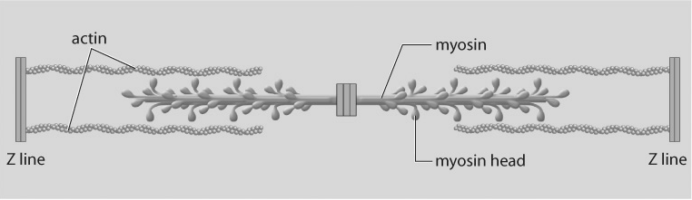
Mechanism of Muscle Fibre Contractions (continued)
Actin is anchored at the Z line
Muscle contracts as the Z line at each end of a pair of actin myofilaments are pulled closer to each other
Notes:
See page 338, Figure 10.6
10

Slide 11
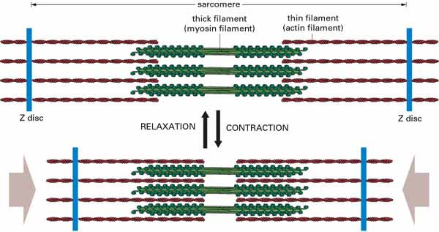

Slide 12
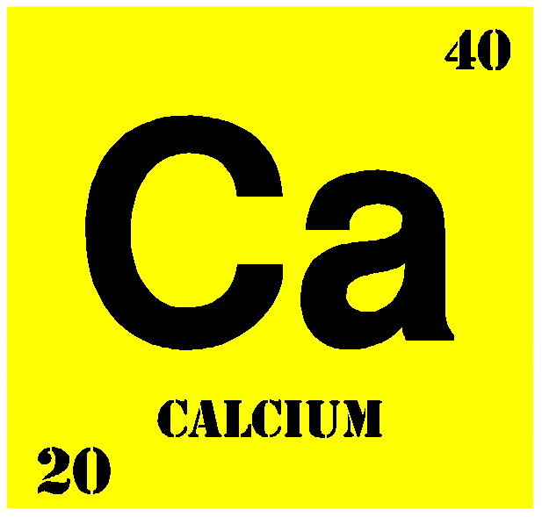
Role of Calcium
Attachment sites for myosin are blocked by tropomyosin in relaxed muscle
  To be removed, it must bond with troponin
  Concentration of calcium ions in the sarcoplasm regulates the bonding
    High Ca²⁺ concentration → Ca²⁺ binds with the troponin
    Low Ca²⁺ concentration → myosin is blocked

Slide 13
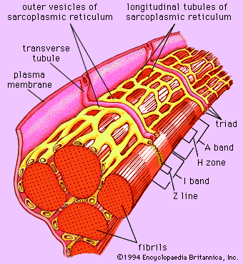
Storage
Where does the calcium come from?
  Muscle fibre is stimulated to contract, Ca²⁺ is released from the sacroplasmic reticulum, diffusing into the myofibrils
  When muscles are no longer stimulated, Ca²⁺ returns to sacroplasmic reticulum by active transport

