Slide 1
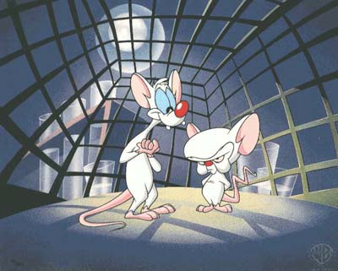
The Central Nervous System

Slide 2
White Matter vs. Grey Matter
White Matter
Myelinated axons running in tracts
Inner regions of brain
Outer area of spine
Grey Matter
Mostly cell bodies, dendrites, short unmylenated axons
Outside areas of brain
H-shaped core in spine

Slide 3
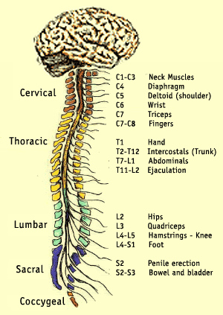
Spinal Cord
Vital communication link between PNS and CNS
Primary reflex centre
Coordinates incoming and outgoing information
Protected by cerebrospinal fluid

Slide 4
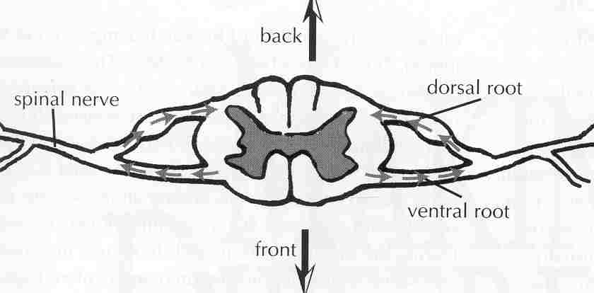
Cross Section of Spine
Spinal cord : carries sensory messages to and from brain, plus relays many reflexes on it’s own.
Dorsal root carries sensory neurons
Ventral root carries motor neurons

Slide 5
The Brains Bodyguards
The brain is extremely fragile, so for protection it has:
Skull
Meninges (membranes)
Dura mater – outer layer
Arachnoid – middle layer
Pia mater – inner layer
Cerebrospinal fluid
between pia and arachnoid
Shock absorber and transport system (nutrients, hormones)

Slide 6
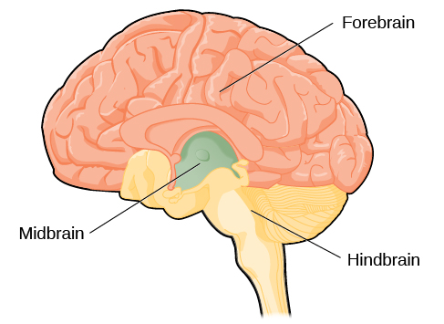
Parts of the Brain
Composed of three distinct regions:
Forebrain
Olfactory lobes – smell
Cerebrum – two hemispheres
Surface of cerebrum is called cerebral cortex
Folds in cortex are called fissures
Midbrain
Hindbrain
Corpus callosum bundle of nerves allowing for communication between hemispheres

Slide 7
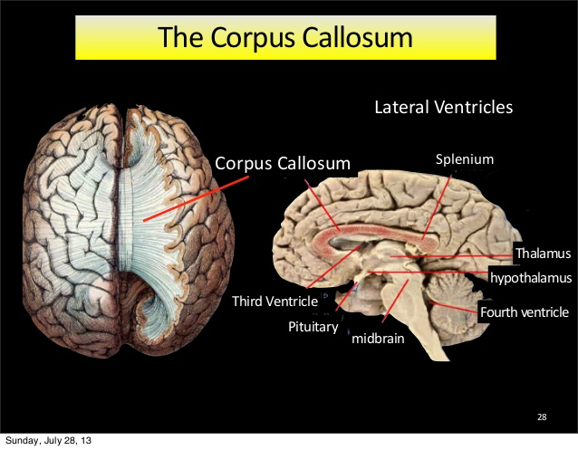
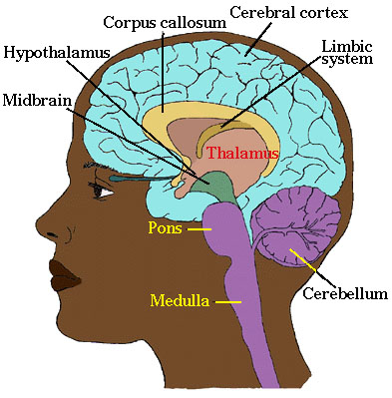
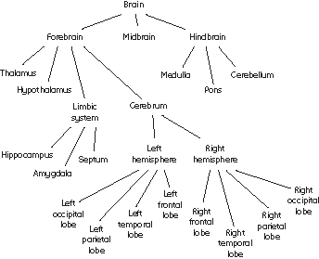

Slide 8
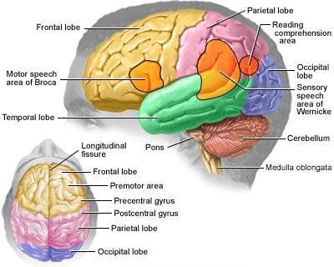
THE BRAIN

Slide 9
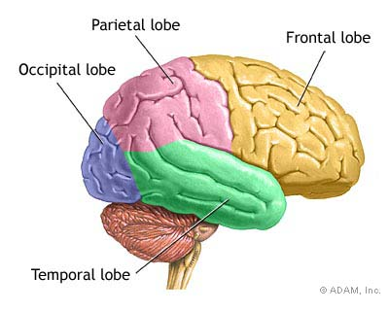
Forebrain
Cerebrum (4 lobes)
Frontal Lobe
Motor areas
Voluntary muscle movement
Intellectual activities
Personality
Temporal Lobe
Vision & Hearing
Memory
Interpretation of sensory information

Slide 10
Forbrain continued
Parietal Lobe
Touch
Temp awareness
Emotions
Interpreting speech
Occipital Lobe
Vision
Interpreting visual information
Thalmus
Coordinates & interprets sensory info to & from cerbral cortex
Hypothalamus

Slide 11
Midbrain
Relay center for eye and ear reflexes
Hindbrain
Cerebellum
Controls limb movement, balance, & muscle tone
Pons
Passes info between two regions of cerebellum, and between cerebellum and medulla oblongata
Medulla oblongata
Connection between PNS and CNS
Regulates involuntary muscle action (i.e. Breating, HR, etc.)

Slide 12
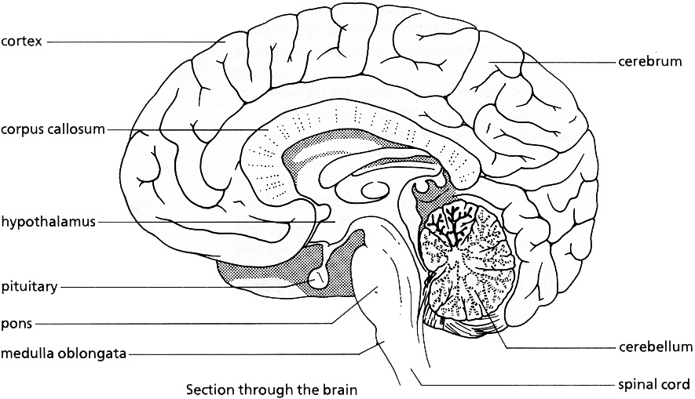
The Brain (Structure)

Slide 13
Speech and the Cerebrum
Broca's Area
Coordinates muscles for speaking
Translates thought to speech
Damage to this area
Inability to speak
Still understand speech
Wernicke's Area
Stores info involved in language comprehension
Damage to this area
able to speak
Words would make little sense

Slide 14
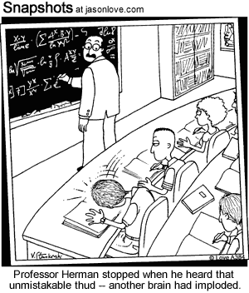
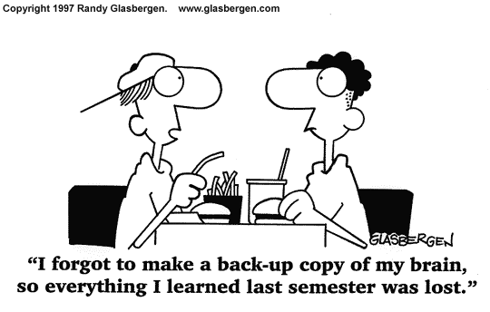

Slide 15
Watch Crash Course A&P 11 https://youtu.be/q8NtmDrb_qo

