Slide 1
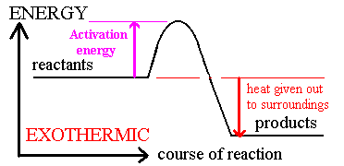
Enthalpy Diagram -Exothermic Change
If ∆H is negative, H_{(products)} < H_{(reactants)}
There is an enthalpy decrease and heat is released to the surroundings.
enthalpy

Slide 2
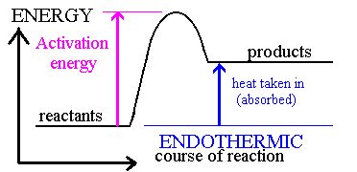
Enthalpy Diagram - Endothermic Change
If ∆H is positive, H_{(products)} > H_{(reactants)}
There is an enthalpy increase and heat is absorbed from the surroundings.
enthalpy

Slide 3
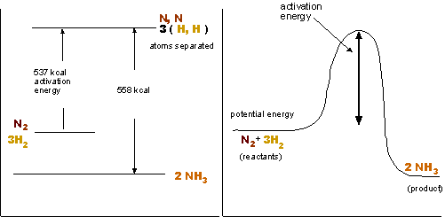
Example: Enthalpy change in a chemical reaction
Exothermic reactions release heat
N₂(g) + 3H₂(g) → 2 NH₃(g) ∆H = -92.4 kJ/mol
The coefficients in the balanced equation represent the number of moles of reactants and products.

Slide 4
N₂(g) + 3H₂(g) → 2 NH₃(g)
∆H = -92.4 kJ/mol
State symbols are ESSENTIAL as changes of state involve changes in thermal energy.
The enthalpy change is directly proportional to the number of moles of substance involved in the reaction.
For the above equation, 92.4 kJ is released - for each mole of N₂ reacted - for every 3 moles of H₂ reacted - for every 2 moles of NH₃ produced.

Slide 5
Note: the enthalpy change can be read directly from the enthalpy profile diagram.
The reverse reaction
2 NH₃(g) → N₂(g) + 3H₂(g) ∆H = +92.4 kJ/mol
N₂(g) + 3H₂(g)
2 NH₃(g)

Slide 6
Thermochemical Standard Conditions
The ∆H value for a given reaction will depend on reaction conditions.
Values for enthalpy changes are standardized :
for the standard enthalpy ∆Hº
Temperature is 298 K
Pressure is 1 atmosphere
All solutions involved are 1 M concentration

Slide 7
Collision Theory
Back to contents
Particle must collide before a reaction takes place
Not all collisions are successful
Activation energy is needed fro a reaction to take place
Particles must approach each other in certain relative way
This is known as the steric effect
To increase the rate you have to:
Have more frequent collisions:
Increase the speed (temperature)
Have more particles (pressure/concentration)
More successful collisions:
Give particles more energy (temperature)
Lower the activation energy (catalyst)

Slide 8
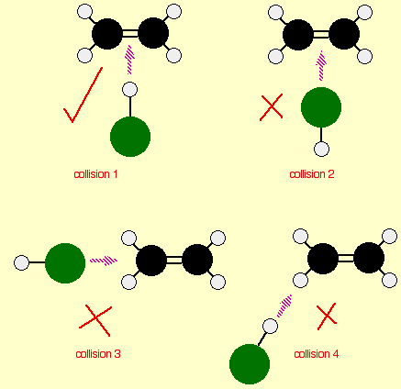
The orientation of collision
Consider a simple reaction involving a collision between two molecules - ethene, CH₂=CH₂, and hydrogen chloride, HCl, for example. These react to give chloroethane.
The reaction can only happen if the hydrogen end of the H-Cl bond approaches the carbon-carbon double bond. Any other collision between the two molecules doesn't work. The two simply bounce off each other.

Slide 9
Factors Effecting Rates of Reaction
Back to contents
Surface Area
Pressure
More chance of a successful collision as more particles exposed
Catalysts in catalytic converters are used in a finely divided form to increase surface area
Particles get closer together which increases the frequency of collisions
It can affect the position of equilibrium

Slide 10
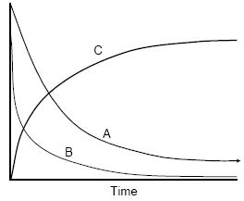
Concentration
Back to contents
Increasing concentration = more frequent collisions = rate increaed
E.g. A + 2B ➔ C
A + B ➔ concentration decreases with time
C ➔ concentration increases with time

Slide 11
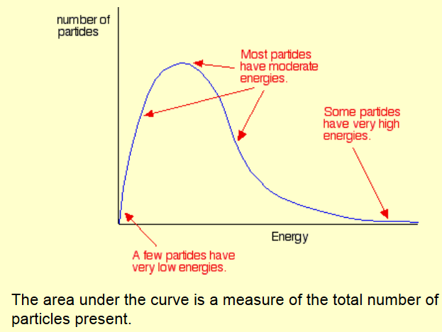
the Maxwell-Boltzmann Distribution
In any system, the
particles present will
have a very wide range
of energies. For gases,
this can be shown on a
graph called the
Maxwell-Boltzmann Distribution which is a plot of the number of particles having each particular energy.

Slide 12
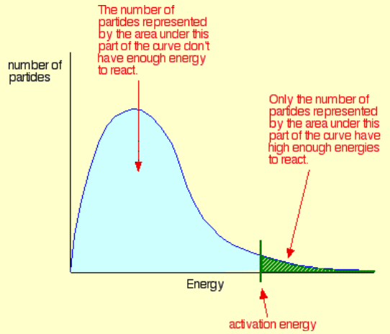

Slide 13
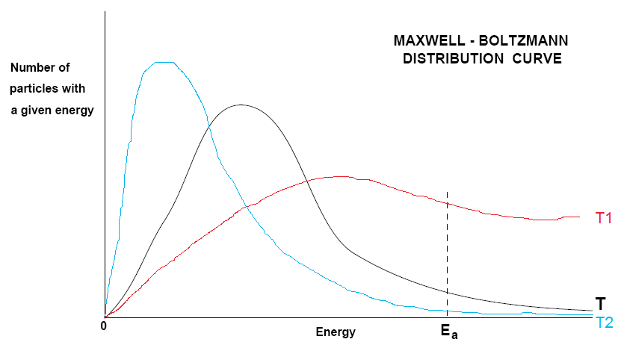
Temperature
Back to contents
Maxwell-Boltzmann Distribution Curve
Particles gain more energy and their speed increases
No particles have zero energy
Move particles have intermediate energy
Area under the curve stays constant
T2: curve gets broader/flatter shift to higher energy
T1: shift to lower energy
T2 > T > T1

Slide 14
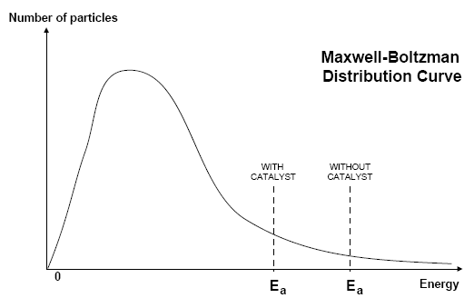
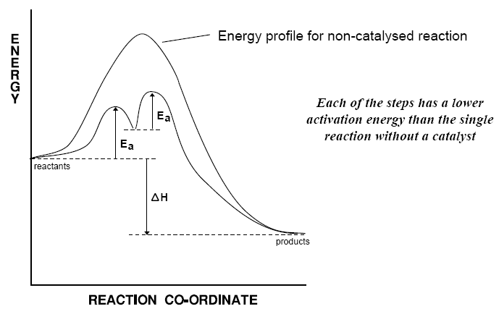
Catalysts
Back to contents
A catalyst increases the rate of a chemical reaction without being used up in the process
Catalysts lower the activation energy so more particles overcome this barrier
There are two types: homogeneous (e.g. CFC’s and ozone) and heterogeneous (e.g. Fe in the Haber Process)

Slide 15
Catalysts Continued
Back to contents
Uses
Catalysts...
Allow reactions to take place at lower temperatures:
Saves energy
Reduces CO₂ output
Enable different reactions to be used:
Better atom economy
Reduce waste
Are often enzymes:
Generate specific products
Operates at lower temperatures
Non-poisonous and are biodegradable
Have great economic importance in industry:
Poly(ethene)
Sulphuric acid
Ammonia
Ethanol production
Can reduce pollution:
Catalytic converters in cars
Used in industry where an increase in temperature would result in lower yield
E.g. Haber Process
They don’t affect equilibrium but do affect the rate of equilibrium
More effective catalysts could result in dramatic savings
They need to be regularly changed as they may become “poisoned” by other chemicals
They are finely divided state to increase the surface area

Slide 16
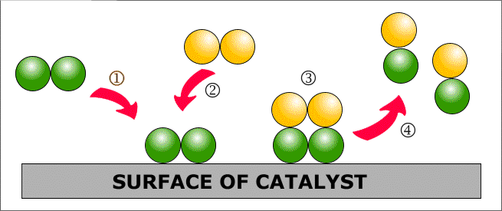
Heterogeneous Catalysis
Back to contents
HARD
etero
=
Adsorption (1)
Particle(s) land onto an active site of a catalyst and forms bonds with the catalyst
It may use some of the bonding electrons in the molecules thus weakening them and making any further reactions easier
Reaction (2 and 3)
Adsorbed gases are held onto the surface in the right orientation for a reaction to occur
This increases the chances of favourable collisions taking place.
Desorption (4)
This is when the molecules that are formed break away from the active site of the catalyst

