Slide 1
Adrenal
Coping with

Slide 2
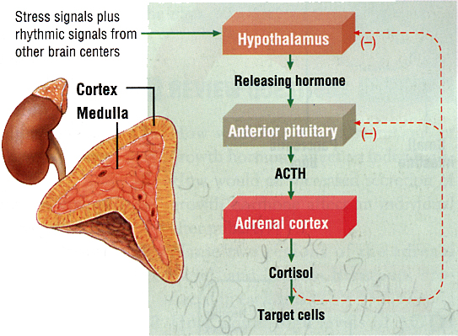
Location and Function
located above the kidney
important for stress situations
Medulla releases adrenaline
cortex releases:
glucocorticoids
mineralocorticoids
sex hormones.

Slide 3
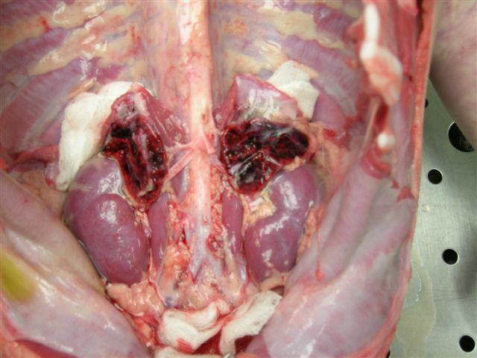

Slide 4
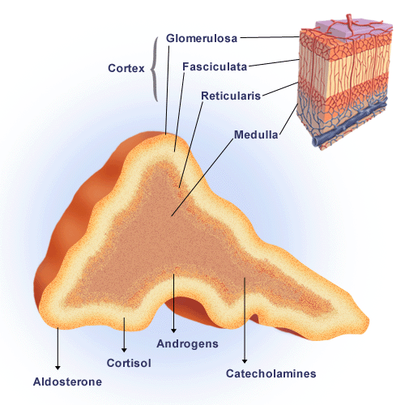
Adrenal Cortex

Slide 5
Glucocorticoids – Cortisol (gluco – think glucose or sugar!)
Target
blood
Primary Function
Increase level of amino acids in blood to be converted into glucose
Released during periods of stress
Malfunction
Addisons Disease (hyposectretion) Characterized by:
Weight loss
Muscle weakness
Fatigue
Low blood pressure

Slide 7
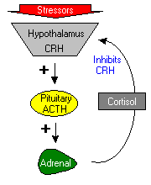
Cortisol Control

Slide 8
Mineralocorticoids - Aldosterone
Target
Kidney
Primary Function
Increase sodium and water reabsorption

Slide 9
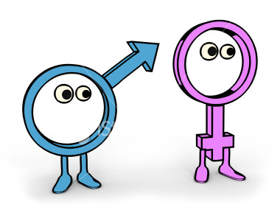
Sex Hormones (not stress)
In males
Converted to testosterone
Accounts for pubic hair growth and increased muscle mass
In females
Produces small amount of estrogen

Slide 10
Adrenal Medulla
Unique in that is it stimulated by the nervous system. A neural implus will be given by the hypothalamus to activate the medulla.

Slide 11
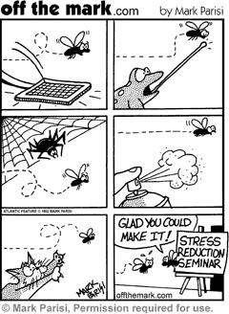
Epinephrine (adrenaline) & Norepinephrine (noradrenaline)
Target
Many organs
Primary Function
Increase
Blood pressure
Heart rate
Breathing
Metabolism
Vessels dialate

Slide 12
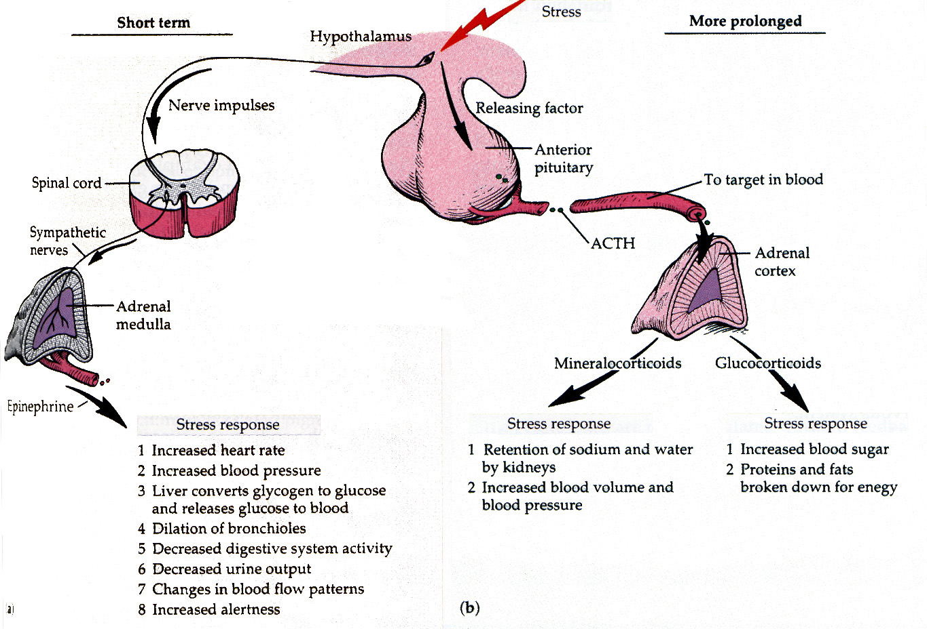

Slide 13
The Big 3
Testosterone
Progesterone
Estrogen

Slide 14
Testosterone
Is produced in the testes
Promotes sperm formation and development of male secondary sex characteristics
More in the next chapter.

Slide 15
Progesterone
Producedin the ovaries
Promotes growth of uterine lining and prevents uterine mascle contractions
More in the next chapter

Slide 16
Estrogen
Produced in the ovaries
Stimulate uterine lining growth and development of female secondary sex characteristics
More in the next chapter

