Slide 1
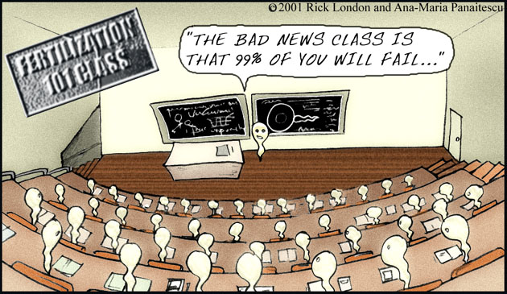
Semen
Transports sperm to female
Nourishes sperm
Protects sperm

Slide 2
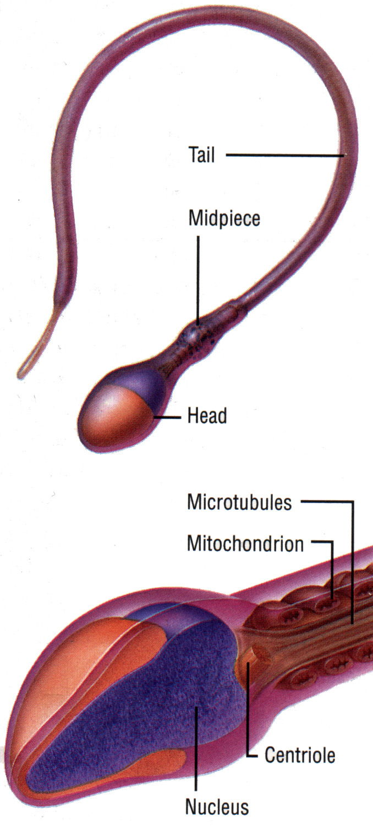
Sperm - Structure
Head
acrosome
enzymes allow penetration of ova
nucleus
DNA, essential for new organism
Middle piece
lots of mitochondria
Tail
flagellum rotates like corkscrew

Slide 3
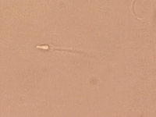
Fluid
Glands secrete it
Seminal Vesicles (4)
drain into ejaculatory duct
Prostate gland
ejaculatory duct join urethra
secretes fluid into urethra
Bulbourethral gland (COWPER'S)
drains into urethra at the base of the prostate
Produce
95% of the
ejaculate volume

Slide 4
Nutrients
Seminal vesicle
fructose (energy)
prostaglandins (muscle contraction in female)
Prostate gland
Alkaline buffer (against acid in vagina – like tums)
Bulbourethral gland (cowper's)
mucus (pre-cum, cleans urethra, aid movement)

Slide 5
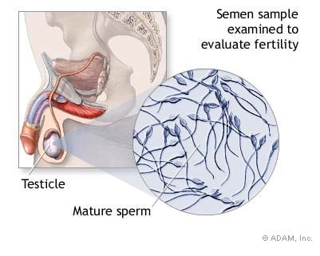
Spermatogenesis
creation of sperm

Slide 6
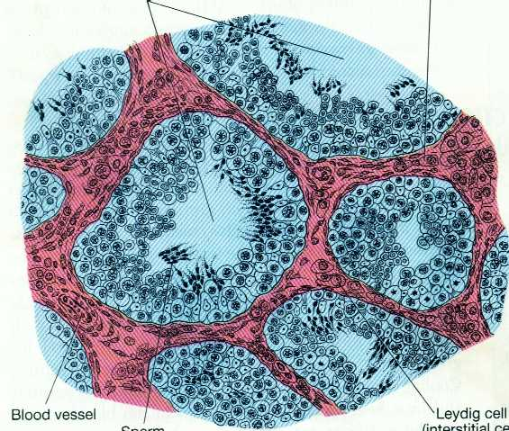
Occurs in Testes
Seminiferous tubules
Sertoli Cells
Respond to FSH
Start sperm production, and nourish developing sperm
Cross Section of Testis
Lumen seminiferous tubule
Leydig cell
Sertoli Cells
Sperm

Slide 7
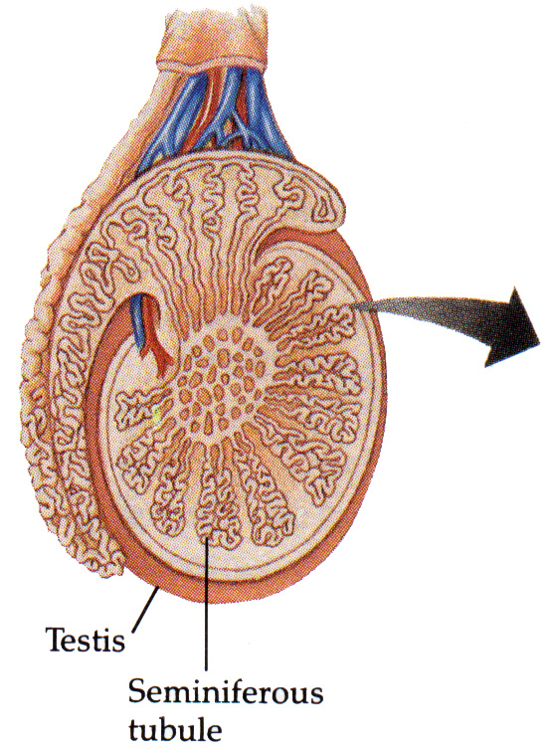
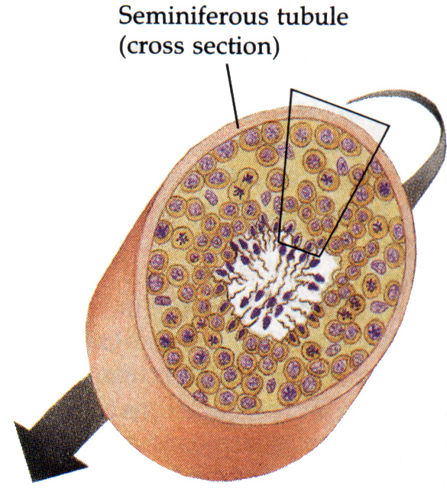
Spermatogenesis – in tubules

Slide 8
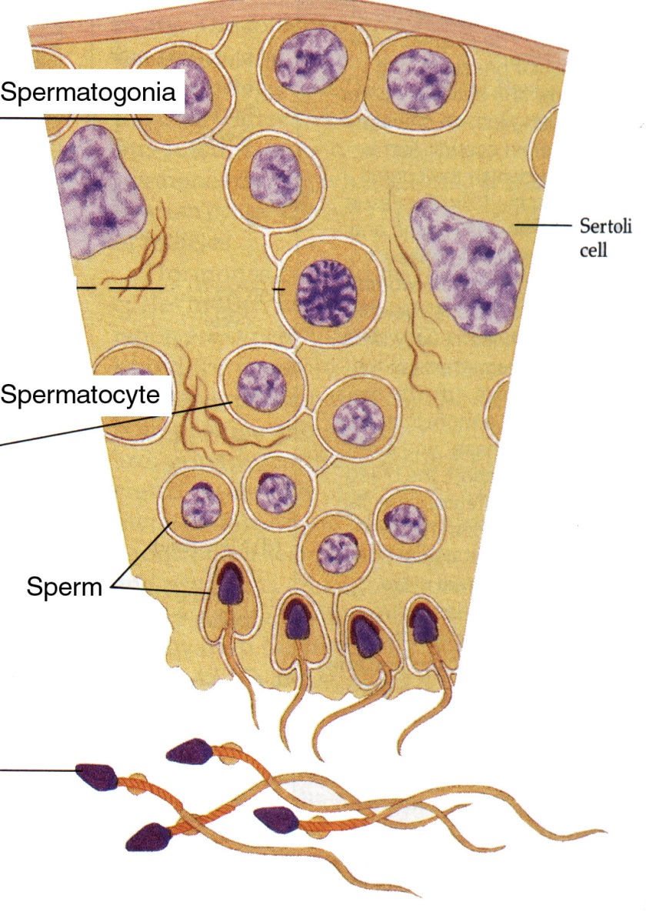
Why males can produce for their lifetime.
Spermatogonia
stem cells that are the precursors of sperm.
divide by mitosis to produce more spermatogonia or
differentiate into spermatocytes.

Slide 9
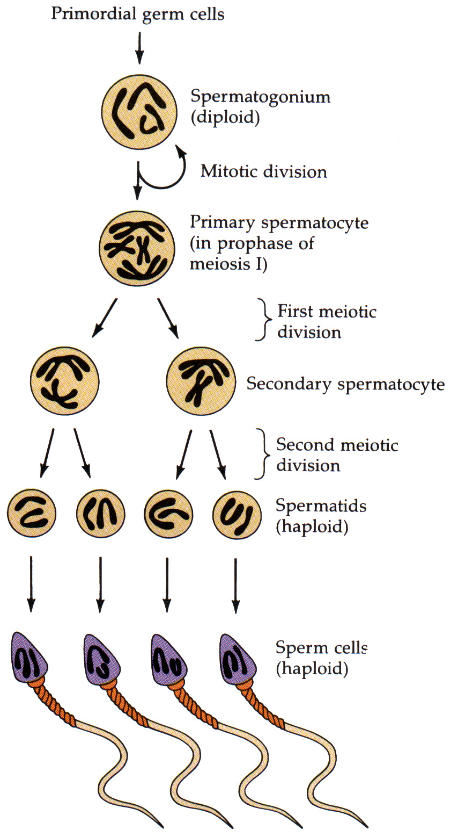
Reductional Division

Slide 10
Testes also produce testosterone
Interstitial space
Leydig cells
Respond to LH
Start testosterone production into blood
Lumen seminiferous tubule
Leydig cell
Sertoli Cells
Sperm
Cross Section of Testis

