Slide 1
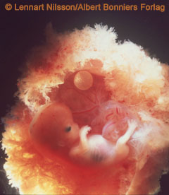
Early Embryo
Embryo bud and cell layers

Slide 2
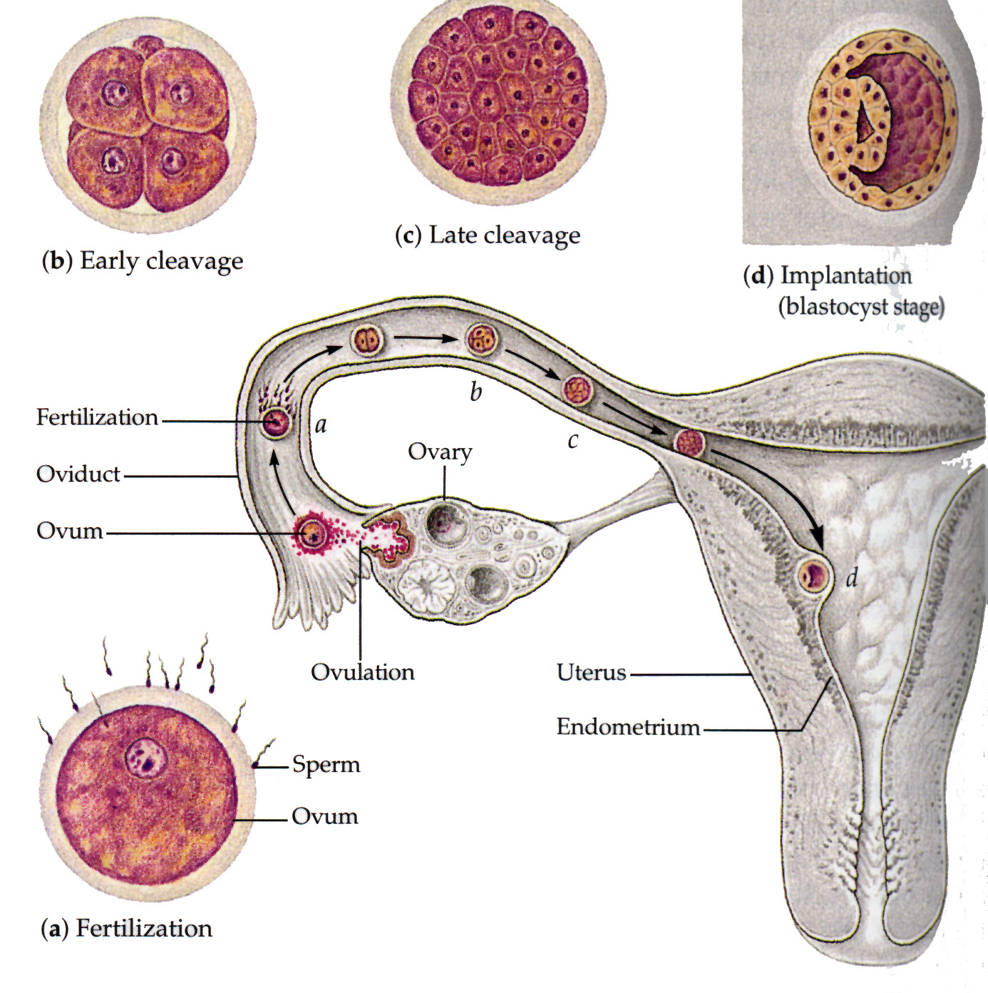

Slide 3
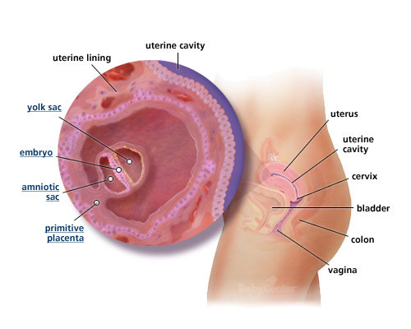
Starting at Blastocyst 5-7 days
Cells start to differentiate.
An embryo and three surrounding membranes embryo result.
Surrounding Membranes:
Chorion
Amnion
Allantois.

Slide 4
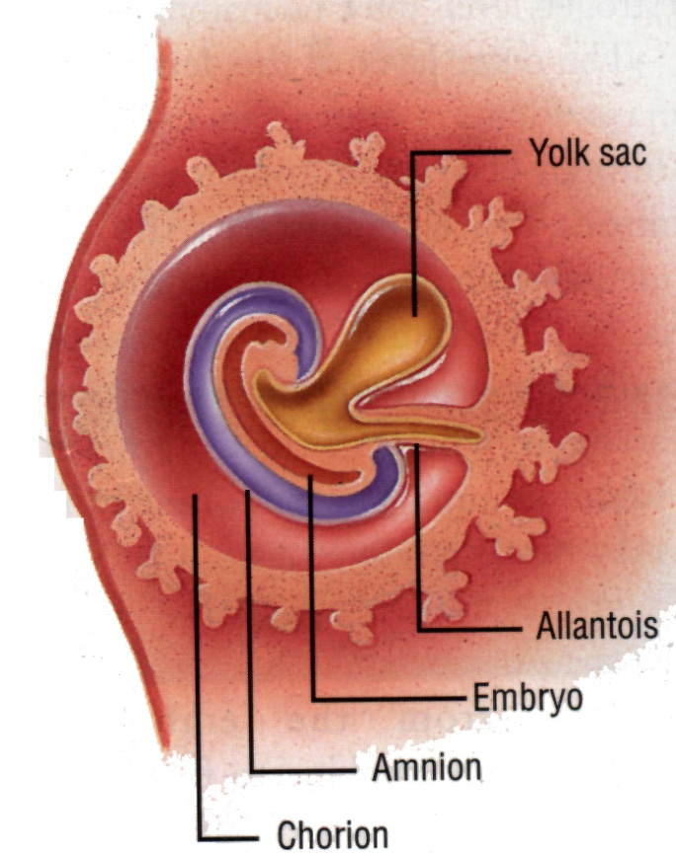
Membranes
Chorion membrane
Outermost
first role is to secrete HCG
develops into placental wall
HCG or human chorionic gonadotropic hormone maintains the corpus luteum.
Corpus luteum continues secrete estrogen and progesterone which maintain the endometrium.

Slide 5
Membranes
Amnion membrane:
grows into fluid filled sac that insulates and protects the embryo.
Allantois membrane:
Does not surround the embryo.
With yolk sac it helps produce blood cells.

Slide 6
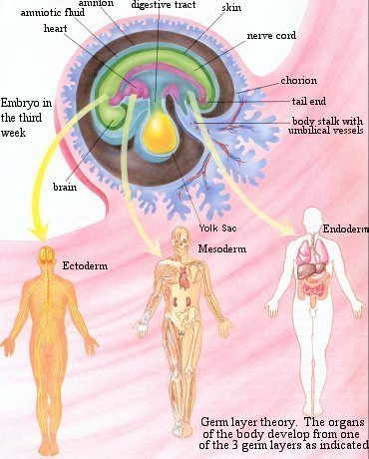
Embryonic Layers
New Embryo has three layers called the GERM LAYERS
Ectoderm
Mesoderm
Endoderm

Slide 7
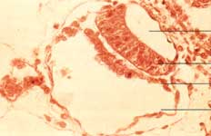
Embryonic Layers
Ectoderm (outer) forms:
NS, brain, teeth and mouth, skin, hair, etc.
Mesoderm (middle) forms:
forms muscle, bone, blood, reproductive structures, connective tissue, etc.
Endoderm (inner) forms:
liver, GI tract, respiratory tract, pancreas, thyroid, etc.

Slide 8
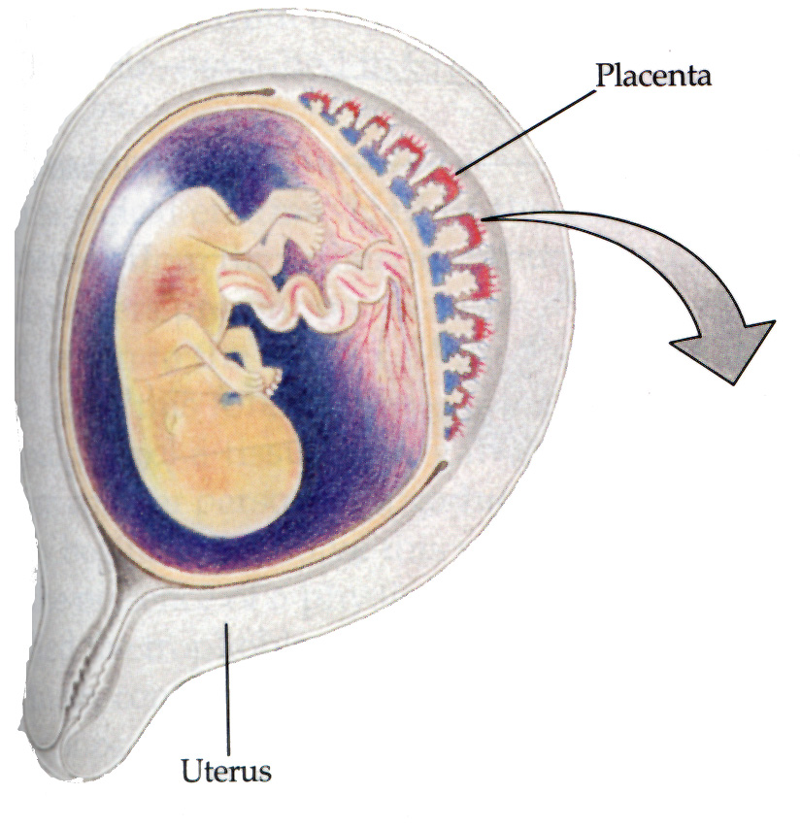
Placenta
Chorionic Villi: small projections filled with fetal and maternal capillaries. Actual site of waste/nutrient exchange.
No blood cells move through the membrane barrier!

Slide 9
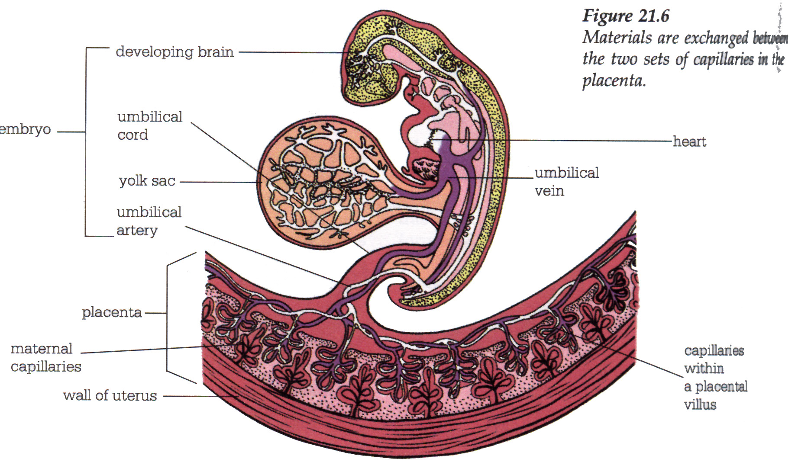
Placenta Detail

Slide 10
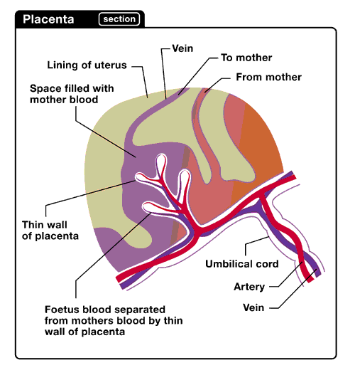
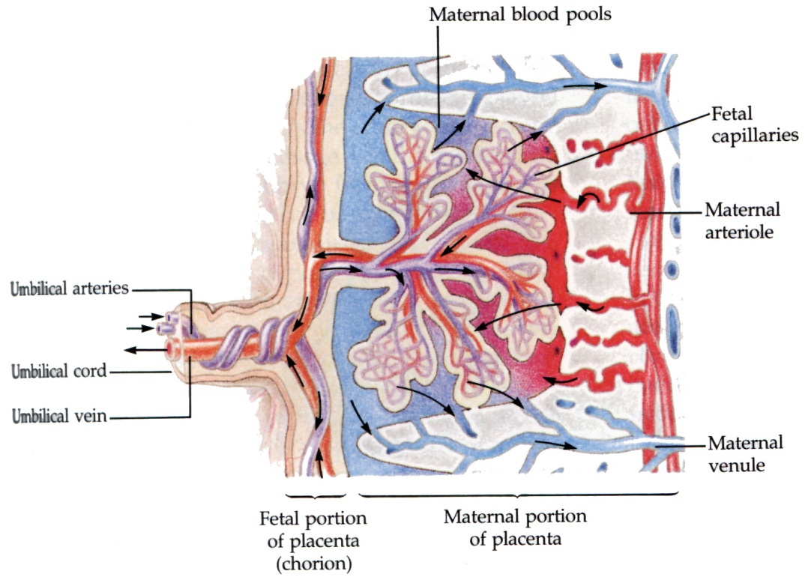
Placenta – villia detail

Slide 11
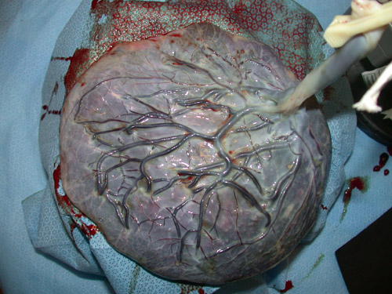
Placenta - Embryo
Umbilical cord:
transports blood with wastes to the placental wall
brings back blood with nutrients to the embryo.

Slide 12
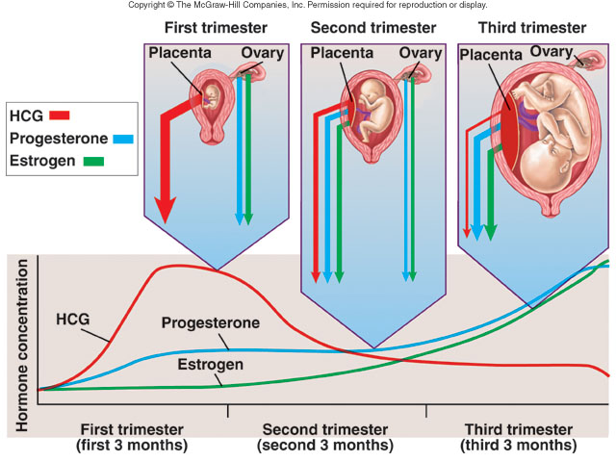
Hormones During Pregnancy

Slide 13
Discussion Topics: Control of Pregnancy
Lactation
Chemical methods
Oral contraceptives
Injections as Depo-Provera
Implants
Morning-after pills
Surgical methods
IUD
Vasectomy
Tubal ligation
Abortions
Behavioral methods
Abstinence
Coitus interruptus
Rhythm method
Barrier methods
Condom
Male and female
Diaphragm
Cervical cap
Spermicidal agents

Slide 14
Discussion Topics: Effects of Aging
Male
Decrease in size and weight of testes
Decrease in sperm production
Prostate gland enlarges and increase in cancer
Impotence is age-related
Female
Menopause
Decrease in size of uterus and vaginal wall thins
Age related increase in breast, uterine, ovarian cancer
genetic defects in children of older women linked to aging follicles.

