Slide 1
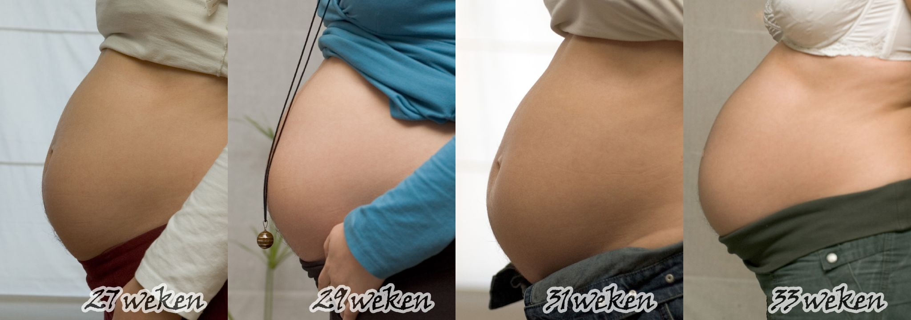
A view into the Womb
From Fertilization to Birth

Slide 2
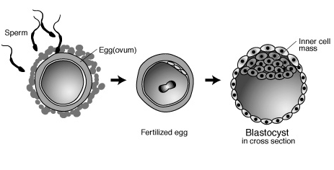
Overview
morula

Slide 3
Fertilization

Slide 4
Zygote to Morula through cleavage

Slide 5
Morula: still totipotent (days 1-4)

Slide 6
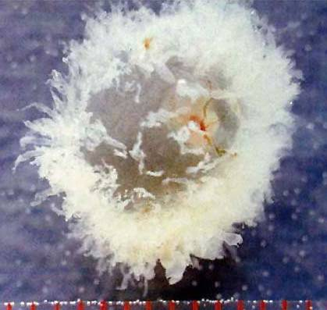
Blastocyst (Days 5 – 7)

Slide 7
Review of Terms
Zygote → morula → blastula →
Days: 1 → 2 – 4 → 5 - 7
embryo → fetus → baby
Weeks: 2 – 8 → 8 – birth → after birth
Cell Development (all with mitosis)
Cleavage – simple duplication (smaller size)
Gastrulation – formation of distinct germ layers.
Morphogenesis – organization of cells into body plan.
Differentiation – cells with different function
Growth – increase size, energy storage, more complex function.

Slide 8
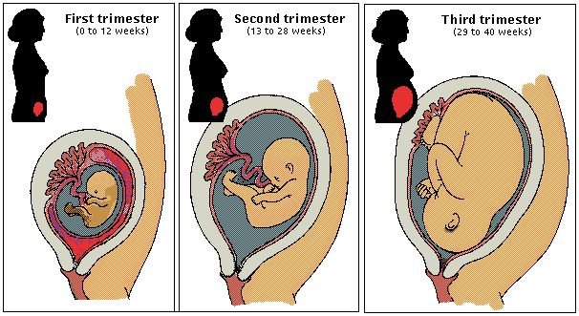
Gestation in Humans
9 Months
Divided into three trimesters (3 mo. each)

Slide 9
1st Trimester
Yolk sac produces blood cells.
Later, the bone marrow will take this role over and produce blood cells.
NS begins

Slide 10
1st Trimester
18th day: heart beats
2.5 cm long
All major organs begin

Slide 11
1st Trimester
gonads become distinct
testosterone must be present now to be externally male

Slide 12
2nd Trimester
15 cm long
Movement is obvious
Waking and sleeping
Sensory Organs
Body covered with fine hair (lanugo)

Slide 13
2nd Trimester
Urinates in the amniotic fluid
Sucks thumb, and drinks amniotic fluid
Both actions stimulate the development of internal organs

Slide 14
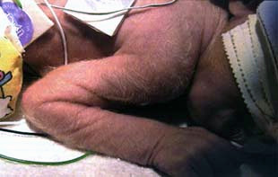
3rd Trimester: 6 – 9 Months
Fat deposits form
Circulatory and Respiratory Systems
Lungs Develop
Body hair is lost
Last weeks, head moves downward
28 Weeks is 40 cm at 36 Weeks is 45 cm

Slide 15
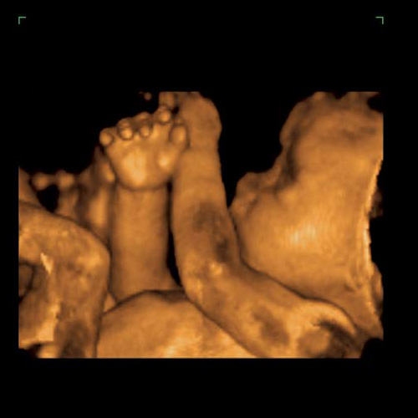
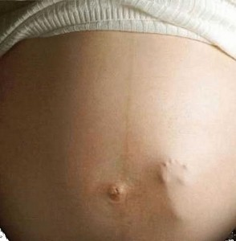

Slide 16
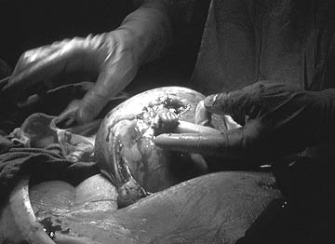
Surgery in the uterus!

Slide 17
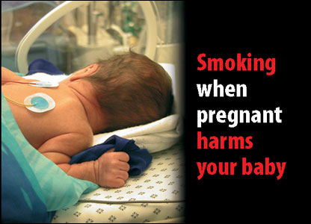
Environmental Influence
Teratogens

Slide 18
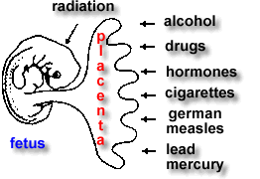
Teratogens
Teratogens are substances or conditions that affect the normal development of the embryo and fetus.
One teratogen is alcohol. Women that drink during pregnancy run the risk of causing their child developing Fetal Alcohol Syndrome or Fetal Alcohol Effects.

Slide 19
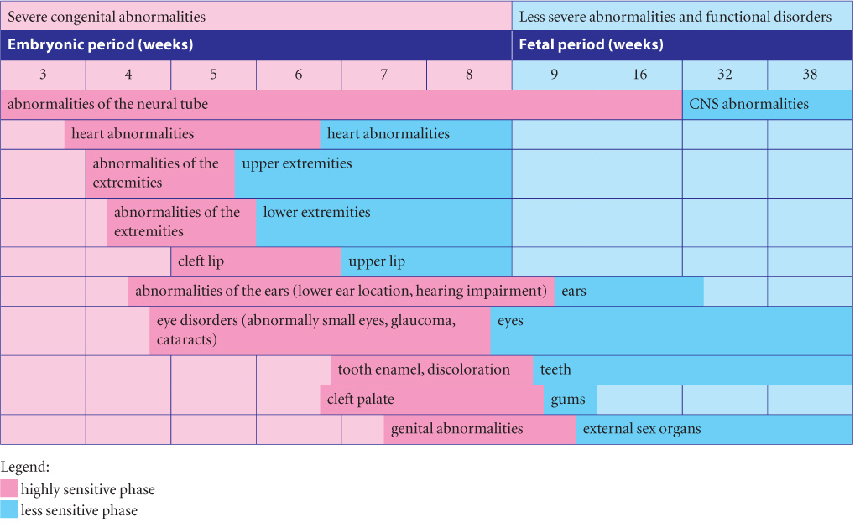
Sensitivity to Influence

Slide 20
Alcohol Effects on Developing Embryos
Alcohol can affect the fetus’s brain, central nervous system, and physical development.
Alcohol will dehydrate the growing cells of the fetus, causing cell death.
These children are more likely to have decreased weight and head size, malformations of the head and face, and varying degrees of learning and memory difficulties.

Slide 21
Common Signs
Although not completely agreed upon

Slide 22
FAS brain images

