Slide 1
Rh Factor
Rh factor or rhesus factor complications with pregnancy

Slide 2
ABO blood group Review
The I gene encodes enzymes that attach cell surface molecules on the sugar chains of red blood cells.
A allele attaches antigen A
B allele attaches antigen B
O allele no attachment performed
Blood type incompatibility
A person with type A blood who is transfused with type B blood will have antibodies that recognize and destroy the red blood cells carrying type B.

Slide 3
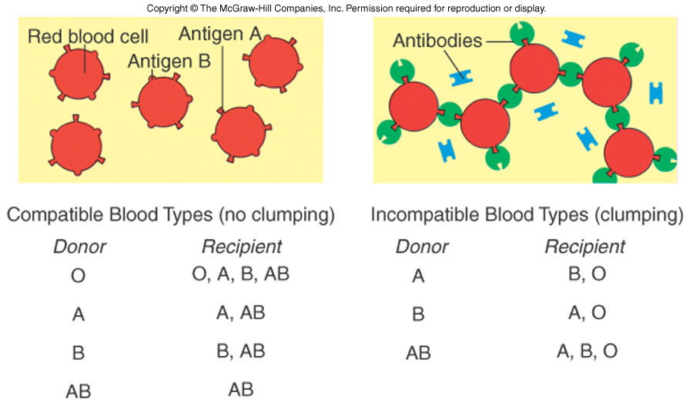
Type O is the universal donor.
Type AB is the universal recipient.

Slide 4
Rh factor
Rh factor or rhesus factor is another blood group affecting cell surface molecules.
Phenotypes:
Rh+ - produces Rh factor on RBC
Rh- - no Rh factor on RBC
Rh incompatibility occurs when an Rh- mother has an Rh+ child.
hemolytic disease of the newborn - HDN
HDN occurs with the second pregnancy
preventable through screening and anti-Rh+ therapy

Slide 6
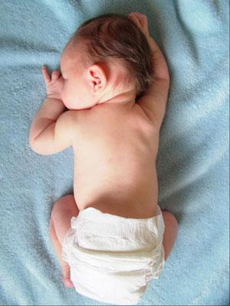
Steps to HDN
Rh- Mom exposed to Rh+ blood of first fetus during birth.
Mom develops antibodies.
During second pregnancy, if fetus is Rh+, mom’s antibodies diffuse through the placental barrier and bind (clump) to the fetal blood.
Miscarriage / Death occurs
Prevention
Mother is given immune suppression drugs for around 3 weeks during and around the birth event.

Slide 7
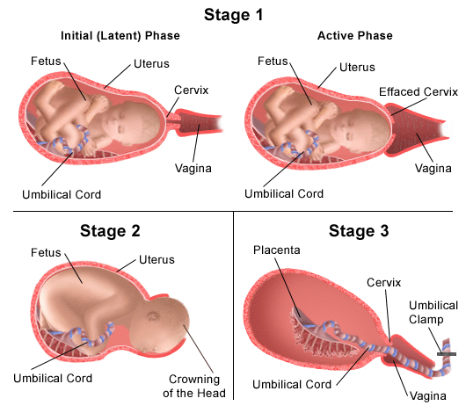
Labour and Delivery

Slide 8
Hormonal Control at Birth
Estrogen levels rise (placenta)
uterus expresses receptors for oxytocin
Oxytocin (posterior pituitary)
oxytocin and prostaglandins cause the uterus to contract and labor begins.
Relaxin (more in other animals)
relax the pubic ligaments
soften and enlarge the opening to the cervix.

Slide 9
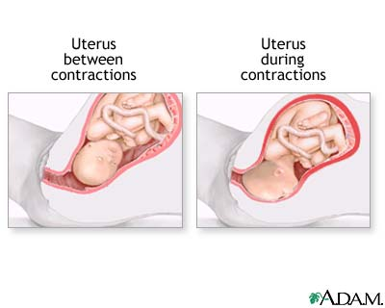
Three Stages to Labour
Early Labour (0-3cm) – contractions every 5 minutes
Active Labour (4cm-7cm) – contractions less than 5 minutes apart.
Transition (8cm-10cm) – contractions last 60s-90s with approximately 45s rest.

Slide 10
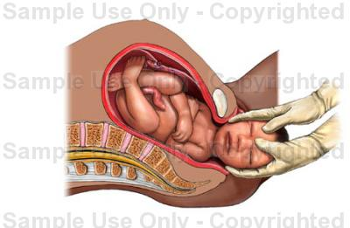
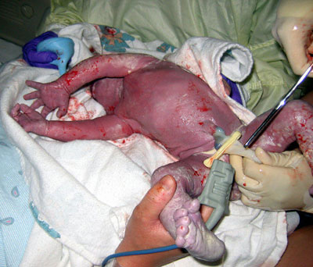
Delivery
This stage can last from .5 to 2 hours.
With strong contractions and pushing the baby is moved through the birth canal.

Slide 11
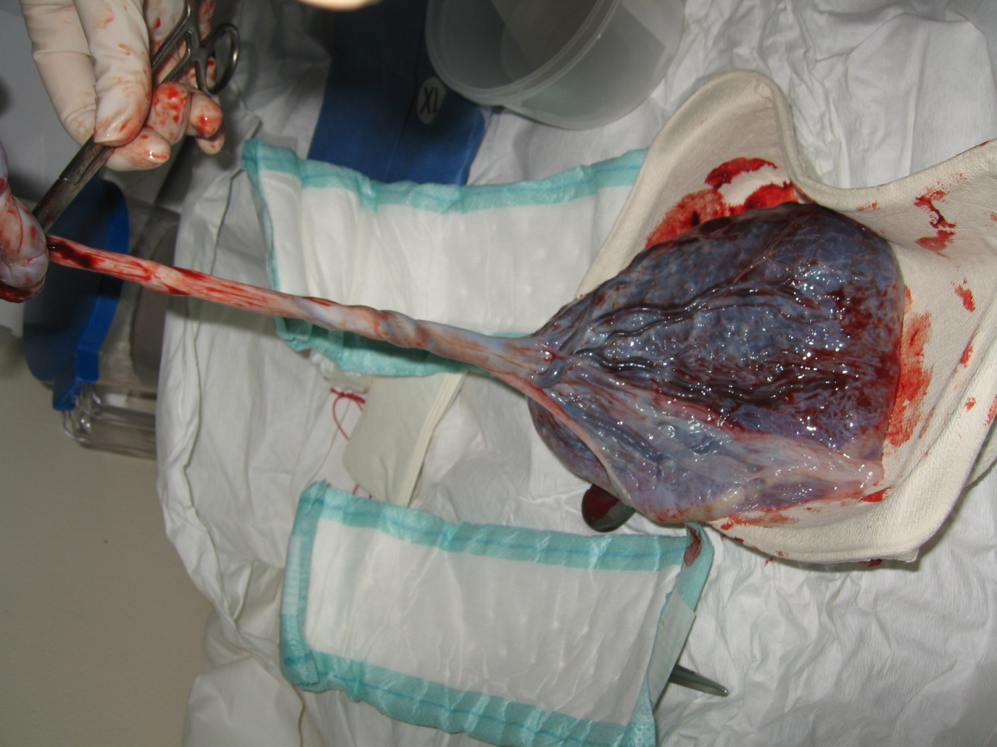
Afterbirth
After baby is born the placenta will follow. This could occur anywhere from 5 minutes to 30 minutes after delivery.

Slide 12
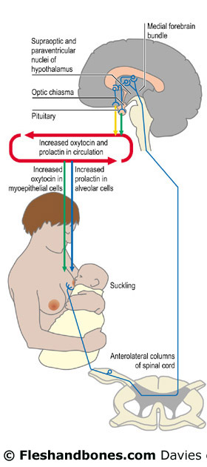
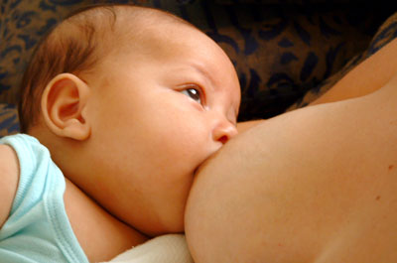
Breastfeeding
Milk synthesis is stimulated by the pituitary hormone prolactin (PRL)
its release from the breast is stimulated by oxytocin

