Slide 1
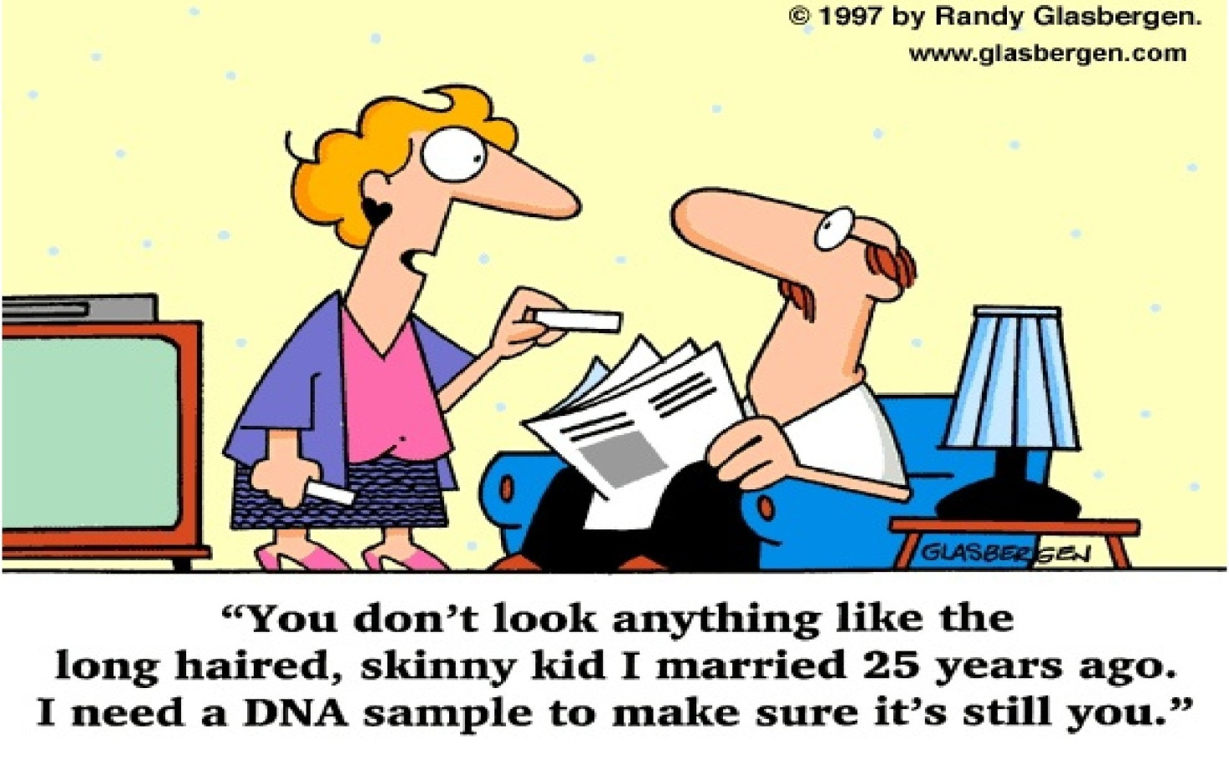
MOLECULAR GENETICS
DNA & RNA

Slide 2
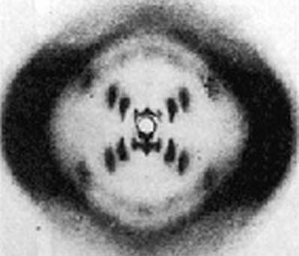
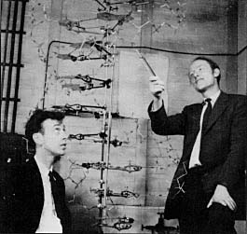
A Brief Look at History
Key figures:
  Leverne
  Griffith
  Avery, MacCleod, McCarty
  Hershey, Chase
  Chargaff
  Franklin
  Watson and Crick

Slide 3
How does DNA really look? - Time line

Slide 4
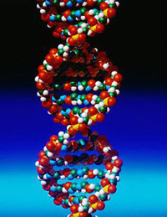
Double Helix
“twisted ladder”
Handrails are sugar-phosphate backbone
  Five carbon sugar
  Phosphate group
Rungs are the nucleotides
One of five nitrogen-containing bases
  Adenine (A), Thymine (T), Cytosine (C), Guanine (G) and RNA has Uracil (U).

Slide 5
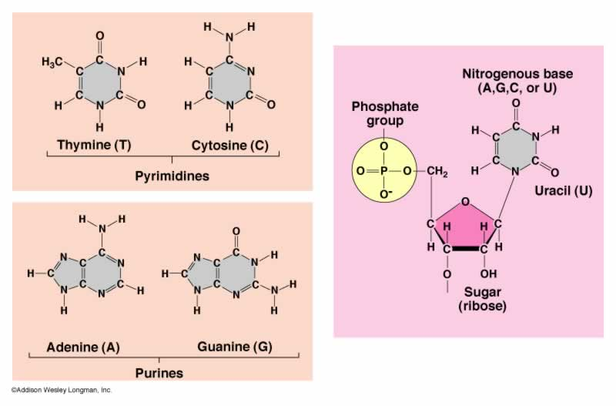

Slide 6
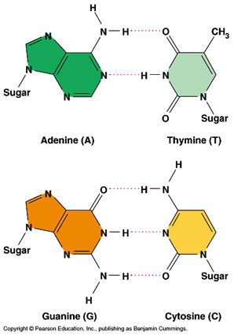
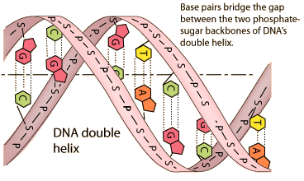

Slide 7
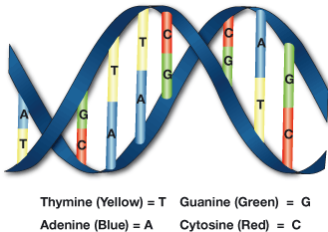
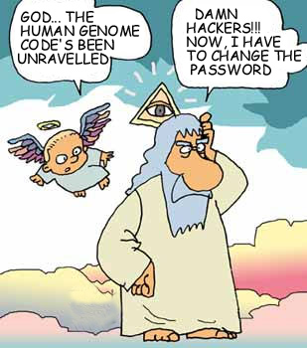
A few TERMS! YAHOO!
Complementary base pairs-A&T, G&C
Anti-parallel – like a highway
Gene – functional sub unit of DNA
Genome – sum of all the DNA an organism

Slide 8
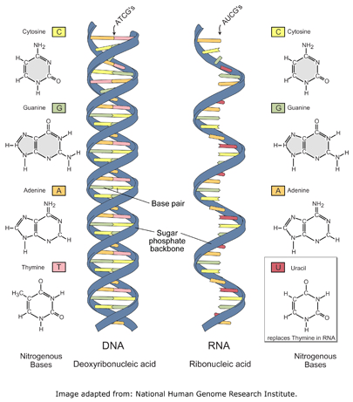
DNA vs RNA

