Slide 1
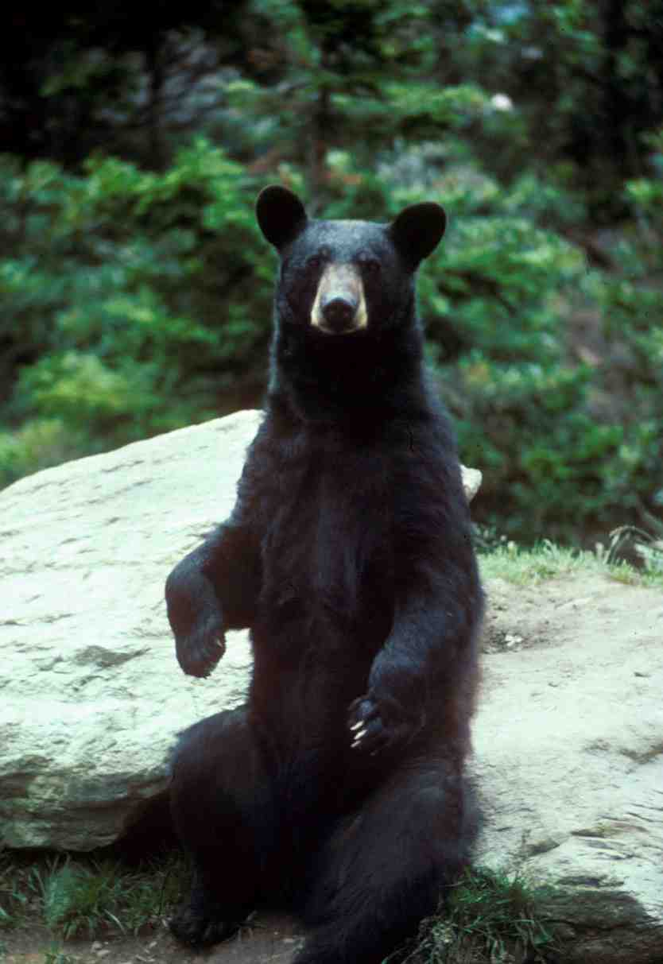
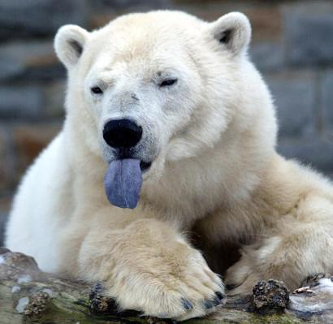
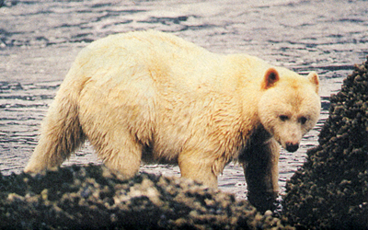
Pause for thought!
Yesterday we learned that looking at the DNA sequence of two individuals will indicate how closely they are related by how similar the sequences are.
Knowing that information, we were able to show that Kermode bear in northern BC is more closely related to a black bear than a polar bear. (In other words, the black bear is the Kermode’s closest relative!)
Kermode Bear

Slide 2
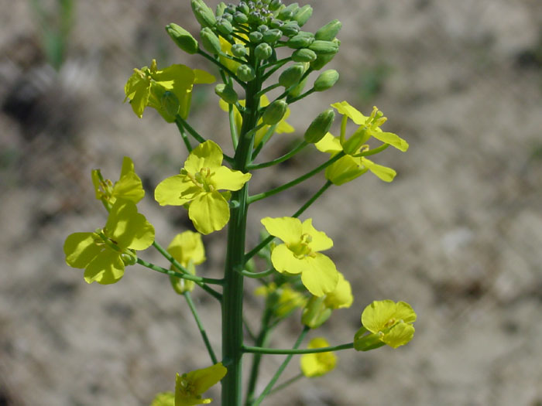
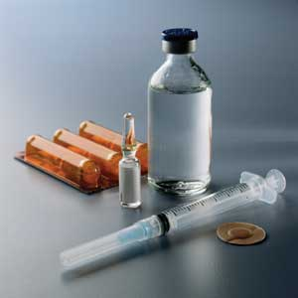
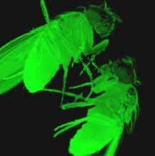
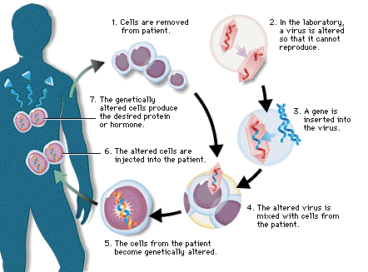
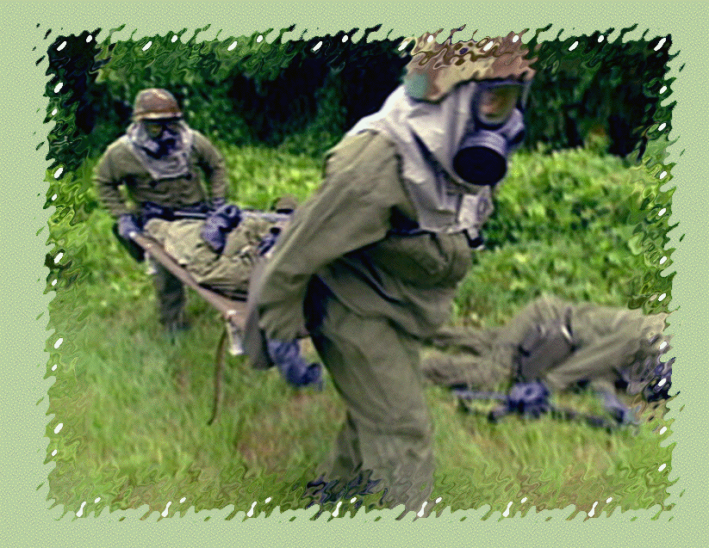
Recombinant DNA technology
What is the present and future of DNA technology?

Slide 3
Recombinant DNA Technology
What is recombinant DNA technology?
Taking genetic information from one organism and splicing it into another.
Current uses of this technology are:
  production of insulin using bacterial cultures
  genetically-modified crops for agriculture
  genetically-modified animals in research and agriculture.
Future uses of this technology could include:
  Gene therapy to cure genetic diseases
  Biological warfare with ‘superbugs’

Slide 4
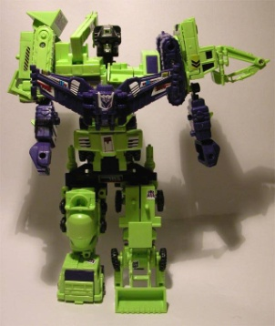
Recombinant DNA Technology
How does recombinant DNA technology work?
Extract DNA from two organisms.
Cut DNA samples with restriction enzymes.
Insert gene from one organism into the DNA of the other organism and stick together using ligases.
Insert the recombined DNA into a host and let them grow and reproduce with the recombined DNA.
NOTE: The process of inserting new DNA sequences into the genome of an organism is called transformation!

Slide 5
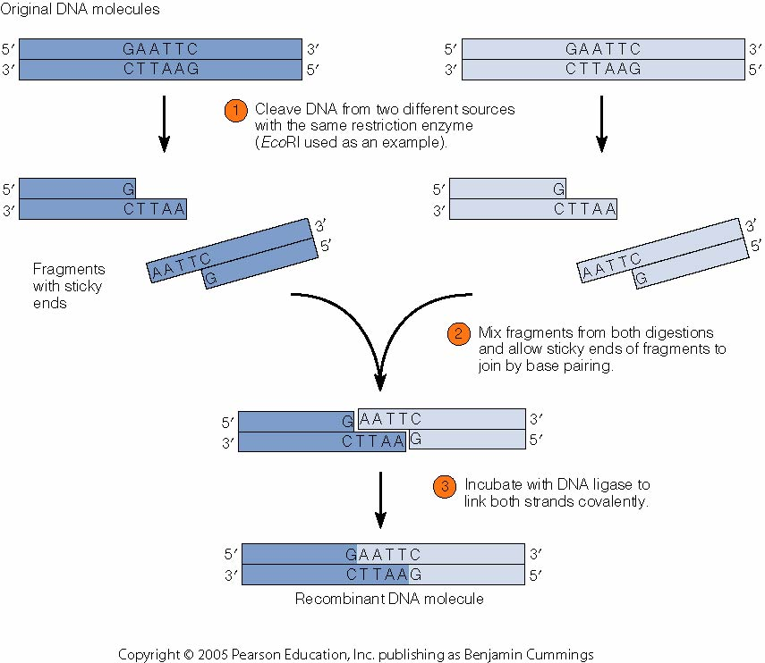
Protein Synthesis

Slide 6
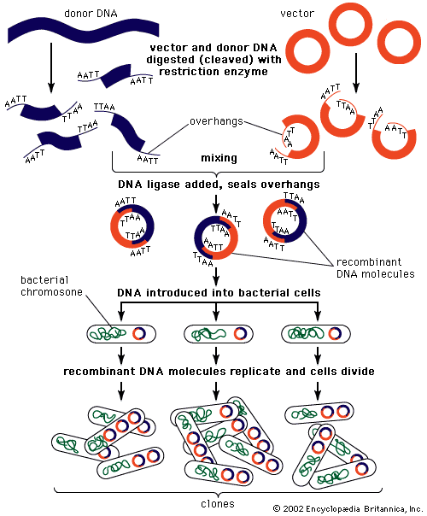
Protein Synthesis

Slide 7
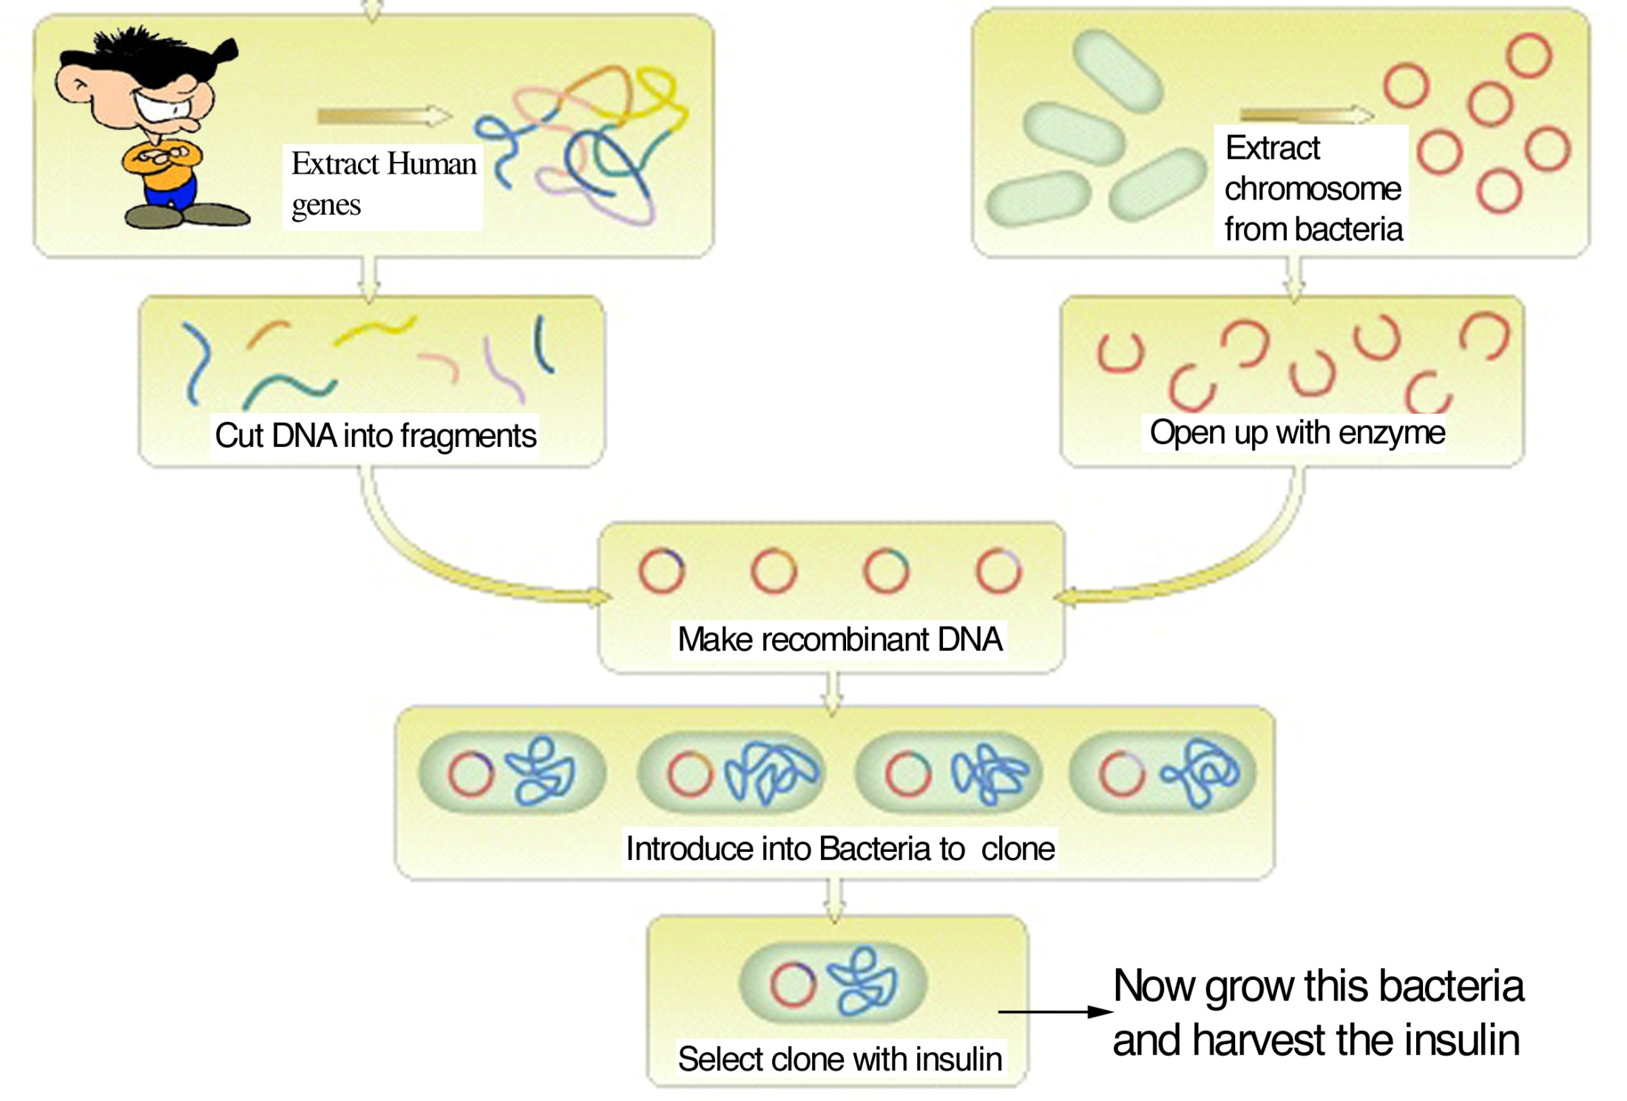

Slide 8
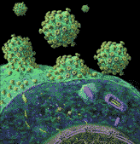
Recombinant DNA Technology
Where did the idea for recombinant DNA come from?
From the way that viruses replicate themselves in nature!
For viruses to reproduce they must:
  Enter a host cell
  Insert it’s DNA into the host DNA
  Wait for the host to make the virus proteins during protein synthesis.
  Put all the virus proteins together and burst out of the host cell.

