Slide 1
THERMOCHEMISTRY (Chemical Energy)
Thermochemistry is the study of chemical changes and the energy associated with the change.
Notes:
10

Slide 2
Chemical potential energy relates to the attractions between atoms and molecules. When a chemical or phase change occurs, atoms or molecules are rearranged and new attractions are made. The change in the attractions contributes to the energy associated with the change.

Slide 3
Energy is the ability to do work; create heat and/or generate electricity. Energy can exist in many different forms, but is classified into two main types: potential energy and kinetic energy.

Slide 4
Kinetic energy (Ek) is the energy due to the motion of particles. There are three types of motion vibrational, translational, and rotational.
Both types of energies can be demonstrated on graphs. Kinetic energy is shown by a heating or cooling curve: Graph A
bp
Temperature
or E_{k} (ºC)
mp
Time
Potential energy diagrams are graphs that show the change in energy due to the change:

Slide 5
ENTHALPY
CHANGES

Slide 6
Background and Review
First Law of Thermodynamics (Law of Energy Conservation)
Energy can be neither created nor destroyed but it can be converted from one form to another
Energy Changes in Chemical Reactions
All chemical reactions are accompanied by some form of energy change
Exothermic Energy is given out
Endothermic Energy is absorbed
Examples Exothermic combustion reactions
neutralization (acid + base)
Endothermic photosynthesis
thermal decomposition of calcium carbonate
Activity : observing exothermic and endothermic reactions

Slide 7
Key Concept
The heat content of a chemical system is called enthalpy (represented by H).
We cannot measure enthalpy directly, only the change in enthalpy ∆H i.e. the amount of heat released or absorbed when a chemical reaction occurs at constant pressure.
∆H = H_{(products)} – H_{(reactants)}
∆Hº (the STANDARD enthalpy of reaction) is the value measured when temperature is 298 K and pressure is 100 kPa. (SATP)

Slide 8
Enthalpy & Heat
Enthalpy (H) - is the thermodynamic potential of a system. It is the sum of internal energy and the product of pressure and volume of a system
H = E + PV (PV is usually excluded so)
Enthalpy =Internal Energy
-Exothermic (heat released, ΔH < 0)
-Endothermic (heat absorbed, ΔH > 0)
Heat (Q) - Amount of thermal energy transferred
Q=ΔH under constant pressure

Slide 9
Calorimetry
Measurement of heat changes
Performed in a calorimeter which prevents heat loss from the system
Constant volume calorimeter
Constant pressure calorimeter

Slide 10
Calorimeter
Used to prevent the escape of heat
One version - Styrofoam cup in a beaker with a cardboard lid

Slide 11
Calorimetry – Part 1
Specific Heat Capacity
The specific heat capacity of a substance is a physical property. It is defined as the amount of heat (Joules) required to change the temperature (ºC or K) of a unit mass (g or kg) of substance by ONE degree.
Specific heat capacity (SHC) is measured in
J g⁻¹ K⁻¹ (we use this one) or kJ kg⁻¹ K⁻¹ (chemistry)
J kg⁻¹ K⁻¹ (physics)

Slide 12
Calorimetry – continued
Heat and temperature change
Knowing the SHC is useful in thermal chemistry. Heat added or lost can be determined by measuring temperature change of a known substance (water).
Q = mc∆T
heat = mass x SHC x ∆Temp

Slide 13
Determining Specific Heat Capacity of Water
Sample results (continued)
Mass of water in kettle was 1405 g. To change the temperature of this water by 1 degree, 5870 J of heat were required.
The amount of heat required to change 1 g of water is therefore 4.18 J. This is the SHC of water (very close to the literature value of 4.19 J/gºC)
SHC of H₂O is 4.18 J g⁻¹ K⁻¹

Slide 14
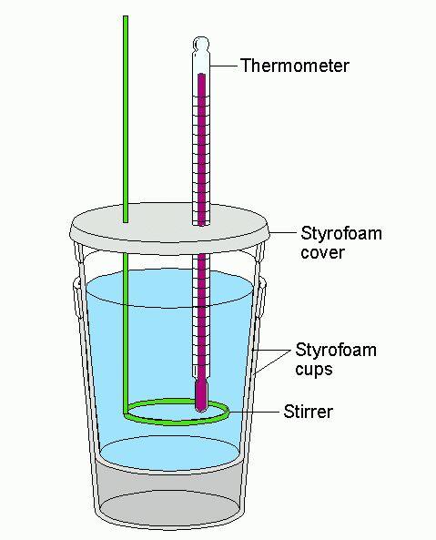
Calorimetry – Part 2
Applications
A calorimeter is used to measure the heat absorbed or released in a chemical (or other) process by measuring the temperature change of an insulated mass of water.

Slide 15
Sample Problem 1
When 3 g of sodium carbonate are added to 50 cm³ of 1.0 M HCl, the temperature rises from 22.0 °C to 28.5 °C. Calculate the heat required for this temperature change.

Slide 16
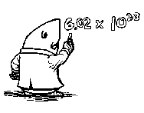
Sample problem 2: to determine the enthalpy of combustion for ethanol (see reaction), a calorimeter setup (below) was used. The burner was lit and allowed to heat the water for 60 s. The change in mass of the burner was 0.518 g and the temperature increase was measured to be 9.90 ºC.
What is the big assumption made with this type of experiment?

Slide 17
Hess’s Law
Enthalpy of a reaction does not depend on number of steps involved
If the enthalpy of a set of reactions is known, use combination of reactions to find enthalpy
Notes:
Sometimes indirect method must be used because it is not possible to directly measure the enthalpy of a particular reaction.

Slide 18
Hess’s Law : Example
Determine the enthalpy of the reaction
shown using the three reactions given.
C(gr) + 2S(rh) CS₂(l)
ΔH (kJ/mole)
C(gr) + O₂(g) CO₂(g), ΔH⁰_{rxn1}= -393.5
S(rh) + O₂(g) SO₂(g), ΔH⁰_{rxn2}= -296.4
CS₂(l) + 3O₂(g) CO₂(g) + 2SO₂(g) ΔH⁰_{rxn3}= -1073.6
Does this add up to: C(gr) + 2S(rh) CS₂(l)?

Slide 19
C(gr) + 2S(rh) → CS₂(l)
C(gr) + O₂(g) CO₂(g)
S(rh) + O₂(g) SO₂(g)
CS₂(l) + 3O₂(g) CO₂(g) + 2SO₂(g)
Therefore, rewrite equations
C(gr) + O₂(g) CO₂(g)
2S(rh) + 2O₂(g) 2SO₂(g)
2SO₂(g) + CO₂(g) CS₂(l) + 3O₂(g)
C(gr) + 2S(rh) CS₂(l)
ΔH⁰_{rxn} = ΔH⁰_{rxn1} + 2ΔH⁰_{rxn2} - ΔH⁰_{rxn3}
_{= 87.3 kJ/mol}
2 x
-1 x
Notes:
Explain what is going on in each step. Successive clicks will cross out common species (if you have problems with the animation, just click until you see everything on the screen).

Slide 20
Homework
Read P. 480-489
P. 487 # 1-8

