Slide 1
Technological developments are making space exploration possible and offer benefits on Earth.
Ch. 2.1 Getting there

Slide 2
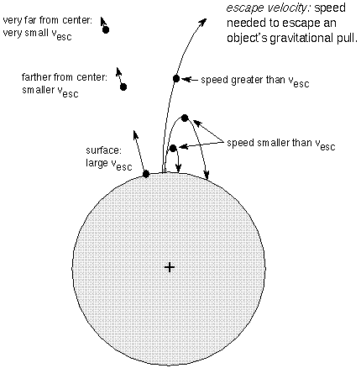
Getting There: Technologies For Space Transport
The gravitational escape velocity had to be achieved (28,000 km/h), if humans were to venture into space

Slide 3
The Achievements of Rocket Science
400 B.C - Archytas used escaping steam to propel a model pigeon along some wires
1st Century - Chinese used gunpowder to propelled ‘flaming arrows’
17th Century - Polish General uses solid fuel rockets in war
Early 1900’s - Konstantin Tsiolkovskii suggested liquid fuel be used for rockets
1920’s - Wernher Von Braun developed the V-2 rocket for war
1926 - Robert Goddard launched the world's first liquid-propellant rocket.

Slide 4
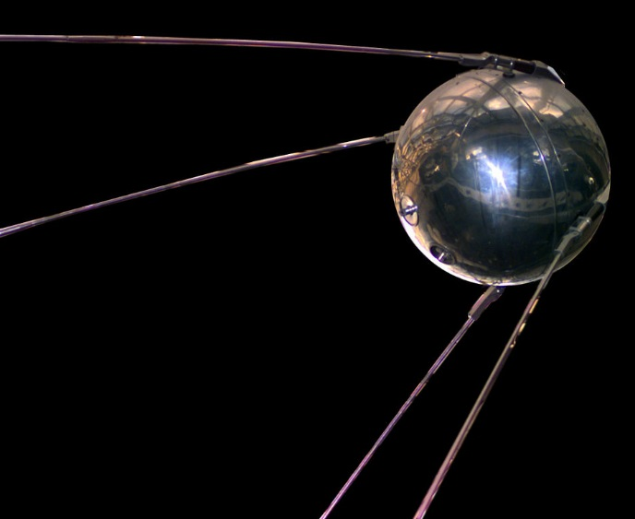
The Achievements of Rocket Science
Oct. 4, 1957 - Sputnik was launched by the Russians
Nov, 1957 - Laika (a dog)
survived in Earth orbit for 7 days
1961 - Explorer I launched by USA
1962 - Alouette launched by Canada
1969 - First man on the moon
1981 - First launch of the Shuttle

Slide 5
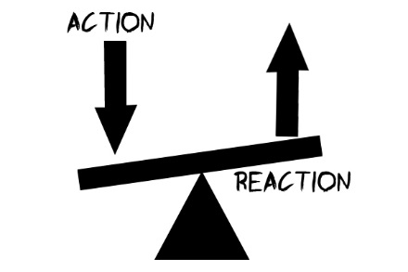
The Science of Rocketry
The science of rocketry relies on a basic physics principle that you learned in Grade 7.
For every action – There is an equal and opposite reaction

Slide 6
3 basic parts to a Rocket:

Slide 7
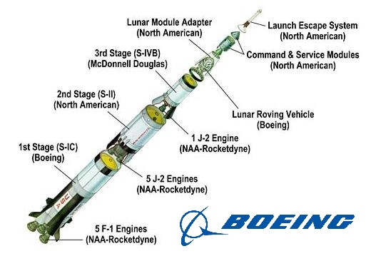
3 basic parts to a Rocket: 1→ structural and mechanical elements
• The structural and mechanical elements are everything from the rocket itself to engines, storage tanks, and the fins on the outside that help guide the rocket during its flight.

Slide 8
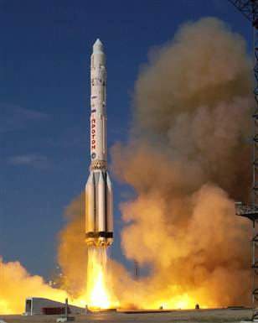
3 basic parts to a Rocket: 2→ The Fuel
• The fuel can be any number of materials, including liquid oxygen, gasoline, and liquid hydrogen. The mixture is ignited in a combustion chamber, causing the gases to escape as exhaust out of the nozzle.

Slide 9
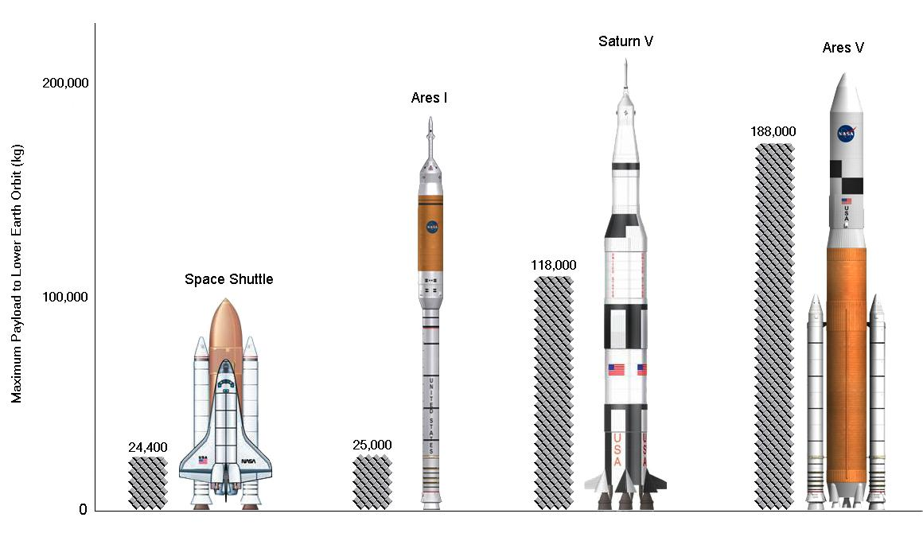
3 basic parts to a Rocket: 3→ The Payload
• The payload refers to the materials needed for the flight, including crew cabins, food, water, air, and people.

Slide 10
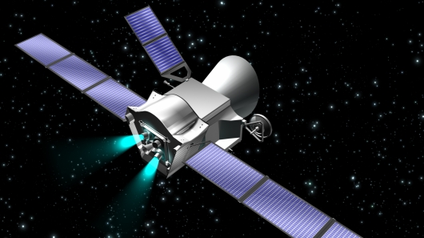
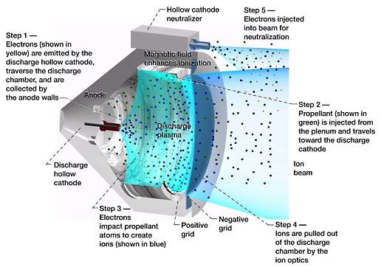
The Future of Space Transport Technology
Ion Drives are engines that use xenon gas instead of chemical fuel. The xenon is electrically charged, accelerated, and then released as exhaust, which provides the thrust for the spacecraft. The thrust is 10 times weaker than traditional engine fuels, but it lasts an extremely long time. The amount of fuel required for space travel is about 1/10 that of conventional crafts.

Slide 11
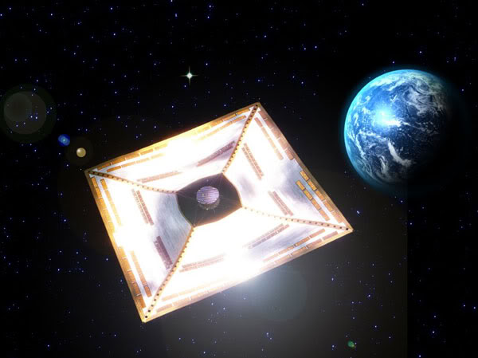
Solar Sail
Solar Sail Spacecraft use the same idea as sailboats. They harness the light of the Sun. The Sun’s electromagnetic energy, in the form of photons, hits the carbon fiber solar sails, and is transmitted through the craft to propel it through space.
These spacecraft could travel up to 5 times faster than spacecraft today.

Slide 12
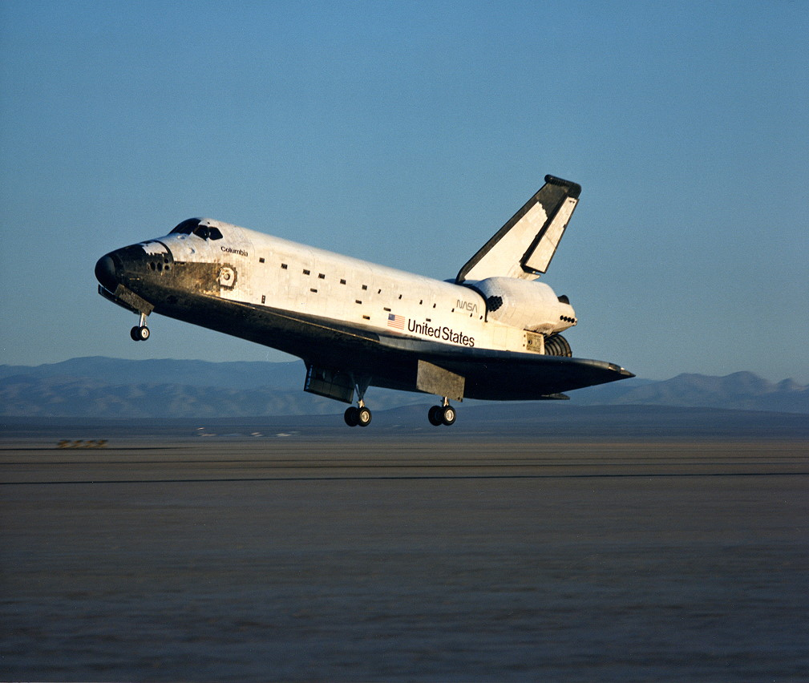
Shuttles
Shuttles transport personnel and equipment to orbiting spacecraft

Slide 13
Space Probes
Space probes contain instrumentation for carrying out robotic exploration of space
Mariner 10

Slide 14
Space Stations
Space Stations are orbiting spacecraft that have living quarters, work areas and support systems to enable personnel to live in space for extended periods
International Space Station

Slide 15
The Next Step
Manned interplanetary space missions, possibly to Mars or Jupiter (one of it’s Moons), or the colonization of the moon are ideas that have surfaced recently. Building a remote spacecraft-launching site (on the Moon, or on the International Space Station) is the first step to enable interplanetary flight to become a reality and will reduce the cost dramatically. As more space stations are built the reaches of space will soon be within our grasp.
Private developers and companies are even planning tourist flights and possibly hotels and amusement parks in space, or, on the Moon.

Slide 16
Homework This Week
2.1 Tech for space transport P. 417 # 1-8
2.2 Tech for living in Space P. 425 # 1-7
2.3 Space Tech on Earth P. 433 # 1-7

