Slide 1
2.2
Surviving There: Technologies For Living In Space

Slide 2
To survive in space (which is a cold vacuum), technologies have needed to be developed to overcome the hazards of this harsh environment. A manned flight to Mars would last 2 to 3 years,
which is a long time to be in an enclosed environment.

Slide 3
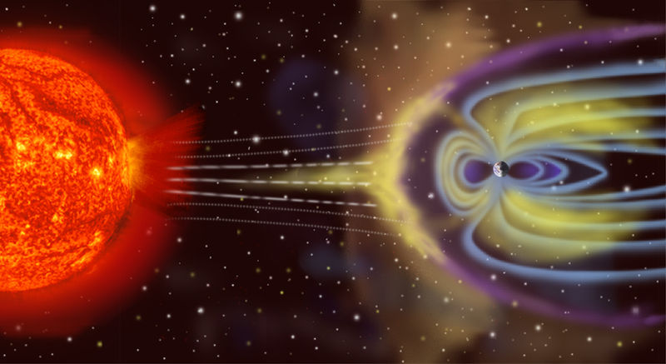
Hazards Of Living In Space
Environmental Hazards
Space is a vacuum with no air or water.
Cosmic and solar radiation, and meteoroids are the greatest dangers.

Slide 4
Hazards Of Living In Space
Because there is no atmosphere, the temperatures in space have both extremes– from extremely hot, to extremely cold.
There is also no atmospheric pressure to help regulate the astronaut’s heartbeats.

Slide 5
Psychological Challenges to Confined Living
Long trips can present psychological difficulties, as can the claustrophobic feeling of such tight living conditions.

Slide 6
The Body and Microgravity
Living in microgravity can cause problems because of the effects of weightlessness on the human body.
Bones have less pressure on them and so they expand. They also lose calcium and become more brittle.
The heart doesn’t have to pump as hard to circulate blood.
Muscles weaken and shrink.
Depth perception is also affected.

Slide 7
The Space Suit
The space suit is a mobile chamber that houses and protects the astronaut from the hostile environment of space. It provides atmosphere for breathing and pressurization, protects from heat, cold, and micrometeoroids, and contains a communications link.

Slide 8
The suit is worn by the astronauts during all critical phases of the mission, during periods when the command module is not pressurized, and during all operations outside the command and lunar modules whether in space, in the International Space Station, or on the moon.

Slide 9
A Home In Space
Outside Earth’s atmosphere, life-support systems have to be artificially produced. Clean water, fresh air, comfortable temperatures and air pressure are essential to life. All these support systems, including a power supply to operate them, must be operational on the Space Station at all times.

Slide 10
Recycling Water
Almost 100% of the water in the station must be recycled. This means that every drop of wastewater, water used for hygiene, and even moisture in the air will be used over and over again. Storage space is also a problem, making recycling essential for survival.

Slide 11
life-support system functions
• Recycling wastewater
• Using recycled water to produce oxygen
• Removing carbon dioxide from the air
• Filtering micro-organisms and dust from the air
• Keeping air pressure, temperature and humidity stable

Slide 12
Producing Oxygen
Electrolysis of water (remember H2O can be split into hydrogen and oxygen). The astronauts use the oxygen and the hydrogen is vented into space.
Learn what it takes to be an astronaut, by reading Dr. Roberta Bondar’s story on p. 426 in the Science In Action 9 textbook.

Slide 13
2.3.
Using Space Technology To Meet Human Needs

Slide 14
Satellites
Satellites can be natural – small bodies in space that orbit a larger body ( the moon is a satellite of the Earth ), and they can be artificial – small spherical containers loaded with electronic equipment, digital imaging and other instruments that are launched into Earth’s orbit to perform one of four functions:

Slide 15
Communication Satellites
These satellites provide ‘wireless’ technologies for a wide range of applications. Digital signals have resulted in clearer communications and more users. Anik 1 (launched by Canada in 1972) transmitted the first television broadcasts by satellite.

Slide 16
Satellites for Observation and Research
A geosynchronous orbit is one that enables a satellite to remain in a fixed position over one part of the Earth, moving at the same speed as the Earth. Numerous applications are now possible including:
Monitoring and forecasting weather
LANDSAT and RADARSAT (are not in geosynchronous orbit) – follow ships at sea, monitor soil quality, track forest fires, report on environmental change, and search for natural resources.
Military and government surveillance

Slide 17
Remote Sensing
Those satellites in low orbits perform remote sensing – a process in which digital imaging devices in satellites make observations of Earth’s surface and send this information back to Earth. The activities include providing information on the condition of the environment, natural resources, effects of urbanization and growth. This information is usually used for planning purposes.

Slide 18
Satellites as Personal Tracking Devices ( GPS )
The Global Positioning System (GPS) allows you to know exactly where you are on the Earth at any one time. The system involves the use of 24 GPS satellites positioned in orbit, allowing for 3 to always be above the horizon to be used at any one time. The three GPS satellites provide coordinated location information, which is transmitted to a GPS receiver (hand-held) to indicate the person’s exact position on the Earth.

Slide 19
“Space Age” Inspired Materials And Systems
Many materials that were originally designed for a space application have practical applications on the Earth. These are called ‘spin-offs’.

Slide 20
The table of ‘spin-offs’ on p. 431 provides some examples in the fields of computer technology, consumer technology, medical and health technology, industrial technology, transportation technology, and public safety technology.

