Slide 1
Balance of Matter and Energy Exchange
2.3

Slide 2
No significant exchange of matter between biosphere & space
Constant energy input
Amount of solar energy received determines the productivity of an ecosystem

Slide 3
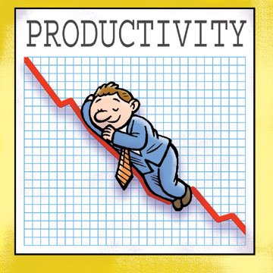
Productivity
The rate at which organisms produce new biomass or energy, measured in
J/m²/a
g/m²/a
Dependent on
# of producers
Rainfall
Heat & light
Available nutrients
Notes:
J/m2/a → energy per unit area per year
g/m2/a → biomass of vegetation added to an ecosystem per area per year
Can too much solar radiation affect productivity?
Discuss Thought Lab 2.3

Slide 4
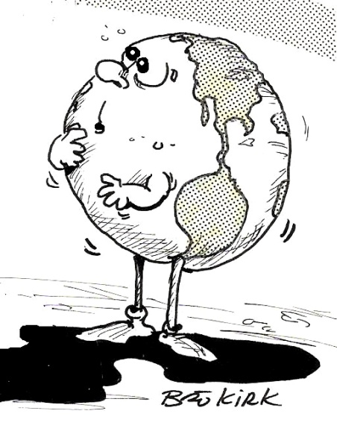
Maintaining Equilibrium in the Biosphere
Human – maintains internal conditions within a narrow range (homeostasis)
Earth – must do the same
Gaia Hypothesis
Biosphere acts as an organism, maintaining environmental conditions within certain limits.
Notes:
Needs constant energy input and cycling of nutrients. We’ve already started to explore how this works by investigating the biogeochemical cycles.

Slide 5
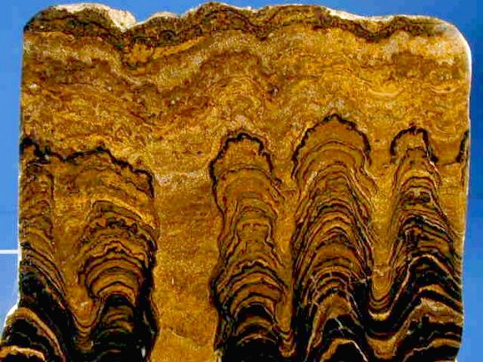
The Changing Atmosphere
Life changes concentration of gases in atmosphere
Stromatolites (free oxygen increases due to photosynthetic activity)
Plants
Animals
Notes:
Bacteria that are able to live in low-oxygen conditions grow, forming mats.
The bacteria in the mats die, leaving cell bodies behind, which eventually forming sedimentary rocks – stromatolites. Many stromatolites contained iron which bonded with oxygen, forming iron oxides. When much of the iron was tied up in these stromatolites, the oxygen from photosynthetic micro-organisms (cyanobacteria) built up in the atmosphere as oxygen gas.
The change in atmospheric gases allowed plants and animals to evolve.
Now Earth has an atmosphere that is 21% oxygen. Much different than 4 billion years ago.

Slide 6
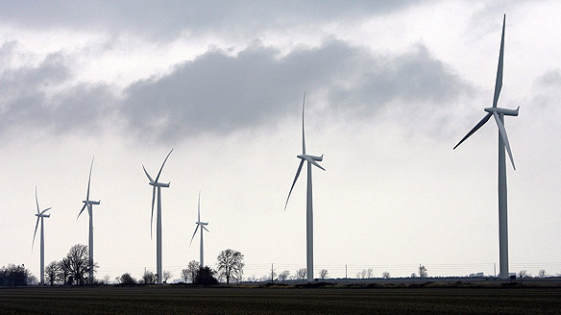
Preserving the Natural Balance
Develop new technologies/tools to meet human needs while preserving the natural balance
Eg. Wind-powered turbines used to create electricity

Slide 7
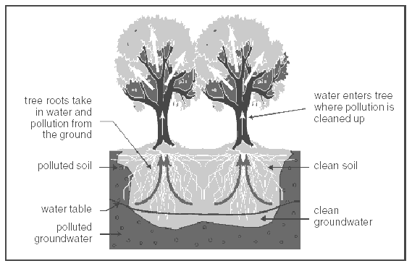
Phytoremediation
The natural ability of plants and microorganisms to degrade/remove contaminants from soil and water
Converts contaminants to less-harmful materials
Notes:
Plants produce compounds that stimulate bacteria metabolism
Plants with fibrous roots readily adsorb (attract to their surface) hydrocarbons → take up contaminated water, removing contaminants from soil
Plants break down some hydrocarbons
Transpiration releases volatile hydrocarbons into the atmosphere
Slow process
Petrochemical spills may be treated on site (in situ) or off site in a lab, depending on whether there is an immediate threat to wildlife/humans

