Slide 1
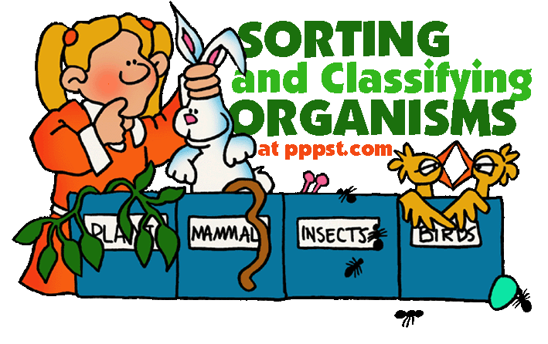
3.2 – Classifying and Naming Organisms

Slide 2
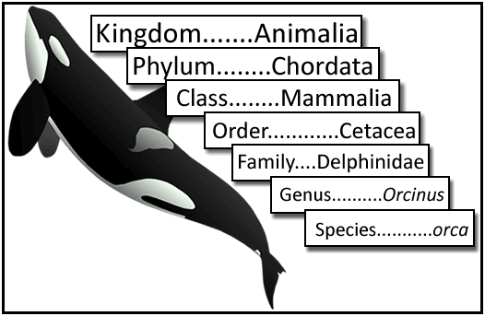
The Classification of Organisms
Taxonomy
The classification of living things
Notes:
Taxonomy is continually changing as scientists try to fit all animals into a nice classification scheme

Slide 3
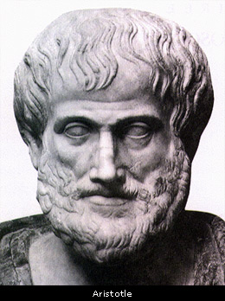
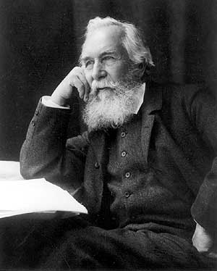
In the Past…
Aristotle put organisms into 2 large groups:
Kingdom Plantae, Kingdom Animalia
1866 – Ernst Haeckel
Came up with 3rd Kingdom (Protista) that was neither plant nor animal

Slide 4
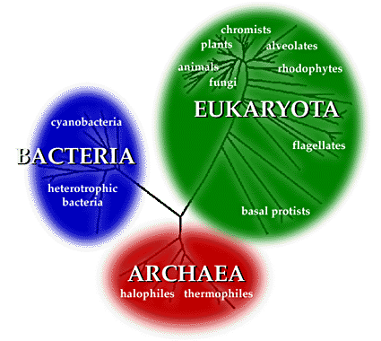
Three Domains
Bacteria, Archaea, Eukarya
Domains are based
on cellular composition
of organisms

Slide 5
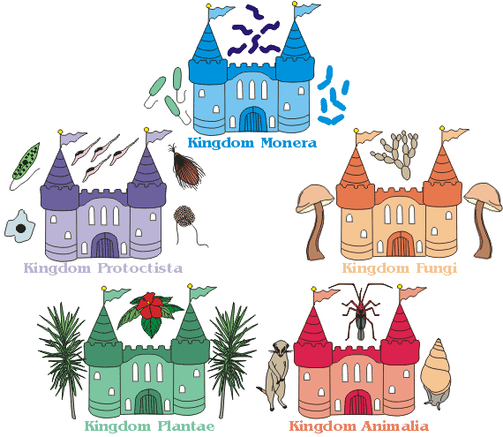
Current Classification (See Handout)
6 Kingdoms:
Archaea
Bacteria
Protista
Fungi
Plantae
Animalia
Notes:
Archaea and Bacteria both consist of single celled organisms that lack a nucleus (prokaryotes). Archaea are well adapted to extreme conditions.
All other kingdoms contain single or multi-cellular organisms whose cells contain a nucleus (eukaryotes)

Slide 6
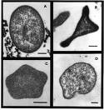
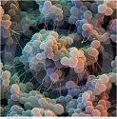
Prokaryotes
Kingdom Archaea
Single celled
Live in extreme environments
Eg) deep sea vents
Kingdom Bacteria
Single celled Prokaryotes
Very diverse
Wide range of habitats
Notes:
Prokaryotes are single-celled organisms that lack a nucleus
Bacteria - On the left is E. coli, on the right is Staphylococcus epidermis

Slide 7
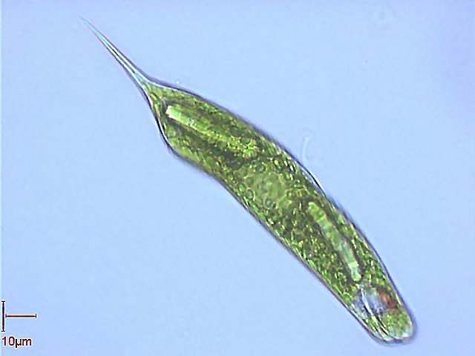
Kingdom Protista
Unicellular or multicellular
Obtain food one of three ways:
Photosynthesis
Ingestion
Decomposition
Includes algae

Slide 8
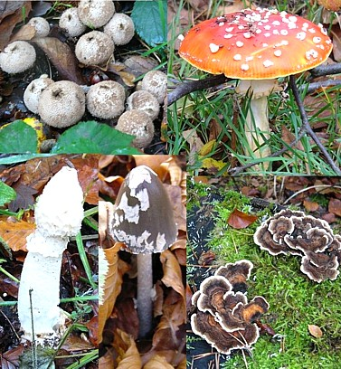
Kingdom Fungi
Decomposers
Secrete enzymes to digest their substrate, then absorb nutrient molecules
Mushrooms, moulds, and yeasts

Slide 9
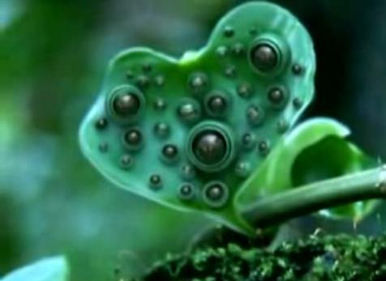
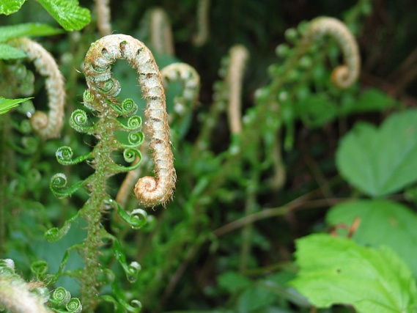
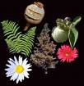
Kingdom Plantae
Organisms that photosynthesize to make their own food
Have specialized cells to carry out life functions
Mosses, ferns, coniferous trees, flowering plants

Slide 10
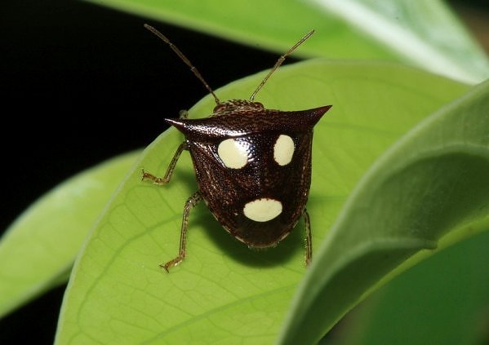
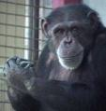
Kingdom Animalia
Ingest food
Motile (able to move on their own)
Complex, specialized cells
Insects, Mammals, Birds

Slide 11
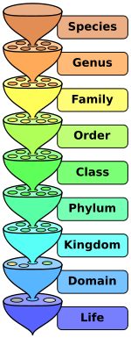
Levels of Classification
Domain
Kingdom
Phylum
Class
Order
Family
Genus
Species
Danish King Philip Came Over For Green Spinach
Notes:
This system was developed by Carolus Linnaeus. It used simple physical characteristics to categorize and describe organisms.

Slide 12
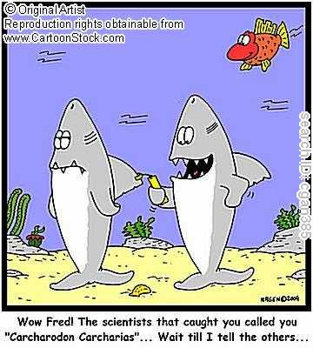
Naming
Use the Linnean system with Genus and Species names
Eg.) Lynx rufus (bobcat)
Latin or Greek
World wide naming system allows people from around the world to understand each other
Notes:
Binomial nomenclature – a two part name

Slide 13
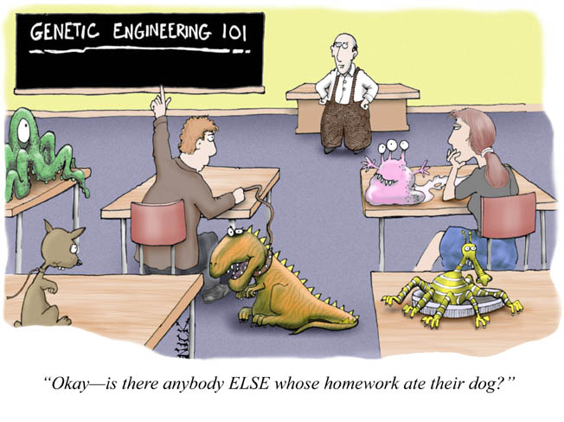
Dichotomous Keys
Multi-step identification keys
Two choices at each step
Moves from general to more specific
Notes:
Section 3.2 Review questions, page 92, #1-3,5,6

