Slide 1
Chapter 3
Optical telescopes, radio telescopes, and other technologies advance our understanding of space.
3.1
Using Technology to See the Visible

Slide 2
Optical Telescopes
In 1608, Hans Lippershey made one of the first telescopes – but it was Galileo Galilei who made practical use of it. Optical telescopes are ‘light collectors’. The series of lenses or mirrors enable the optical device to collect and focus the light from stars.
There are two types of optical telescopes:

Slide 3
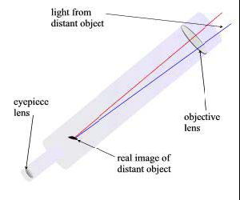
Refracting Telescopes
The first telescope designed was a simple refracting telescope. It uses two lenses to gather and focus starlight
There is also a limit to the size of lens that a refracting telescope can have. Diameters over 1 meter will cause the lens to warp.

Slide 4
Reflecting Telescopes
Reflecting telescopes use mirrors instead of lenses to gather and focus the light from the stars. A process called ‘spin-casting’ today makes mirrors, by pouring molten glass into a spinning mold. The glass is forced to the edges, cooled and solidified.
Mirrors as large as
6m across have been
made using this method.

Slide 5
One of the newest innovations for ground-based optical reflecting telescopes is the use of segmented mirrors (a segmented-mirror telescope uses several lightweight-segments to build one large mirror).

Slide 6
Interferometry: Combining Telescopes For Greater Power
The technique of using a number of telescopes in combination is called interferometry. When working together, these telescopes can detect objects in space with better clarity and at greater distances than any current Earth-based observatory.

Slide 7
The Hubble Space Telescope (HST)
To improve the views of space, astronomers are able to access images from a telescope in space. Free from the interferences of weather, clouds humidity and even high winds, the Hubble Space Telescope, launched in 1990, orbits 600 kms above the Earth, collecting images of extremely distant objects. It is a cylindrical reflecting telescope, 13 m long and 4.3 m in diameter. It is modular (parts can be removed and replaced) and is serviced by shuttle astronauts.

Slide 8
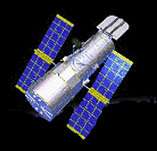
The HST makes one complete orbit of the Earth every 95 minutes.

Slide 9
3.2
Using Technology to See Beyond the Visible

Slide 10
Besides the visible light that optical telescopes can give us, other forms of electromagnetic energy can also give us information about objects in space.

Slide 11
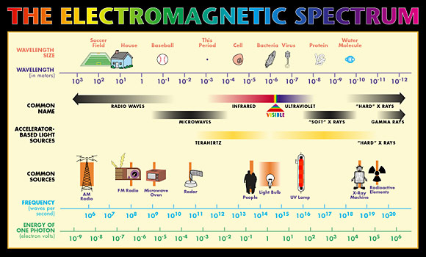

Slide 12
This energy travels at the speed of light, but has different wavelengths and frequencies from those of visible light. Energy with a short wavelength has a high frequency. Gamma rays are the most dangerous and radio waves are the safest. Visible light is measured in micrometers with 1 micrometer equal to 1 millionth of a meter.

Slide 13
Radio Telescopes
Radio waves are received from stars, galaxies, nebulae, the Sun and even some planets. With the development of radio telescopes, astronomers gain an advantage over optical telescopes, because they are not affected by weather, clouds, atmosphere or pollution and can be detected day or night. Much information has been gained about the composition and distribution of matter in space, namely neutral hydrogen, which makes up a large proportion of matter in our Milky Way galaxy. Radio telescopes are made of metal mesh and resemble a satellite dish, but are much larger, curved inward and have a receiver in the center.

Slide 14
Radio telescope in
Arecibo, Puerto Rico. p. 442 text

Slide 15
Radio Interferometry
By combining several small radio telescopes ( just like they do with optical telescopes ) greater resolving power can be achieved. This is referred to as radio interferometry, improving the accuracy and performance of the image in making radio maps. The greater the distance between the radio telescopes the more accurately they can measure position.

Slide 16
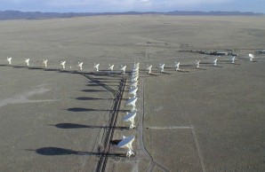
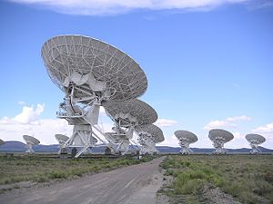
Arrays
Arrays, like the Very Large Array in Sorocco, New Mexico, which uses 27 telescopes arranged in a Y, can improve accuracy even more.

Slide 17
Viewing More Than What The Eye Can See
Ultraviolet radiation is absorbed by the atmosphere and therefore cannot be studied very well from Earth. A distant planet orbiting a distant star cannot be seen because of the bright light from its star. However, when viewed in the infrared spectrum through a radio telescope, the stars brightness dims and the planets brightness peaks. The Keck Observatory in Hawaii is actively searching for planets, with its radio telescope. Other discoveries include fluctuations in microwave energy left over from the formation of the universe; X-rays emitted from black holes and pulsating stars; and huge bursts of gamma rays appearing without warning and then fading just as quickly.

Slide 18
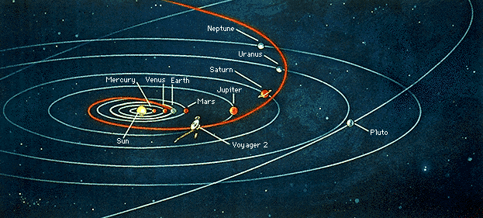
Space Probes
Observation equipment is sent out into space to explore distant areas of our solar system. Space probes are unmanned satellites or remote-controlled ‘landers’ that put equipment on or close to planets where no
human has gone before. Probes have done remote sensing on Mercury and Jupiter, taken soil samples
on Mars, landed on Venus, and studied Saturn’s rings up close. (See chart in SIA p. 444).

Slide 19
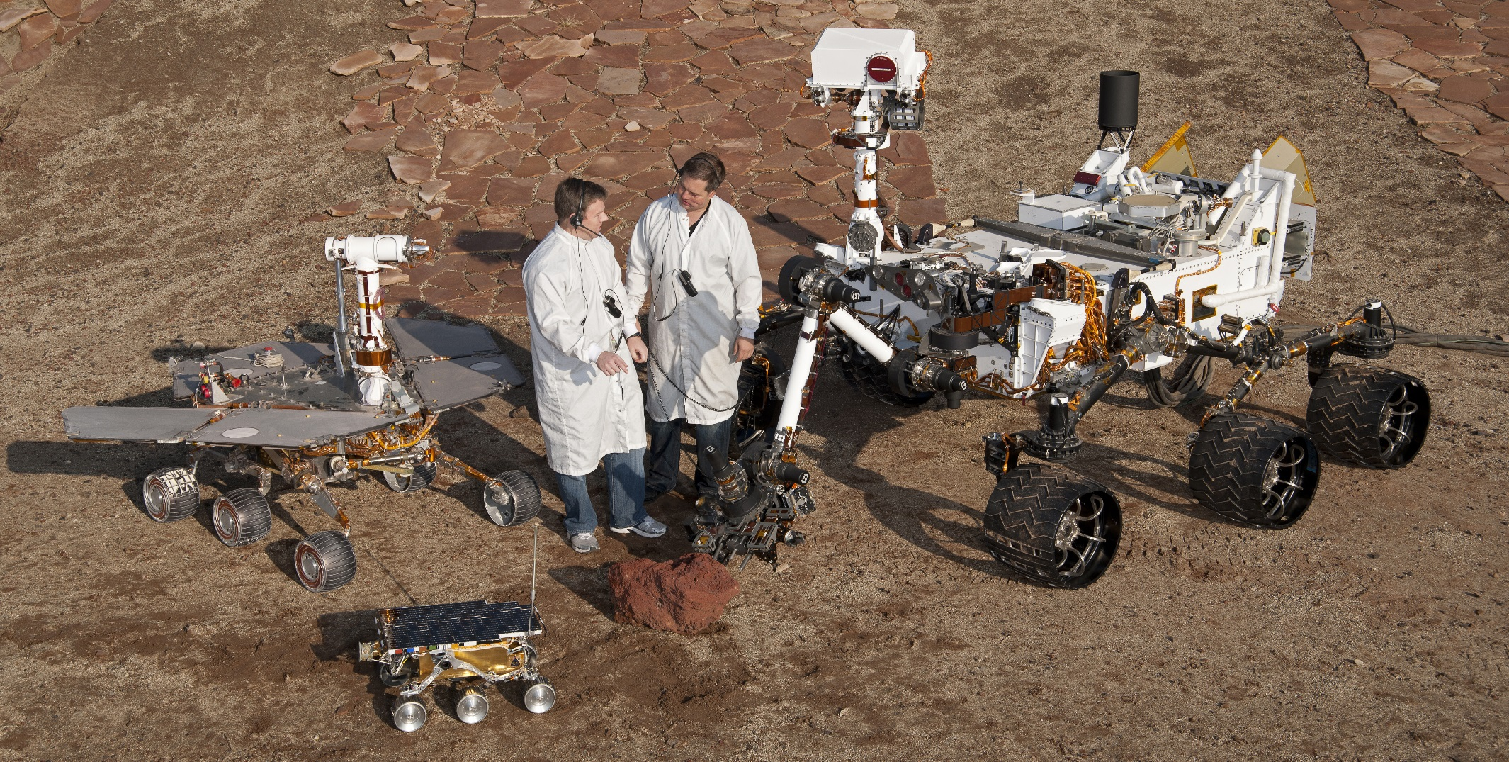
Recent probes to explore Mars, Spirit and Opportunity, are still there. They were looking for evidence of water to determine if Mars at one time could have sustained life.
Curiosity is larger and more sophisticated.

Slide 20
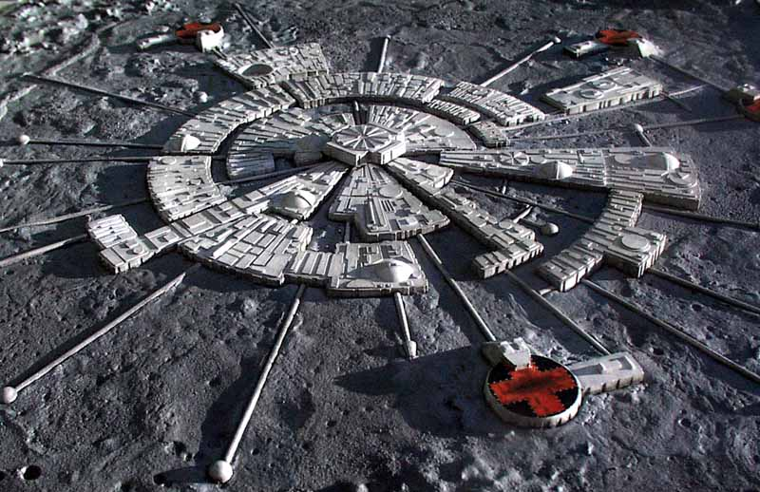
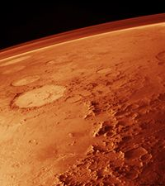
The only place that has been explored by humans in space, other than our Earth is the Moon. Apollo 11 was the first landing and there have been many others since. The next step is to establish a base for interplanetary manned missions to Mars.

Slide 21
Homework
3.1 Tech to see the visible better
  P. 439 # 1-9
3.2 Tech to see the invisible
  P. 445 # 1-7

Slide 22
3.3.
Using Technology to Interpret Space

Slide 23
Measuring Distance
Triangulation and Parallax are two ways to measure distances indirectly, on the ground, or in space.

Slide 24
Triangulation
Triangulation is based on the geometry of a triangle. By measuring the angles between the baseline and a target object, you can determine the distance to that object.
To measure the distance indirectly, you need to know the length of one side of the triangle (baseline) and the size of the angles created when imaginary lines are drawn from the ends of the baseline to the object.

Slide 25
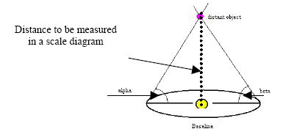

Slide 26
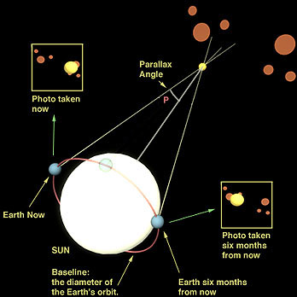
Parallax
Parallax is the apparent shift in position of a nearby object when the object is viewed from two different places. Astronomers use a star’s parallax to determine what angles to use when they triangulate the star’s distance from the Earth. The larger the baseline, the more accurate the result.
The longest baseline that
astronomers can use is the
diameter of Earth’s orbit.
Measurements have to be
taken six months apart to
achieve the diameter of the
orbit.

Slide 27
Determining A Star’s Composition
Astronomers refract the light from distant stars to determine what the star is made of. Stars have dark bands in distinct sequences and thicknesses on their spectra. Each element that is present in the star creates its own black-line ‘fingerprint’. The spectra of the star is then compared to known spectra of elements to determine the star’s composition. A spectrometer is used to do this.

Slide 28
Determining A Star’s Direction Of Motion
A change in the pitch (frequency) of sound waves because they are stretched or squeezed is known as the Doppler effect. Changes in the sound waves can be measured to determine how fast and in what direction a light-emitting object is moving. The position of the dark bands is what shifts in the light waves of a moving star. The spectrum of an approaching star shows the dark bands shifting to the blue end of the spectrum, whereas, the shift is to the red part of the spectrum if a star is moving away from the Earth. The amount of shift indicates the speed at which the star is approaching or moving away.

Slide 29
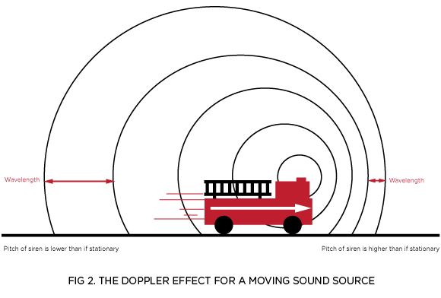
There are also practical applications that use the Doppler effect. Law enforcement officers detect the speed of an approaching vehicle by using a radar gun, which sends out a radio signal and receives one back from the vehicle. To determine the speed of the vehicle, the hand-held device records the difference in the outgoing wavelength and incoming wavelength.

