Slide 1
Chapter 4
Society and the environment are affected by space exploration and the development of space technologies.
4.1.
The Risks and Dangers of Space Exploration

Slide 2
The dangers of the ‘unfriendly to humans’ space environment were introduced in Section 2. Besides those dangers, there are others. Accidents that may result in loss of life, economic setbacks and many years of work. There are tragedies that bring to life the true dangers of space travel, such as:

Slide 3
1967
3 astronauts of Apollo 1 died during a training exercise

Slide 4
1986
7 astronauts died when the Space Shuttle Challenger exploded shortly after launch

Slide 5
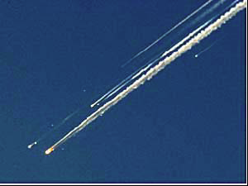
2003
7 astronauts died when the Space Shuttle Columbia broke apart during re-entry

Slide 6
Other accidents or lost missions have occurred that have cost many millions of dollars and thousands of hours of work, including most recently, the European Rover on Mars – Beagle, that did not return any data, or signal, after it landed.
Sometimes decisions may have to be made that will ultimately determine if missions are to fail. Apollo 11’s lunar (Moon) landing almost didn’t occur, because the original landing site was found to be too rocky. With a precise amount of fuel, an alternate landing site had to be chosen on the first try, or the mission would be scrubbed.

Slide 7
The Dangers of Manned Space Travel
A launch can be affected by many dangers, including highly explosive fuel, poor weather, malfunctioning equipment, human error and even birds. Once in flight, the spacecraft can be affected by floating debris, meteoroids and electromagnetic radiation (coronal mass ejections – or, solar flares).
Re-entering Earth’s atmosphere also has it dangers (as proven by the Colombia disaster). The re-entry path the spacecraft takes must be perfect, otherwise, if it is too shallow - it will bounce off the atmosphere, and if it is too steep – it will burn-up.

Slide 8
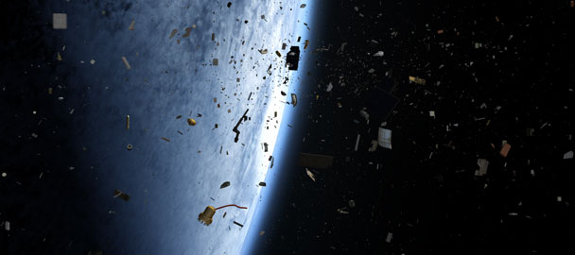
Space Junk
Space junk refers to all the pieces of debris that have fallen off rockets, satellites, space shuttles and space stations that remain in space. This can include specks of paint, screws, bolts, nonworking satellites, antennas, tools and equipment that is discarded or lost.

Slide 9
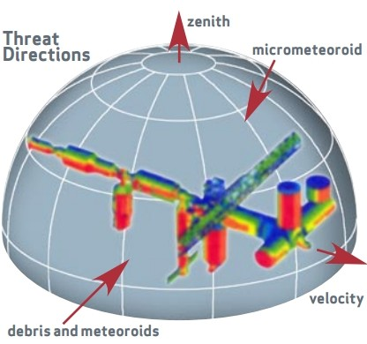
The Hazards in Space
Over 4000 missions have been sent into space. Micrometeorites are constantly bombarding spacecraft and the International Space Station. They travel at extremely high velocity and can cause great damage. Once they enter the atmosphere, they
usually burn up.

Slide 10
Some debris in space will enter the atmosphere and will not totally burn up. When this occurs, it may land in populated areas and cause loss of life or damage to property.
Some satellites, or decommissioned space stations, that re-enter the atmosphere have radioactive parts and can contaminate a very large area, costing a lot of money and hours to clean it up. Some burn up in the atmosphere and those parts that don’t, can fall into the ocean, making recovery and clean-up less costly.

Slide 11
4.2
Canadian Contributions to Space Exploration and Observation

Slide 12
One of the most notable Canadian contributions to the international space program is the ‘Canadarm’.
It was launched in 1981 and has served a very useful purpose on many missions, including launching and retrieving satellites for use or repair, fixed the Hubble Telescope and put modules of the International Space Station together.

Slide 13
Canadarm 2 is currently operating as a vital part of the International Space Station. It has three main parts:
Remote manipulator system – seven motorized joints, carries large payloads, assists with docking shuttles, moves around to different parts of the station.
Mobile base system – can travel along a rail system to move to different parts of the station
Special purpose dexterous manipulator – uses its two-armed
robotic hands for delicate assembly work.

Slide 14
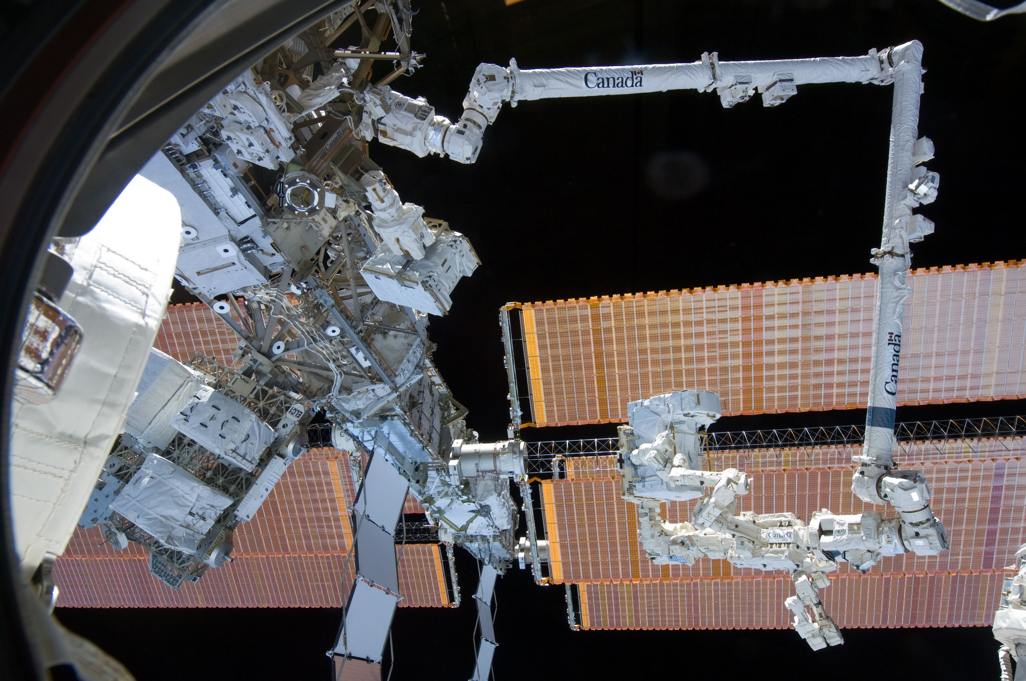

Slide 15
Canada has also launched satellites into orbit:
• Alouette 1 in 1962 – one of the first satellites launched for non-military use
• Anik 1 in 1972 – communications across the entire country
• 1973 – Canada was the 1st nation to broadcast television signals via satellite

Slide 16
Brief Summary of Canada’s Contributions in Space:
1839 – Sir Edward Sabine establishes the 1st magnetic observatory and discovers that the Aurora Borealis is associated with sunspot activity
1962 – 3rd nation to launch a satellite
1969 – supplied landing gear for Apollo 11
1981 – Canadarm 1 used for the first time in space

Slide 17
1984 – 1st astronaut – Marc Garneau
1992 – 1st female astronaut – Roberta Bondar
1997 – Technology for the Mars Pathfinder Mission - Sojourner rover ramp
2001 – Chris Hadfield - 1st Canadian to walk in space – he helped deliver the Canadarm 2 to the ISS.

Slide 18
4.3
Issues Related to Space Exploration

Slide 19
Should money be spent to explore space
or
  Should it be used to fix the problems we have on the Earth?

Slide 20

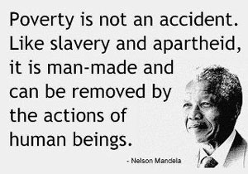
The Pros and Cons Of Space Exploratio
Disease, poverty, hunger, pollution and terrorism are all problems that face the people of the Earth. Spending billions to explore space, or spending billions to solve the conditions we currently experience is an ongoing debate that likely will never be solved. With depleting natural resources, population increases and advances in technology, the exploration of space may be the only option in the future.

Slide 21
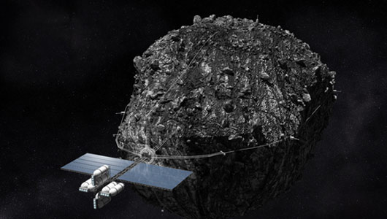
The Potential Value Of Space’s Resourc
Resources in space mean economic wealth. Energy supplies appear to be unlimited – solar energy from the Sun and mineral resources from the Asteroid belt. The cost of travel in space could be cut substantially if fuel and construction material is readily available in space. The Moon is one of the first places scientists looked for resources where they were able to process hydrogen and oxygen from Moon rock. The oxygen could be used for life support and hydrogen for fuel on lunar bases.
Combining the two,
water can be produced.

Slide 22
Political Issues
Who owns space?
Who can use the resources in space?
Who will determine what goes on in space?

Slide 23
Ethical Issues
Is it right to spend so much on space, instead of fixing Earth’s problems?
Do we have a right to alter materials in space to meet our needs?
How can we ensure that exploration will be used for good and not evil?
Who is responsible for protecting space environments from alteration?
Who is responsible for cleaning up space junk?

Slide 24

Collaboration between nations with a ‘space treaty’ may resolve some of these issues and pave the way to ensure that space exploration is orderly, meaningful and fair to all humans and all nations.

