Slide 1
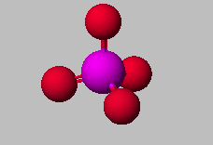

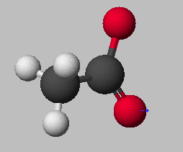
Compound Nomenclature
PO₄³⁻
phosphate ion
HC₂H₃O₂
Acetic Acid
C₂H₃O₂⁻
acetate ion

Slide 2
Forms of Chemical Bonds
There are 2 forms bonding atoms:
Ionic—(binary) complete transfer of 1 or more electrons from one atom to another (one loses, the other gains)
Covalent—(molecular) some valence electrons shared between atoms

Slide 3
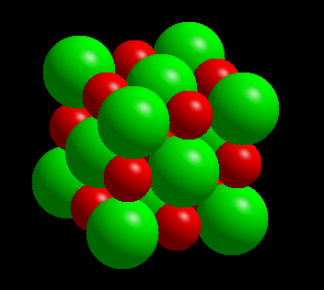
COMPOUNDS FORMED FROM IONS
CATION +
ANION
COMPOUND
Na⁺ + Cl⁻ NaCl
A neutral compound
requires
equal number of +
and - charges.

Slide 4
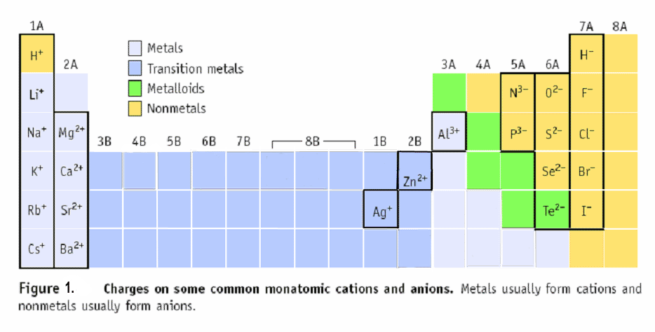
Predicting Charges on Monatomic Ions
KNOW THESE !!!!
+1 +2 -3 -2 -1 0
Cd⁺²

Slide 5
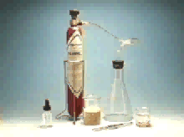
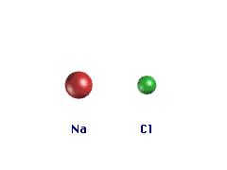
Properties of Ionic Compounds
Forming NaCl from Na and Cl₂
A metal atom can transfer an electron to a nonmetal.
The resulting cation and anion are attracted to each other by electrostatic forces.

Slide 6
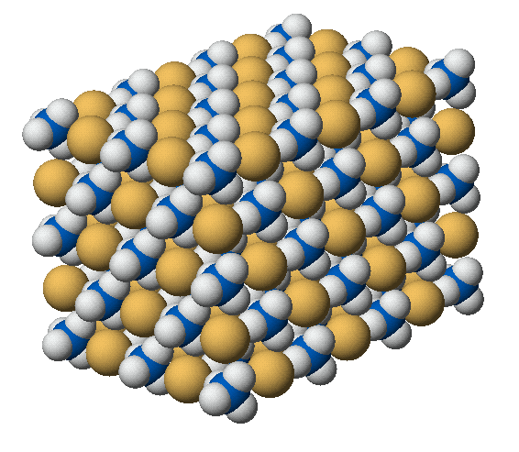
IONIC COMPOUNDS
NH₄⁺
Cl⁻
ammonium chloride, NH₄Cl

Slide 7
Some Ionic Compounds
Ca²⁺ + 2 F⁻ --->
CaF₂
Mg²⁺ + N⁻³ ---->
Mg₃N₂
magnesium nitride
Sn⁴⁺ + O²⁻ ---->
SnO₂
Tin (IV) oxide
calcium fluoride

Slide 8
Formulas of Ionic Compounds
Formulas of ionic compounds are determined from the charges on the ions
atoms ions
• • • • –
Na • + • F : ⎯→ Na⁺ : F : ⎯→ NaF
• • • •
sodium + fluorine sodium fluoride formula
Charge balance: 1+ 1- = 0

Slide 9
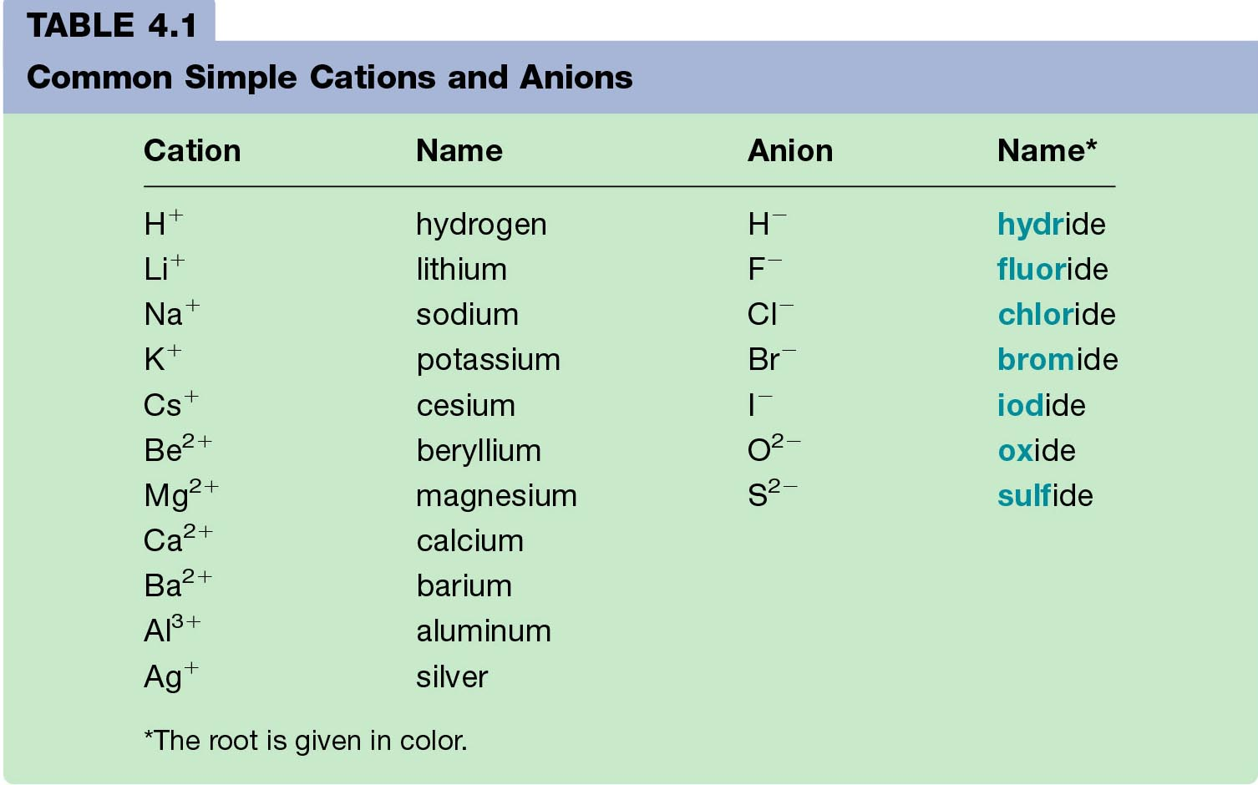
Monatomic Ions

Slide 10
Writing a Formula
Write the formula for the ionic compound that will form between Ba²⁺ and Cl⁻.
Solution:
1. Balance charge with + and – ions
2. Write the positive ion of metal first, and the
negative ion ²⁺
3. Write the number of ions needed as
subscripts BaCl₂
2⁺
-
-

Slide 11
Learning Check
Write the correct formula for the compounds containing the following ions:
1. Na⁺, S²⁻
a) NaS b) Na₂S c) NaS₂
2. Al³⁺, Cl⁻
3. Mg²⁺, N³⁻

Slide 12
Solution
1. Na⁺, S²⁻
b) Na₂S
2. Al³⁺, Cl⁻
AlCl₃
3. Mg²⁺, N³⁻
Mg₃N₂

Slide 13
Naming Compounds
Binary Ionic Compounds:
1. Cation first, then anion
2. Monatomic cation = name of the element
Ca²⁺ = calcium ion
3. Monatomic anion = root + -ide
Cl⁻ = chloride
CaCl₂ = calcium chloride

Slide 14
Naming Binary Ionic Compounds
Examples:
      NaCl
      ZnI₂
      Al₂O₃
sodium chloride
zinc iodide
aluminum oxide

Slide 15

Learning Check
Complete the names of the following binary compounds:
Na₃N sodium ________________
KBr potassium ________________
Al₂O₃ aluminum ________________
MgS _________________________

Slide 16
Solution
Complete the names of the following binary compounds:
Na₃N
KBr
Al₂O₃
MgS
sodium nitride
potassium bromide
aluminum oxide
magnesium sulfide

Slide 17
Transition Metals
Elements that can have more than one possible charge MUST have a Roman Numeral to indicate the charge on the individual ion.
1+ or 2+ 2+ or 3+
Cu⁺, Cu²⁺ Fe²⁺, Fe³⁺
copper(I) ion iron(II) ion
copper (II) ion iron(III) ion

Slide 18
Names of Variable Ions
These elements REQUIRE Roman Numerals because they can have more than one possible charge:
anything except Group 1A, 2A, Ag, Zn, Cd, and Al
(You should already know the charges on these!)
Another way to say this is: Transition metals and the metals in groups 4A and 5A (except Ag, Zn, Cd, and Al) require a Roman Numeral.
FeCl₃ (Fe³⁺) iron (III) chloride
CuCl (Cu⁺ ) copper (I) chloride
SnF₄ (Sn⁴⁺) tin (IV) fluoride
PbCl₂ (Pb²⁺) lead (II) chloride
Fe₂S₃ (Fe³⁺) iron (III) sulfide

Slide 19
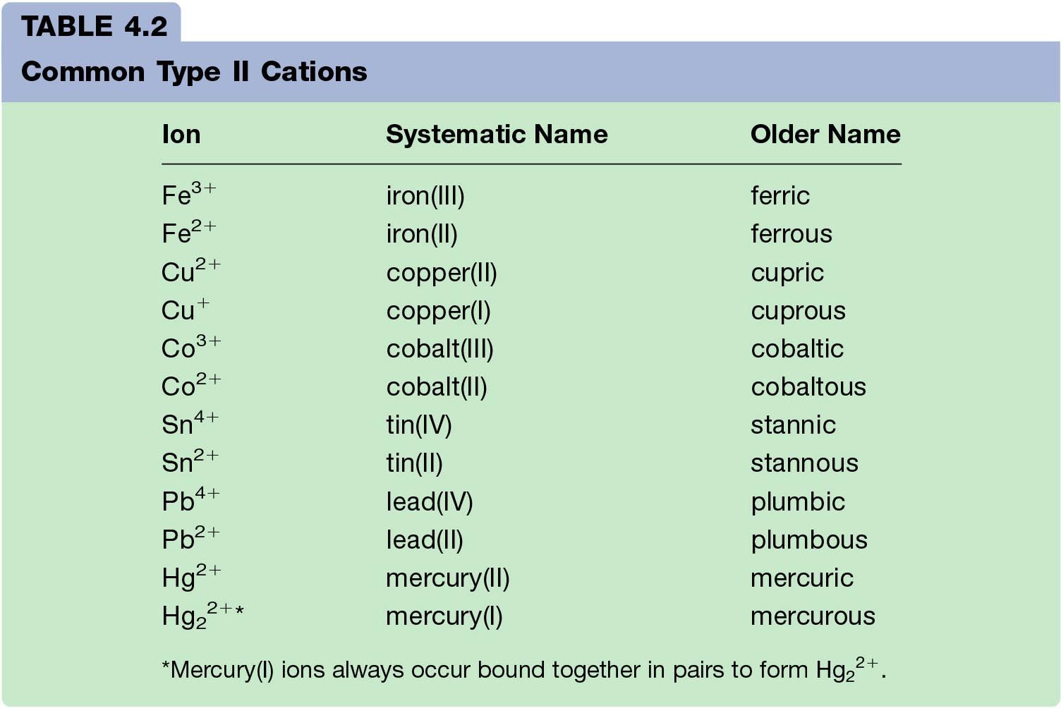
Examples of Older Names of Cations formed from Transition Metals
(you do not have to memorize these)

Slide 20
Learning Check
Complete the names of the following binary compounds with variable metal ions:
FeBr₂ iron (_____) bromide
CuCl copper (_____) chloride
SnO₂ ___(_____ ) ______________
Fe₂O₃ ________________________
Hg₂S ________________________

Slide 21
Solution
Complete the names of the following binary compounds with variable metal ions:
iron ( II ) bromide
copper ( I ) chloride
tin (IV) oxide
iron (III) oxide
mercury (I) sulfide
FeBr₂
CuCl
SnO₂
Fe₂O₃
Hg₂S

Slide 22
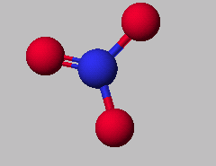
Polyatomic Ions
NO₃⁻
nitrate ion
NO₂⁻
nitrite ion

Slide 23
Polyatomic Ions
You can make additional polyatomic ions by adding a H⁺ to the ion!
CO₃ ⁻² is carbonate
HCO₃– is hydrogen carbonate
H₂PO₄– is dihydrogen phosphate
HSO₄– is hydrogen sulfate

Slide 24
Ionic Nomenclature
Writing Formulas
Write each ion, cation first. Don’t show charges in the final formula.
  Remember → Roman numerals indicate the ion’s charge when needed.
Overall charge must equal zero.
  If charges cancel, just write symbols.
  If not, use subscripts to balance charges.
Use parentheses to show more than one of a particular polyatomic ion.

Slide 25
Ionic Compound Nomenclature
Sodium Sulfate
Na⁺ and SO₄ ⁻²
Na₂SO₄
Iron (III) hydroxide
Fe⁺³ and OH⁻
Fe(OH)₃
Ammonium carbonate
NH₄⁺ and CO₃ ^{–2}
(NH₄)₂CO₃

Slide 26
Learning Check
1. aluminum nitrate
a) AlNO₃ b) Al(NO)₃ c) Al(NO₃)₃
2. copper(II) nitrate
a) CuNO₃ b) Cu(NO₃)₂ c) Cu₂(NO₃)
3. Iron (III) hydroxide
4. Tin(IV) hydroxide

Slide 27
Solution
1. aluminum nitrate
c) Al(NO₃)₃
2. copper(II) nitrate
b) Cu(NO₃)₂
3. Iron (III) hydroxide
4. Tin(IV) hydroxide

Slide 28
Naming Ionic Compounds
If it contains 3 or more elements, there MUST be at least one polyatomic ion
(it helps to circle the ions)
Examples:
NaNO₃ Sodium nitrate
K₂SO₄ Potassium sulfate
Al(HCO₃)₃ Aluminum bicarbonate
or
Aluminum hydrogen carbonate

Slide 29
Learning Check
Match each set with the correct name:
1. Na₂CO₃ a) magnesium sulfite
MgSO₃ b) magnesium sulfate
MgSO₄ c) sodium carbonate
2 . Ca(HCO₃)₂ a) calcium carbonate
CaCO₃ b) calcium phosphate
Ca₃(PO₄)₂ c) calcium bicarbonate

Slide 30
Solution
1. Na₂CO₃ MgSO₃ MgSO₄
2. Ca(HCO₃)₂
CaCO₃
Ca₃(PO₄)₂
c) sodium carbonate
magnesium sulfite
magnesium sulfate
calcium bicarbonate
calcium carbonate
b) calcium phosphate

Slide 31
Mixed Practice!
Name the following:
Na₂O
CaCO₃
PbS₂
Sn₃N₂
Cu₃PO₄
HgF₂
Write formulas for the following:
Sodium oxide
Calcium carbonate
Lead (IV) sulfide
Tin (II) nitride
Copper (I) phosphate
Mercury (II) fluoride

Slide 32
Mixed Up… The Other Way
Write the formula:
Copper (II) chlorate
Calcium nitride
Aluminum carbonate
Potassium bromide
Barium fluoride
Cesium hydroxide
Cu(ClO₃)₂
Ca₃N₂
Al₂(CO₃)₃
KBr
BaF₂
CsOH

Slide 33
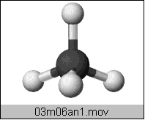
Naming Molecular Compounds
All are formed from two or more nonmetals.
CO₂ Carbon dioxide
Ionic compounds generally involve a metal and nonmetal
(NaCl)
BCl₃
boron trichloride
CH₄ methane

Slide 34
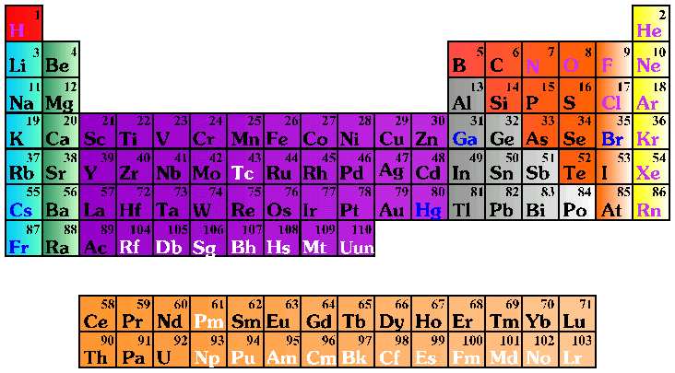
Molecular (Covalent) Nomenclature for two nonmetals
Prefix System (binary compounds)
  1. Less electronegative atom
  comes first.
  2. Add prefixes to indicate # of atoms. Omit mono- prefix on the FIRST element. Mono- is OPTIONAL on the SECOND element (in this class, it’s NOT optional!).
  3. Change the ending of the
  second element to -ide.

Slide 35
Molecular Nomenclature Prefixes
PREFIX
mono-
di-
tri-
tetra-
penta-
hexa-
hepta-
octa-
nona-
deca-
NUMBER
1
2
3
4
5
6
7
8
9
10

Slide 36
Molecular Nomenclature: Examples
CCl₄
N₂O
SF₆
  carbon tetrachloride
  dinitrogen monoxide
  sulfur hexafluoride

Slide 37
More Molecular Examples
arsenic trichloride
dinitrogen pentoxide
tetraphosphorus decoxide
  AsCl₃
  N₂O₅
  P₄O₁₀

Slide 38
Learning Check
Fill in the blanks to complete the following names of covalent compounds.
CO carbon ______oxide
CO₂ carbon _______________
PCl₃ phosphorus _______chloride
CCl₄ carbon ________chloride
N₂O _____nitrogen _____oxide

Slide 39
Solution
CO carbon monoxide
CO₂ carbon dioxide
PCl₃ phosphorus trichloride
CCl₄ carbon tetrachloride
N₂O dinitrogen monoxide

Slide 40
Learning Check
1. P₂O₅ a) phosphorus oxide
b) phosphorus pentoxide
c) diphosphorus pentoxide
2. Cl₂O₇ a) dichlorine heptoxide
b) dichlorine oxide
c) chlorine heptoxide
3. Cl₂ a) chlorine
b) dichlorine
c) dichloride

Slide 41
Solution
1. P₂O₅
2. Cl₂O₇
3. Cl₂
c) diphosphorus pentoxide
a) dichlorine heptoxide
a) chlorine

Slide 42
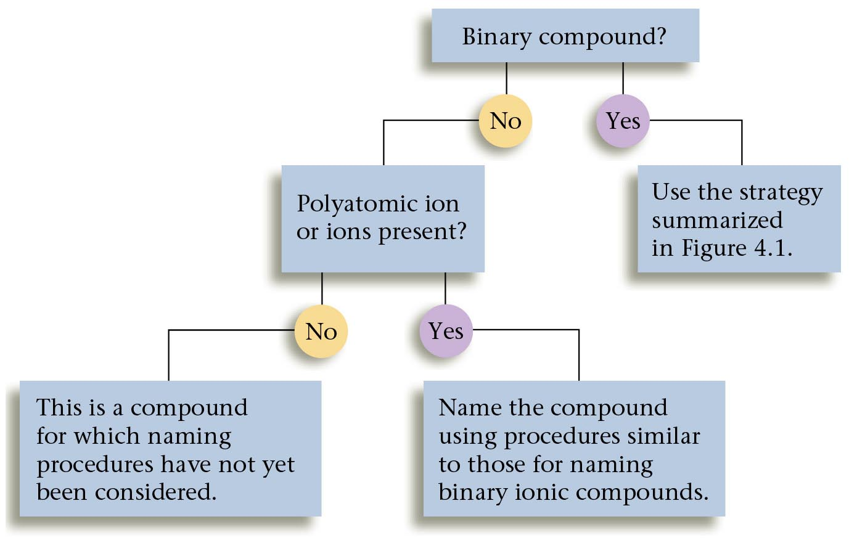
Overall strategy for naming chemical compounds.
A 2.3

Slide 43
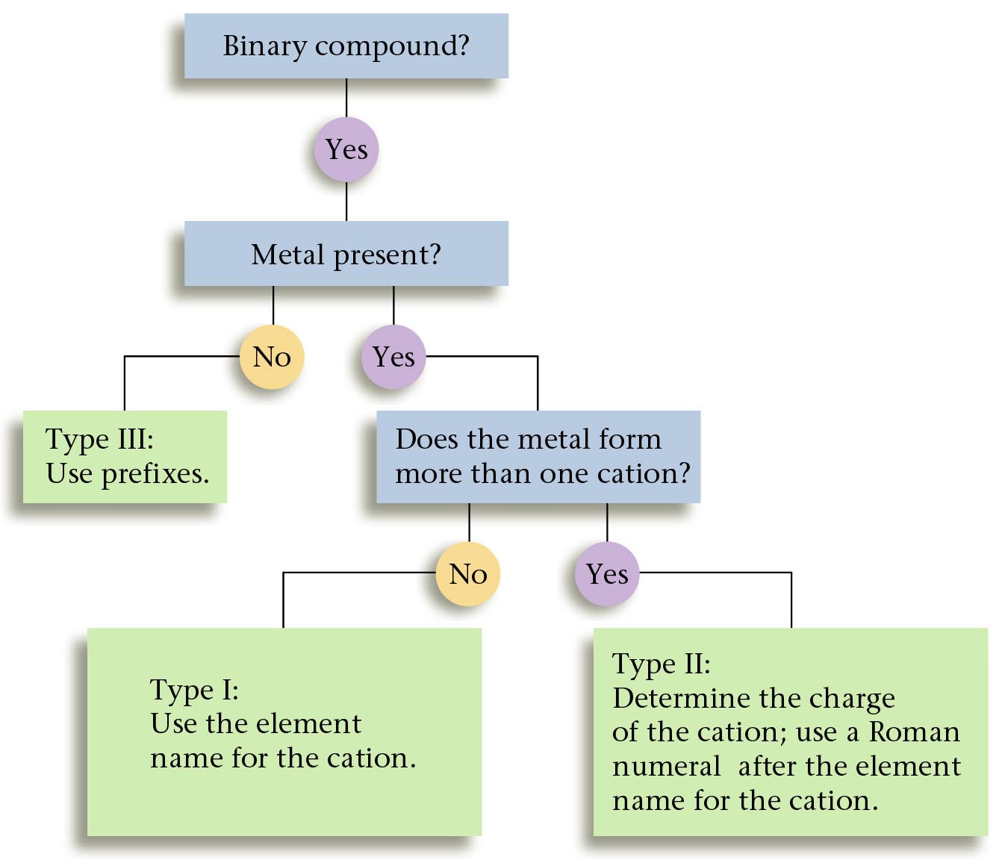
A flow chart for naming binary compounds.

Slide 44
Mixed Review
Name the following compounds:
1. CaO
a) calcium oxide b) calcium(I) oxide
c) calcium (II) oxide
2. SnCl₄
a) tin tetrachloride b) tin(II) chloride
c) tin(IV) chloride
3. N₂O₃
a) nitrogen oxide b) dinitrogen trioxide
c) nitrogen trioxide

Slide 45
Solution
Name the following compounds:
1. CaO
2. SnCl₄
3. N₂O₃
a) calcium oxide
c) tin(IV) chloride
b) Dinitrogen trioxide

Slide 46
Mixed Practice
Dinitrogen monoxide
Potassium sulfide
Copper (II) nitrate
Dichlorine heptoxide
Chromium (III) sulfate
Iron (III) sulfite
Calcium oxide
Barium carbonate
Iodine monochloride
N₂O
K₂S
Cu(NO₃)₂
Cl₂O₇
Cr₂(SO₄)₃
Fe₂(SO₃)₃
CaO
BaCO₃
ICl

Slide 47
Mixed Practice
BaI₂
P₄S₃
Ca(OH)₂
FeCO₃
Na₂Cr₂O₇
I₂O₅
Cu(ClO₄)₂
CS₂
B₂Cl₄
Barium iodide
Tetraphosphorus trisulfide
Calcium hydroxide
Iron (II) carbonate
Sodium dichromate
Diiodine pentoxide
Copper (II) perchlorate
Carbon disulfide
Diboron tetrachloride

Slide 48
Acid Nomenclature
Acids
Compounds that form H⁺ in water.
Formulas usually begin with ‘H’.
In order to be an acid instead of a gas, binary acids must be aqueous (dissolved in water)
Ternary acids are ALL aqueous
Examples:
HCl _{(aq)} – hydrochloric acid
HNO₃ – nitric acid
H₂SO₄ – sulfuric acid

Slide 49
Acid Nomenclature
Binary →
Ternary
An easy way to remember which goes with which…
“In the cafeteria, you ATE something ICky”

Slide 50
Acid Nomenclature Flowchart

Slide 51
Acid Nomenclature
HBr _{(aq)}
H₂CO₃
H₂SO₃
  2 elements, -ide
⇒ hydrobromic acid
  3 elements, -ate
⇒ carbonic acid
  3 elements, -ite
⇒ sulfurous acid

Slide 52
Acid Nomenclature
hydrofluoric acid
sulfuric acid
nitrous acid
  2 elements
⇒ H⁺ F-
⇒ HF _{(aq)}
  3 elements, -ic
⇒ H⁺ SO₄²⁻
⇒ H₂SO₄
  3 elements, -ous
⇒ H⁺ NO₂⁻
⇒ HNO₂

Slide 53
Name ‘Em!
HI _{(aq)}
HCl
H₂SO₃
HNO₃
HIO₄
Hydroiodic acid
Hydrogen chloride (not aq!)
Sulfurous acid
Nitric acid
Periodic acid

Slide 54
Write the Formula!
Hydrobromic acid
Nitrous acid
Carbonic acid
Phosphoric acid
Hydrotelluric acid
HBr _{(aq)}
HNO₂
H₂CO₃
H₃PO₄
H₂Te _{(aq)}

Slide 55
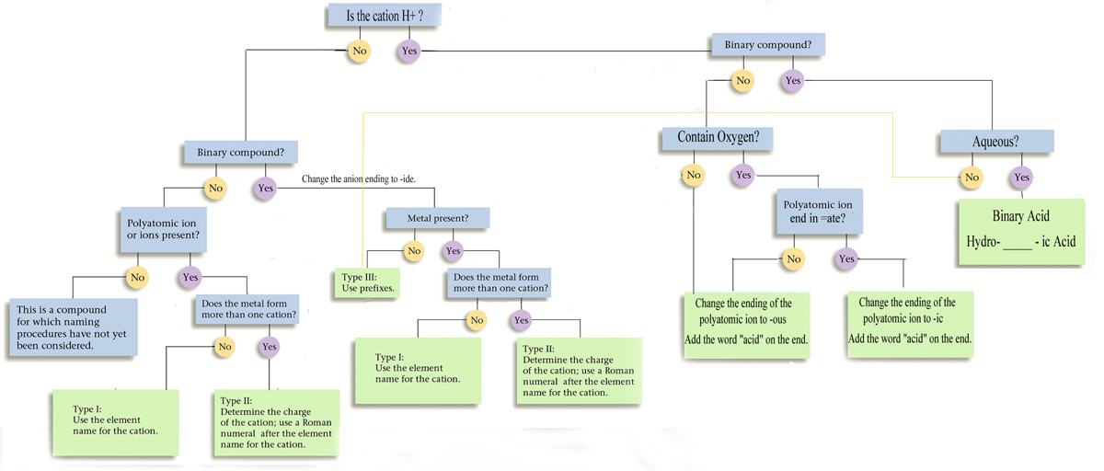
Nomenclature Summary Flowchart

Slide 56
Now You Should Be Able To…
Identify common elements and compounds using scientific nomenclature.
Use:
  • Common system
  • Stock system,
  • Prefix system,
  • IUPAC nomenclature
  • acid nomenclature
WITH:
  • common monatomic ion
  • common polyatomic ions
Binary compounds
  • Ionic
  • Molecular
  • Acids
Ternary compounds
  • Ionic
  • Acids

Slide 57
Now You Should Be Able To…
Demonstrate (students performing) the
use of symbols, formulas, and equations
in describing interactions of matter such
as chemical and nuclear reactions.
Write formulas and equations with:
• Words only
• Formula equations
• Symbols in equations like, aq,
s, l, g, etc.
Use Empirical and molecular formulas

Slide 58

Now it’s Study Time
DONE

Slide 59
Rainbow Matrix Game
Link on Chemistry Geek.com on Chemistry I page
http://chemistrygeek.com/rainbow
Use [ ] to represent subscripts since you can’t enter subscripts into the computer
So H₂O would be H[2]O
And Al₂(SO₄)₃ would be Al[2](SO[4])[3]
Additional Polyatomic Ions (you do not have to memorize these, but they are in the game!)
Borate = BO₃ ⁻³ ; Silicate = SiO₄ ⁻⁴ ;
Manganate = MnO₄ ⁻² (permanganate is -1)

