Slide 1
5.1 Acids and Bases
Many familiar compounds are acids or bases.
Classification as acids or bases is based on chemical composition.
Acids and bases can be very dangerous.
Both can be very corrosive.
NEVER try to identify an acid or base by taste or touch!
See pages

Slide 2
The pH scale
The strength of acids and bases in measured on the pH scale.
< > =
pH below 7 = acidic, pH above 7 = basic, pH 7 = neutral
0 1 2 3 4 5 6 7 8 9 10 11 12 13 14
Acids Neutral Bases
Each decrease of 1 on the pH scale indicates 10× more acidic
For example, pH 4 is 10 times more acidic than pH 5.
pH 3 is 1000 times more acidic than pH 6.

Slide 3
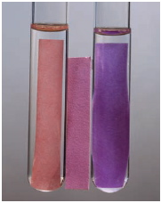
pH Indicators
The pH of acids and bases cannot be determined by sight.
Instead, pH is measured by other chemicals called indicators
or by a pH meter that measures the electrical
conductivity of the solution.
pH indicators change colour based on
the solution they are placed in.
Litmus is the most common indicator, and is used on litmus paper.
Two colours of litmus paper: Blue = basic and Red = acidic.
Blue = pH above 7, Red = pH below 7.
Litmus paper
See pages

Slide 4
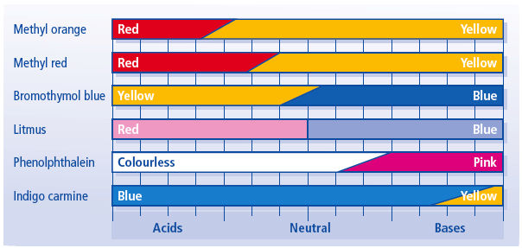
There are many pH indicators
Universal indicator contains many indicators that turn different colours at different pH values (can be in liquid form, or on paper strips like litmus).

Slide 5
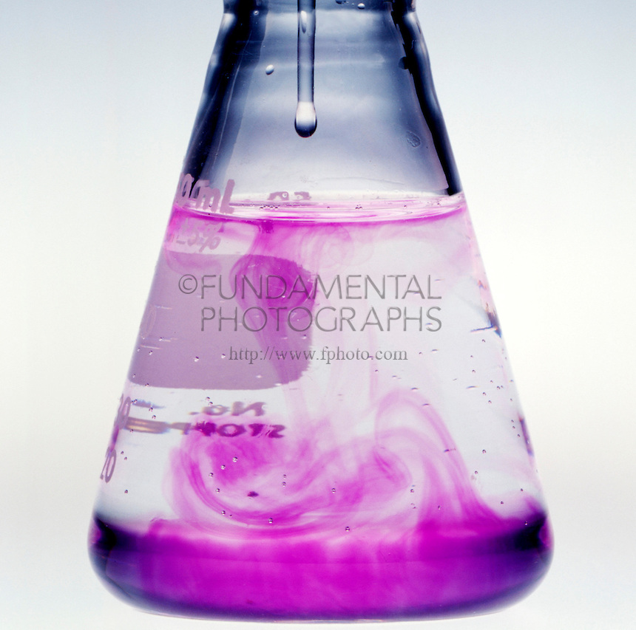
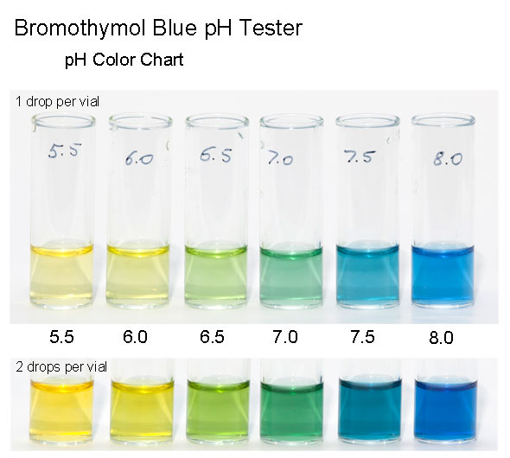
Indicators change colour at different pH values, so different indicators are used to identify different pH values.
Bromothymol blue for pH 6 – 7.6, phenolphthalein for pH 8.2 – 10.

Slide 6
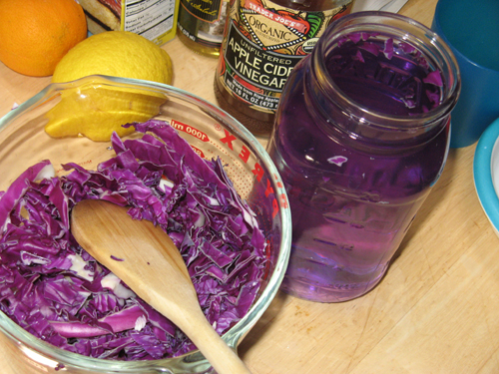
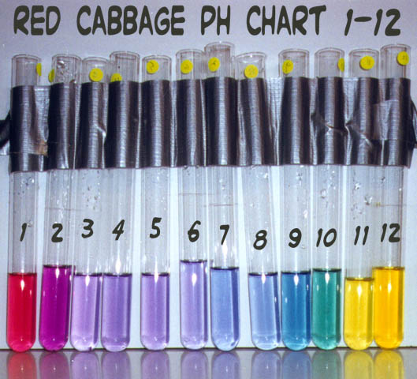
Many natural sources, such as beets and cabbage, are also indicators.

Slide 7
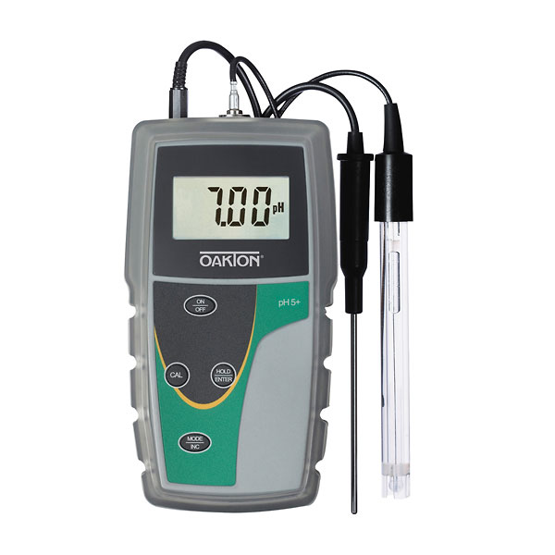
pH Meter
A pH meter uses electrical probes to measure how solutions conduct electricity.

Slide 8
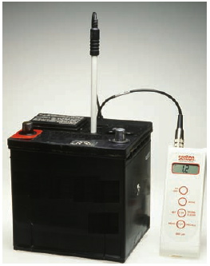
Acids
If you know a compound’s chemical formula, you may be able to identify whether it as an acid.
Acids behave like acids only when dissolved in water.
Therefore, acids are written with symbol (aq) = aqueous = dissolved in water.
Sulfuric acid is used in batteries.
H₂SO₄
See pages

Slide 9
Acid Formulas
The chemical formula of an acid usually starts with hydrogen (H).
Acids with a carbon usually have the
C written first.
HCl_{(aq)} = hydrochloric acid,
HNO_{3(aq)} = nitric acid,
CH₃COOH_{(aq)} = acetic acid

Slide 10
Naming acids
Hydrogen + …-ide = hydro…ic acid
HF_{(aq)} = hydrogen fluoride = hydrofluoric acid
Hydrogen + …-ate = …ic acid
H₂CO_{3(aq)} = hydrogen carbonate = carbonic acid
Hydrogen + …-ite = …ous acid
H₂SO_{3(aq)} = hydrogen sulphite = sulphurous acid

Slide 11
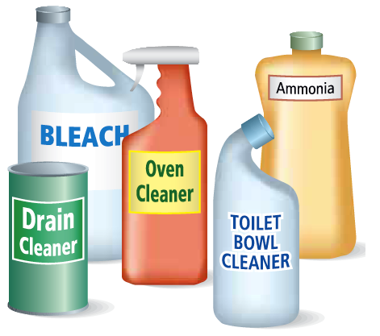
Bases
If you know a compound’s chemical formula, you may be able to identify it as a base.
Bases behave like bases only when dissolved in water.
Therefore, bases are written with the symbol (aq) = aqueous = water.
The chemical formula of a base usually ends with hydroxide (OH).
Bases can be gentle or very caustic.
Examples of common bases:
NaOH_{(aq)}
Mg(OH)_{2(aq)}
Ca(OH)_{2(aq)}
NH₄OH_{(aq)}
See page

Slide 12
Production of Ions
Acids and bases can conduct electricity because they
release ions in solution.
Acids release hydrogen ions, H⁺ .
Bases release hydroxide ions OH–.
The pH of a solution refers to the concentration of ions it has.
See page

Slide 13
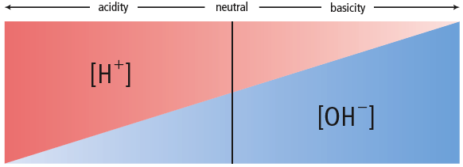
Ion concentrations
Square brackets are used to signify concentration, [H⁺], [OH–]
High [H⁺] = low pH, very acidic
High [OH–] = high pH, very basic
A solution cannot have BOTH high [H⁺] and [OH–]; they cancel each other out and form water. This process is called neutralization.
H⁺ + OH– → H₂O

Slide 14
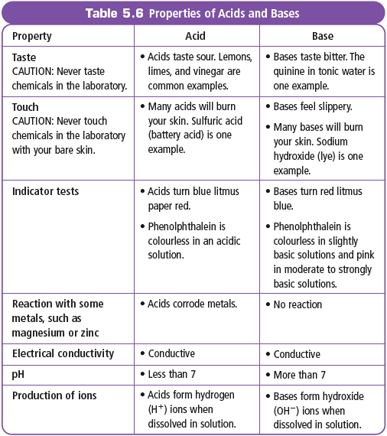
Properties of Acids and Bases
See page

