Slide 1
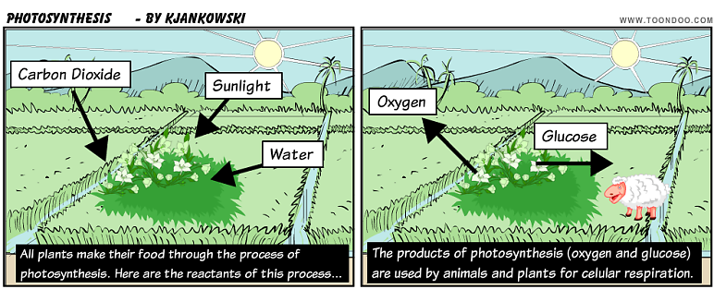
Photosynthesis Stores Energy in Organic Compounds

Slide 2
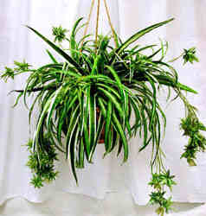
Photosynthesis
Photosynthesis produces 1.4 X 10¹⁵kg of energy-storing sugars each year
Often, but not
always glucose
Notes:
Only a small portion of the Sun’s energy output reaches Earth’s surface. A fraction of this is used for photosynthesis
We spoke about how the equation for photosynthesis represents the overall reaction. The arrow in this equation represents over 100 distinct reactions.

Slide 3
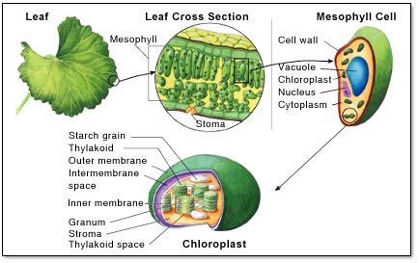

Slide 4
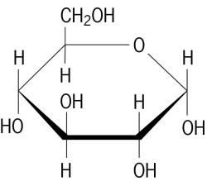
Glucose
Glucose is converted into:
Cellulose & other structural tissues
Other sugars & carbohydrates
Amino acids (used to produce proteins)

Slide 5
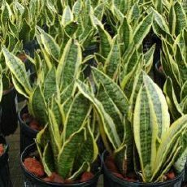
Photosynthesis
2 sets of reactions:
Photo → reactions that capture light energy
Light-Dependent reactions
Products: ATP and NADPH
Synthesis → reactions that produce a carbohydrate
Notes:
(adenosine triphosphate and reduced nicotinamide adenine dinucleotide phosphate)

Slide 6
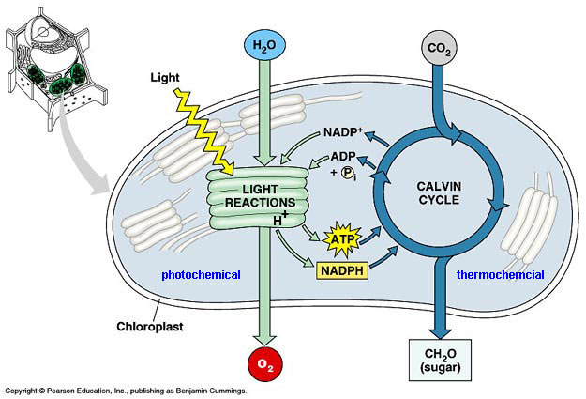
Light-Independent reactions
Uses ATP and NADPH to reduce CO₂ to make glucose, which can be converted to starch

Slide 7
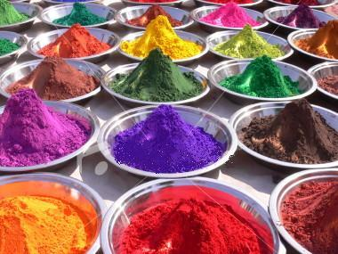
Light-Dependant Reactions
Pigment – a compound that absorbs certain wavelengths of visible light while reflecting others
Notes:
Is it the absorbed, or reflected light that gives something its color? (reflected)
Go through figure 5.9, page 171 with students.

Slide 8
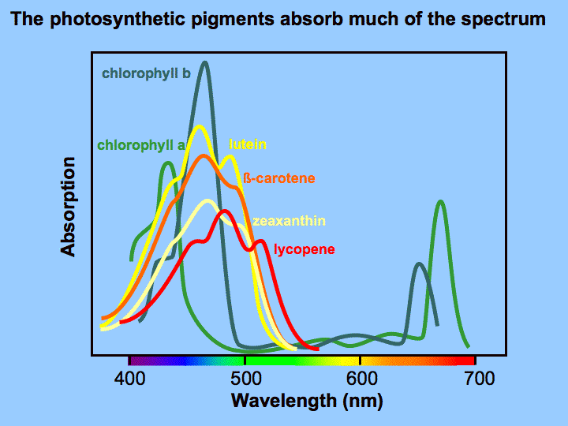
Photosynthetic pigments
Capture energy and pass it on to other chemicals
Plants use many
different pigments
to trap a greater
percentage of
sunlight
Chlorophyll is
the main pigment

Slide 9
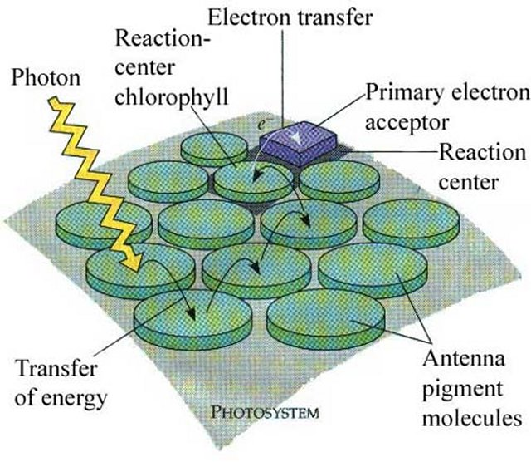
Path of Electrons in Light-Dependent Reactions
Photosystems are clusters of pigment within the thylakoid
Notes:
Photosystems are named for the order in which they were discovered, not the order in which they occur

Slide 10
Chloroplasts of plants/algae have 2 photosystems (PSI & PSII)

Slide 11
Consist of pigment molecules (chlorophyll & carotenoid) and a molecule that accepts electrons

Slide 12
Reaction center receives energy → excites electron, which moves to a higher energy level → electron passes to the electron-accepting molecule.
After this, the electron moves through 4 steps

Slide 13
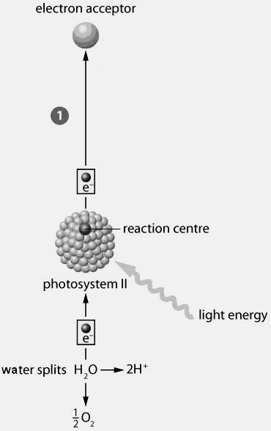
Step 1
Water splits
Electron from water is accepted in the reaction center of photosystem II
Now the photosystem can absorb more light energy
Electron becomes excited, and is released to the electron acceptor
Notes:
Photosystem II is continually gaining and losing electrons. It must have all electrons before it can absorb light energy. After it loses it’s electron, water must be split so that it can gain another one.

Slide 14
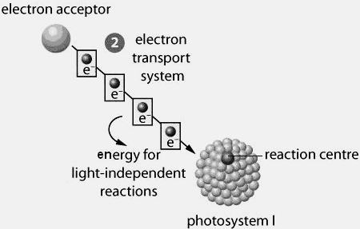
Step 2
The energized electron is carried along a series of electron-carrying molecules → electron transport system (chain)
With each transfer, a small amount of energy is released

Slide 15
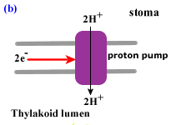
Energy used to make H+ gradient
Energy is used to push H⁺ from stroma across the thylakoid membrane and into the thylakoid

Slide 16
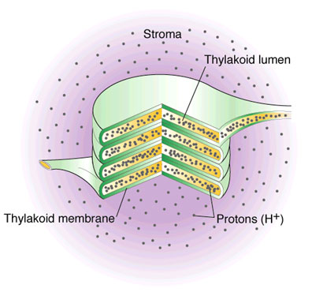
High concentration of H⁺ in thylakoid creates a concentration gradient.
Notes:
See figure 5.12, page 175

Slide 17
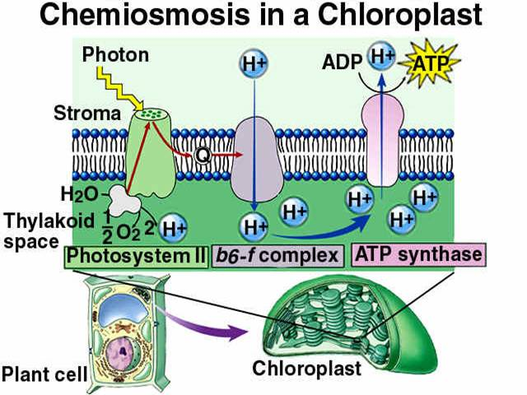
Chemiosmosis
As H⁺ ions move, energy is created for the synthesis of ATP from ADP + P.
Requires ATP synthase →
structure in
thylakoid
membrane
(Much like a
dam for
hydroelectricity)

Slide 18
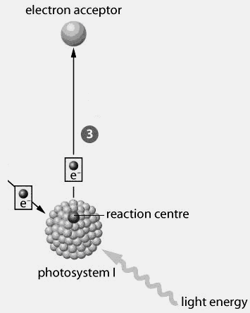
Step 3
Photosystem I absorbs light energy while steps 1 & 2 are taking place
Electron is excited, moves to a high-energy electron acceptor
Excited electron is replaced by an electron from the end of the electron transport system

Slide 19
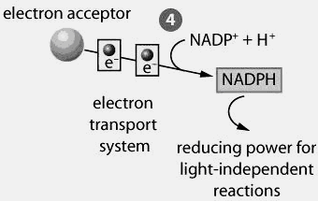
Step 4
Electron received from photosystem I is used to reduce NADP+ to form NADPH, which is used in the light-independent reactions

Slide 20
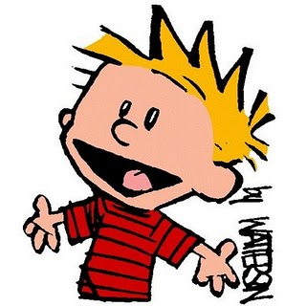
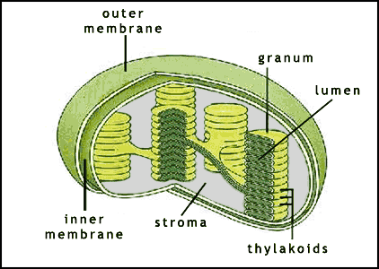
Light-Independent Reactions
When enough NADPH and ATP has been made, glucose can be synthesized through the Calvin-Benson Cycle
Summary of Steps:
Fixing Carbon Dioxide
Reduction
Replacing RuBP
Takes place
in the stroma

Slide 21
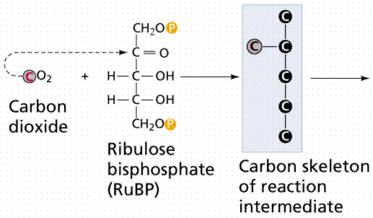
Step 1: Fixing Carbon Dioxide
Carbon from CO₂ is bonded to a 5-carbon compound called ribulose bisphosphate (RuBP)

Slide 22
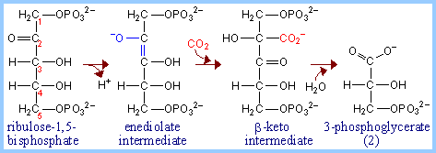
Resulting compound is very unstable and immediately breaks into two 3-carbon compounds
CO₂ + RuBP → unstable C₆ → 2 C₃

Slide 23
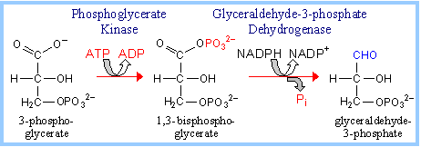
Step 2: Reduction
3-C compounds are in a low-energy state and need to be converted to a high-energy state
Compounds are activated by ATP, then reduced by NADPH, resulting in
2 molecules of glyceraldehyde-3-phosphate (PGAL or G3P)

Slide 24
PGAL or 3PG
some PGAL molecules leave cycle and are used to produce glucose, others remain in the cycle

Slide 25
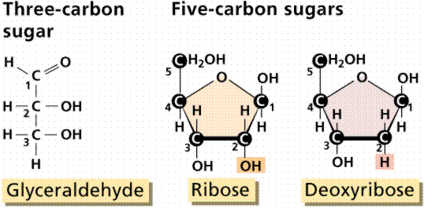
Step 3: Replacing RuBP
Most PGAL molecules are used to make more RuBP
Energy from ATP is used to break PGAL bonds, so that they can reform the 5-C compounds

Slide 26
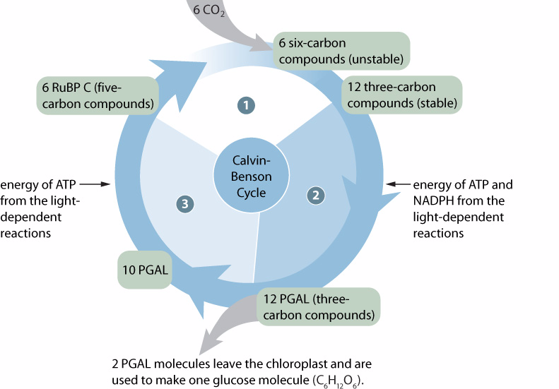
6 Cycles = 1 Glucose Molecule
Notes:
This diagram shows six cycles (note 6 CO2 at the beginning of the cycle). For every 6 cycles, 10 PGALs are used to make more RuBP, and 2 PGALs are used to synthesize one glucose molecule.
Assignment: pg 179, Q#1,2,4,5,7,9,10,11

Slide 27
http://www.youtube.com/watch?v=Wi60tQa8jfE

