Slide 1
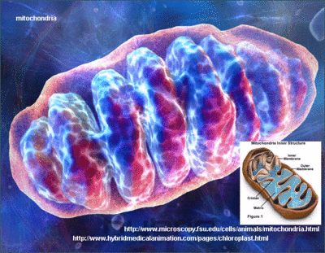
Cellular Respiration Releases Energy from Organic Compounds

Slide 2
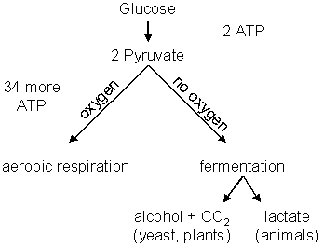
The Process of Cellular Respiration
Three Pathways for Energy Release
Aerobic Cellular Respiration
Requires oxygen (oxic-conditions)
Notes:
What is the equation for cellular respiration?
Organisms that require a complete absence of oxygen are called ‘facultative anaerobes’ – includes some bacteria. Regular anaerobes thrive in very low concentrations of oxygen.

Slide 3
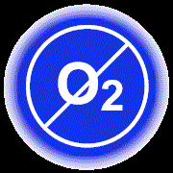
Releasing energy without oxygen
Anaerobic Cellular Respiration
Occurs in the absence of oxygen (anoxic conditions) – oxygen may be lethal to the organism
Fermentation
An anaerobic process

Slide 4
Aerobic Cellular Respiration
Oxidation reaction
Electrons move from high-energy molecules (eg. Glucose) to oxygen
Main process for releasing energy (ATP) in most eukaryotic cells

Slide 5
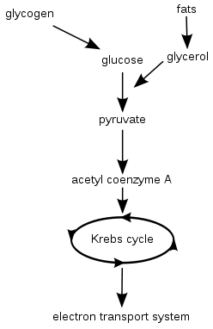
Aerobic Cellular Respiration
Key Events
Glycolysis
Preparation for Krebs
Krebs Cycle
Electron Transport System

Slide 6
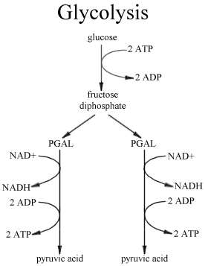
Outside the Mitochondria: Glycolysis
Occurs in all living cells
Can proceed anaerobically
Goal: split glucose (6-C) into 2 pyruvate molecules (3-C)
Notes:
Muscles can function without oxygen for a while, but must get oxygen eventually

Slide 7
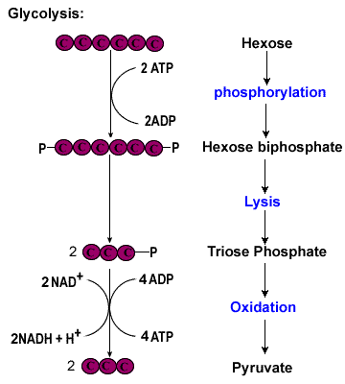
Steps of Glycolysis
Energy (2 ATP) is added to glucose to start reactions
2 intermediate 3-C molecules are formed
4 molecules of ATP are synthesized, and NAD⁺ is reduced to NADH
2 molecules of pyruvate are formed
NET GAIN: 2 ATP and 2 pyruvate molecules

Slide 8
Glycolysis overview
Glucose (6-C)
2 ATP
2 ADP
Intermediate 3-C molecule (PGAL)
Intermediate 3-C molecule (PGAL)
4 ADP
4 ATP
Pyruvate (3-C)
Pyruvate (3-C)

Slide 9
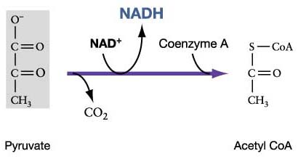
Krebs Cycle Preparation
Pyruvate breaks down into CO₂ and a 2 carbon group (acetyl) which bonds to a coenzyme → acetyl CoA
NAD⁺ is reduced to NADH
Notes:
Coenzyme tows the acetyl group to the proper place in the Krebs cycle

Slide 10
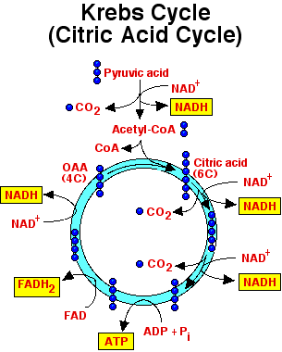
The Krebs Cycle
It is a cycle because one of the products becomes a reactant
Cycle occurs twice for each molecule of glucose processed
During one cycle:
3 NADHs and 1 FADH₂ are formed
1 ATP is formed
2 CO₂ molecules are produced and released as waste
Notes:
The 4-C compound is a product of the Krebs cycle, and it also becomes a reactant in the same cycle.
Since 2 molecules of acetyl-CoA are formed from one molecule of glucose, the Krebs cycle occurs twice for each molecule of glucose processed
The CoA from the acetyl group is released as the acetyl group enters the cycle. The CoA goes back to be re-used for the next pyruvate.

Slide 12
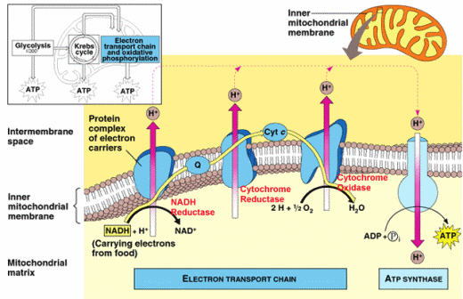
Electron Transport
Most ATP molecules in cellular respiration are produced during electron transport
Very similar to electron transport in chloroplasts
Notes:
Do a quick review of electron transport. Explain that the difference is that H+ are moved across the mitochondrial membrane into the matrix during cellular respiration. Again the ATP is synthesized as H+ diffuse back out of the mitochondria through the ATP synthase molecules

Slide 13
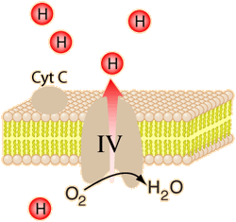
Oxygen in the e⁻ transport chain
In this case, oxygen is the final electron acceptor, and also picks up excess H⁺
Creates water molecules

Slide 14
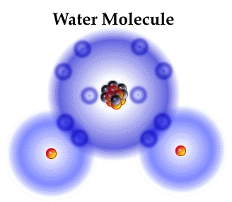
Role of Oxygen in Aerobic Cellular Respiration
Oxygen picks up the electron from the last set of reactions in electron transport
So why is it so important???
If it did not pick up the last electron, the entire process would become backed up – electrons from previous steps would not be passed on.
Glycolysis would be the only part of aerobic cellular respiration that could proceed → doesn’t produce enough ATP for life functions of most Ekaryotic cells
Notes:
Like having a traffic jam – If one car at the front of the line does not go when the light turns green, all cars behind him will not be able to go either (assuming no room to get around on either side)

Slide 15
Notes:
Glycolysis and the Krebs Cycle produce only a small amount of ATP. Most ATP is synthesized through chemiosmosis. The entire process of cellular respiration creates 36 ATP from one glucose.

Slide 16
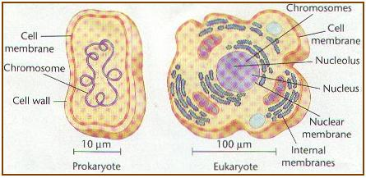
Anaerobic Cellular Respiration Uses a Different Final Electron Acceptor
Occurs in some prokaryotic cells
Uses another type of electron transport system

Slide 17
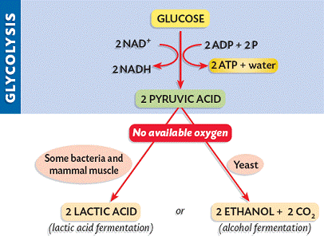
Anaerobic Respiration
Not as efficient (less ATP synthesized)
Oxygen not available, so it uses sulfate, nitrate, or carbon dioxide as the final electron acceptor
Byproducts: S8, N2, nitrite, or methane

Slide 18
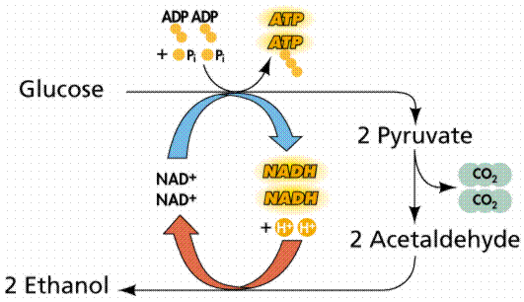
Fermentation
Occurs in cytoplasm
A pathway including glycolysis and the oxidation of NADH → NAD+ by reducing pyruvate

Slide 19
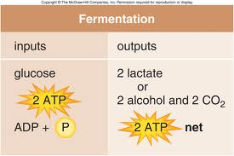
Fermentation
Inefficient – only produces ATP in glycolysis
Many types of fermentation, including:
Lactate Fermentation
Ethanol Fermentation

Slide 20
Lactate Fermentation
Pyruvate is converted to lactate (lactic acid)
Eg) muscle soreness during a workout
Rate of glycolysis exceeds oxygen supply
Lactic acid is temporarily stored in muscles, causing cramping
After exercise, lactic acid is converted back to pyruvate as oxygen supply is replenished

Slide 21
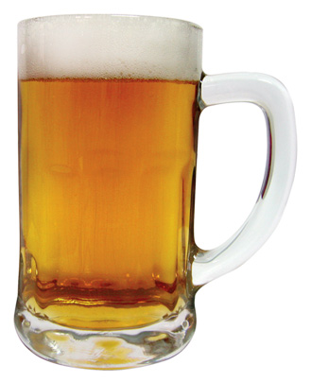
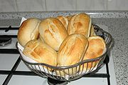
Ethanol Fermentation
Yeasts and other organisms
Convert pyruvate to ethanol and carbon dioxide
Used commercially to make bread, wine, beer, champagne, mead, cider…
Ethanol is released as a waste product
Notes:
Assignment: pg 194, Q# 2,4,6,8,9

Slide 22
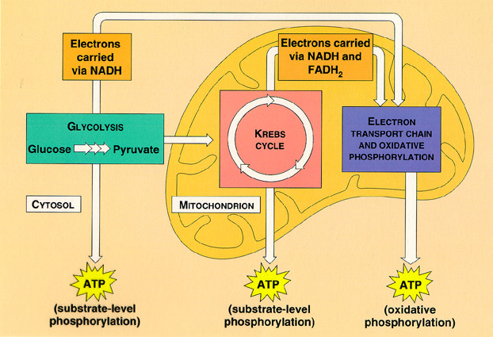
http://www.youtube.com/watch?v=3aZrkdzrd04

