Slide 1
5 Common Types of Chemical Reactions
Formation (Synthesis)
Decomposition
Hydrocarbon Combustion
Single Replacement Reaction
Double Replacement Reaction
See pages 91-106

Slide 2
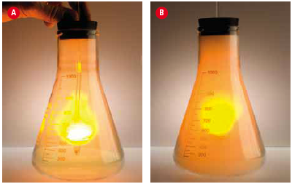
Types of Chemical Reactions: Formation
Synthesis reactions are also known as formation reactions.
Two or more reactants (usually elements) join to form a compound.
A + B → AB where A and B represent elements
The elements may form ionic compounds, like the following:
Sodium metal and chlorine gas combine to form sodium chloride.
2Na + Cl₂ → 2NaCl
Sodium added to chlorine gas

Slide 3
Synthesis (Examples)
Magnesium metal reacts with oxygen gas to form magnesium oxide.
2Mg + O₂ → 2MgO
Or the elements may form covalent compounds, like the following:
Nitrogen gas and oxygen gas join to form dinitrogen monoxide.
2N₂ + O₂ → 2N₂O

Slide 4
Types of Chemical Reactions: Decomposition
Decomposition reactions are the opposite of synthesis reactions.
A compound breaks down into two or more products (often elements).
AB → A + B where A and B represent elements
Ionic compounds may decompose to produce elements, like the following:
Table salt, sodium chloride, can be broken down into sodium metal and chlorine gas by melting salt at 800ºC and running electricity through it.
2NaCl → 2Na + Cl₂

Slide 5
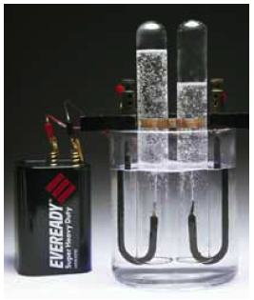
Decomposition (Examples)
Or covalent compounds may decompose into elements, like the following:
By running electricity through
water, the water molecules
decompose into hydrogen
and oxygen gases.
2H₂O → 2H₂ + O₂

Slide 6
Types of Chemical Reactions: Single Replacement
Single replacement reactions replace one element from a compound with a separate element added as a reactant.
A compound and an element react, and the element switches places with part of the original compound.
A + BC → B + AC where A is a metal, or
A + BC → C + BA where A is a non-metal

Slide 7
Single Replacement (Examples)
When A is a metal:
Aluminum foil in a solution of copper(II) chloride produces solid copper and aluminum chloride.
2Al + 3CuCl₂ → 3Cu + 2AlCl₃
When A is a non-metal:
When fluorine is bubbled through a sodium iodide solution, iodine and sodium fluoride are produced.
Fl₂ + 2NaI → I₂ + 2NaF

Slide 8
Types of Chemical Reactions: Double Replacement
Double replacement reactions swap elements between two compounds reacting together to form two new compounds.
Two compounds react, with elements switching places between the original compounds.
Two solutions react to form a precipitate (ppt, solid) and another solution
Ionic solution + ionic solution → ionic solution + ionic solid
AB + CD → AD + CB

Slide 9
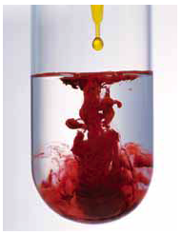
Double Replacement (Example)
When potassium chromate and silver nitrate react,
they form a red precipitate, silver chromate,
in a solution of potassium nitrate.
K₂CrO₄ + 2AgNO₃ → Ag₂CrO₄ + 2KNO₃
silver chromate

Slide 10
Types of Chemical Reactions: Neutralization (Acid-Base Reactions) A special type of Double Replacement
Neutralization reactions occur when an acid (most compounds starting with H) and a base (most compounds ending in OH, or beginning with NH₄) react to form a salt and water.
Acid + base → salt + water
HX + MOH → MX + H₂O where X and M are elements

Slide 11
Neutralization (Examples)
Sulfuric acid is used to neutralize calcium hydroxide:
H₂SO₄ + Ca(OH) ₂ → CaSO₄ + 2H₂O
Phosphoric acid helps to neutralize the compounds that cause rust, such as iron(II) hydroxide.
H₃PO₄ + 3Fe(OH)₂ → Fe₃(PO₄)₂ + 6H₂O

Slide 12
Types of Chemical Reactions: Combustion
Combustion reactions occur when a compound or element react with oxygen to release energy and produce an oxide.
Also sometimes referred to as hydrocarbon combustion.
C_{X}H_{Y} + O₂ → CO₂ + H₂O where X and Y represent integers
Natural gas (methane) is burned in furnaces to heat homes.
CH₄ + O₂ → CO₂ + 2H₂O

Slide 13
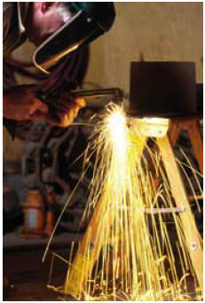
Combustion (Examples)
Carbohydrates like glucose combine with oxygen in our body to release energy.
C₆H₁₂O₆ + 6O₂ → 6CO₂ + 6H₂O
An acetylene torch is used to
weld metals together.
2C₂H₂ + 5O₂ → 4CO₂ + 2H₂O
Acetylene torch

Slide 14
