Slide 1
Goals for this Chapter:
Explain how the upper respiratory tract filters, moistens, and directs air.
Describe the composition, structure, and function of the lower respiratory system.
Describe how the mechanical action of breathing moves gases into and out of the lungs.
Explain how gases are exchanged between the respiratory system and the environment.
Identify factors that affect the rate of respiration.
Identify diseases that are associated with the respiratory system.
Identify technologies used to identify and treat diseases and disorders of the respiratory system.

Slide 2
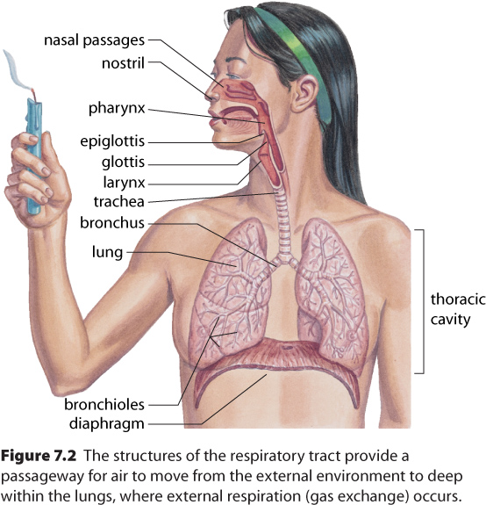
Chapter 7: Respiratory System
7.1 Structures of the respiratory system

Slide 3
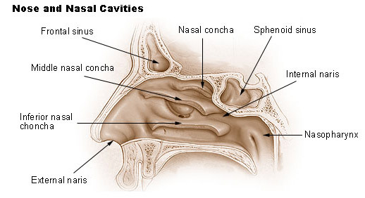
Structures of the upper respiratory system: The Nasal Cavity
Air enters via the nasal cavities and mouth
The nasal cavities contain hairs and mucus that traps particles and keeps cells moist
At the same time, the large number of blood vessels inside the nose also warm the incoming air

Slide 4
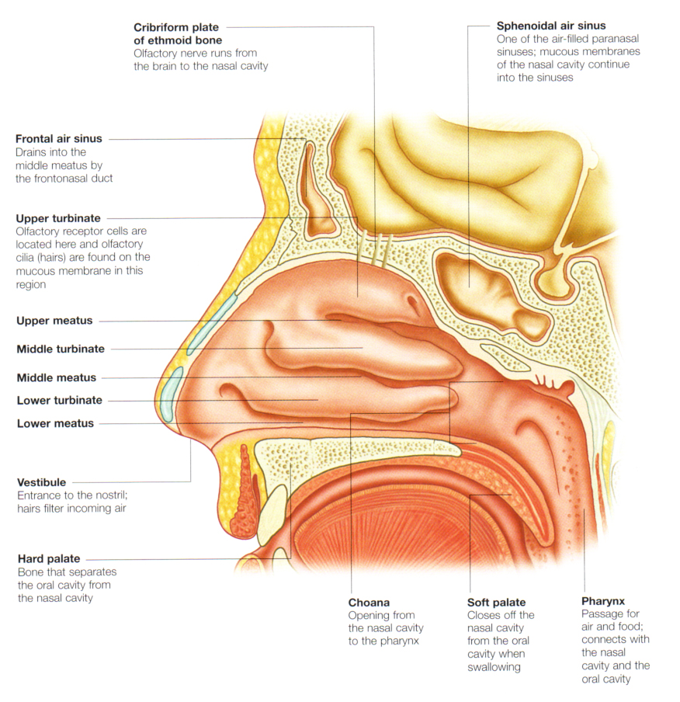
The Pharynx
The air then travels through the pharynx, which is the common pathway for food and air

Slide 5
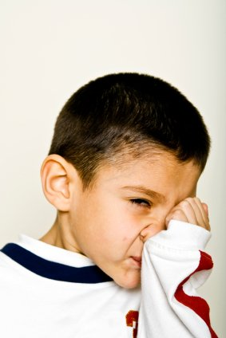
Interesting Fact:
Why do men's jackets have buttons on the cuffs (besides the ones to do them up)?
To stop people wiping their nose on them. The most accepted designer of this accessory was George Washington, whose
army fought and caught colds,
and were added to stop them
using them to wipe their noses.

Slide 6
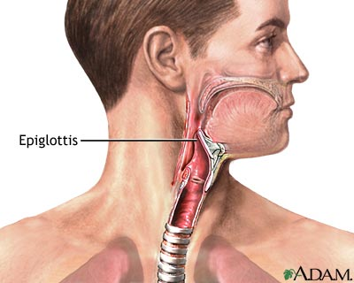
When eating, an enlarged flap of cartilage called the epiglottis covers the trachea to prevent food from entering

Slide 7
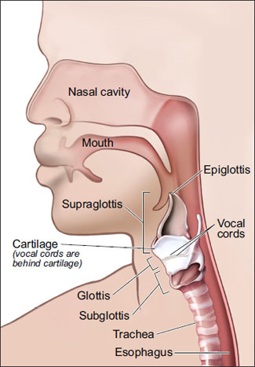
The Glottis
The glottis lies just after the epiglottis, just before the start of the larynx.
This spot is where your
Adam's Apple (also
called Thyroid cartilage)
is located.

Slide 8
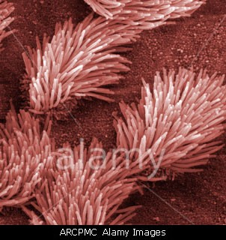
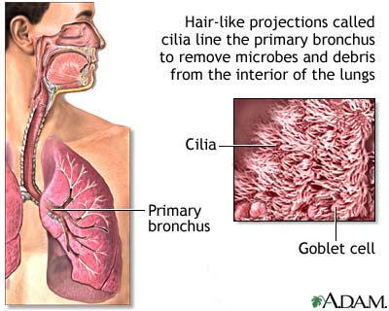
Cilia
Food and drink that enter the trachea stimulates cilia that lines the respiratory tract, producing a cough

Slide 9
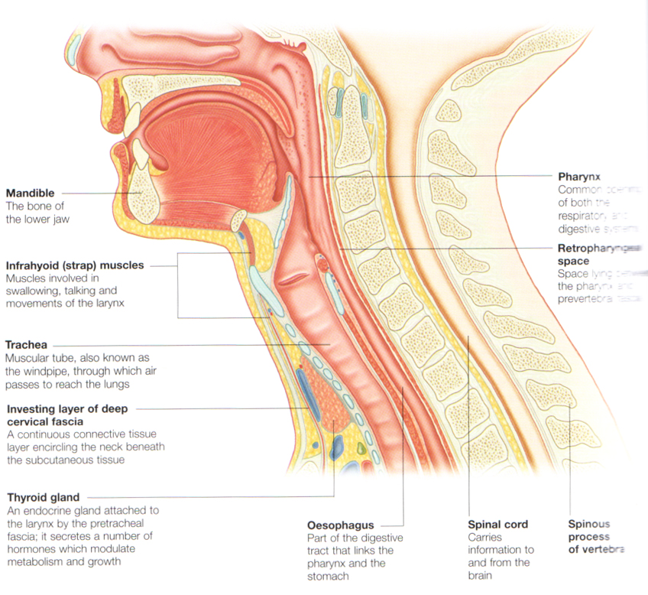
Extra Detail

Slide 10
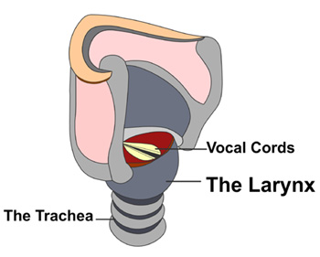
The Larynx
Beyond the pharynx is the larynx, which is composed of thin sheets of elastic ligaments
When air passes past the larynx, sounds are produced (the larynx contains the vocal cords)
During speech, muscles contract and move these cords closer together

Slide 11
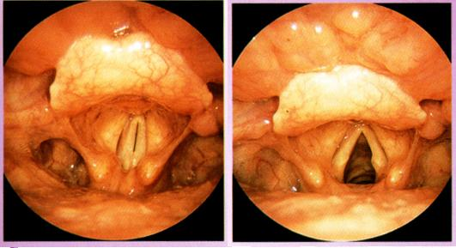
The Voice Box

Slide 12
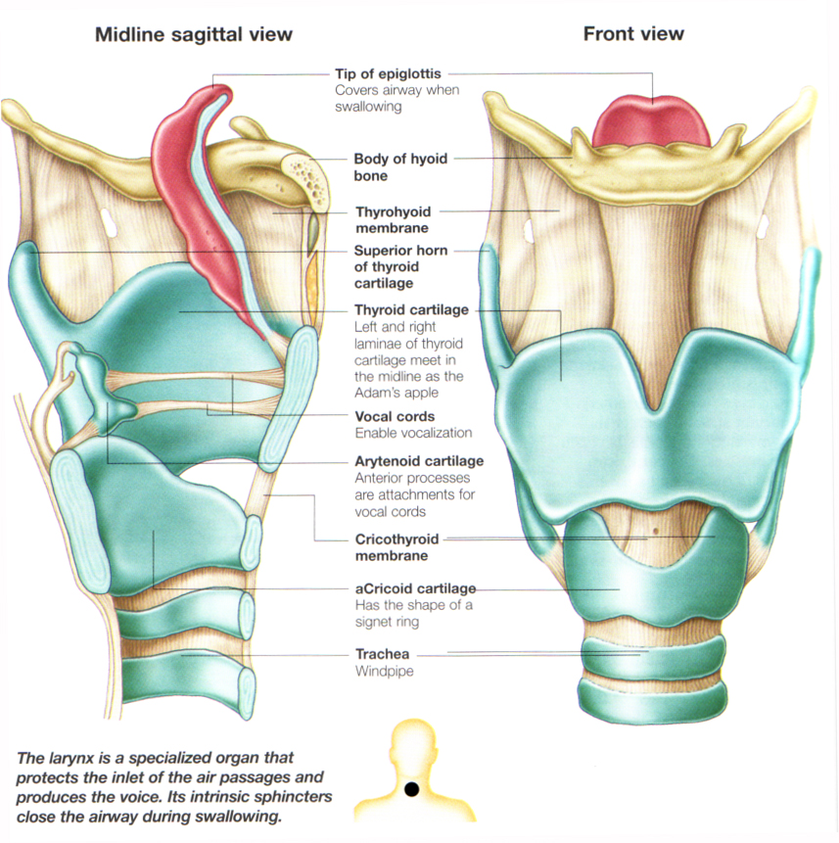
Extra
Detail

Slide 13
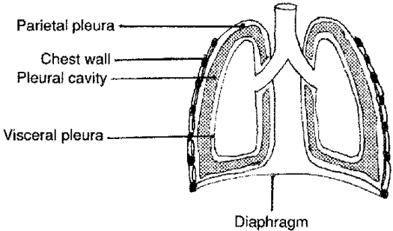
The Lungs
The lungs are surrounded by the pleural membrane, which attaches the lungs to the thoracic cavity

Slide 14
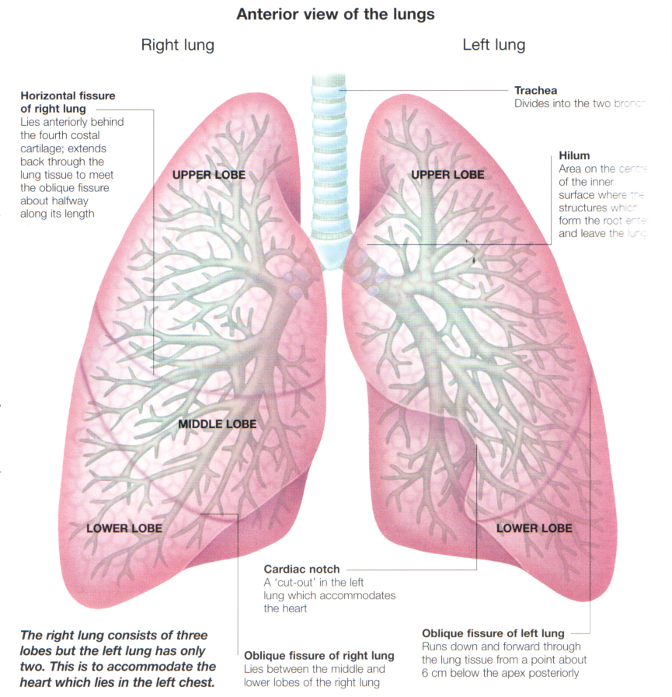
Anatomy of the lungs
Note the right lung has 3 lobes while the left has only 2 making room for the heart

Slide 15
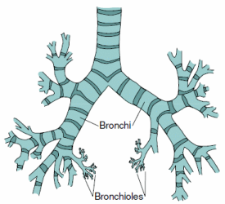
The Bronchi & Bronchioles
The trachea branches into two bronchi, one for each lung
These bronchi then continue to branch into bronchioles
The bronchioles, unlike the bronchi and trachea, lack rings of cartilage
Smooth muscle can change the diameter of the bronchioles

Slide 16
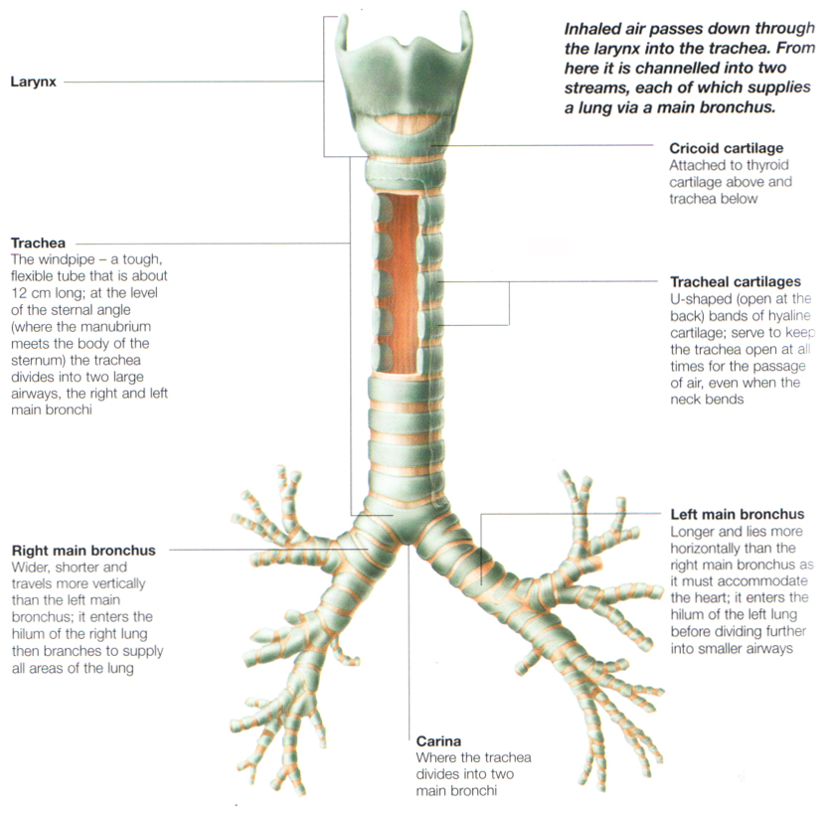
Extra Detail

Slide 17
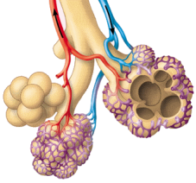
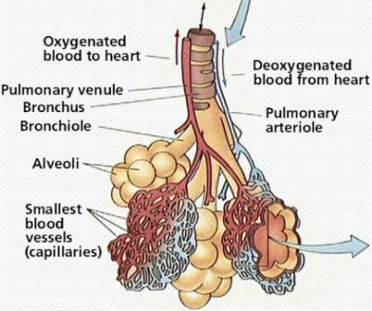
The Alveoli
The alveoli walls are very thin and are surrounded by capillaries
Carbon dioxide and oxygen transfer between the alveoli and capillaries through diffusion
You have about 150 million alveoli, whose total combined surface area could cover a tennis court!

Slide 18
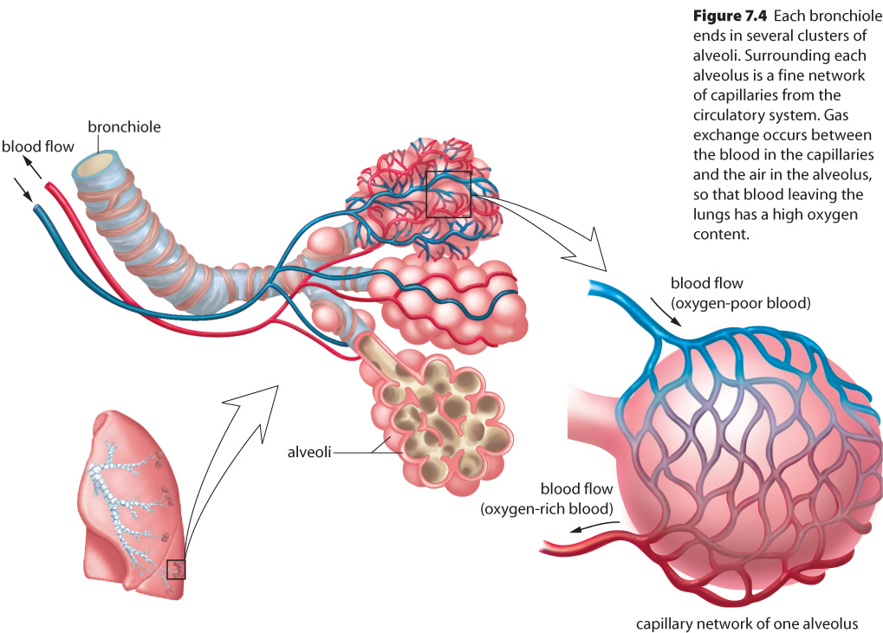
Alveoli

