Slide 1
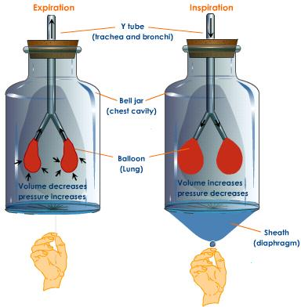
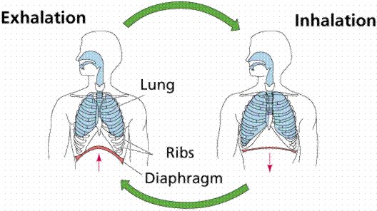
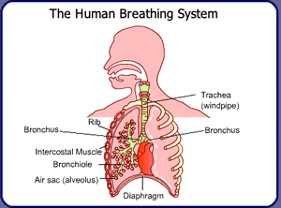
Section 7.2 – Breathing and Respiration

Slide 2
Section 7.2 – Breathing and Respiration
Respiration actually involves a 4-stage process:
Breathing – the movement of air into & out of the lungs
External respiration – the exchange of oxygen and carbon dioxide within the lungs
Internal respiration – the exchange of oxygen and carbon dioxide within the blood and body tissues
Cellular respiration – the oxidation of glucose for energy

Slide 3
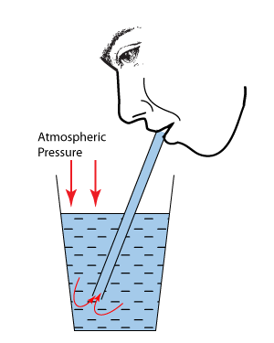
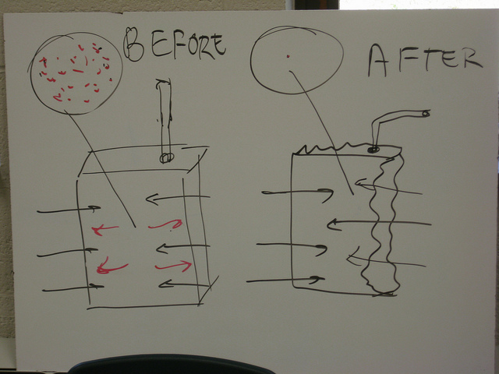
Breathing and Muscles
Pressure differences between the chest cavity and the atmosphere move gases into and out of the lungs (atmospheric pressure is constant, but the lung pressure changes)
Gases move from high pressure areas to low pressure areas

Slide 4
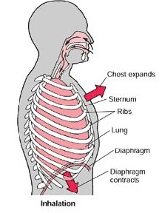
When you inhale, the diaphragm contracts and flattens, and the lungs expand in volume (The ribs also move up and out)
The atmospheric
pressure is now higher
than the lung pressure,
and air moves into the
lungs

Slide 5
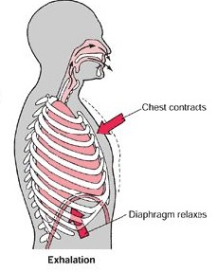
When you exhale, the diaphragm relaxes and becomes dome-shaped (the ribs relax, falling in)
As a result, the lung
volume is reduced
The atmospheric
pressure is now lower
than the lung pressure,
and air moves out of
the lungs

Slide 6
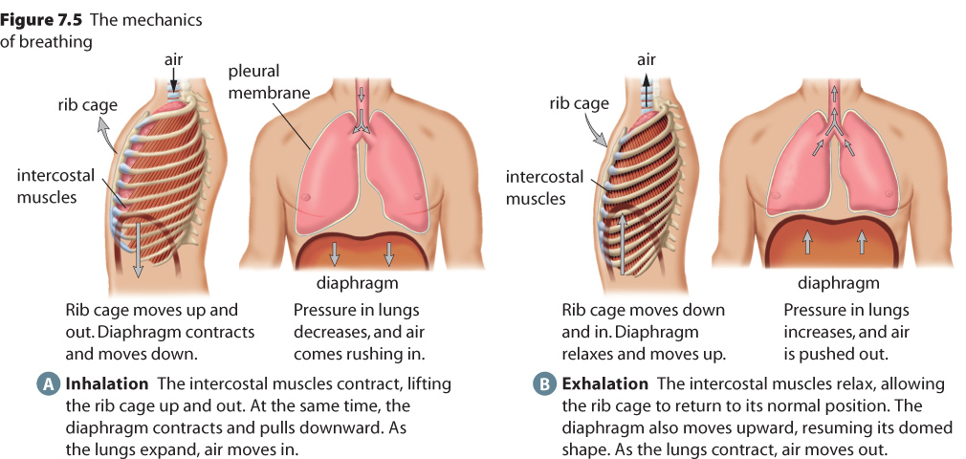
The diaphragm is assisted by the movement of the ribs and the bands of intercostal muscle between them

Slide 7
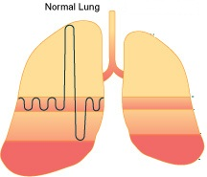
Respiratory Volume
The normal volume of air that is exhaled and inhaled is known as our tidal volume
The total volume of air that our lungs can contain is known as our vital capacity
The extra air that can be
forced out of the lungs is
called the expiratory reserve
The air that stays in the
lungs is the residual volume

Slide 8
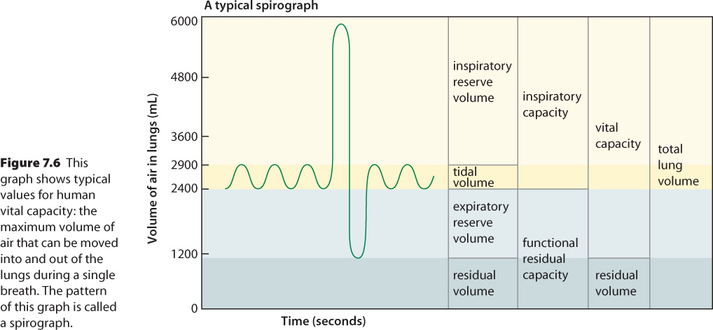
A Spirograph:

Slide 9
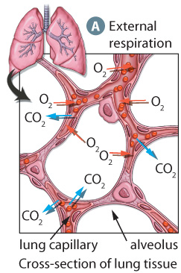
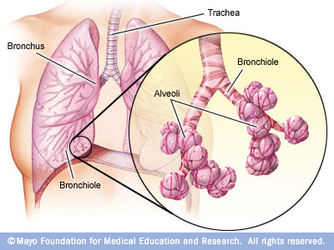
Gas Exchange
Gases are exchanged between the air in the alveoli and the blood of the capillaries
O₂ will diffuse out of the alveoli and into the capillary while CO₂ moves in the opposite direction
About 30% of the O₂ transfer occurs through facilitated diffusion to increase the rate of exchange

Slide 10
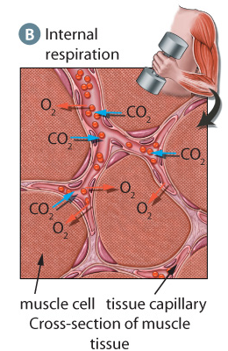
Within tissues, CO₂ and O₂ are also exchanged
O₂ leaves the blood and diffuses into the tissue
CO₂ diffuses out of the tissue and into the blood

Slide 11
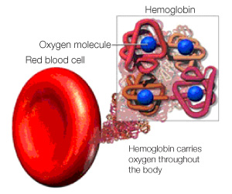
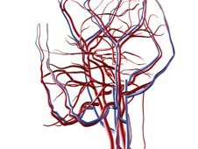
O₂ and CO₂ Transport in the Blood
Only 1% of O₂ in the blood is dissolved in blood plasma
99% of the O₂ is bonded to hemoglobin molecules
Hemoglobin allows red blood cells to carry 70 times more oxygen than cells without hemoglobin
You would only be able to maintain life for about 4.5 seconds without hemoglobin (we can go without oxygen for about 5 minutes!)

Slide 12
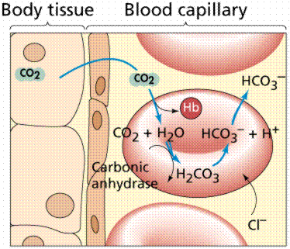
CO₂ Transport in the blood
CO₂ can be transported by hemoglobin, but only about 23% of all CO₂ is carried in this fashion
The blood plasma only carries about 7%
70% of the CO₂ in
your blood is in the
form of the Bicarbonate
(HCO₃⁻ ion)

Slide 13
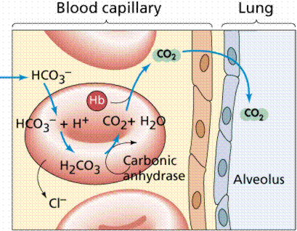
Carbon Dioxide & Bicarbonate
When CO₂ is added to water, carbonic acid (H₂CO₃) is formed
This loses an H⁺ ion, which is picked up by hemoglobin
The remaining HCO₃⁻ ion remains in the blood plasma
When the plasma reaches the lungs, the hemoglobin gives up its H⁺, and the sequence reverses – CO₂ is formed and released

