Slide 1
7.3 – Respiratory Health
Respiratory health problems can be identified as conditions that affect either the upper respiratory tract, or the lower respiratory tract
Many disorders are preventable – particularly those that are caused by smoking

Slide 2
Upper Respiratory Infections
Tonsillitis: This is caused by bacterial or viral infections.
Laryngitis: This is an inflammation of the larynx caused by infection, allergies, or straining of the voice. Eg. Losing your voice

Slide 3
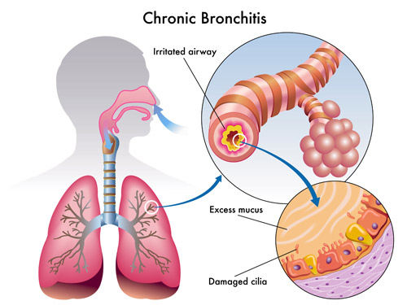
Lower Respiratory Tract Disorders: Bronchitis
This is an inflammation of the bronchi.
It can be classified as acute (usually a bacterial infection) or chronic (caused by irritants).
During chronic bronchitis, the cilia lining the bronchi can become damaged.
The most common
cause of chronic
bronchitis is smoking.

Slide 4
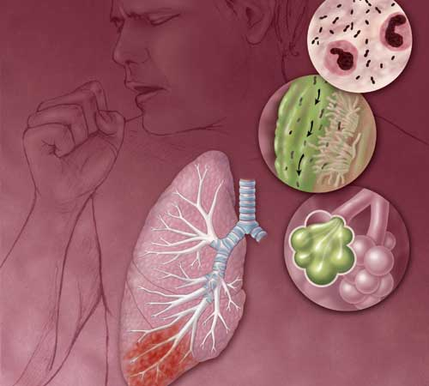
Pneumonia
A condition where the alveoli fill with thick sticky fluid
Can affect an entire lobe of the lung (lobular), or be found in small patches (bronchial)
Lobular pneumonia is caused by bacteria and is typically more serious than viral pneumonia
There are vaccines for
bacterial pneumonia
AIDS patients often
die because of a rare
bacterial form of pneumonia

Slide 5
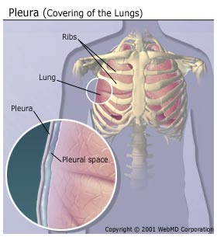
Pleurisy
This is a swelling of the pleura
May be caused by infection, blood clots, or cancer
A common symptom is
a localized sharp, stabbing
Pain
Treatment of pleurisy
often focuses on reducing
the swelling

Slide 6
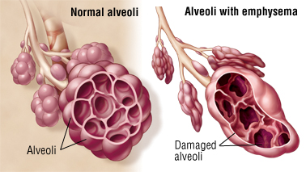
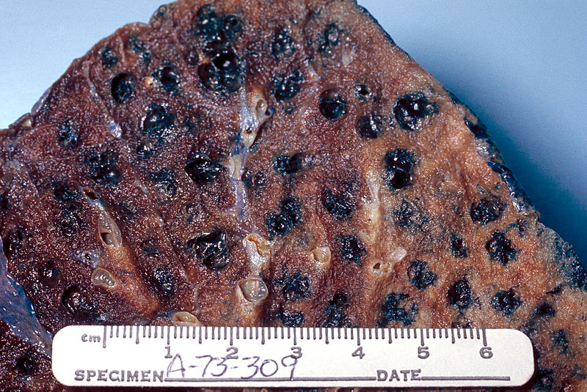
Emphysema
Emphysema is a loss of elasticity in the alveoli wall
Alveoli may fuse
As a result, the surface area for absorption is reduced
Most cases of emphysema are associated with smoking

Slide 7
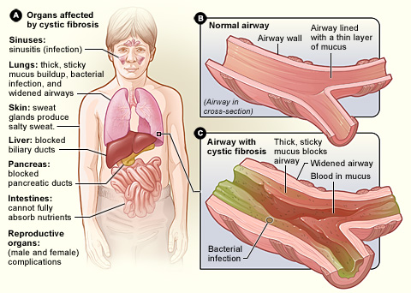
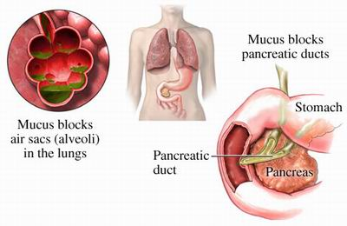
Cystic Fibrosis
Genetic condition that prevents the formation of sodium channels in cell walls
This disrupts the water balance in the lung cells
As a result, the normally runny mucus in the lungs becomes very thick and cannot be expelled

Slide 8
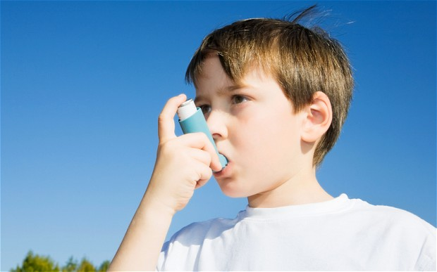
Asthma
This is a chronic obstructive disease which reduces the diameter of the bronchi & bronchioles
Environmental triggers and stress can often cause asthma attacks
Bronchial dilators are used to treat asthma
Most of these drugs are administered through
inhalers which produce
a mist or fine powder
that contains the drug

Slide 9
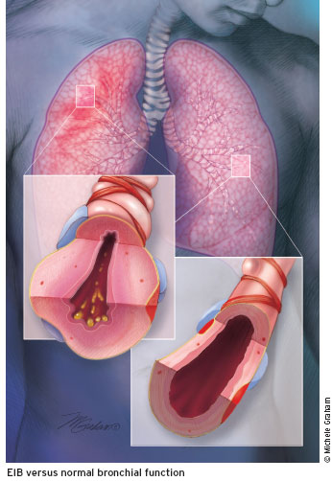
Exercise Induced Bronchospasm
This condition produces symptoms similar to asthma which are only brought on by exercise
In most cases, dry, dusty
and cold environments trigger
this condition
Patients with EIB can use
bronchial dilators before
exercise to avoid symptoms

Slide 10
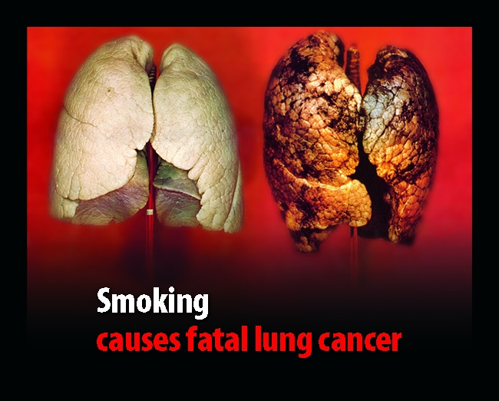
Lung Cancer
This (like all cancers) is an uncontrolled, abnormal growth of invasive cells
The tumors that form reduce the available volume of the lung for gas exchange
Often carcinogens (chemicals that cause cancer) trigger the production of tumors in the lungs
Carcinogens are found
in cigarette smoke, but also
include asbestos and radon

Slide 11
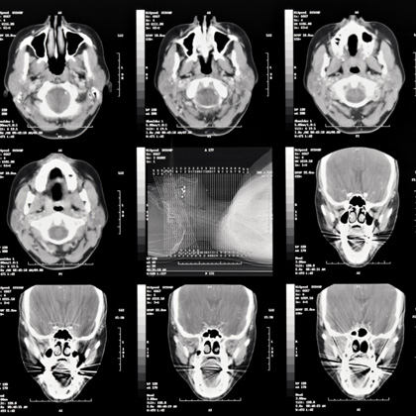
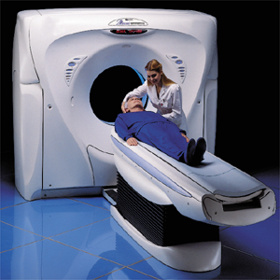
Technologies for Detection and Treatment of Lung Disorders
Diagnosis of disorders such as cancer, and some other infections (such as inhalational anthrax and tuberculosis) are typically done using X-rays and CT scans

Slide 12
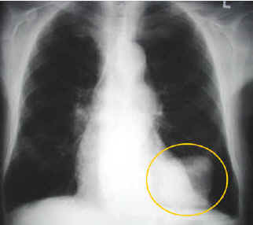
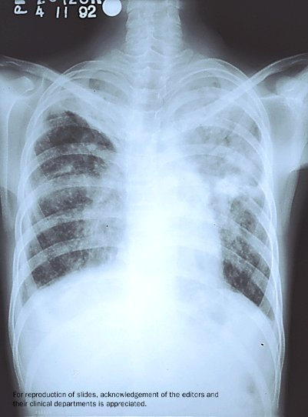
http://www.lakeridgehealth.on.ca
Lung Cancer
http://www.ecosur.mx/tuberculosis/Tuberculosis-4.jpg
Tuberculosis

Slide 13
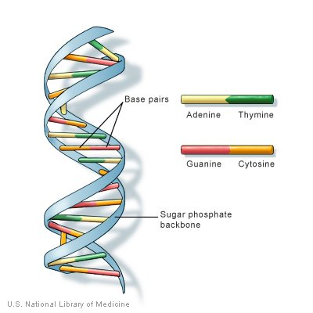
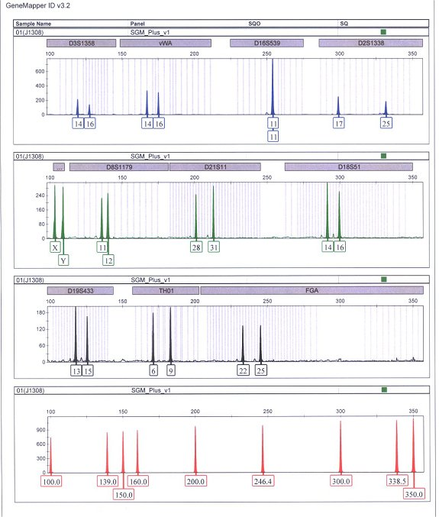

Genetic Screening
DNA analysis can be used to identify if genes for cancer are present
Cancers can be treated in several ways, including radiation therapy and chemotherapy

Slide 14
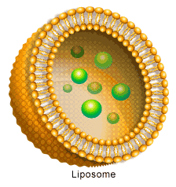
Liposomes for Fighting Cancer
In some cases, liposomes (small, hollow sacks of lipids) are filled with cancer-fighting drugs
These liposomes follow the spread of the cancer cells and attack them before they start new growth in a new area of the body

