Slide 1
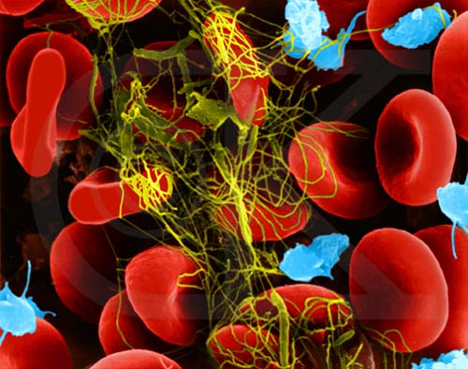
8.2 – Blood and Circulation
Blood is considered a connective tissue because it links all cells and organs in the body
Blood consists of a fluid portion and a solid portion

Slide 2
Plasma – The Fluid Component
55% of blood volume is plasma (fluids, proteins, glucose, gases, wastes and vitamins and minerals)
Blood proteins come in 3 types:
Albumins – serve to maintain osmotic balance
Globulins – act as part of immune response
Fibrinogen – helps with blood clotting

Slide 3
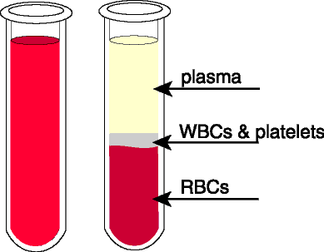
The Other 45%...
There are several cell types that make up the remaining volume of blood:
Erythrocytes
Leukocytes
Platelets

Slide 4
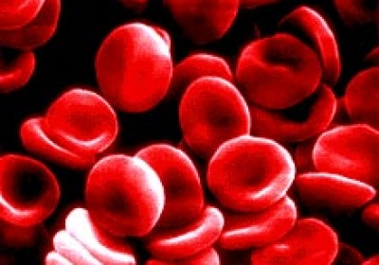
Erythrocytes
Erythrocytes are red
blood cells
They are specially designed to carry oxygen
Red blood cells lack a nucleus and have a “folded disk” shape
This allows them to have a much greater surface area than a spherical cell
However, without a nucleus, red blood cells cannot divide

Slide 5
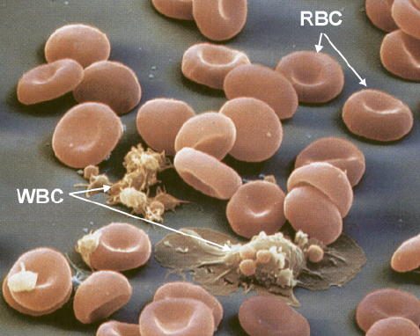
Leukocytes
These are also known as white blood cells
These cells are responsible for immune system responses
There are a number of
different leukocyte types

Slide 6
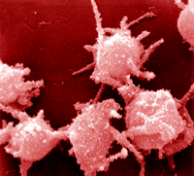
Platelets
Platelets are formed from stem cell cytoplasm and have irregular shapes
The platelets float through blood vessels and catch on broken vessel walls
This causes a tear in the platelet, which initiates blood clotting

Slide 7
Blood Clotting
Clotting maintains homeostasis by preventing massive blood loss
This occurs in a series of steps

Slide 8
Clotting Process
When platelets burst on contact with a break in a vessel wall, they release compounds that combine with other blood components to form a protein known as thromboplastin
Thromboplastin and calcium ions activate a blood protein known as prothrombin
Prothrombin is converted to an enzyme known as thrombin, which splits up a fibrinogen molecule
Fibrinogen is converted into fibrin threads, which wrap around the damaged area, sealing it

Slide 9
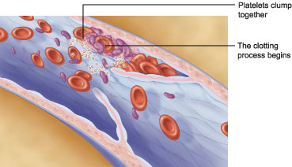
Visual Representation of a Clot:

Slide 10
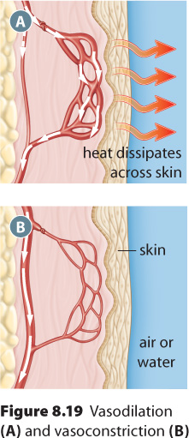
Functions of Blood
Transportation
Oxygen/nutrients
Cellular wastes (uric acid,
carbon dioxide)
Hormones
Homeostasic Regulation
Temperature Control

Slide 11
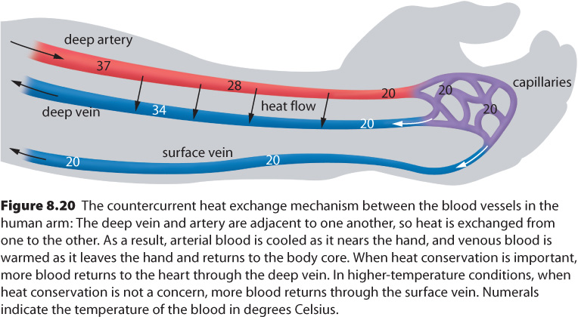
Temperature Regulation

Slide 12
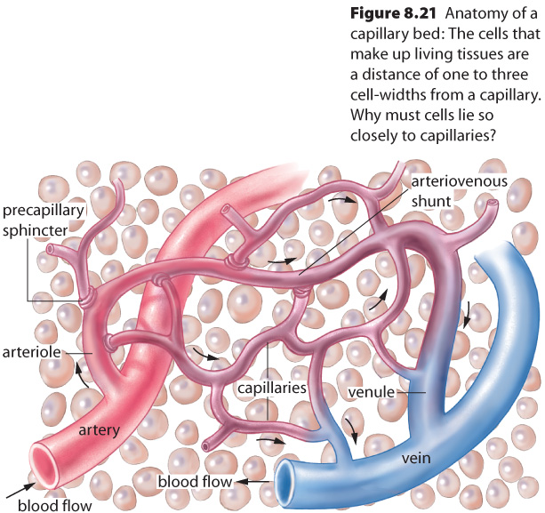
Circulation and the Action of Capillaries
The combined surface area of the capillaries covers about 6300 m²
It is throughout this huge surface that we exchange materials between our blood and our cells

Slide 13
Capillary Exchange
Cells are surrounded by interstitial fluid, which is also known as extracellular fluid or tissue fluid
Materials such as oxygen and nutrients have a low concentration in the interstitial fluid, but high concentrations in the blood
Likewise, waste products have a high concentration in the interstitial fluid, but low concentrations in the blood

Slide 14
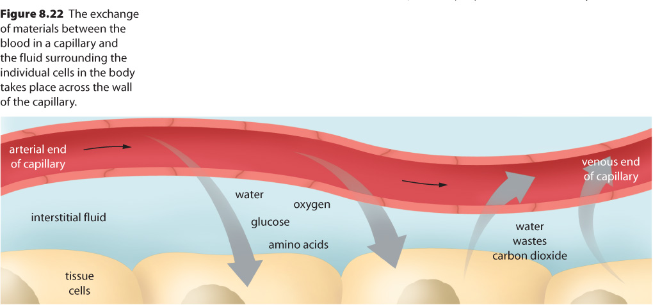
Blood moves slowly through the capillaries, which increases the time over which diffusion may occur

Slide 15
Hemophilia
Facts:
Diagnosis: less that 1% of clotting protein (severe case), appox. 70% of all suffers are considered severe.
Inherited,
potentially fatal
Insufficient clotting proteins in blood
Treatment
No cure
Inject with Factor VIII to replace missing protein

Slide 16
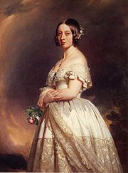
History
Known as “the royal disease”
Queen Victoria passed it to her children
Mainly affects males

Slide 17
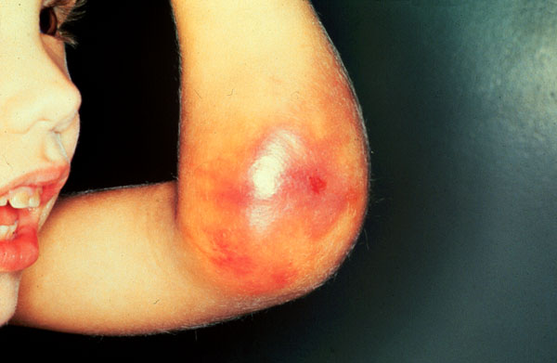
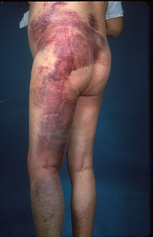
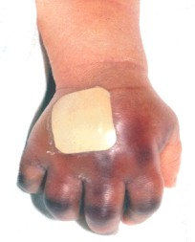

Slide 18
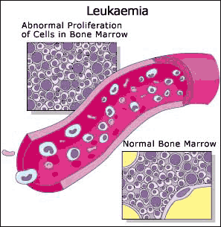
Leukemia
Cancer of leukocytes
Myeloid leukemia → too many WBC’s; immature, unable to fight infection, crowd out RBC’s
Lymphoid leukemia →
cancer of lymphocytes

Slide 19
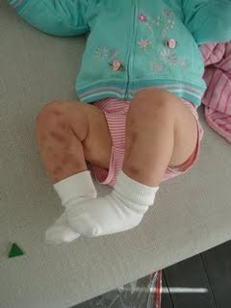
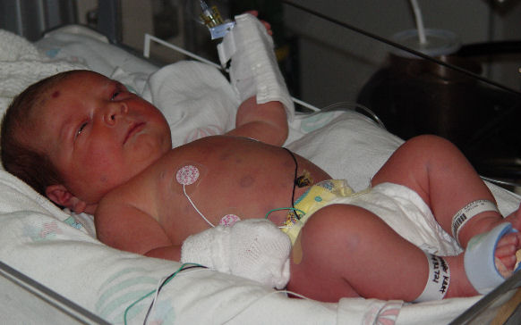
Treatment of Leukemia
blood transfusions
chemotherapy
bone marrow transplants

Slide 20
Anemia
occurs when the level of healthy red blood cells (RBCs) in the body becomes too low
Causes
excessive destruction of RBCs
blood loss
inadequate production of RBCs
nutritional problems (such as an iron or vitamin deficiency), infections, some kinds of cancer, or exposure to a drug or toxin.

Slide 21
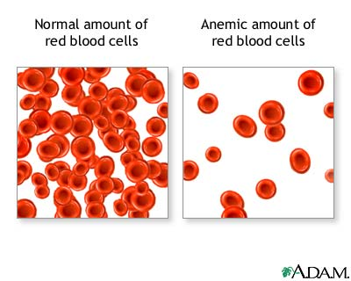
Anemia Treatments
Treatment Depends on Type:
blood cell growth factor
Blood transfusions
Iron supplements
Vitamin supplements

Slide 22
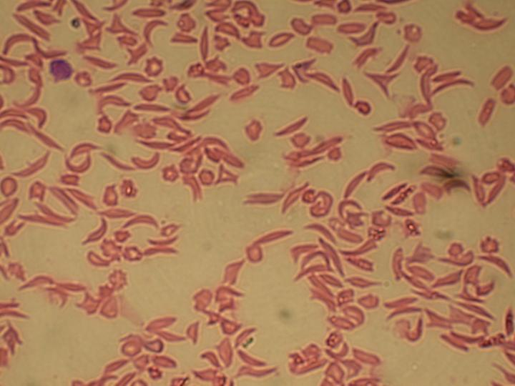
Sickle cell anemia
Mostly those of African heritage
hemoglobin forms long rods when it gives up its oxygen, stretching red blood cells into abnormal sickle shapes

Slide 23
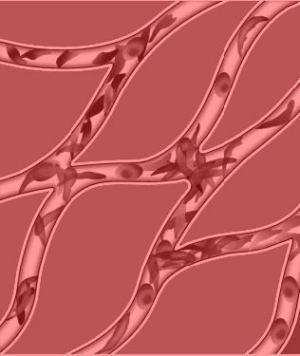
Sickle Cell Anemia
Can cause:
premature destruction of RBCs
low levels of hemoglobin
recurring episodes of pain
problems that can affect virtually every other organ system in the body.
No cure
Treatments
Pain relief
Prevent infections
Blood transfusions

