Slide 1
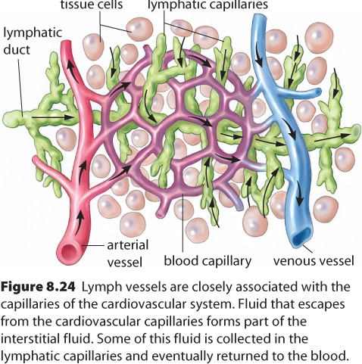
8.3 – The Lymphatic System & Immunity
The lymphatic system is a network of vessels, glands, and nodes spread throughout the body

Slide 2
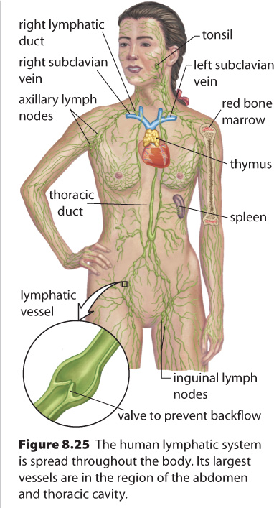
The Lymphatic System
The lymphatic system connects to our circulatory system at the subclavian veins
Lymph works with white blood cells to protect the body from infection (lymphocytes mature in the lymph nodes)
The lymph nodes also contain macrophages which trap and destroy bacteria

Slide 3
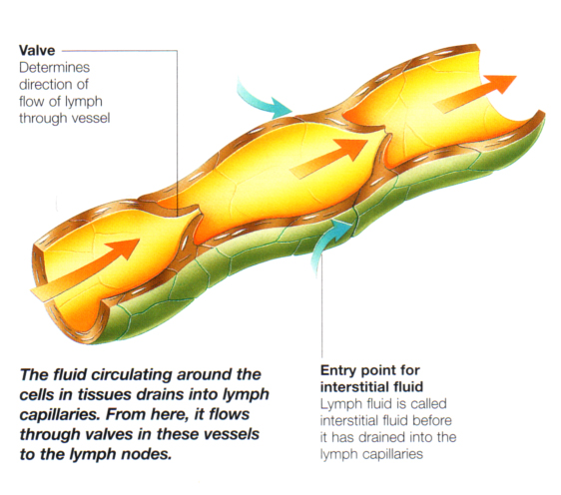

Slide 4
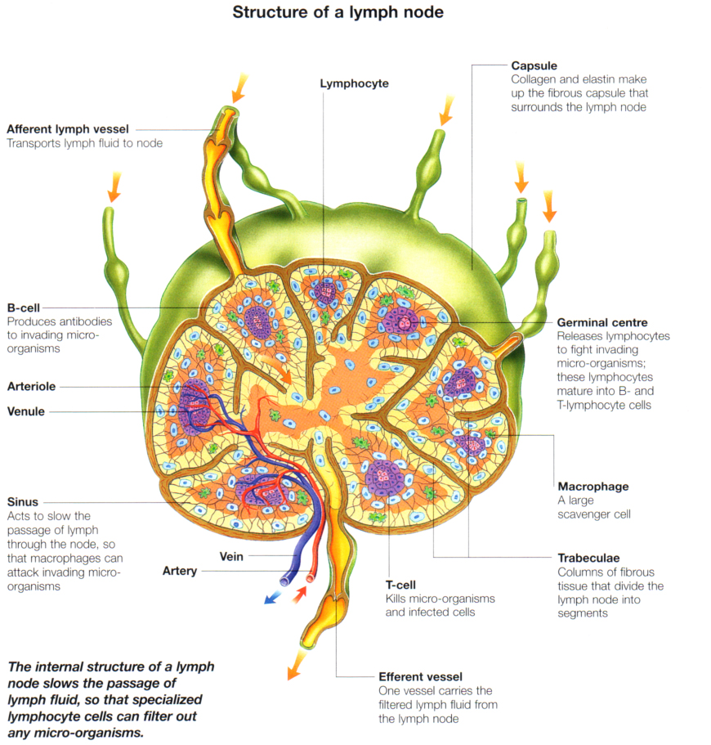

Slide 5
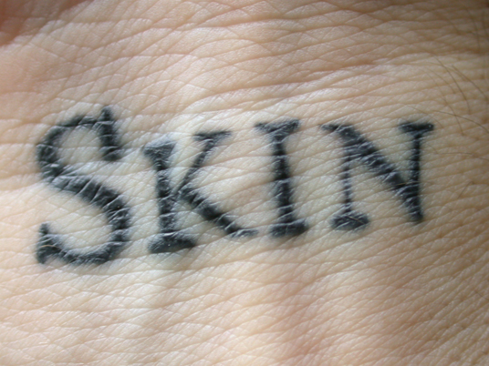
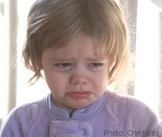
The Human Defense System
The first line of defense for the body is to prevent organisms from entering
The skin and mucus that line the respiratory passages serve to keep out most microbes
Stomach acids, oils in the skin and enzymes in tears also break down bacteria

Slide 6
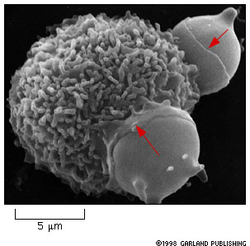
Non-Specific Defenses
This is also known as cell-mediated immunity
Neutrophils, monocytes, and macrophages all kill bacteria by engulfing them

Slide 7
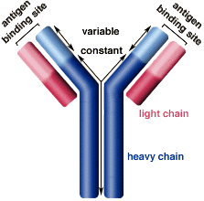
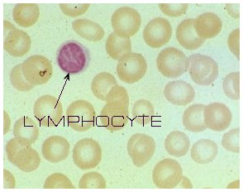
Specific Defenses (Antibody-Mediated Immunity)
Antibodies are proteins that recognize foreign substances and either neutralize or destroy them
Lymphocytes are primarily responsible for this immune response

Slide 8
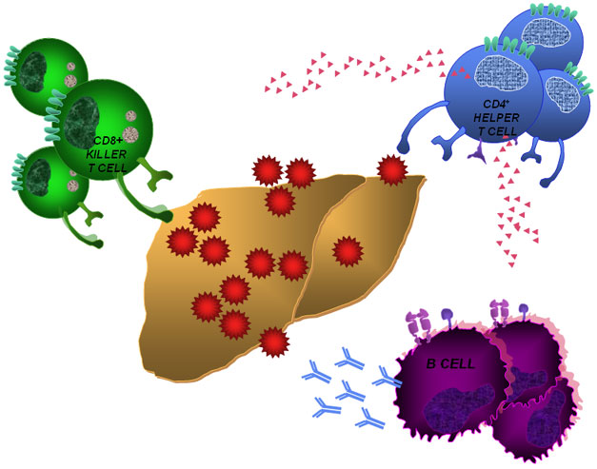
T and B cells (Lymphocytes)
T cells are produced in the thymus gland and signal an attack from foreign invaders
B cells produce the Y-shaped antibodies

Slide 9
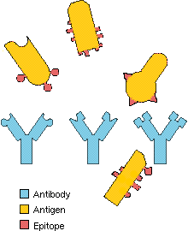
Antigens and Antibodies
Antibodies are Y-shaped proteins
An antibody attaches to specific antigens because they have similar shapes
Often the antigen-antibody complex makes the invader more visible to wandering macrophages, which engulf the bacteria

Slide 10
Antibodies
Antibodies can bind to toxins, changing their shape and preventing them from entering cells
Antibodies also work in the same manner on viruses
However, viruses quickly mutate and prevent the same antibodies from working for very long
HIV can actually “hide” inside the T cells that are supposed to signal its presence

Slide 11
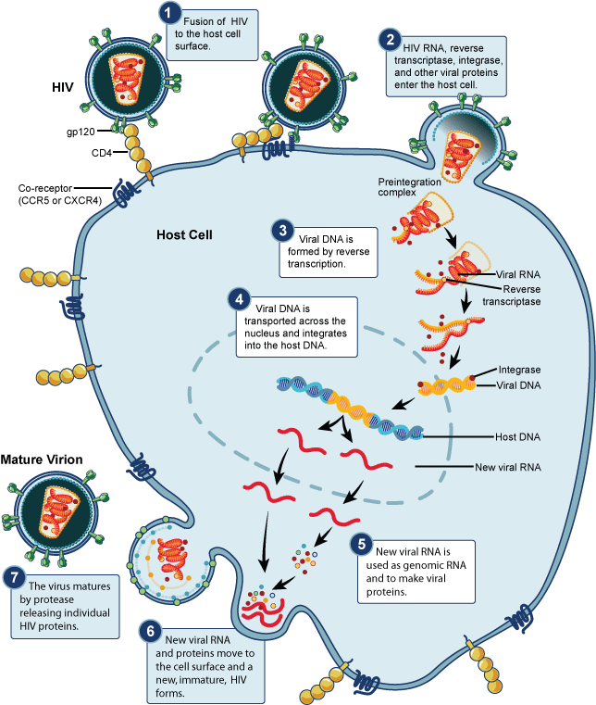
HIV invading a white blood cell
You don’t have to know this in any detail

Slide 12
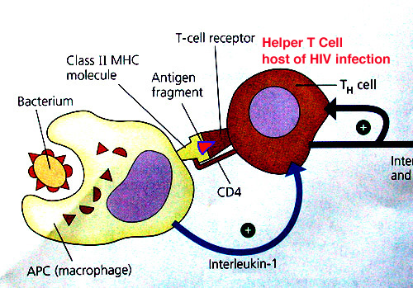
Recognizing Antigens
When an invader is destroyed by a macrophage, its antigens go to the macrophage surface
The macrophage then couples with helper T -cells, which read the antigen shape and release lymphokine

Slide 13
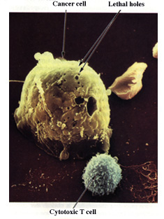
This chemical causes B cells to divide and start to produce antibodies
The helper T cells also activate killer T cells
The killer T cells destroy invading cells and body cells that are infected by viruses by puncturing their cell membranes
Killer T cells can also destroy cancer cells if they have antigens that are different from normal body cells

Slide 14
After Infection
Once an infection is fought off, suppressor T cells signal the immune system to shut down
Phagocytes clean up any dead or injured B and T cells that remain
Finally, memory T cells produce copies of the invader antigens so that they can be more easily identified in the future

Slide 15
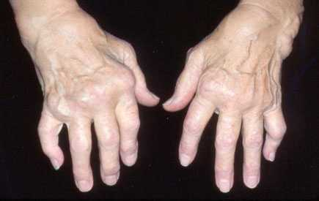
Problems Can Arise…
Allergies → Immune system attacks harmless materials
Immune response may be so violent that it becomes dangerous
Autoimmune Disease → immune system attacks body’s own cells
Mutated T and B cells, or suppressor-T fails to do its job
Example: rheumatoid arthritis → immune response against bones & connective tissue around the joints

Slide 16
Blood Clotting
Prevent blood loss
Provide support to weakened vessels
Platelets
Fragile – burst when they touch a broken vessel wall
Release thromboplastin
Fibrinogen converts into fibrin threads – wrap around damaged area → clot
Invading microbes and erythrocytes can’t pass, but leukocytes can

Slide 17
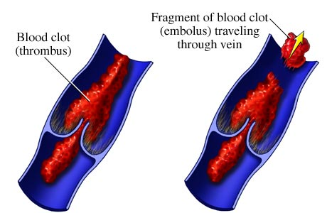
Problems with Clotting
Thrombus
A blood clot that seals a blood vessel
(eg. Cerebral thrombosis – clot in the brain – may cause a stroke)
Embolus
A dislodged clot
May travel to
Lodge elsewhere
(eg. A vital organ)

Slide 18
Blood Types
Early blood transfusion experiments often led to the death of the patient
It wasn’t until the 20th century that doctors realized that there were different blood groups
The glycoproteins on the surface of blood cells can differ from one person to another

Slide 19
Blood Groups
Glycoproteins – markers on cell membranes; act as antigens
Glycoprotein | Blood Type
A | A
B | B
A + B | AB
Neither A nor B | O
*Universal acceptor
*Universal donor
WHY?
Blood typing simulation
Notes:
19
http://nobelprize.org/educational_games/medicine/landsteiner/
Blood type O can only accept blood type O
Blood type AB can only donate to blood type AB.

Slide 20
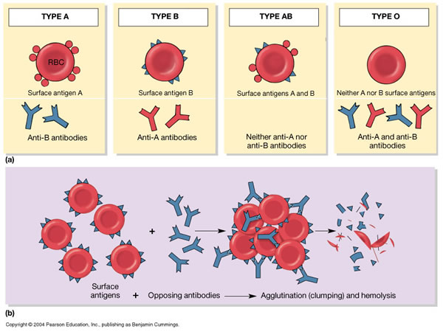
When Transfusions Don’t Work
Antibodies attach to antigen markers → causes blood to agglutinate (clump)
Agglutination leads to clogged blood vessels

Slide 22
Rhesus Factor
85% of Canadians are Rh+
Rh- can donate to, but not receive blood from Rh+
Erythroblastosis fetalis
Rh- mother, Rh+ fetus → first pregnancy safe, fetus of subsequent pregnancies at risk
Blood separated by placenta, but antibodies may cross over

Slide 23
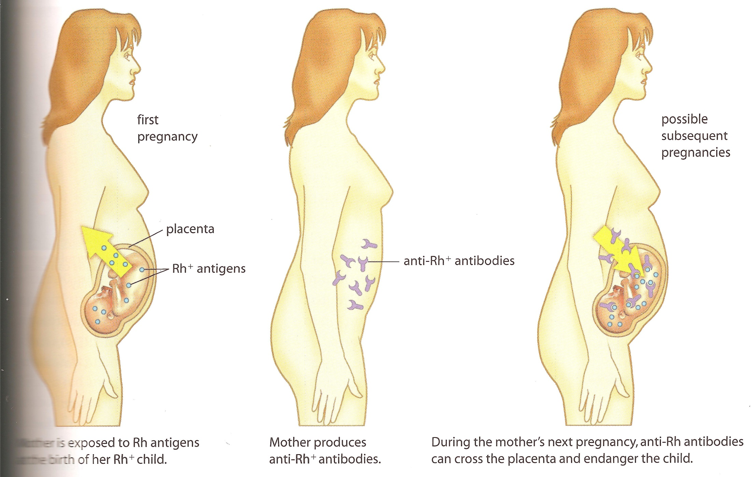

Slide 24
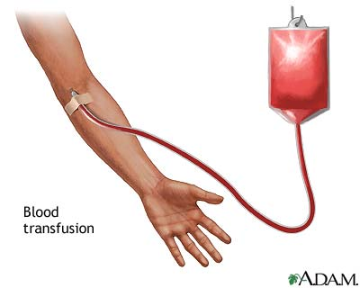
Erythroblastosis fetalis: Treatment
Transfusion of Rh- blood
Inject mother with drug to inhibit formation of Rh+ antibodies

Slide 25
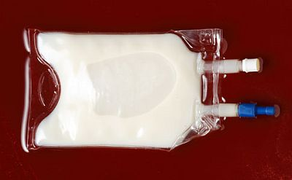
Artificial Blood
Fluosol
Carries O₂ and CO₂
No blood matching required
Not good for clotting or immunity
Used to maintain oxygen levels until erythrocytes could be replenished

