Slide 1
Acids and Bases

Slide 2
Properties of acids and bases:
Acids are substances that dissolve to produce conducting solutions that taste sour, turn litmus red, have a low pH, react violently with metals, and neutralize bases.
Bases are substances that dissolve to produce conducting solutions that taste bitter, turn litmus blue, feel slippery, are corrosive, have a high pH and neutralize acids.

Slide 3
Review acid naming rules
Acid name Ionic name
Hydro____ic acid hydrogen ____ide
Per____ic acid hydrogen per____ate
____ic acid hydrogen ____ate
____ous acid hydrogen ____ite
Hypo____ous acid hydrogen hypo____ite

Slide 4
Empirical and theoretical definitions.
Empirical definitions are practical, observable, or experimental
Theoretical definitions are explanations or ideas.

Slide 5
Empirical definition of an acid would be any solution that conducts electricity, tastes sour, reacts with metals, turns litmus red, neutralizes bases and has a low pH (below 7).
An empirical definition of a base is any conductive solution that tastes bitter, is corrosive, turns litmus blue, neutralizes acids and has a high pH (above 7).

Slide 6
The first theoretical definition for an acid was proposed by Arrhenius:
An acid is any substance that dissociates in water to increase the hydrogen ion concentration.
A base is any substance that dissociates in water to increase the hydroxide ion concentration.

Slide 7
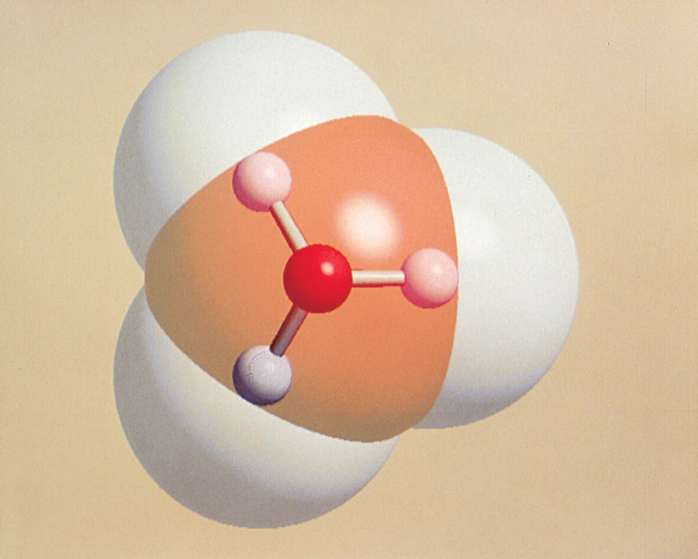
Scientists believe that since water is very polar and hydrogen ions being small are very mobile, they will attract to the water. It is more likely that hydronium ions exist. H₃O+ .

Slide 8
Soon it was found that other substances showed properties of acid or base solutions but did not initially contain hydrogen ions or hydroxide ions.
A modified Arrhenius definition was developed;
An acid is any substance that reacts with water to produce hydronium ions.
A base is any substance that reacts with water to produce hydroxide ions.

Slide 9
The End

