Slide 1
Chemistry
Energy Revision

Slide 2
Contents
Enthalpy
First Law
Enthalpy
Enthalpy
Enthalpy Change
Simple Calorimeter
Endothermic
Exothermic
Standard Enthalpy Change
Of reaction
Of combustion
Calorimeters for Enthalpy Change of Combustion
Of formation
Bond Enthalpy
Rates of reaction
Rates of Reaction
Collision theory
Surface area
Pressure
Concentration
Temperature
Catalysts
Heterogeneous Catalysis
Equilibrium
Dynamic Equilibrium
Le Chatelier’s Principle
Factors affecting the position of the equilibrium
Ammonia and the Haber Process
Glossary
Enthalpy
Rates of Reaction
Equilibrium

Slide 3
Enthalpy
Back to contents
First Law
Enthalpy
Enthalpy
Enthalpy Change
Calorimeter
Endothermic
Exothermic
Standard Enthalpy Change
Of reaction
Of combustion
Calorimeters for Enthalpy Change of Combustion
Of formation
Bond Enthalpy

Slide 4
First Law
Back to contents
Energy can neither be created nor destroyed but it can be converted from one from to another
T ‘n’ T ➔ transfer and transformed

Slide 5
Enthalpy
Back to contents
Enthalpy
Enthalpy change
Enthalpy is the ‘heat content that is stored in a chemical system’
Heat chance is just the difference between the enthalpy of the products and the enthalpy of the reactants
ΔH = H [products] – H [reactants]
In general it is either exo- or endothermic
The heat exchanged with the surroundings can be calculated using the equation
Q = mcΔT Joules
Standard enthalpy has standard conditions which are:
A pressure of 100kPa (1atm)
A temperature of 298K (25°C)
A concentration of 1.0 mol dm⁻¹
All reactants and products have to be in standard states

Slide 6
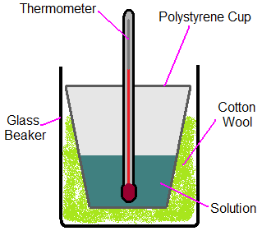
Using a Calorimeter
Back to contents
The particles are dissolved in the solution
The heat is exchanged from the particles into the solution
The heat exchange is measured using the thermometer
There are limitations in using a simple calorimeter which need to be known
Heat loss etc.

Slide 7
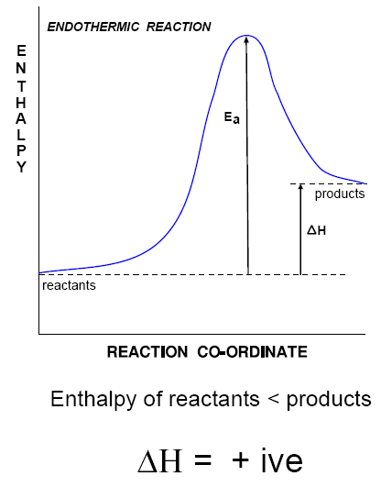
Endothermic
Back to contents
The enthalpy of the products is greater than the enthalpy of the reactants
There is heat gain to the chemical system from the surroundings
ΔH has a positive sign because heat has been gained by the chemical system
There are three examples:
Self-cooling beer can
H ₂O (l) → H₂O (g)
Thermal decomposition
CaCO₃ (s) → CaO (s) + CO ₂ (g)
Photosynthesis
6CO₂ (g) + 6H₂O (l) → C₆H₁₂O₆ (aq) + 6O₂ (g)
Endothermic refers to a reaction in which the enthalpy of the products is greater than the enthalpy of the reactants, resulting in heat being taken in from the surroundings (ΔH = +ve)

Slide 8
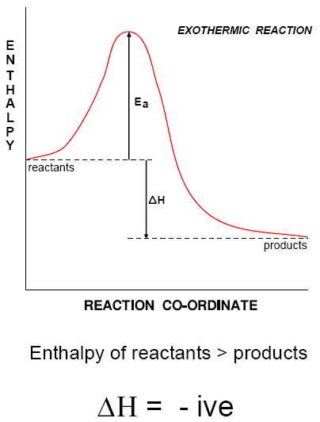
Exothermic
Back to contents
The enthalpy of the products is smaller than the enthalpy of the reactants
There is heat loss from the chemical system to the surroundings
ΔH has a negative sign because heat has been lost by the chemical system
There are three examples:
Self-heating cans
CaO (s) + H₂O (l) → Ca(OH)₂ (aq)
Oxidation of fuels
CH₄ (g) + 2O₂ (g) → CO₂ (g) + 2H₂O (l)
Respiration
C₆H₁₂O₆ (aq) + 6O₂ (g) → 6CO₂ (g) + 6H₂O (l)
Exothermic refers to a reaction in which the enthalpy of the products is smaller than the enthalpy of the reactants, resulting in heat loss to the surroundings (ΔH = -ve)

Slide 9
Standard Enthalpy Change of Reaction (ΔHᵣ)
Back to contents
For a standard enthalpy change of reaction we need:
An equation
This gives the amounts, in mol, of reactants and products
An enthalpy change in kJ mol⁻¹
This gives the enthalpy change for the molar quantities in the state equation
The standard enthalpy change of reaction is the enthalpy change that accompanies a reaction in the molar quantities expressed in a chemical equation under standard conditions, all reactants and products being in their standard states

Slide 10
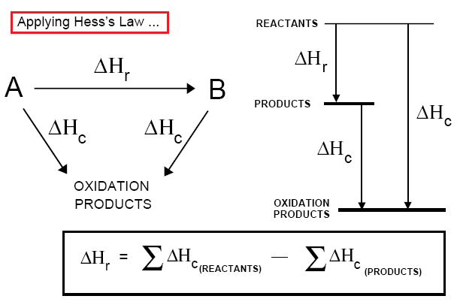
Standard Enthalpy Change of Combustion (ΔHc)
Back to contents
Standard enthalpy change of combustion is the enthalpy change that takes place when one mole of a substance reacts completely with oxygen under standard conditions, all reactants and products being in their standard states

Slide 11
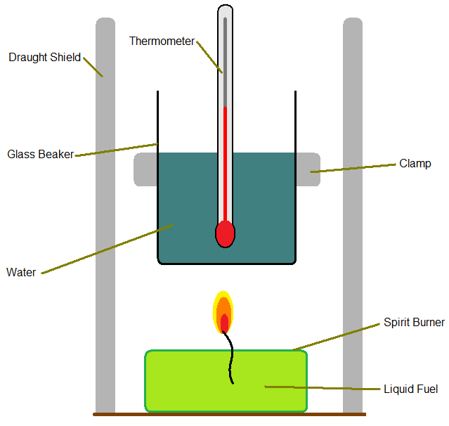
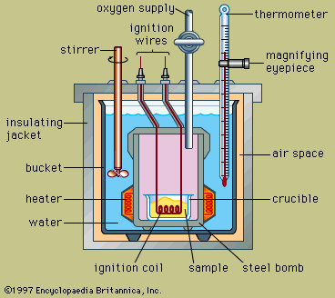
Calorimeters for Enthalpy Change of Combustion
Back to contents
Flame Calorimeter
Bomb Calorimeter

Slide 12
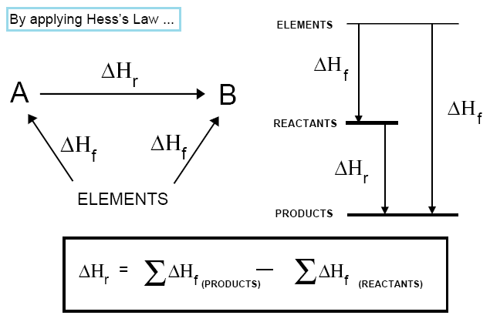
Standard Enthalpy Change of Formation (ΔHf)
Back to contents
Standard enthalpy change of formation of a compound is the enthalpy change that takes place when one mole of a compound is formed from its constituent elements in their standard states

Slide 13
Bond Enthalpy
Back to contents
Bond enthalpy is the enthalpy change that takes place when breaking by homolytic fission 1mole of a given bond in the molecules of a gaseous species
Average bond enthalpy is the average enthalpy change that takes place when breaking by homolytic fission 1mol of a given type of bond in the molecules of a gaseous species
It helps to draw out the molecule when given an equation
The question will also give you the average bond enthalpies needed to answer
Energy require to break bonds = ∑(bond enthalpies of bonds broken)
Energy released when bonds are made = - ∑(bond enthalpies of bonds made)
ΔH = ∑(bond enthalpies of bonds broken) - ∑(bond enthalpies of bond made)

Slide 14
Rates of reaction
Back to contents
Collision theory
Surface area
Concentration
Pressure
Temperature
Catalysts

Slide 15
Rate of Reaction
Back to contents
Rate = Change in concentration/time
Mol dm⁻³s⁻¹ = mol dm⁻³ / sec
mol / L sec

Slide 16
Collision Theory
Back to contents
Particle must collide before a reaction takes place
Not all collisions are successful
Activation energy is needed fro a reaction to take place
Particles must approach each other in certain relative way
This is known as the steric effect
To increase the rate you have to:
Have more frequent collisions:
Increase the speed (temperature)
Have more particles (pressure/concentration)
More successful collisions:
Give particles more energy (temperature)
Lower the activation energy (catalyst)

Slide 17
Factors Effecting Rates of Reaction
Back to contents
Surface Area
Pressure
More chance of a successful collision as more particles exposed
Catalysts in catalytic converters are used in a finely divided form to increase surface area
Particles get closer together which increases the frequency of collisions
It can affect the position of equilibrium

Slide 18
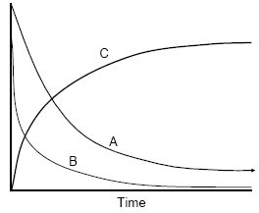
Concentration
Back to contents
Increasing concentration = more frequent collisions = rate increaed
E.g. A + 2B ➔ C
A + B ➔ concentration decreases with time
C ➔ concentration increases with time

Slide 19
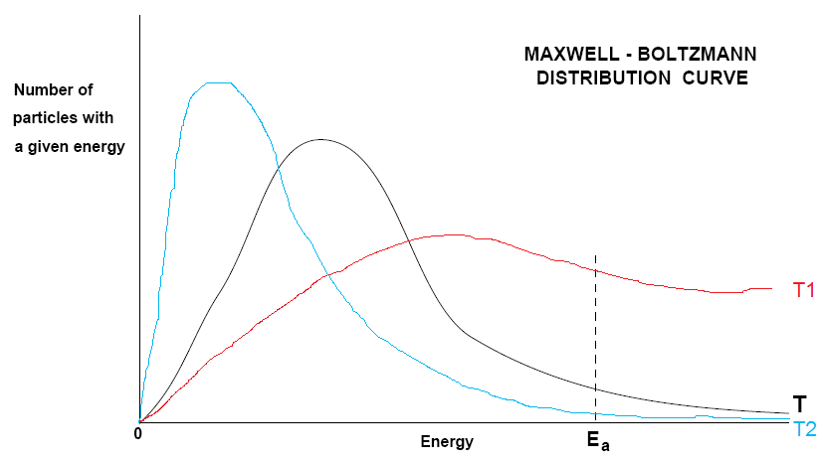
Temperature
Back to contents
Maxwell-Boltzmann Distribution Curve
Particles gain more energy and their speed increases
No particles have zero energy
Move particles have intermediate energy
Area under the curve stays constant
T2: curve gets broader/flatter shift to higher energy
T1: shift to lower energy
T2 > T > T1

Slide 20
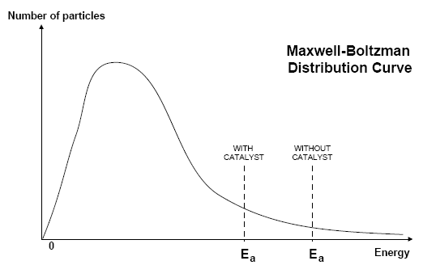
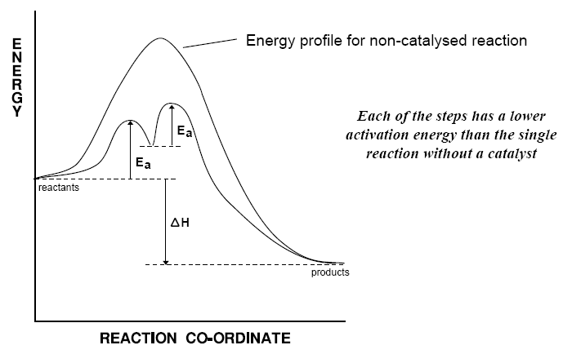
Catalysts
Back to contents
A catalyst increases the rate of a chemical reaction without being used up in the process
Catalysts lower the activation energy so more particles overcome this barrier
There are two types: homogeneous (e.g. CFC’s and ozone) and heterogeneous (e.g. Fe in the Haber Process)

Slide 21
Catalysts Continued
Back to contents
Uses
Catalysts...
Allow reactions to take place at lower temperatures:
Saves energy
Reduces CO₂ output
Enable different reactions to be used:
Better atom economy
Reduce waste
Are often enzymes:
Generate specific products
Operates at lower temperatures
Non-poisonous and are biodegradable
Have great economic importance in industry:
Poly(ethene)
Sulphuric acid
Ammonia
Ethanol production
Can reduce pollution:
Catalytic converters in cars
Used in industry where an increase in temperature would result in lower yield
E.g. Haber Process
They don’t affect equilibrium but do affect the rate of equilibrium
More effective catalysts could result in dramatic savings
They need to be regularly changed as they may become “poisoned” by other chemicals
They are finely divided state to increase the surface area

Slide 22
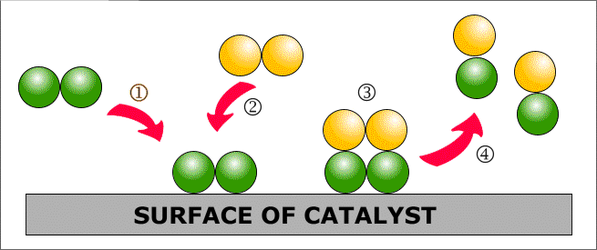
Heterogeneous Catalysis
Back to contents
HARD
etero
=
Adsorption (1)
Particle(s) land onto an active site of a catalyst and forms bonds with the catalyst
It may use some of the bonding electrons in the molecules thus weakening them and making any further reactions easier
Reaction (2 and 3)
Adsorbed gases are held onto the surface in the right orientation for a reaction to occur
This increases the chances of favourable collisions taking place.
Desorption (4)
This is when the molecules that are formed break away from the active site of the catalyst

Slide 23
Equilibrium
Back to contents
Dynamic Equilibrium
Le Chatelier’s Principle
Factors affecting the position of the equilibrium
Ammonia and the Haber Process

Slide 24
Dynamic Equilibrium
Back to contents
Dynamic equilibrium
The equilibrium that exists in a closed system when the rate of the forward reaction is equal to the rate of the reverse reaction
Equilibrium only happens during a reversible reaction
There appears to be no change but the system is dynamic
Constant motion of the forward and backward reaction
When a system is in dynamic equilibrium:
The concentrations of the reactants and products are the same
The rate of the forward and backward reaction is equal to each other
An equilibrium only applies in a closed system so there are no materials added or taken away and no external conditions like temperature or pressure being altered

Slide 25
Le Chatelier’s Principle
Back to contents
This means that if a system in dynamic equilibrium is changed by pressure, temperature, concentration or/ and by a catalyst, the reaction will shift to make sure that the equilibrium will not change.
It opposes the change and tried to counteract it.
Le Chatelier’s principle:
States that when a system is dynamic equilibrium is subjected to a change, the position of equilibrium will shift to minimise the change

Slide 26
Conditions affecting the position of Equilibrium
Back to contents
Concentration
Pressure
Temperature
Increase the concentration of a species
The equilibrium moves to the side without the species, reducing its concentration
Increase pressure:
The equilibrium moves to the side with fewer gaseous moles, reducing pressure
Increase in temperature:
The equilibrium moves in the endothermic direction, taking in the extra energy
A catalyst does not alter the position of equilibrium but speeds up the forward and reverse reactions equally
Catalyst
An equilibrium system opposes changes

Slide 27
Ammonia and the Haber Process
Back to contents
The Haber Process
N₂ (g) + 3H₂ (g) ↔ 2NH₃ (g)
Typical Conditions
Equilibrium Theory Favours
Kinetic Theory Favours
Compromise Conditions
Low temperature: exothermic reaction – higher yield at low temperature
High pressure: decrease in number of gaseous molecules
Pressure: 20000kPa (200 atm)
Temperature: 380-450°C
Catalyst: Iron
High temperature: greater average energy + more frequent collisions
High pressure: more frequent collisions for gaseous molecules
Catalyst: lower activation energy
The conditions used are a compromise with the catalyst enabling the rate to be kept up, even at a lower temperature

Slide 28
Glossary
Back to contents
Enthalpy
Rates of Reaction
Equilibrium

Slide 29
Enthalpy
Back to contents
Enthalpy (H)
The heat content that is stored in a chemical system
Chemical system
The reactants and the products
Refers to a reaction in which the enthalpy of the products is smaller than the enthalpy of the reactants, resulting in heat loss to the surroundings
Refers to a reaction in which the enthalpy of the products is greater than the enthalpy of the reactants, resulting in heat being taken in from the surroundings
A diagram for a reaction to compare the enthalpy of the reactants with the enthalpy of the products
The minimum energy required to start a reaction by the breaking of bonds
Exothermic
Endothermic
Enthalpy profile diagram
Activation energy (Ea)
Surroundings
What is outside the chemical system
Enthalpy Change
The heat exchange with the surroundings during a chemical reaction, at constant pressure
The difference between the enthalpy of the products and the reactants gives you enthalpy change
First Law
Energy can neither be created or destroyed but it can be converted from one form to another

Slide 30
Enthalpy continued
Back to contents
Standard conditions
Pressure of 100kPa (1atm)
Temperature of 298K (25°C)
Concentration of 1.0 mol dm⁻³
Standard state
The physical state of a substance under standard conditions
Standard enthalpy change of reaction
The enthalpy change that accompanies a reaction in the molar quantities expressed in a chemical equation under standard conditions, all reactants and products being in their standard states
Standard enthalpy change of combustion
The enthalpy change that takes place when one mole of a substance reacts completely with oxygen under standard conditions, all reactants and products being in their standard states
Standard enthalpy change of formation
Specific heat capacity (c)
The energy required to raise the temperature of 1g of a substance by 1°C
Bond enthalpy
The enthalpy change that takes place when breaking by homolytic fission 1mole of a given bond in the molecules of a gaseous species
Average bond enthalpy
The average enthalpy change that takes place when breaking by homolytic fission 1mol of a given type of bond in the molecules of a gaseous species
Hess’ Law
Of a compound is the enthalpy change that takes place when one mole of a compound is formed from its constituent elements in their standard states
States that, if a reaction can take place by more than one route and the initial and final conditions are the same, the total enthalpy change is the same for each route
Enthalpy cycle
A diagram showing alternative routes between reactants and products which allows the indirect determination of an enthalpy change from other known enthalpy changes using Hess’ Law

Slide 31
Rates of Reaction
Back to contents
Rate of Reaction
Catalyst
Heterogeneous catalysis
Homogeneous catalysis
Catalysis of a reaction in which the catalyst and reactants are in the same physical state, which is more frequently the aqueous or gaseous state
the change in concentration of a reactant or product per unit time
a substance that initiates or accelerates a chemical reaction without itself being affected
Catalysis of a reaction in which the catalyst has a different physical state from the reactants; frequently, reactants are gases whilst the catalyst is a solid

Slide 32
Equilibrium
Back to contents
Dynamic equilibrium
Le Chatelier’s principle
The equilibrium that exists in a closed system when the rate of the forward reaction is equal to the rate of the reverse reaction
When a system in dynamic equilibrium is subjected to a change, the position of equilibrium will shift to minimise the change

