Slide 1
pH

Slide 2
Dissociation of Water
Pure water has trace amounts of H3O+ and OH- ions, coming from the slight dissociation of water.
Placing an acid in water will increase the [H3O+] and a base will increase [OH-].

Slide 3
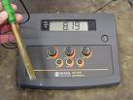
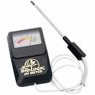
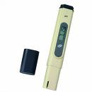
Measuring the hydrogen ion concentration in a solution can be done with a conductivity tester.
A pH meter was developed to accurately measure acidity in solutions.
Other means was to use special indicators on paper that turns specific colors when in a solution with a given pH.
The indicators are not as accurate as meters, but are quite useful.

Slide 4
pH
pH or power of hydrogen simplifies comparing values that have as vast a range as hydrogen ion ( or the hydronium ion) concentration in solutions.
pH is the hydrogen ion concentration expressed in an exponent form. (logarithm scale)
pH scale usually ranges from 1 to 14 but in fact can go as low as -1and as high as 15.
The lower the pH, the more acidic a solution. The higher the pH the more basic it is.

Slide 5
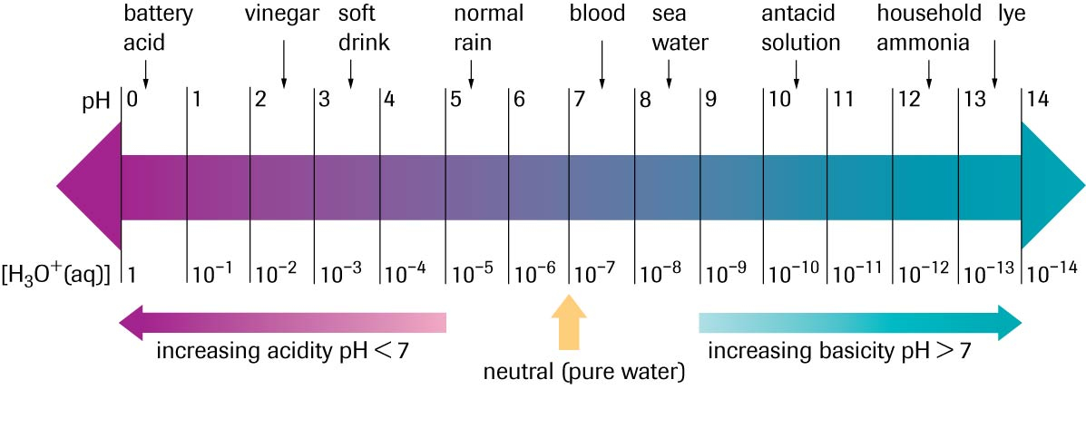
pH Scale

Slide 6
Calculating pH
pH is calculated as follows
pH = - log [H₃O+] or [H₃O+] = 10 ^{–pH}
*Rounding: [H₃O+] significant digits convert to pH digits after the decimal.
[H₃O+] of pure water is 1x 10⁻⁷ which is a pH of 7.
Acids have a pH below 7 while bases have a pH above 7

Slide 7
Although the pH of bases can be measured, a similar value was determined for bases called pOH.
pOH = -log[OH-]
The pH and pOH of a solution are inversely related.
As the pH of a solution goes down the pOH of that solution will go up the same amount.
pH + pOH = 14

Slide 8
The end

