Slide 1
Video Tutorial on Energetics, Hess’s Law, Enthalpy of Formation and Combustion in Energetics.
Prepared by
Lawrence Kok
http://lawrencekok.blogspot.com

Slide 2
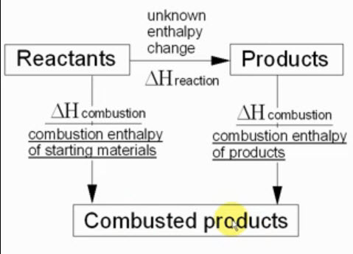
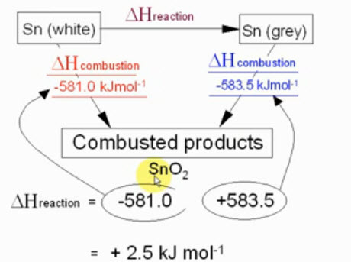
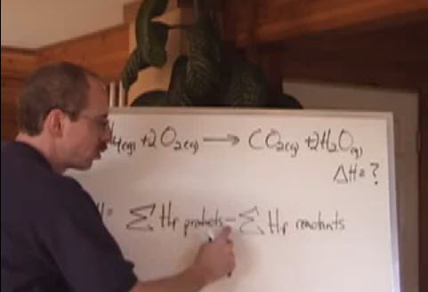
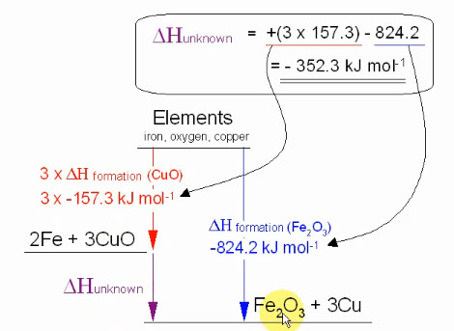
Video on Energetics and Enthalpy Calculation
Enthalpy of reaction using combustion data
Enthalpy of reaction using combustion data
Enthalpy of reaction using formation data
Enthalpy of reaction using formation data

Slide 3
Basic Rules for ΔH Enthalpy changes calculations
1
Total amt energy released/absorbed is α to number of moles of reactants
2
ΔH for reverse reaction is EQUAL in magnitude but opposite in sign to ΔH forward
3
Standard condition for measuring STANDARD ENTHALPY CHANGE, ΔH
4
Unit for ΔH is KJ mol ⁻¹

Slide 4
Basic Rules for ΔH Enthalpy changes calculations
Temp and Heat
5
6
Enthalpy change ΔH measured using a calorimeter
7
Specific heat capacity for a substance – water ( 4.18J g⁻¹K⁻¹)

Slide 5
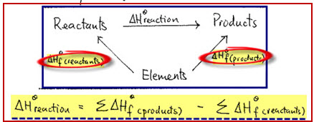
Standard Enthalpy Change of Formation for a reaction, ΔH^{θ} _{f}

Slide 6
Standard Enthalpy Change of reaction, ΔH^{θ} _{f}
ΔH^{θ} _{f} = Amt of energy absorbed or released when ONE mole of compound formed from
Its standard state from its constituents in their standard states
Ex : NaCI _{(s)} + 1/2CI₂ _{(g)} → NaCI _{(s)}
Notes on ΔH^{θ} _{f}

Slide 7
Standard Enthalpy Change of reaction, ΔH^{θ} _{f}
ΔH^{θ} _{f} = Amt of energy absorbed or released when ONE mole of compound formed from
Its standard state from its constituents in their standard states
Ex : NaCI _{(s)} + 1/2CI₂ _{(g)} → NaCI _{(s)}

Slide 8
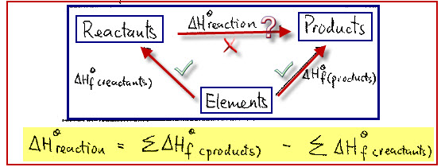
Ex 1
Calculate the ΔH^{θ} ,enthalpy change for the reaction below
4 CH₃NHNH₂ + 5 N₂O₄ → 4CO₂ + 12 H₂O + 9N₂
Steps
1

Slide 9
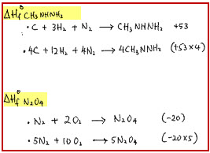
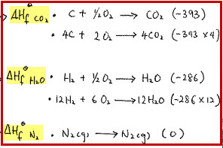
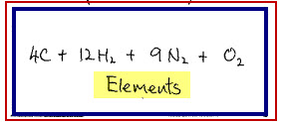
Ex 1
Calculate the ΔH^{θ} ,enthalpy change for the reaction below
4 CH₃NHNH₂ + 5 N₂O₄ → 4CO₂ + 12 H₂O + 9N₂
Steps
1
2
Formation of reactants data
Formation of products data

Slide 10
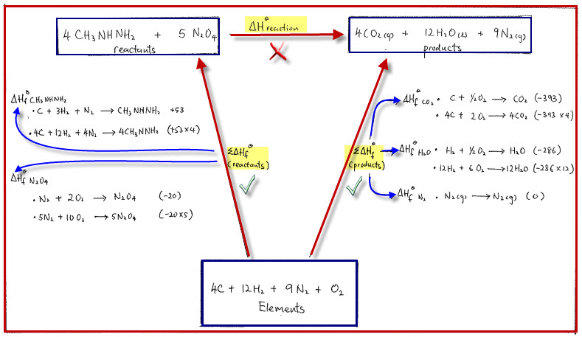
Ans
Calculate the ΔH^{θ} ,enthalpy change for the reaction below
4 CH₃NHNH₂ + 5 N₂O₄ → 4CO₂ + 12 H₂O + 9N₂

Slide 11
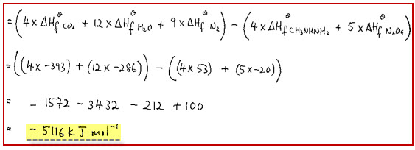
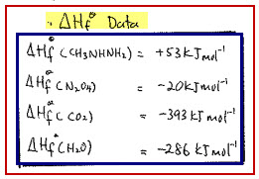
Ans
Calculate the ΔH^{θ} ,enthalpy change for the reaction below
4 CH₃NHNH₂ + 5 N₂O₄ → 4CO₂ + 12 H₂O + 9N₂
Ans
Formation data

Slide 12
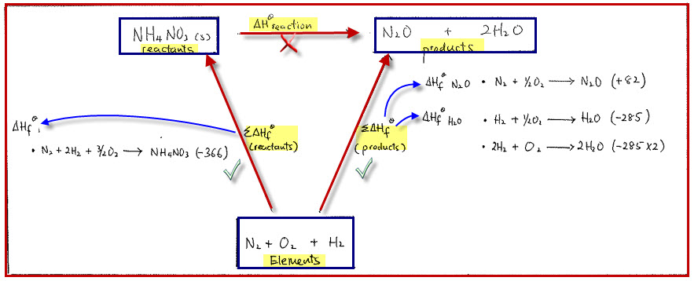
Ex 2
Calculate the ΔH^{θ} ,enthalpy change for the reaction below
NH₄NO₃ → N₂O + 2 H₂O using energy cycle diagram

Slide 13
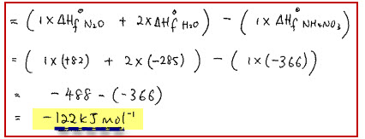
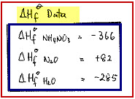
Ex 2
Calculate the ΔH^{θ} ,enthalpy change for the reaction below
NH₄NO₃ → N₂O + 2 H₂O using energy cycle diagram
Ans
Formation data

Slide 14
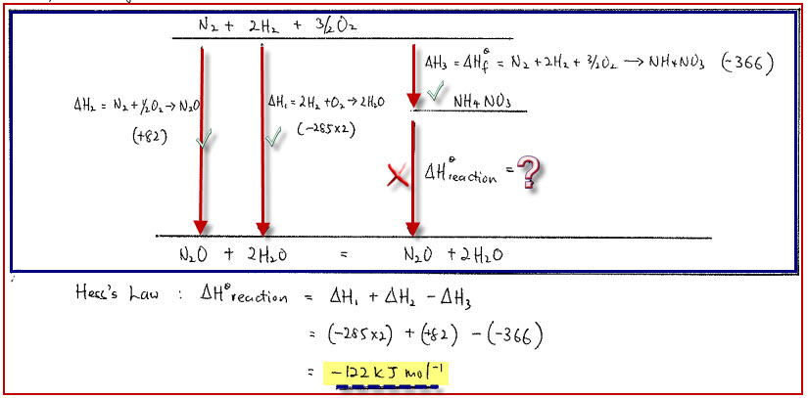
Ex 2
Calculate the ΔH^{θ} ,enthalpy change for the reaction below
NH₄NO₃ → N₂O + 2 H₂O using energy level diagram

Slide 15
Ex 2
Calculate the ΔH^{θ} ,enthalpy change for the reaction below
NH₄NO₃ → N₂O + 2 H₂O using energy level diagram
Ans
Formation data

Slide 16
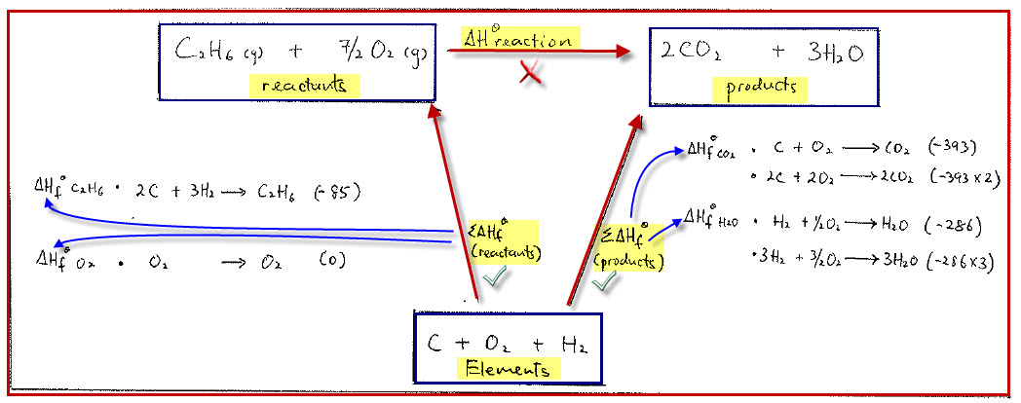
Ex 3
Calculate the ΔH^{θ} ,enthalpy change for the reaction below
C₂H₆ + 7/2O₂ → 2CO₂ + 3 H₂O using energy cycle diagram

Slide 17
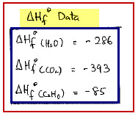
Ex 3
Calculate the ΔH^{θ} ,enthalpy change for the reaction below
C₂H₆ + 7/2O₂ → 2CO₂ + 3 H₂O using energy cycle diagram
Ans

Slide 18
Ex 3
Calculate the ΔH^{θ} ,enthalpy change for the reaction below
C₂H₆ + 7/2O₂ → 2CO₂ + 3 H₂O using energy level diagram

Slide 19
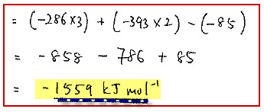
Ex 3
Calculate the ΔH^{θ} ,enthalpy change for the reaction below
C₂H₆ + 7/2O₂ → 2CO₂ + 3 H₂O using energy level diagram
Ans

Slide 20
Ex 4
Calculate the ΔH^{θ} ,enthalpy change for the reaction below
C₂H₄ + H₂ → C₂H₆

Slide 21
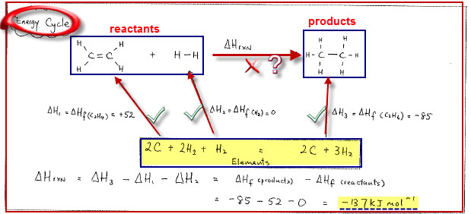
Ex 4
Calculate the ΔH^{θ} ,enthalpy change for the reaction below
C₂H₄ + H₂ → C₂H₆
Ans
Energy Cycle diagram

Slide 22
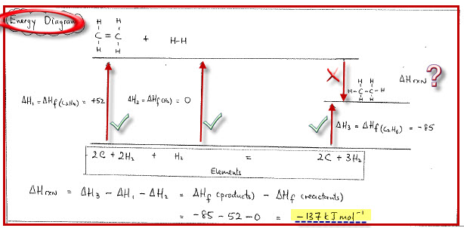
Ex 4
Calculate the ΔH^{θ} ,enthalpy change for the reaction below
C₂H₄ + H₂ → C₂H₆
Ans
Energy Cycle diagram or Energy Level Diagram
Answer the same = -137kJmol⁻¹

Slide 23
Ex 5
Write balanced equation and calculate the ΔH^{θ} for the following reactions
Zinc + Chlorine forming zinc chloride
b) Hydrogen sulfide + sulfur dioxide forming sulfur and water
c) Lead (II) nitrate decomposing to lead (II) oxide, nitrogen dioxide and oxygen

Slide 24
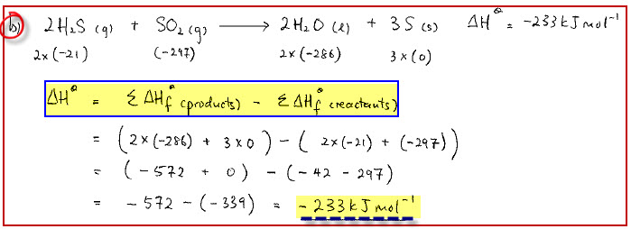
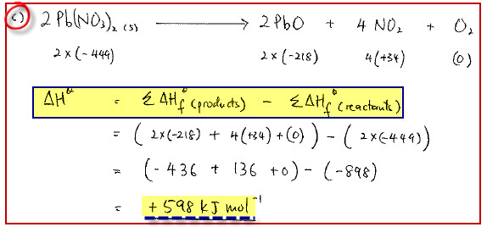
Ex 4
Write balanced equation and calculate the ΔH^{θ} for the following reactions
Zinc + Chlorine forming zinc chloride
b) Hydrogen sulfide + sulfur dioxide forming sulfur and water
c) Lead (II) nitrate decomposing to lead (II) oxide, nitrogen dioxide and oxygen

Slide 25
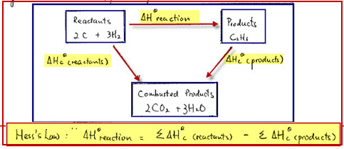
Standard Enthalpy Change of combustion, ΔH^{θ} _{c}

Slide 26
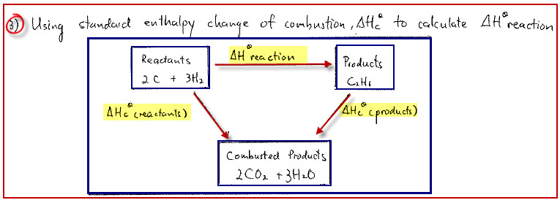
Standard Enthalpy Change of combustion, ΔH^{θ} _{c}
ΔH^{θ} _{c} = Amt of energy released when ONE mole of substance completely burnt in
OXYGEN under standard conditions
Notes on combustion

Slide 27
Ex 1
Calculate the ΔH^{θ} ,enthalpy change for the reaction below
Using Energy Cycle Diagram
2 C + 3H₂ → C₂H₆

Slide 28
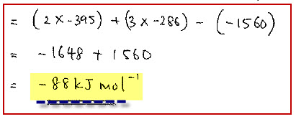
Ex 1
Calculate the ΔH^{θ} ,enthalpy change for the reaction below
Using Energy Cycle Diagram
2 C + 3H₂ → C₂H₆
Ans

Slide 29
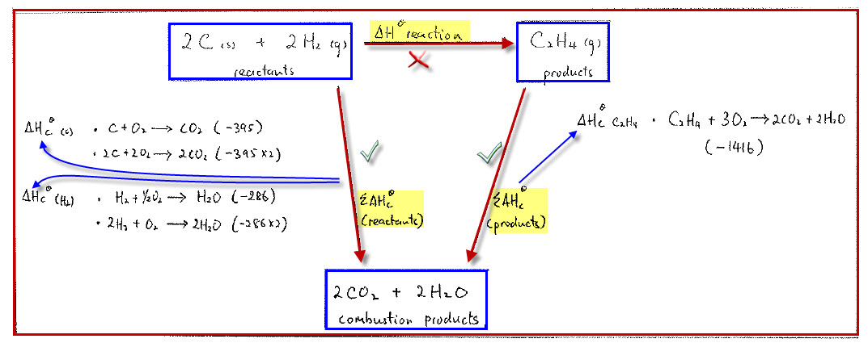
Ex 2
Calculate the ΔH^{θ} ,enthalpy change for the reaction below
1st method
Using Energy Cycle Diagram
2 C + 2H₂ → C₂H₄

Slide 30
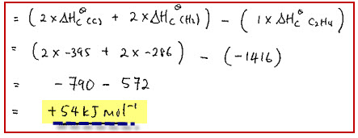
Ex 2
Calculate the ΔH^{θ} ,enthalpy change for the reaction below
1st method
Using Energy Cycle Diagram
2 C + 2H₂ → C₂H₄
Ans

Slide 31
Ex 2
Calculate the ΔH^{θ} ,enthalpy change for the reaction below
2nd method
Using Energy Level Diagram
2 C + 2H₂ → C₂H₄

Slide 32
Ex 2
Calculate the ΔH^{θ} ,enthalpy change for the reaction below
2nd method
Using Energy Level Diagram
2 C + 2H₂ → C₂H₄
Ans

Slide 33
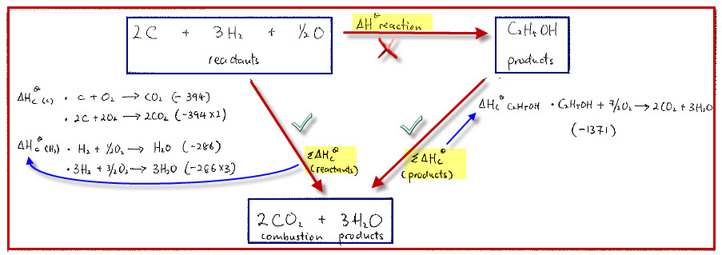
Ex 3
Calculate the ΔH^{θ} ,enthalpy change for the reaction below
1st method
Using Energy Cycle Diagram
2 C + 3H₂ + 1/2O₂ → C₂H₅OH

Slide 34
Ex 3
Calculate the ΔH^{θ} ,enthalpy change for the reaction below
1st method
Using Energy Cycle Diagram
2 C + 3H₂ + 1/2O₂ → C₂H₅OH
Ans

Slide 35
Ex 3
Calculate the ΔH^{θ} ,enthalpy change for the reaction below
2nd method
Using Energy Level Diagram
2 C + 3H₂ + 1/2O₂ → C₂H₅OH

Slide 36
Ex 3
Calculate the ΔH^{θ} ,enthalpy change for the reaction below
2nd method
Using Energy Level Diagram
2 C + 3H₂ + 1/2O₂ → C₂H₅OH
Ans

Slide 37
Ex 4
Calculate the ΔH^{θ} ,enthalpy change for the reaction below
TWO methods
1st method, using combustion data
2 C + 3H₂ + 1/2O₂→ C₂H₅OH
Combustion data

Slide 38
Ex 4
Calculate the ΔH^{θ} ,enthalpy change for the reaction below
TWO methods
1st method, using combustion data
2 C + 3H₂ + 1/2O₂→ C₂H₅OH
Ans
Combustion data

Slide 39
Ex 4
Calculate the ΔH^{θ} ,enthalpy change for the reaction below
2nd method, using formation data
2 C + 3H₂ + 1/2O₂→ C₂H₅OH
Formation data

Slide 40
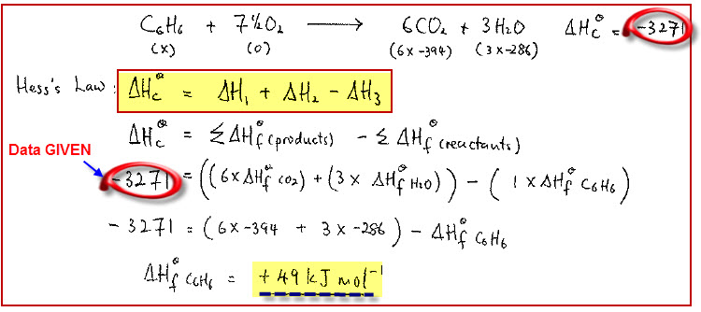
Ex 4
Calculate the ΔH^{θ} ,enthalpy change for the reaction below
2nd method, using formation data
2 C + 3H₂ + 1/2O₂→ C₂H₅OH
Formation data
Ans

Slide 41
Ex 5
Calculate the ΔH^{θ} ,enthalpy change for the reaction below
Using combustion data
3C₂H₂ → C₆H₆
Combustion data

Slide 42
Ex 5
Calculate the ΔH^{θ} ,enthalpy change for the reaction below
Using combustion data
3C₂H₂ → C₆H₆
Ans
Combustion data

Slide 43
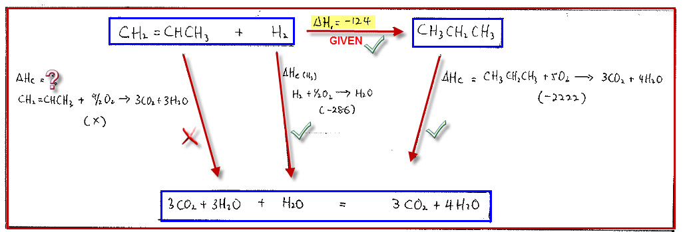
Ex 6
Calculate ΔH^{θ} _{c} ,enthalpy change for combustion of propene shown below
Using combustion /formation data
3CH₂ =CHCH₃ + 9/2O₂ → 3CO₂ + 3H₂O₆

Slide 44
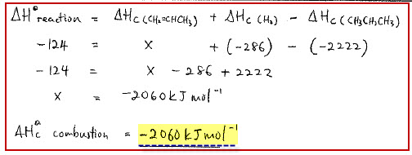
Ex 6
Calculate ΔH^{θ} _{c} ,enthalpy change for combustion of propene shown below
Using combustion /formation data
3CH₂ =CHCH₃ + 9/2O₂ → 3CO₂ + 3H₂O₆
Ans

Slide 45
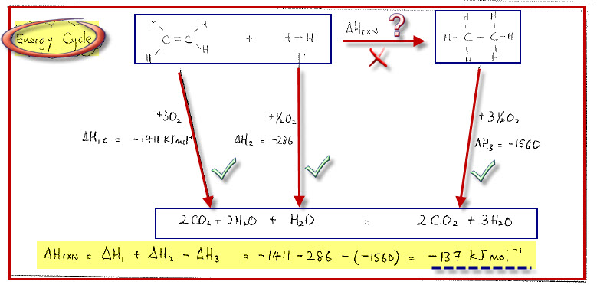
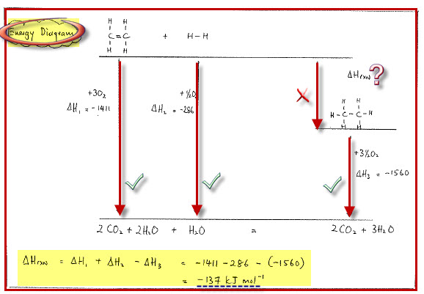
Ex 7
Calculate the ΔH^{θ} ,enthalpy change for the reaction below
C₂H₄ + H₂ → C₂H₆
Using Energy Cycle Diagram
Using Energy Level Diagram
Answer the same = -137kJmol⁻¹

Slide 46
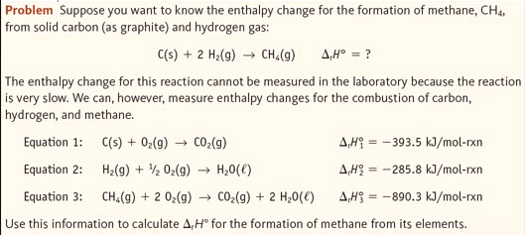
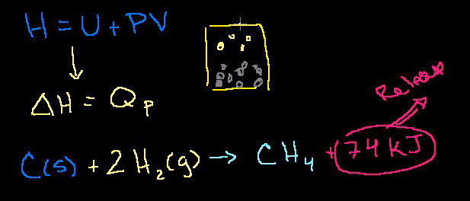
Video on Energetics and Enthalpy Calculation
Using equation method to solve ΔH
Using equation method to solve ΔH
Using formation enthalpy to solve ΔH (Khan Academy)
Concept on enthalpy, ΔH (Khan Academy)

Slide 47
Acknowledgements
Thanks to source of pictures and video used in this presentation
Thanks to Creative Commons for excellent contribution on licenses
http://creativecommons.org/licenses/
Prepared by Lawrence Kok
Check out more video tutorials from my site and hope you enjoy this tutorial
http://lawrencekok.blogspot.com

