Slide 1
Preparation of Solutions
And the calculations involved

Slide 2
MOLARITY
Molarity is: number of moles of a solute that are dissolved per liter of total solution.
A 1 M solution contains 1 mole of solute per liter total volume.

Slide 3
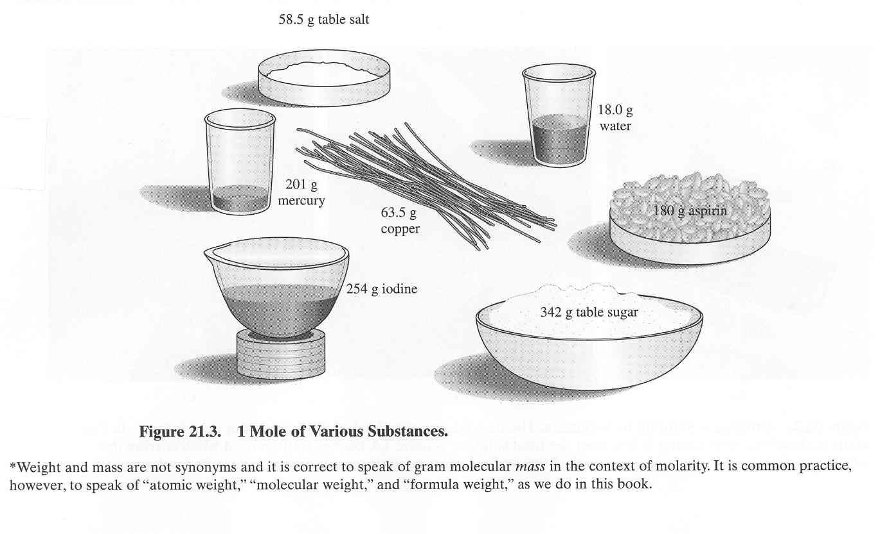
MOLE
How much is a mole?
From Basic Laboratory Methods for Biotechnology: Textbook and Laboratory Reference, Seidman and Moore, 2000

Slide 4
EXAMPLE: SULFURIC ACID
For a particular compound, add the atomic weights of the atoms that compose the compound.
H₂SO₄:
2 hydrogen atoms 2 X 1.00 g = 2.01 g
1 sulfur atom 1 X 32.06 g = 32.06 g
4 oxygen atoms 4 X 16.00 g = 64.00 g
98.08 g

Slide 5
EXAMPLE CONTINUED
A 1M solution of sulfuric acid contains 98.06 g of sulfuric acid in 1 liter of total solution.
"mole" is an expression of amount
"molarity" is an expression of concentration.

Slide 6
DEFINITIONS
"Millimolar", mM, millimole/L.
  A millimole is 1/1000 of a mole.
"Micromolar", µM, µmole/L.
  A µmole is 1/1,000,000 of a mole.

Slide 7
FORMULA
How much solute is needed for a solution of a particular molarity and volume? *(FW → Formula Weight = atomic weight or molecular weight)
grams solute X moles X Liters = g solute needed
1 mole Liters
or
FW X molarity x volume = g solute needed

Slide 8
EXAMPLE
How much solute is required to make 300 mL of 0.800 M CaCl₂?
(111.0 g) (0.800 mole) (0.300 L) = 26.64 g → 26.6
mole L

Slide 9
TO MAKE SOLUTION OF GIVEN MOLARITY AND VOLUME
1. Find the FW of the solute, from the label or by calculation
2. Determine the molarity desired.
3. Determine the volume desired.
4. Determine how much solute is necessary by using the formula.

Slide 10
PROCEDURE CONT.
5. Weigh out the amount of solute.
6. Dissolve the solute in less than the desired final volume of solvent.
7. Place the solution in a volumetric flask or graduated cylinder. Add solvent until exactly the required volume is reached, Bring To Volume, BTV.

Slide 11
Preparing A solution from a solid
How do we prepare 250 mL of 1.00M Na₂SO₄?
How do we prepare 250 L of 1.00M Na₂SO₄?
How do we prepare 1.00 L of 1.00M Na₂SO₄?

Slide 12
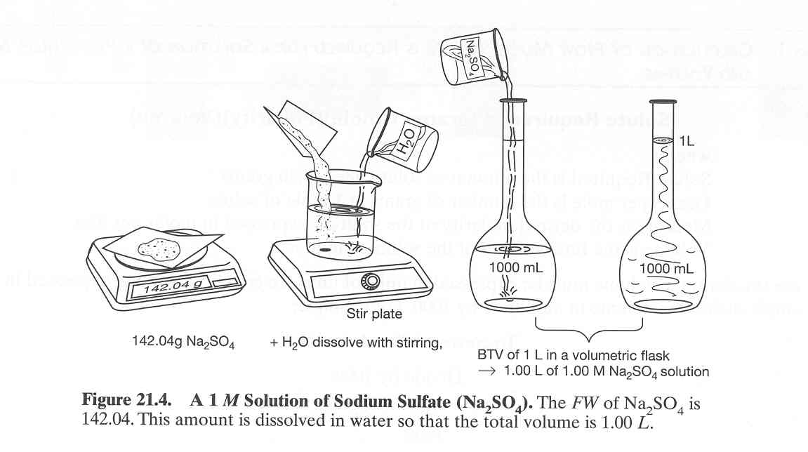
From Basic Laboratory Methods for Biotechnology: Textbook and Laboratory Reference, Seidman and Moore, 2000

Slide 13
Dilution
Suppose you have 0.500 M sucrose stock solution. How do you prepare 250 mL of 0.348 M sucrose solution ?
When a solution is diluted, solvent is added to lower its concentration.
The amount of solute remains constant before and after the dilution:
moles BEFORE = moles AFTER
C₁V₁ = C₂V₂
Concentration 0.500 M Sucrose
250 mL of 0.348 M sucrose
A bottle of 0.500 M standard sucrose stock solution is in the lab.
Give precise instructions to your assistant on how to use the stock solution to prepare 250.0 mL of a 0.348 M sucrose solution.
Notes:
1 Recognize the problem and state it clearly
Making the observation
i.e., there is a ball of fire in the sky

Slide 14
PERCENTS
% Concentration
% (w/w) =
% (w/v) =
% (v/v) =
X % is a fraction
numerator is X___
denominator is 100
Three variations on this theme.

Slide 15
EXAMPLE: BY PROPORTIONS
How would you prepare 500 mL of a 5.00 % (w/v) solution of NaCl?
By definition: 5 % = __5.00 g__
100 mL
5.00 g = ?___
100 mL 500 mL
? = 25.0 g = amount of solute
20 g of NaCl in
100 mL of total solution
  = 20% (w/v) solution.

Slide 16
BY EQUATION
How would you prepare 500 mL of a 5.00 % (w/v) solution of NaCl?
1. Total volume required is 500 mL.
2. 5.00% = 0.0500
3. (0.0500) (500 mL) = 25.0g

Slide 17
% EXAMPLE CONTINUED
4. 25.0 is the amount of solute required in grams.
5. Weigh out 25.0 g of NaCl. Dissolve it in less than 500 mL of water.
6. In a graduated cylinder or volumetric flask, bring the solution to 500 mL.

