Slide 1
Solubility
A Physical Property

Slide 2
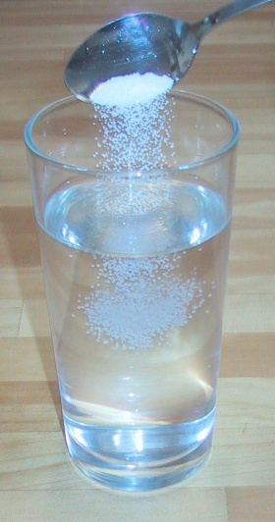
A Definition of solubility:
A measure of how much solute can dissolve in a solvent at a given temperature.
What is a solvent?
A substance that dissolves another substance.
Example: Water
What is a solute?
The part of a solution present in a lesser amount and dissolved by the solvent.
Example: Salt

Slide 6
Saturation
When you have added so much solute that no more dissolves, you have a saturated solution.
If you add more sugar to a saturated solution of iced tea, the extra sugar just settles to the bottom of the glass.
On the other hand, if you continue to dissolve more solute, you still have an unsaturated solution.

Slide 7
Working with Solubility
The solubility of a substance tells you how much solute you can dissolve before a solution becomes saturated.
Solubility is given for a specific solvent (such as water) under certain conditions (such as temperature).

Slide 18
Solubility in 100 g of Water at 0 Degrees Celsius (273K)
Compound | Solubility (g)
Carbon Dioxide Baking Soda Table Salt Table Sugar | 0.348 6.9 35.7 180

Slide 19
Factors Affecting Solubility
Pressure: Affects the solubility of gases. The higher the pressure of a gas over a solvent, the more gas can dissolve.
Solvents: Sometimes you can’t make a solution because the solute and solvent are not compatible. Have you ever tried to mix oil and vinegar? If you have, you can see that the oil and water separate (they are said to be immiscible).
For liquid solutions, the solvent affects how well a solute dissolves.

Slide 20
Factors Affecting Solubility
Temperature: For most solids, solubility increases as the temperature increases.
For example, the solubility of table sugar in 100 grams of water changes from 180 grams at 0 Celsius to 231 grams at 25 Celsius. What is happening?
Unlike most solids, gases become less soluble when the temperate goes up.
For example more carbon dioxide will dissolve in cold water than in hot water.

Slide 21
A Supersaturated Solution
When heated, a solution can dissolve more solute than it can at cooler temperatures.
If a heated saturated solution cools slowly, sometimes the extra solute will remain dissolved.
A supersaturated solution has more dissolved solute than is predicted by its solubility at the given temperature.

Slide 22
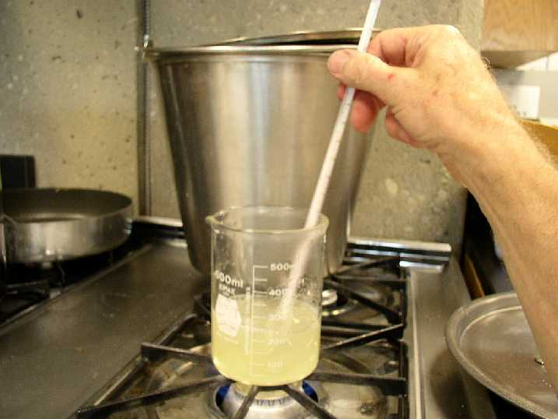
Solubility
Solubility is the maximum amount of solute that can be dissolve in 100g of solvent at a given temperature

Slide 23
Solubility
Example
What is the solubility of sugar in water at 25.0°C if 28.0 g of sugar can be dissolved in 250 ml of water?
(mass of 1ml of water is 1g)
Amount of sugar in 1g of water
= 28.0 g / 250 ml = 0.112 g/ml
Amount of sugar in 100g of water
= 0.112 g/ml x 100 ml = 11.2g
Solubility of sugar in water at 25°C is 11.2g per 100g of water

Slide 24
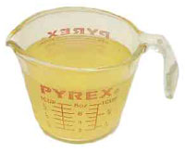
Solubility
Example
The solubility of salt in oil at room temperature is 25.0 g/100 ml. How much salt can be dissolved in 200 g oil at room temperature? (density of oil is 0.9g/cm³)
Volume of 200 g oil
= 200 g x 1 cm³ /0.9g
= 222 cm³ = 222 ml
= 25.0 g/100 ml x 222 ml
= 55.6g NaCl

