Slide 1
Gas Laws

Slide 2
GAS LAWS They’ll save your life!
Boyle’s Law
Charles’s Law
Lussac’s Law
Avogadro’s Law
Molar Volume
Combined Gas Law
Ideal Gas Law

Slide 3
P_{i}V_{i} = P_{f}V_{f}
High Pressure = Low Volume
Low Pressure = High Volume
Temperature does not change

Slide 4
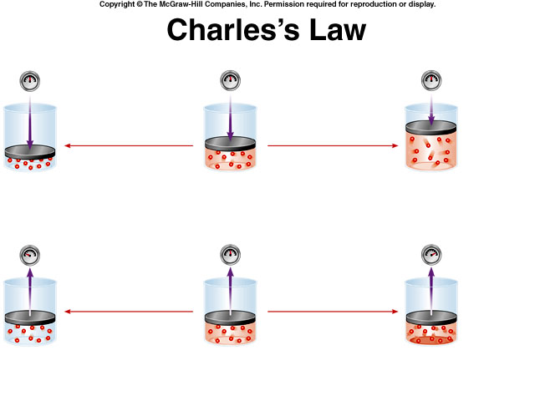
As the temperature increases, the gas expands (volume ↑).
As Temperature decreases, the gas contracts (volume ↓).
V_{i}/T_{i} = V_{f}/T_{f}
Pressure does not change

Slide 5
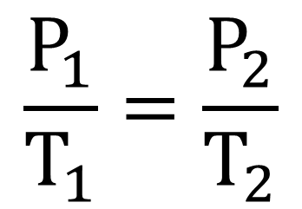
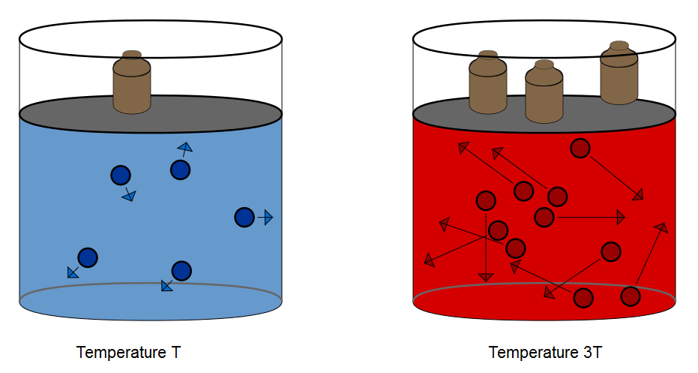
Lussac’s Law: Temperature & Pressure
Low Temperature = Low Pressure
High Temperature = High Pressure

Slide 6
COMBINED GAS LAW
Boyle’s, Charles’s, & Guy Lussac’s Laws may be combined algebraically to yield the
combined gas law:
Temperature must be in Kelvin
Pressure must be in atm, torr, Pa, or Kpa (but same for 1 & 2)
Volume must be in mL, L, cm³, or dm³ (but same for 1 & 2)

Slide 7
AVOGADRO’S LAW: Equal Volumes
At the same temperature and pressure, equal volumes of gases contain equal numbers of molecules (or atoms for the Noble Gases).
That means that if temperature and pressure remain constant,
V_{i}/n_{i} = V_{f}/n_{f}
V = volume
n = number of molecules
One of any gas contains 6.02x10²³ gas particles (Avogadro’s number)

Slide 8
V_{i}/n_{i} = V_{f}/n_{f}
Increasing the number of moles of gas causes an increase in the volume needed to keep constant pressure and temperature.
Pressure and Temperature remain unchanged

Slide 9
AVOGADRO’S LAW: Equal Volumes
Molar Volume – it follows from Avogadro’s law that the volume of a mole of any ideal gas at STP occupies the same volume as a mole of any other ideal gas at STP.
For ideal gases, this molar volume is 22.4 L @ STP (1 atm & 273K).

Slide 10
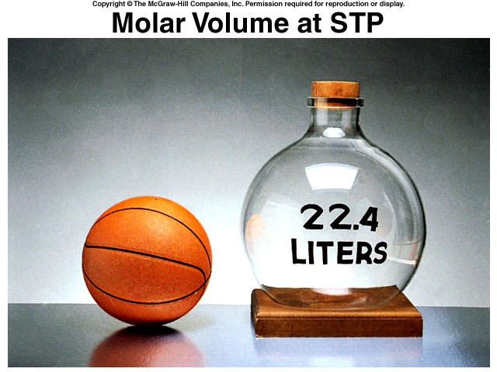
4 grams of He gas *
20 grams of Ne gas *
32 grams of O₂ gas *
46 grams of CO₂ gas *
1 mol of He gas *
1 mol of Ne gas *
1 mol of O₂ gas *
1mol of CO₂ gas *

Slide 11
IDEAL GAS LAW
PV = nRT
Using the proportionalities in Boyle’s Charles’s, and Avogadro’s Laws:
V = constant x 1/Pressure (fixed mass & temperature)
V = constant x Temperature (fixed mass & pressure)
V = constant x moles (fixed pressure & temperature)
V = constant x 1/P x T x n
R is the ideal gas constant.

Slide 12
IDEAL GAS CONSTANT
PV=nRT
P_{(atm,Kpa, mmHg, torr,)}V_{(mL,L,cm3,dm3)} = nRT_{(kelvin)}
*Depending on the units you use, will choose an R to cancel the units*
R = 8.314 L kPa/(mol K) We’ll use these
R = 0.0821 L atm/(K mol)
R = 8.31 dm³ kPa / K mol
R = 62.36 L torr / mol K

Slide 13
IDEAL GAS LAW to solve for Gas Density & Molecular Weight
Density = mass / volume
d = m/V
Substitute into ideal gas law:
PV=nRT
Molecular Weight = mass / moles
M = m/n
Substitute into ideal gas law:
PV=nRT

Slide 14
GAS LAWS REVIEW
Boyle’s Law P_{i}V_{i} = P_{f}V_{f}
Charles’s Law V_{i}/T_{i} = V_{f}/T_{f}
Lussac’s Law P_{i}/T_{i} = P_{f}/T_{f}
Avogadro’s Law V_{i}/n_{i} = V_{f}/n_{f}
Molar Volume (STP) 22.4 L @ 1atm and 273 K
Molar Volume (SATP) 24.8 L @ 100kPa and 298 K
Combined Gas Law
Ideal Gas Law PV = nRT

