Slide 1
The Digestive System (Part 2)
6.2

Slide 2
Small Intestine
Longest part of digestive tract
Some physical digestion through segmentation
Chyme sloshes back and forth between segments as circular muscles briefly contract
Main function
Complete digestion of macromolecules and absorb the subunits
Notes:
Named for its diameter

Slide 3
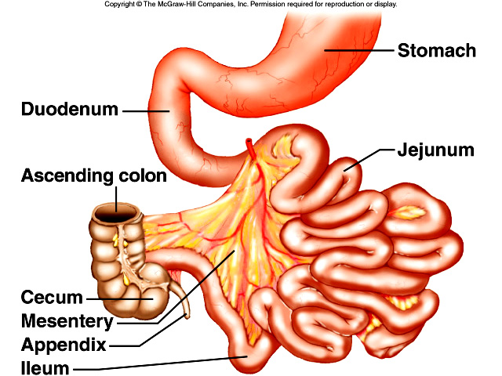
Structures of the Small Intestine
3 regions:
Duodenum – 25 cm
Jejunum – 2.5 m
Ileum – 3 m

Slide 4
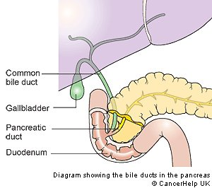
Ducts in the Small Intestine
Ducts from the liver gallbladder and pancreas join in one duct that enters the duodenum

Slide 5
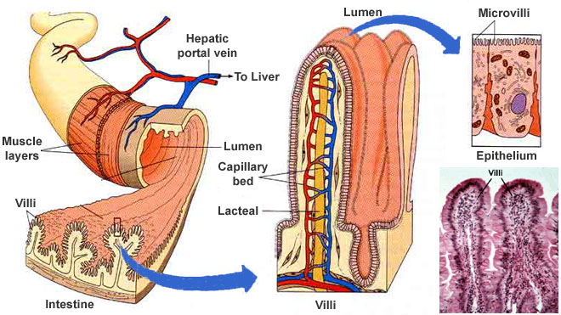
Max Surface Area = Max Absobtion
Folds in the lining of the intestine are covered with millions of villi
Villi are covered with millions of microscopic microvilli

Slide 6
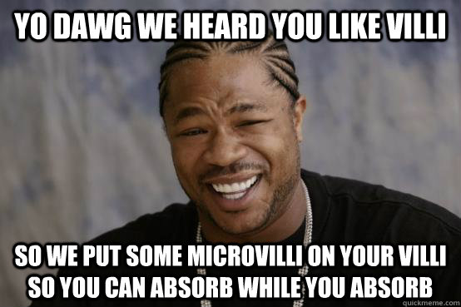

Slide 7
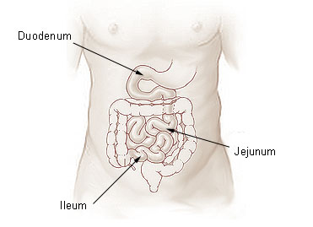
The Jejunum (middle) & Ileum (end)
Jejunum has more folds than duodenum
Continues the breakdown of food
Ileum has fewer, smaller villi
main purpose is absorption, and pushing remaining undigested food toward the large intestine

Slide 8
Accessory Organs
Enzymes are secreted from microvilli of the small intestine to help digest materials in chyme
Substances secreted from 3 organs near the stomach & small intestines also help digestion
Accessory organs
Vital to digestive process, but not physically part of the digestive tract

Slide 9
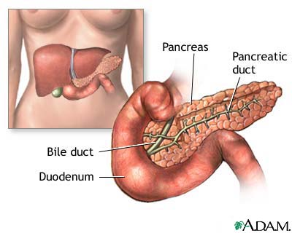
Accessory Organs: Pancreas
1 L of pancreatic fluid/day
Contains many enzymes
Trypsin & chymotrypsin → proteases that digest proteins
Pancreatic amylase → carbohydrase that digests starch
Lipase → digests fat

Slide 10
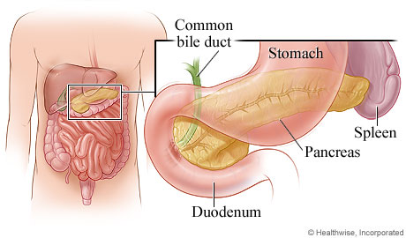
Accessory Organs: Pancreas
Breaks nutrients down into small enough molecules to be digested and absorbed by small intestine
Also contains bicarbonate to neutralize the HCl from the stomach (resulting pH → 8)

Slide 11
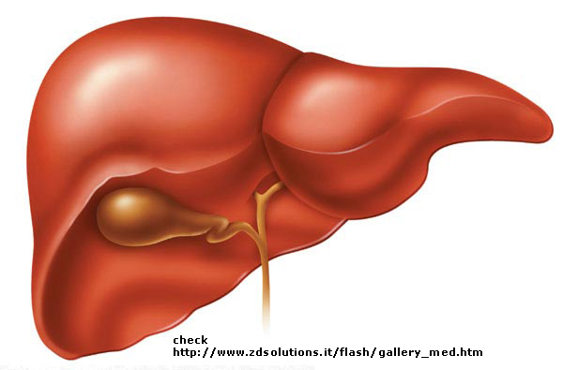
Accessory Organs: Liver
Largest internal organ
Suspend smaller fat molecules in water, provide greater surface area for lipases to attack, so digestion occurs more quickly

Slide 12
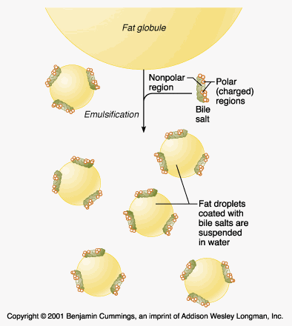
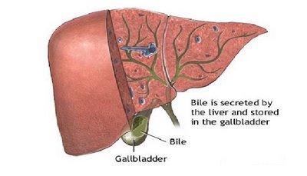
The Liver
Secretes bile
Bile pigments → no digestive function; old red blood cells, eliminated through feces
Bile salts → assist in fat digestion; they are emulsifiers
Notes:
Emulsifiers are partly soluble in water, and partly soluble in fats. They break up larger fat molecules into smaller ones, and surround them so that they stay suspended in water (the same way a detergent acts on grease).

Slide 13
Accessory Organs: Gall Bladder
Stores bile between meals
Chyme that contains fat stimulates the gall bladder to contract
Bile travels from the gall bladder to the duodenum via a duct shared with the liver

Slide 14
Digestion and Absorption in the Small Intestine
Enzymatic Digestion is performed by
Carbohydrases
Lipases
Proteases
Nucleases
Note P 225, Fig. 6.21 and Table 6.3
Notes:
Have students do the Absorption of Nutrients in Small Intestine Worksheet. (BLM 6.2.7) Explain to them that they will be doing this rather than take notes on this section.

Slide 15
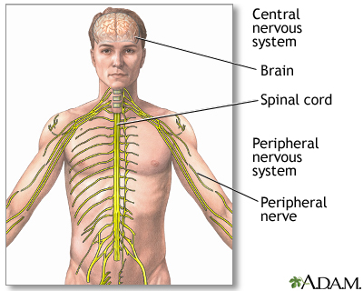
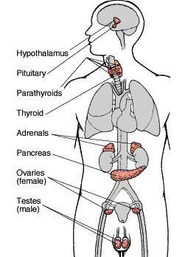
Regulation of Processes in the Small Intestine
Regulated by nervous system and endocrine system
Chemical signals from food → nervous system → salivary & gastric secretions

Slide 16
Stomach Acid & Negative Feedback
Proteins in stomach → gastrin → HCl & pepsin
Lowered pH inhibits further secretion of gastrin, therefore no more HCl & pepsin secreted (negative feedback)
Gastrin Released
Increased gastric juices
Lower pH
(Acid)
CGRP
(a protein)
Somatostatin
Release

Slide 17
Controlling the Stomach
Passage of chyme from stomach to duodenum inhibits stomach contractions through secretions of
Secretin
released when chyme has high acidity; stimulates pancreas to release more bicarbonate
CCK (cholecystokinin)
Released when chyme has high fat content; stimulates increased pancreatic & gall bladder secretions
GIP (gastric inhibitory peptide)
Released when chyme has a high fat content; allows fatty meals to remain in stomach longer than non-fatty meals

Slide 18
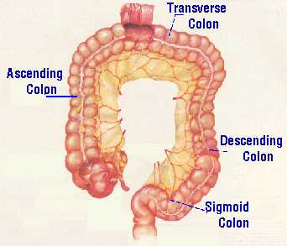
The Large Intestine
Main function:
Concentrate and eliminate waste materials (500 mL of indigestible residue is reduced to 150 mL of feces)
Absorb water and salts
Notes:
Assign BLM 6.2.7, pg 231 #1-6

