Slide 1
Health and the Digestive System
6.3

Slide 2
Common Digetive Disorders
Ulcers
Inflammatory Bowel Disease
Hepatitis
Cirrhosis
Gallstones

Slide 3
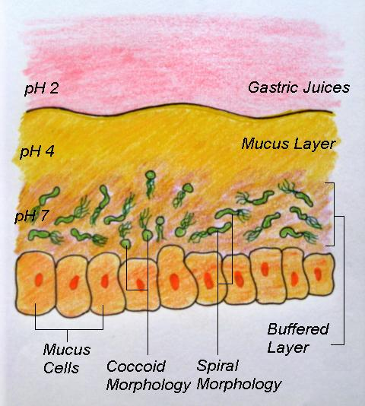
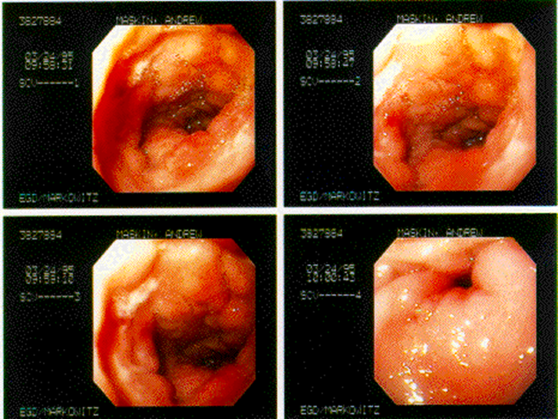
Ulcers
Thick layer of protective mucus lining the stomach is eroded
Most ulcers are caused by bacteria (Heliobacter Pylori) that attach to the stomach wall

Slide 4
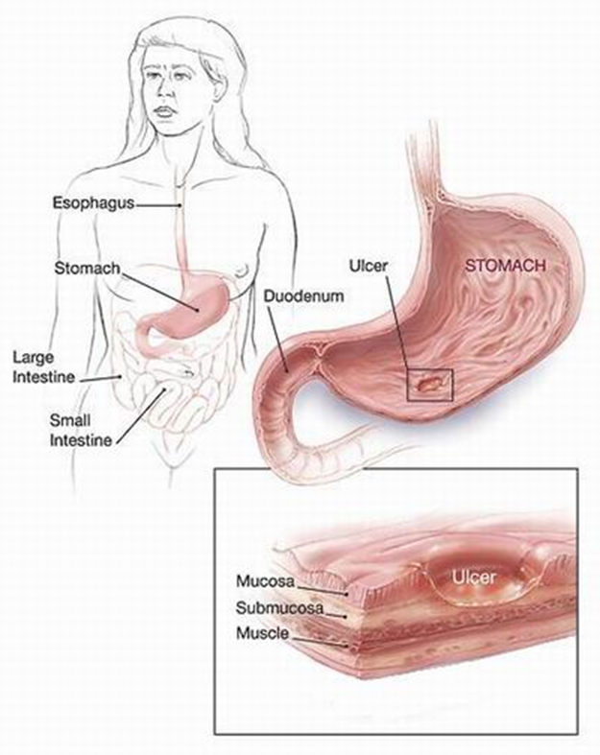
Factors & Treatments
Other contributing factors: alcohol, smoking, caffeine, stress
Treatments: antibiotics, medications that reduce secretions of stomach acid, or lifestyle changes

Slide 5
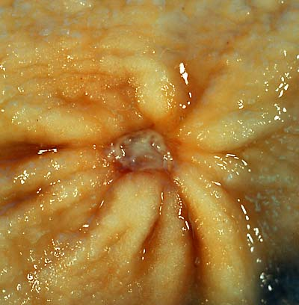
mmmm… McUlcers

Slide 6
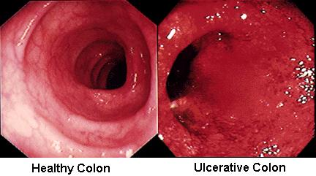
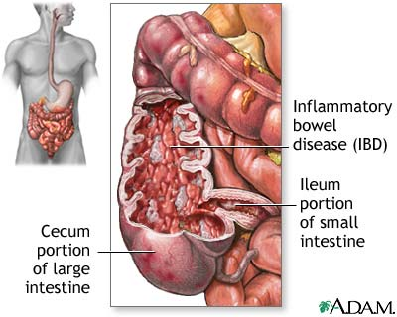
Inflammatory Bowel Disease
General name for any disease causing inflammation of the intestines

Slide 7
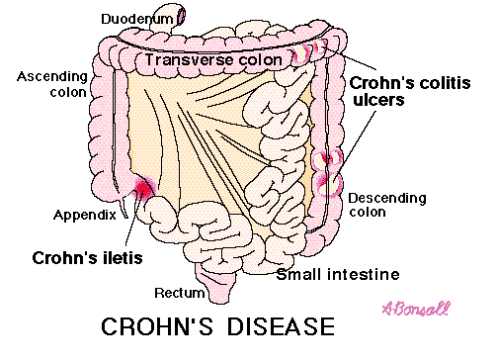
Crohn’s Disease
Normally affects ileum, but can attack any part of the digestive tract
Diarrhea and sometimes rectal bleeding
Might be an autoimmune disorder (body attacks itself)
Treatment: medication to reduce pain & inflammation; sometimes surgery to remove affected portions of the intestines

Slide 8
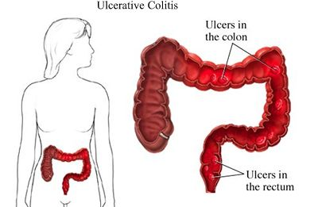
Colitis
Inflammation and ulceration of the lining of the colon
Symptoms: loose, bloody stool; abdominal pain; cramping
Treatment: medications to reduce pain & inflammation, surgery to remove entire colon and rectum (last resort)
External opening is created for waste

Slide 9
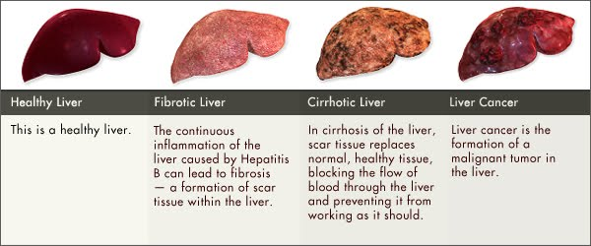
Disorders of the Accessory Organs
Liver
Hepatitis → inflammation of the liver
Hepatitis A → drinking contaminated water
Hepatitis B → sexual transmission, more contagious than AIDS; vaccine available
Hepatitis C → transmission through blood; no vaccine available

Slide 10
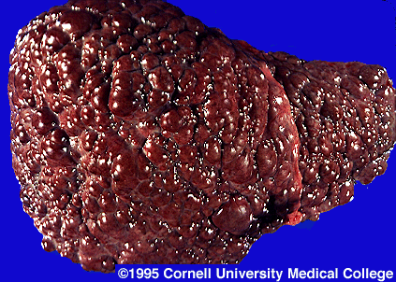
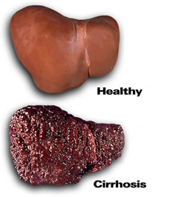
Cirrhosis
Scar tissue replaces healthy tissue
Chronic alcoholism, Hepatitis C are common causes
Liver can’t function properly
Treatment: transplantation after liver failure

Slide 11
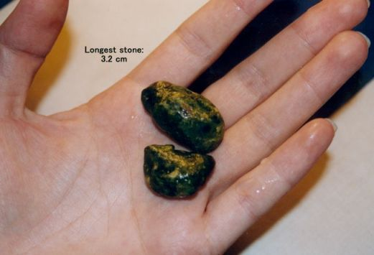
Gallstones
Cholesterol in bile can precipitate (settle) out of the bile and form crystals, which can grow until they cause severe pain/problems

Slide 12
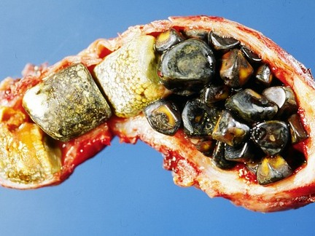
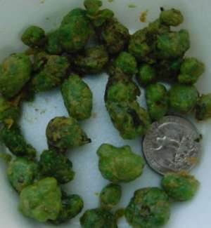
Factors & Treatments
3 factors: obesity, alcohol intake, heredity
Treatment: medications, ultrasound shock-therapy, or in serious cases, surgical removal of gall bladder

Slide 13
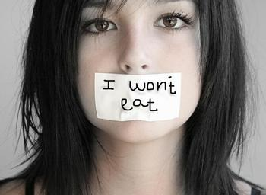
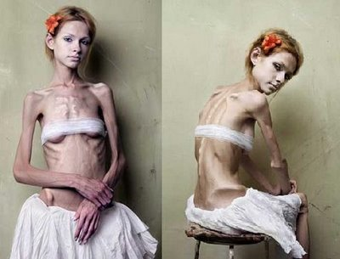
Anorexia Nervosa
A morbid fear of gaining weight/poor self-image
Body mass is <85% of ‘healthy’ body mass
Starvation & related symptoms: low blood pressure, irregular heartbeat, digestive & other systems shut down
Treatment: physical treatment first, then psychological

Slide 14
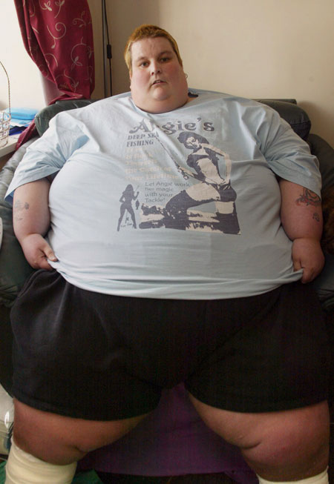
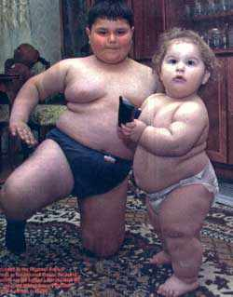
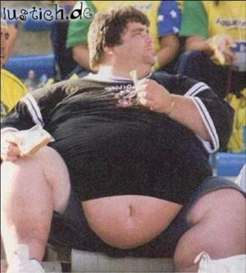
Obesity
Body mass is >20% of ‘healthy’ body mass
Hormonal, genetic, and lifestyle factors
Associated conditions: high blood pressure, joint and bone impairment
Notes:
Assignment Pg 238, Q# 1-5, Vocabulary Handout

