Slide 1
Bonding
A bond is any force that holds two atoms together.
There are four active forces that occur when any two atoms are near each other
e⁻
Blue is attractive (two forces)
Red is repulsive (two forces)
e⁻

Slide 2
The only way that a bond will naturally form is if the two attractive forces overcome the two repulsive forces.
When a bond does form, the bonding electrons will acquire a lower state of energy. They become more stable. This leads to a general energy principle on bonding;
“Two atoms will bond only when they have less energy together than when they are separate (or if you add energy to them)”.

Slide 3
There are two basic types of bonds;
ionic and covalent bonds.
Ionic bonds occur when an outer electron is transferred from one atom to another producing an anion and a cation which attract.
A covalent bond occurs between two atoms of similar attraction so they “share” some of their valence electrons.

Slide 4
There are many factors that affect the ability of two atoms to bond, but the two main factors determining the strength of an ionic bond are:
the size of the atom or its radius
(number of orbitals).
how positive the nucleus is
(number of protons).
Larger metal atoms with more orbitals (then those above) and less protons (then those to the right) can most easily lose their electrons. (Down and to the left on the periodic table).

Slide 5
Smaller nonmetal atoms with less orbitals (then those below) and more protons (then those to the left) can most easily gain extra electrons. (Up and to the right on the periodic table).
It is possible to compare the strengths of ionic bonds by looking at these two factors.
Ionization energy is the amount of energy required to remove the outermost electron of an atom. This produces an ion.

Slide 6
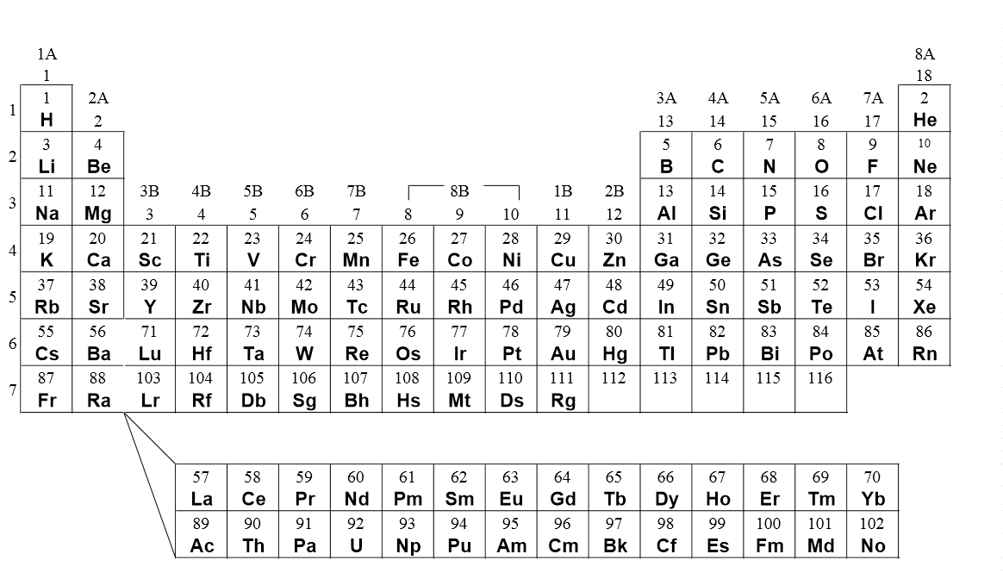

Slide 7
It is possible to depict molecules and their covalent bonds. Scientists have developed rules that allow us to predict how electrons are being shared. One major contributor to these rules was a scientist named Lewis. The foundation for Lewis theory relies on two basic principles:
Covalent bonds only occur between nonmetals, since they have similar attractions.
All atoms want to have a full outer orbital. (octet rule)

Slide 8
Rules for Lewis bond diagrams
Each atom in a molecule has an individual symbol.
All valence electrons are indicated.
Any unpaired electrons are available for bonding.
Paired electrons are called “lone pairs” and do not bond.
The atom with the most unpaired electrons is the central atom.
All electrons must pair up and the outer orbital is full.

Slide 9
Lewis diagrams of elements
valence electrons | 1 | 6 | 5 | 7 | 4
nonbonding pairs | 0 | 2 | 1 | 3 | 0
unpaired electrons | 1 | 2 | 3 | 1 | 4
typical # of bonds | 1 | 2 | 3 | 1 | 4

Slide 10
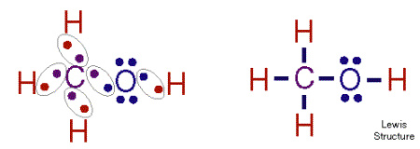
Try drawing Lewis structures for the following
H₂O
PCl₃
CH₃OH

Slide 11
End

