Slide 1
Intermolecular Forces a.k.a. van der Waal’s Forces
Intramolecular
H
O
δ-
δ+
H
Intermolecular
H
O
δ-
δ+
H

Slide 2
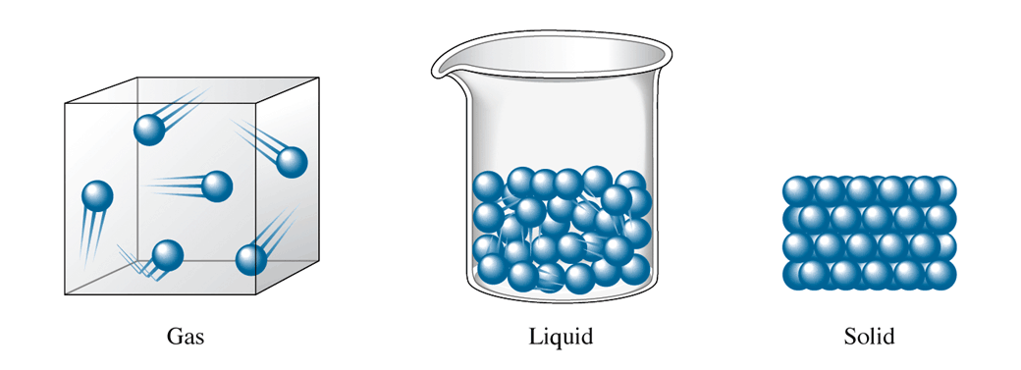
States of Matter
Attraction between molecules increasing

Slide 3
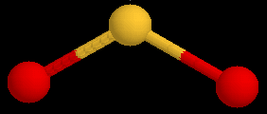
Intermolecular Forces a.k.a. van der Waal’s Forces
Attractive force between molecules
Much weaker than chemical bonds within molecules

Slide 4
Types of Intermolecular Forces
London Dispersion Forces: an attractive force acting between all molecules
* attraction of electrons of one atom to nucleus of another atom
* very weak force
* increases in strength as molar mass increases (more electrons)

Slide 5
London Forces
A temporary dipole is induced in a non polar molecule due to electron movements.
These INDUCE similar but opposite forces in neighboring molecules which cause weak momentary attractions.
These are the WEAKEST attractive forces that exist between molecules.
London forces get stronger as the molecule/atom gets bigger because there are more electrons that can create dipoles..
Two non polar molecules.
Electrons moving
Electrons repelled
δ+ δ−
δ+ δ−
Temporary dipole
Induced dipole
Weak short lived attraction
Example:
I₂ & CCl₄

Slide 6
Dipole-Dipole Forces: attractive force acting between oppositely charged ends of polar molecules.
* medium strength
* strongest when molecules close together

Slide 7
Dipole - Dipole Forces
Attractive forces that exist between molecules that have permanent dipoles.
These exist in any polar substance.
In order to create a dipole or polar molecule, the molecule must have:
Polar bonding
An asymmetrical shape (not symmetrical)
The following would exhibit Dipole Dipole forces
H₂S yes – polar bonds & asymettrical, CO₂ No - symmetrical, C₂H₄ No – no polar bonds.
dipole
dipole
Cl
δ+
Cl
δ-
δ+
δ-
H
H
Attractive force
Example:
H-Cl, H-Br, H₂S

Slide 8
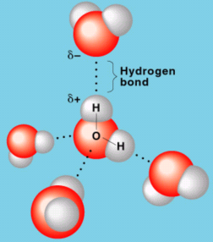
Hydrogen Bonding: attractive force between positive hydrogen atom of one molecule and N, O or F in another molecule
* strongest force
* NOT a chemical bond

Slide 9
Predict IMF acting between molecules of:
F₂
- London dispersion
PH₃
- dipole-dipole, London dispersion
CH₄
- London dispersion
H₂O
- Hydrogen bonds, dipole-dipole, London dispersion

Slide 10
Properties of Liquids
Boiling Point: Temperature at which a liquid becomes a gas
* It represents the amount of energy to overcome the intermolecular forces holding the liquid molecules together
* Substances with greater intermolecular forces have higher boiling points

Slide 11
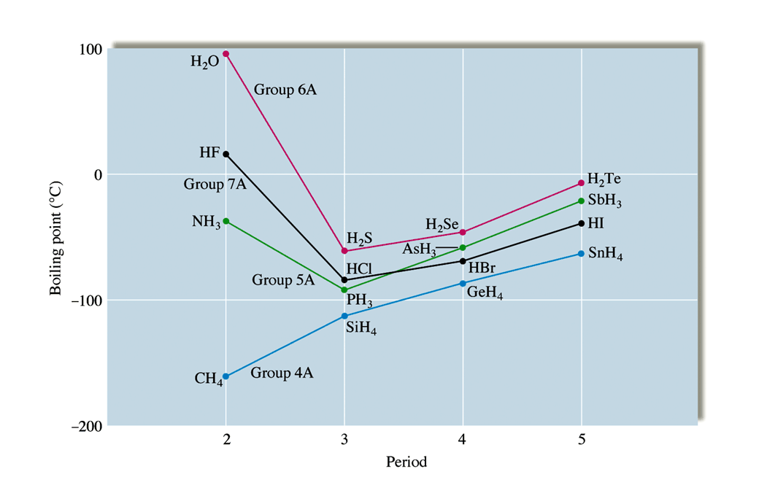
Boiling point is higher for molecules with greater intermolecular forces

Slide 12
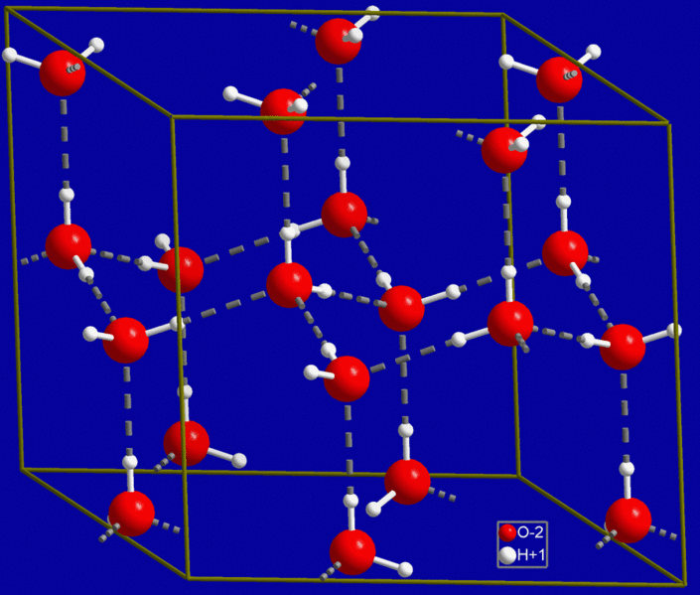
Hydrogen Bonding in Ice
Oxygen atoms
Hydrogen bonds
Hydrogen atoms
http://commons.wikimedia.org/wiki/File:Hex_ice.GIF licence behind image

Slide 13
Ion-Dipole Forces
Ion - dipole forces-
arise from the attraction between an ion and the oppositely charged pole of a polar molecule
Ionic substance (sodium chloride) dissolving in a polar solvent (water).
H
O
δ+
δ-
H
H
O
δ+
δ-
Na⁺
H
H
O
δ-
δ+
Example:
Salt & Water
H

Slide 14
Dissolution (dissolving)
Salt (NaCl) dissolves in water spontaneously.
H
δ+
δ-
O
δ+
δ-
H
Cl⁻
δ+
δ-
δ+
δ-
Na⁺
The charged ends of the dipole would be attracted to the opposite charge on the ionic solid.

Slide 15
The dissolution process
Solvent molecules (water) are attracted to the solute particles as they have similar forces of attraction between them.
Solvent: water -hydrogen bonding (electrostatic forces - strong)
Cl⁻
δ+
δ-
Na⁺
δ+
δ-
δ+
δ-
Cl⁻
Na⁺
δ+
δ-
δ+
δ-
Solute: Sodium Chloride - ionic bonds strong electrostatic attraction of oppositely charged ions.
δ+
δ-
Since the forces in the SOLVENT are similar to those in the SOLUTE the solvent particles are able to substitute for and break up the forces in the solute material - which is then literally ripped apart!

Slide 16
Iodine + Water
Iodine is only sparingly soluble in water?
Water contains hydrogen bonds,
iodine contains london forces.
The bonds have very different strengths.
Iodine molecules can not substitute for water molecules in the solution - there is very weak attraction between the solvent particles (H₂O) and solute particles (I₂).
Dipole - induced dipole forces exist between water and iodine molecules.

Slide 17
KMnO₄ + Water
Potassium permanganate is very soluble in water.
KMnO₄ is an ionic substance.
Water contains hydrogen bonds,
ION - DIPOLE FORCES EXSIST between these two substances.
These are relatively strong intermolecular forces and that accounts for the solubility of ionic substances in polar solvents.

Slide 18
KMnO₄ + Hexane
Potassium permanganate is insoluble in hexane.
KMnO₄ is an ionic substance
Hexane is non-polar - v.d. Waals (london) forces
Ion - induced dipole forces would exist between solvent molecules - these are VERY weak interactions
The solubility is VERY LOW.

Slide 19
Ethanol + Iodine
Iodine is soluble in Ethanol (C₂H₅OH)
INTERMOLECULAR FORCES
Iodine - v.d. Waals (London) forces
Ethanol - hydrogen bonds and london forces
Dipole - induced dipole forces would exist between solvent and solute as well as v.d.Waals (London) forces
The london forces between ethanol molecules could be substituted for london forces in the iodine and so iodine is soluble in ethanol.
Ethanol + KMnO₄
Potassium permanganate is soluble in Ethanol (C₂H₅OH).
The ion-dipole interactions between KMnO₄ and ethanol molecules are strong enough to cause dissolution of the ionic salt.

Slide 20
Solubility Rules
Polar solutes will be soluble in ………………solvents.
Non-polar solutes will be soluble in …………… solvents.
Non-polar solutes will NOT be soluble in ………... solvents.
Polar solutes will NOT be soluble in ………………. solvents.
…………………………………….

Slide 21
Solubility Rules
Polar & Ionic solutes will be soluble in polar solvents.
Non-polar solutes will be soluble in non-polar solvents.
Non-polar solutes will NOT be soluble in polar solvents.
Polar & Ionic solutes will NOT be soluble in non-polar solvents.
LIKE DISSOLVES LIKE!

Slide 22
Homework Questions
P. 109 # 1-3, 5
P. 117 # 1-5

