Slide 1
Tutorial on Titration curve for acids bases and indicators used for titration .
Prepared by
Lawrence Kok
http://lawrencekok.blogspot.com

Slide 2
Titration Strong Acid + Strong Base

Slide 3
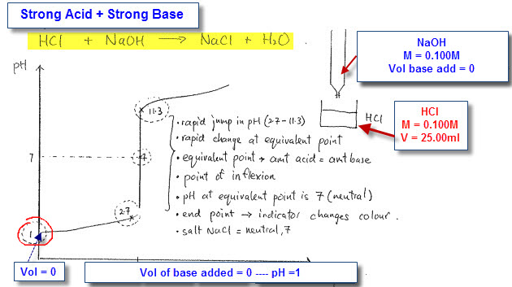
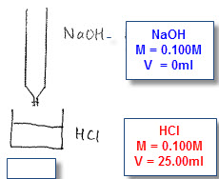
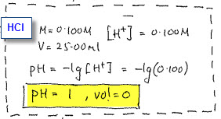
Titration Strong Acid + Strong Base
HCI
M = 0.100M
V = 25.00ml
Calculation for pH
Volume base added = 0ml, pH is 1
Vol acid left is 25ml

Slide 4
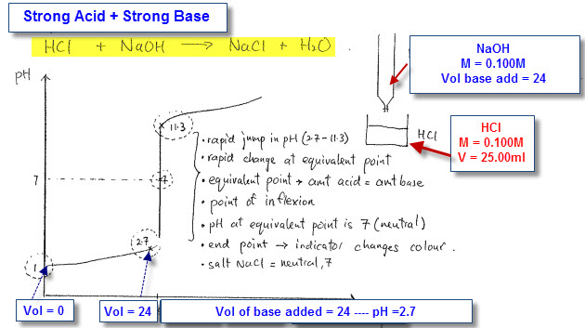
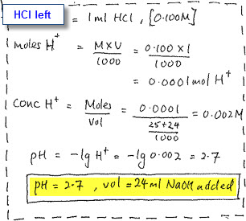
Titration Strong Acid + Strong Base
Volume base added = 24ml, pH is 2.7
Calculation pH
Vol acid after titration = 1ml

Slide 5
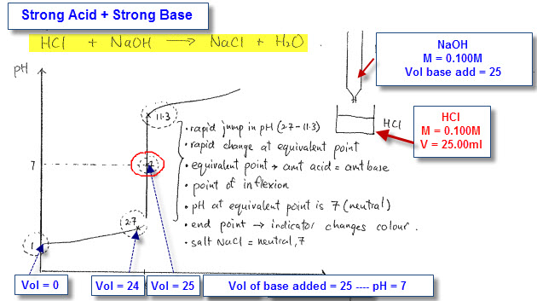
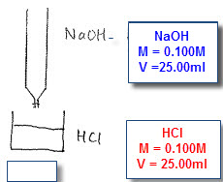
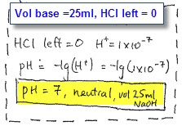
Titration Strong Acid + Strong Base
Equivalent point
Amt acid = Amt base
=
Volume base added = 25ml, pH is 7
Vol acid left is 0ml
(Neutralization point)

Slide 6
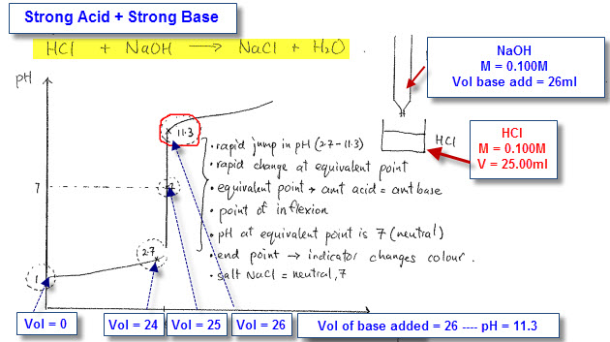
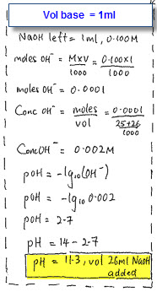
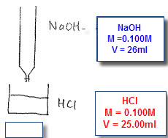
Titration Strong Acid + Strong Base
Calculation for pH
Volume base added = 26ml, pH is 11.3
Base
M = 0.100M
V = 1ml
1ml base left after titration

Slide 7
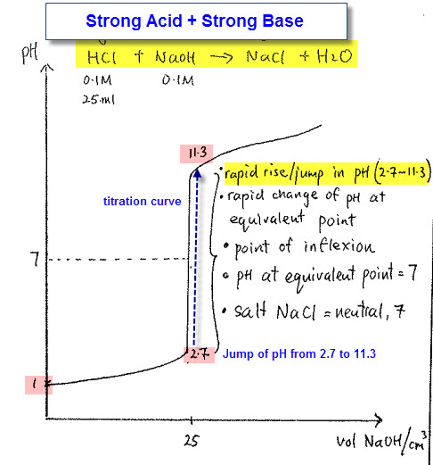
Titration Strong Acid + Strong Base
Titration curve for strong acid/base
Volume at equivalent point = 25ml
Rapid jump/rise in pH 2.7 – 11.3
Equivalent point,
Amt acid = Amt base
pH at equivalent point = 7
Salt is neutral

Slide 8
Titration Weak Acid + Strong Base

Slide 9
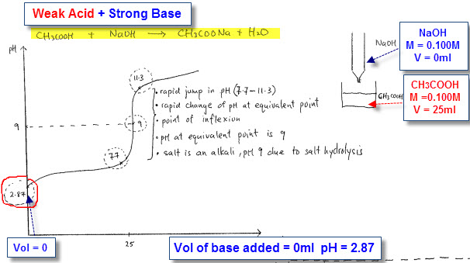
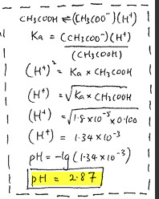
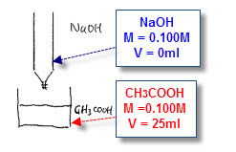
Titration Weak Acid + Strong Base
Calculation for pH
Volume base added = 0ml, pH 2.87
>
25ml of acid left after titration

Slide 10
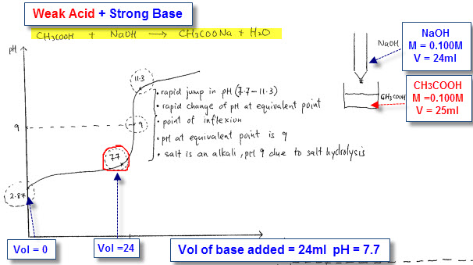
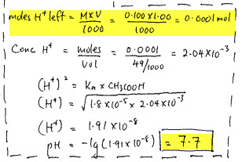
Titration Weak Acid + Strong Base
Calculation for pH
Volume base added = 24ml, pH 7.7
>
1ml acid left after titration

Slide 11
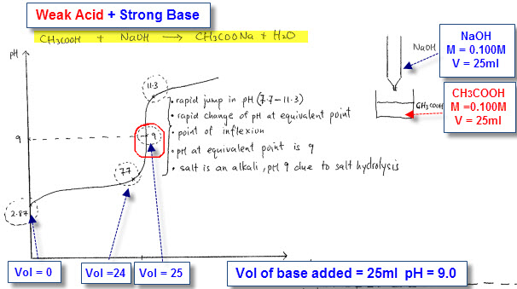
Titration Weak Acid + Strong Base
Equivalent point
Amt acid = Amt base
Volume base added = 25ml, pH 9.0
Vol acid left is 0ml
(Neutralization point)
=
Basic salt due to salt hydrolysis
CH₃COONa → CH₃COO⁻ + Na
CH₃COO- is weak conjugate base
pH = 9.0

Slide 12
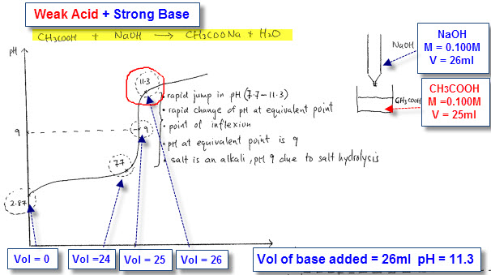
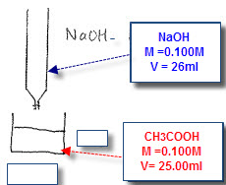
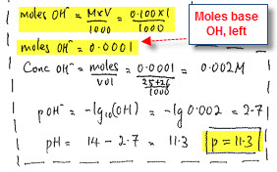
Titration Weak Acid + Strong Base
Volume base added = 26ml, pH 11.3
Calculation for pH of base
1ml of base left after titration
<

Slide 13
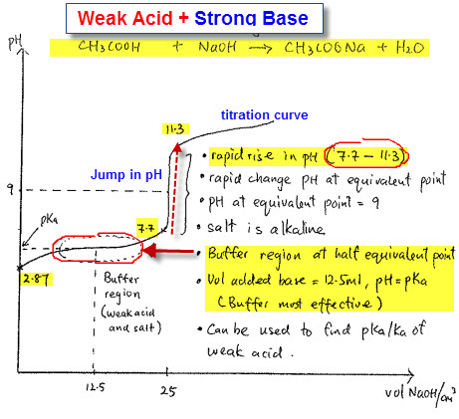
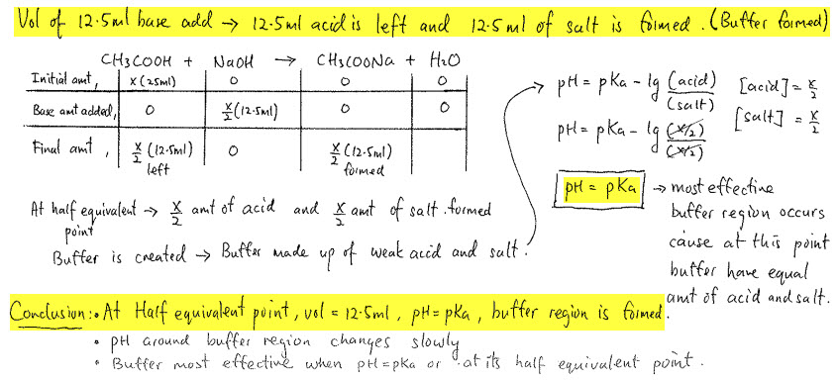
Titration Weak Acid + Strong Base
Buffer region occurs
At half equivalent point
Amt weak acid = Amt salt
Vol base added is 12.5ml
pH = pKa
Buffer region calculation

Slide 14
Titration Strong Acid + Weak Base

Slide 15
Titration Strong Acid + Weak Base
1
Vol base added = 0ml
pH = -log (H+)
pH = -log (0.100)
pH = 1
2
Vol base added = 24ml
Vol of acid left is 1ml
pH = -log (H+)
pH = - log (0.002)
pH = 2.7

Slide 16
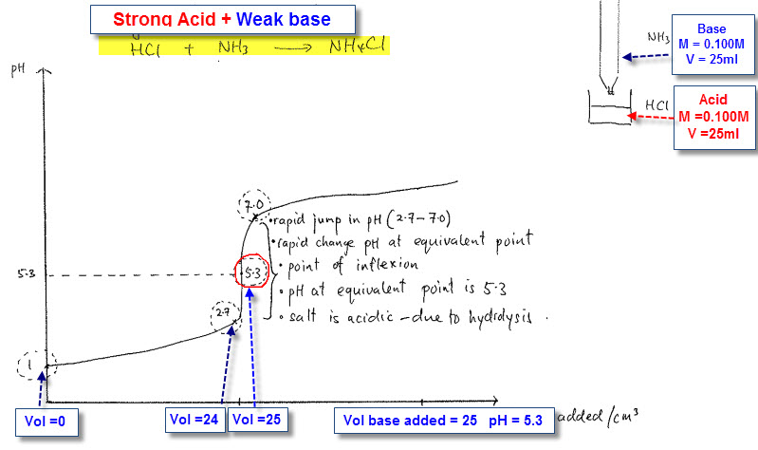
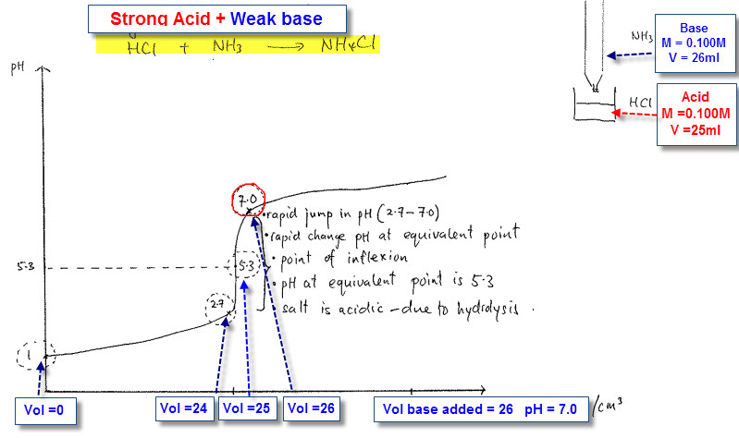
Titration Strong Acid + Weak Base
3
Vol base added = 25ml
=
Equivalent point is reached
Amt acid = Amt base
Salt is NH4CI (weak acid)
Acidic salt
pH = 5.3 due to hydrolysis
Vol base added = 26ml
4
<
Vol of base left = 1ml
pH = -log (H+)
pH = -log (10-7)
pH = 7

Slide 17
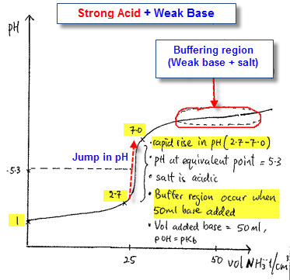
Titration Strong Acid + Weak Base
Buffer region occurs
At half equivalent point
Amt Weak base = Amt salt
Vol base added is 50ml
pOH = pKb
Buffer region calculation

Slide 18
Titration Weak Acid + Weak Base

Slide 19
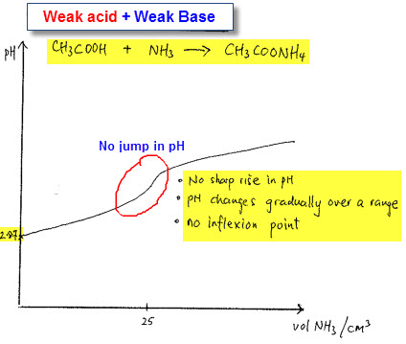
Titration Weak Acid + Weak Base
No sharp rise in pH
pH changes gradually over a range
No inflexion point

Slide 20
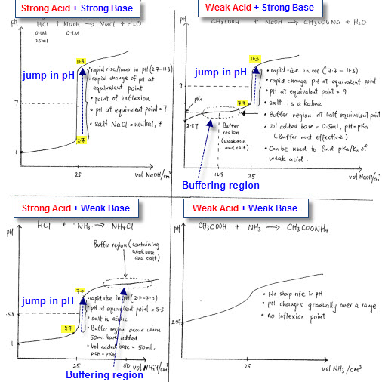
Conclusion

Slide 21
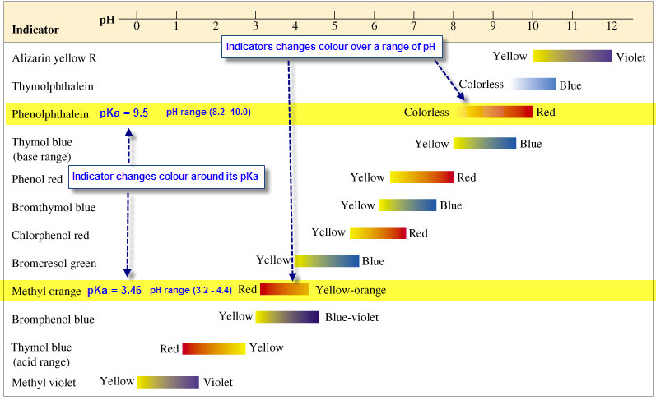
Indicators
Suitable indicators must be chosen for different titrations
Taken from: http://cwx.prenhall.com/bookbind/pubbooks/hillchem3/medialib/media_portfolio/15.html

Slide 22
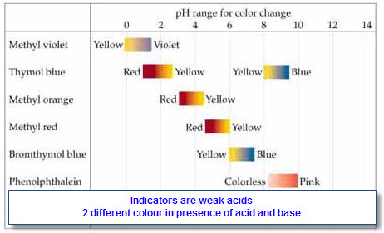
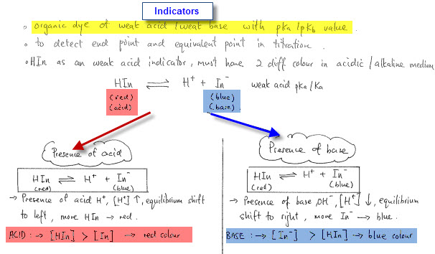
Indicators
Taken from: http://wps.prenhall.com/wps/media/objects/3312/3392119/blb1604.html
Indicators
Weak acids with pKa
Molecule (HIn) and ions (In-) form has two
diff colours in diff medium
Hin is RED, In- is BLUE
Acid, shift equi to left (turn RED)
Base, shift equi to right (turn BLUE)

Slide 23
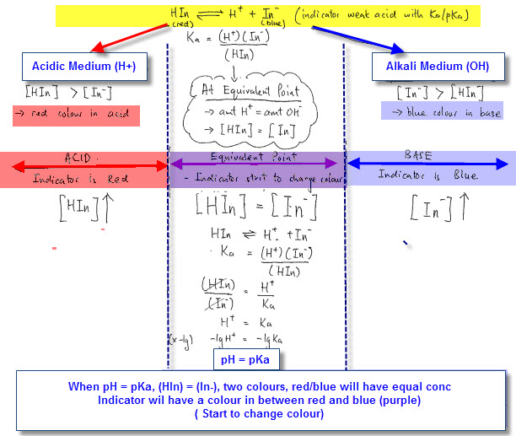
Indicators
Indicator start to change colour when pH of a solution is equal to its pKa
Colour change when pH = pKa

Slide 24
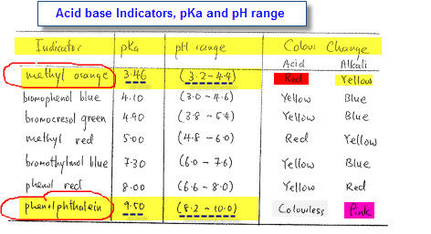
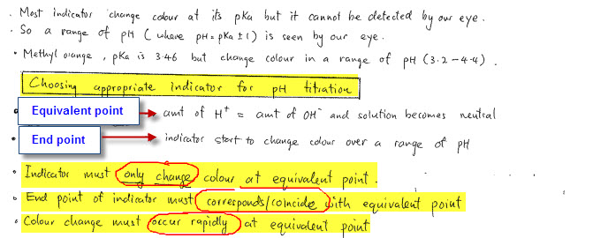
Indicators with its pKa and pH range
Methyl orange, changes colour over pH range (3.2-4.4)
Phenolphthalein, changes colour
over pH range (8.2 – 10.0)
Equivalent point -Amt acid = Amt base
End point = indicator change colour

Slide 25
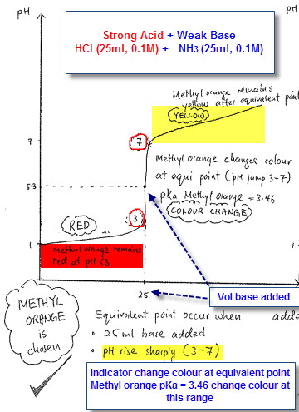
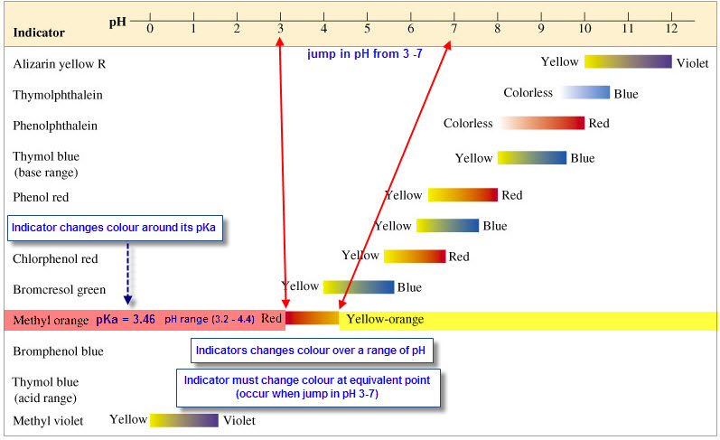
Titration Strong Acid + Weak Base
At equivalent point, 25ml
Jump rise in pH from 3 -7
Methyl orange change colour in that range. Why?
pKa methyl orange = 3.46 fall in that pH range (3-7)
End point does coincide with equivalent point
Methyl orange is chosen

Slide 26
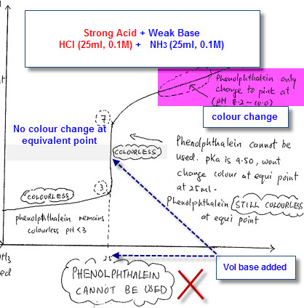
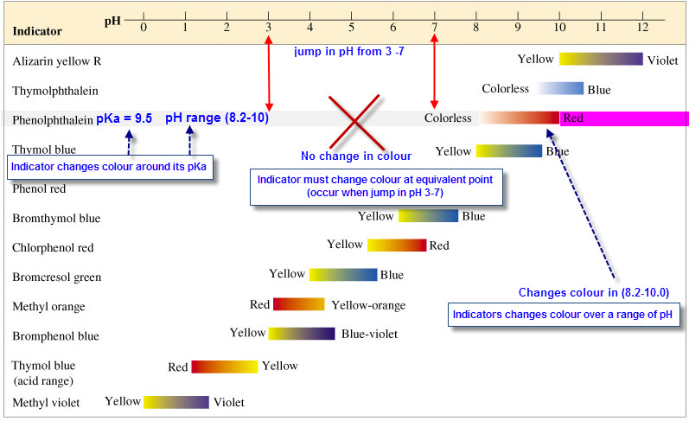
Titration Strong Acid + Weak Base
At equivalent point, 25ml
Jump rise in pH from 3 -7
Phenolphthalein remain colourless. No colour change
pKa phenolph = 9.5, change colour at pH (8.2-10)
End point is 9.5 but equivalent point is from 3-7
End point DOES NOT coincide with equivalent point
Phenolphthalein cannot be used

Slide 27
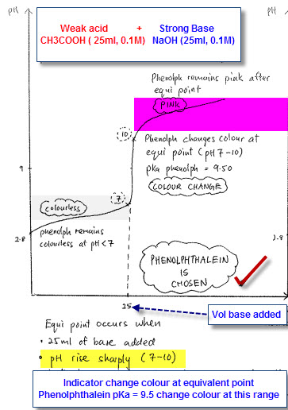
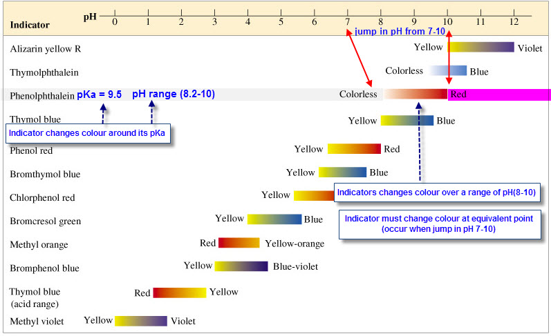
Titration Weak acid + Strong Base
At equivalent point, 25ml
Jump rise in pH from 7- 10
Phenolphthalein changes colour
pKa = 9.5, change colour at pH (8.2-10)
End point coincide with equivalent point
Phenolphthalein is chosen

Slide 28
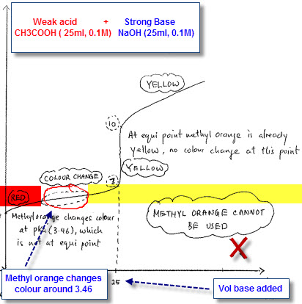
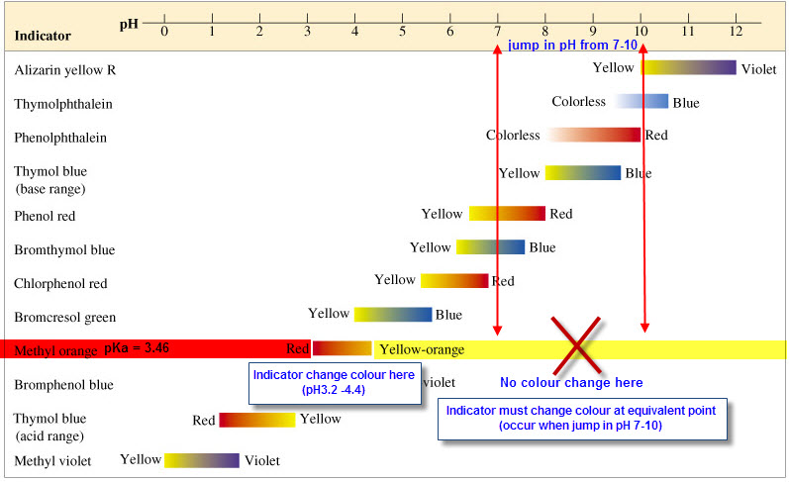
Titration Weak acid + Strong Base
At equivalent point, 25ml
Jump rise in pH from 7- 10
Methyl orange change colour before equivalent point
pKa = 3.46, change colour at pH (3.2- 4.4)
End point DOES NOT coincide with equivalent point
Methyl orange cannot be used

Slide 29
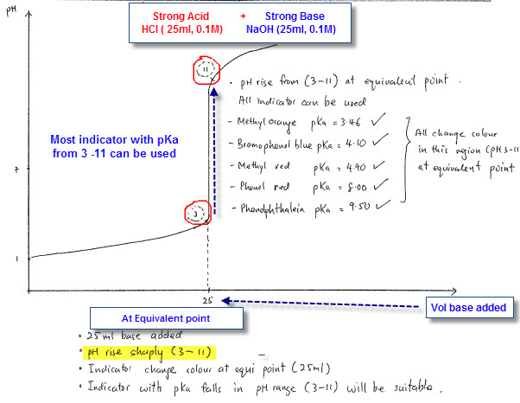
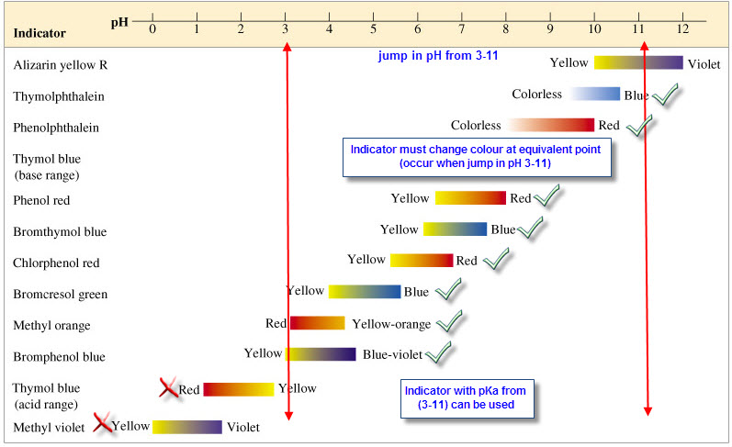
Titration Strong acid + Strong Base
At equivalent point, 25ml
Jump rise in pH from 3 - 11
Most indicators changes colour
pKa of (3 -11) and changes colour
at pH (3 – 11) can be used
End point coincide with equivalent point
Only Methyl violet and Thymol Blue
cannot be used

