Slide 1
POLYMERS
POLYMERS
INTRODUCTION & CLASSIFICATION OF POLYMERS
ADDITION & CONDENSATION – POLYMERIZATION

Slide 2
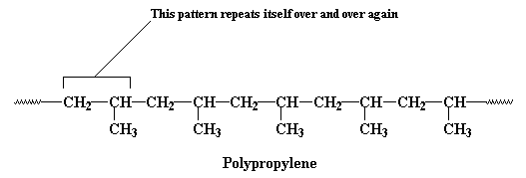
What are polymers, monomers and polymerizations?
Polymers are macromolecules built up by the linking together of large numbers of much smaller molecules.
Polymerization : The process of linking the repeating units (monomers) is termed as polymerization

Slide 3
What are polymers, monomers and polymerizations?
The small molecules which combine with each other to form polymer molecules are termed monomers.

Slide 4
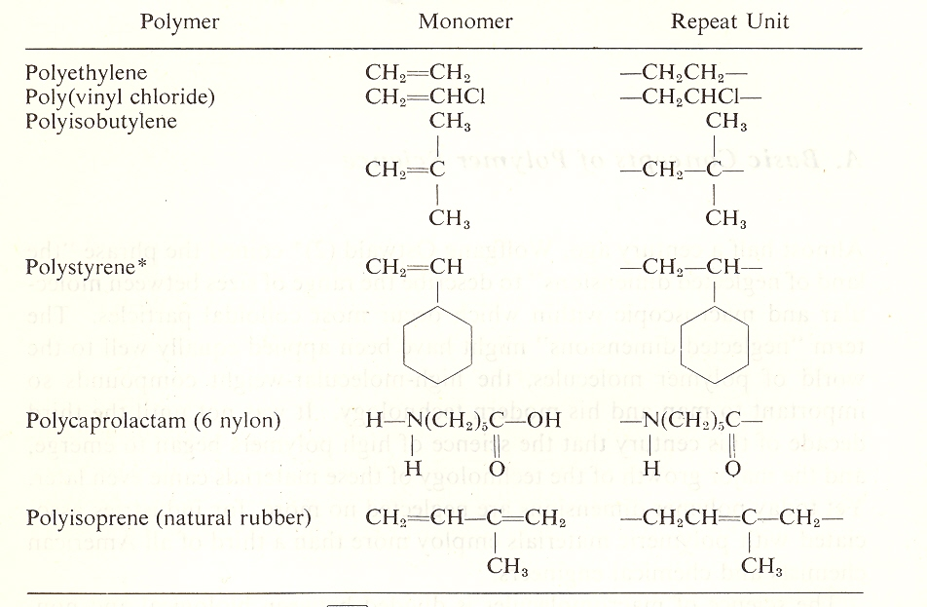

Slide 5
Building Polyethylene
Ethylene
Polyethylene

Slide 6
Type of Polymerization
Monomers undergo polymerizaton by two types. They are:
Addition
Or
Condensation

Slide 7
The addition-condensation system
What are addition polymers?
Addition polymers are those formed from monomers without the loss of a small molecule.
Y
Y

Slide 8
Polymer Structure The addition-condensation system
Condensation polymers
Polymers whose repeating units are joined together by functional units such as an ester (-OCO-), amide (-NHCO-), urethane (-OCONH-), sulfide (-SO₂-) and other linkages.
-R-Z-R-Z-R-Z-R-Z-R-Z-
R is aliphatic or aromatic grouping and Z is functional unit.

Slide 9
Polymer Structure The addition-condensation system
The major addition polymers are those formed by polymerization of monomers containing carbon-carbon double bond; such monomers are called vinyl monomers or substituted ethylenes.

Slide 10
Addition polmerization
Self addition of several bifunctional monomers to each ohter takes place by chain reaction without the elimination of any simple molecules.
GENERAL REACTION:
n [CH₂=CH] → [-CH₂-CH-]_{n}
| |
Y Y
Where Y=H,Ethylene, CH3,Propylene, Cl, Vinyl Chloride,
C6H5, Sterene, CN , Acrylonitrile

Slide 11
Condensation polymerization (Including Polyesters)
Self addition of several bifunctional monomer to each other takes place accompanying elimination of simple molecues like H2O,NH3 & HCL
General reaction :
n[HOOC-X-COOH] + n[HO-Y-OH]
HO-[….OC-X-COO-Y-O]n-H + (2n-1)H20

Slide 12
E.g..
Terylene is obtained by condensing terpthalic acid
[HOOC-C6H4-COOH] with
ethylene glycol [HO-C2H4-OH]
Nylon is made by the condensation of adipic acid
[HOOC-(CH2)4-COOH] with
hexamethylene diamine [NH2-(CH2)6-NH2]

