Slide 1
Atomic Structure

Slide 2
Part 1
The Atom

Slide 3
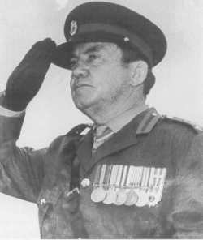
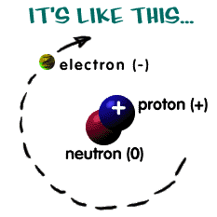
ATOM BASICS
General Concepts
All atoms, with the exception of H, are made up of 3 subatomic particles: protons, neutrons and electrons.
Hydrogen is the simplest atom (1 proton & 1 electron)
Atomic radius is on the order of 10⁻¹⁰ m.
Atoms are mostly empty space.
Protons and neutrons are located in the nucleus.
Electrons are found in energy levels (shells) surrounding the nucleus.

Slide 4
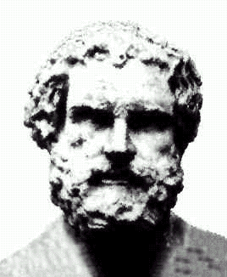
Cultural bias in scientific history?
“Nothing exists but atoms and empty space; everything else is opinion.”
“Atom” – Greek word meaning “indivisible”
In 420 BCE, the Greek philosopher, Democritus, suggested that the universe was made of indivisible units…
…or so we’ve heard.
Δημόκριτος, Dēmokritos,
"chosen of the people“
(460 – 370 BCE)

Slide 5
Cultural bias in scientific history?
“I grew up in Europe,
where the history comes from.”
Eddie Izzard
(Dress to Kill)

Slide 6
Cultural bias in scientific history?
Many historians believe the idea was first proposed at least a century earlier in the Indian subcontinent.
The theory of atomism was also much developed in both Chinese and Arabic culture during the Dark Ages in Europe, when the teachings of the church dictated much of Western thought.

Slide 7
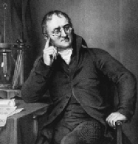
JOHN DALTON
Dalton’s Atomic Theory (proposed in 1808):
All elements are made of tiny atoms.
Atoms cannot be subdivided.
Atoms of the same element are exactly alike.
Atoms of different elements can join to form molecules.

Slide 8
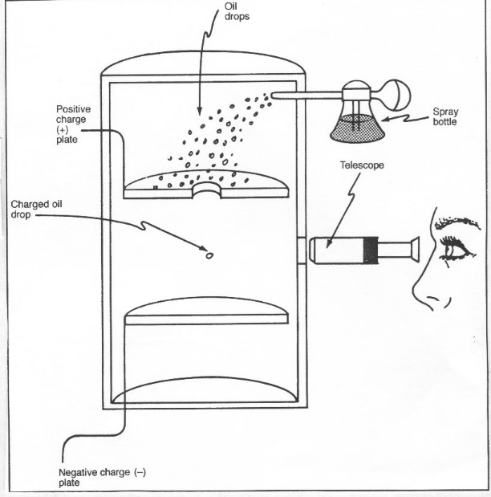
Evidence for Subatomic Particles
Thompson and Millikan are given credit for the first discoveries relating to electrons.
Robert Millikan
J.J. Thompson
J.J. Thomson
(1856 - 1940)
1906 Nobel

Slide 9
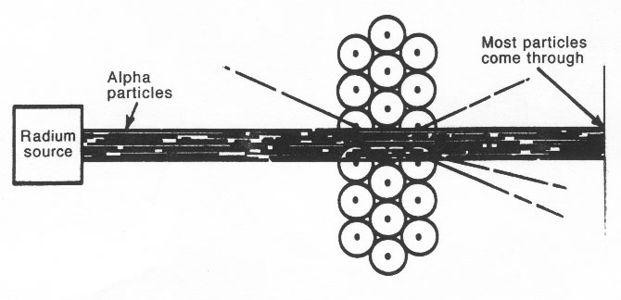
Evidence for Subatomic Particles
Rutherford discovered the positively charged nucleus.
Ernest Rutherford
Ernest Rutherford
(1871 - 1937)
1908 Nobel
Observations:
1) Most of the particles passed directly through - no deflection 2) Some of the particles were deflected somewhat from their path. 3) Some of the particles bounced back in the same direction from which they approached the gold foil.

Slide 10
Relative mass and charge of subatomic particles
Actual mass of a proton: 1.672 x 10⁻²⁴ g
neutron mass is virtually identical
electron is 1/2000 of this mass
Actual charge of an electron: 1.602 x 10⁻¹⁹ Coulombs
PARTICLE | RELATIVE MASS | RELATIVE CHARGE
proton | 1 | +1
neutron | 1 | 0
electron | 5 x 10⁻⁴ | -1

Slide 11
Periodic Key
6
C
Carbon
12.011
Atomic number (Z)
Element’s symbol
Element’s name
Atomic mass (A)
# of protons = Z
# of electrons = # of protons (in a neutral atom)
# of neutrons = A-Z

Slide 12
Shorthand notation for an atom or ion
MASS #: # protons + # neutrons
A
X
n+/n-
Z
CHARGE: leave blank if n=0 (neutral atom)
ATOMIC #: # protons (which is = # electrons if a neutral atom)

Slide 13
Examples
Symbol | Atomic number (Z) | Mass number (A) | # protons | # neutrons | # electrons
4
9
4
5
4
20
40
20
20
18
17
37
17
20
18

Slide 14
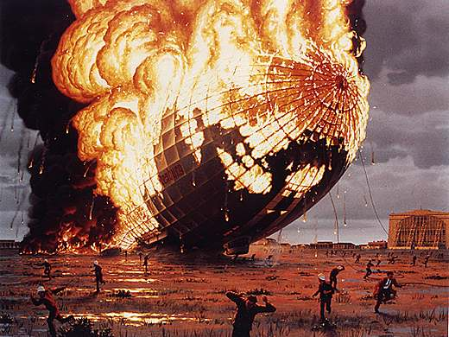
ISOTOPES
Isotopes: atoms that have the same # of protons, but a different # of neutrons.
Example: Isotopes of hydrogen
1p+, 1e-, 0n
1p+, 1e-, 1n
1p+, 1e-, 2n

Slide 15
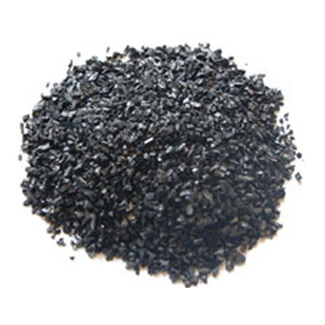
ISOTOPES
Isotopes: atoms that have the same # of protons, but a different # of neutrons.
Example: Isotopes of carbon
6p+, 6e-, 6n
6p+, 6e-, 8n

Slide 16
ISOTOPES
Isotopes: atoms that have the same # of protons, but a different # of neutrons.
Example: Isotopes of chlorine
17p+, 17e-, 18n
17p+, 17e-, 20n

Slide 17
RELATIVE ATOMIC MASS: weighted mean molar mass of atoms of elements.
Example: The two isotopes of chlorine occur in the ratio of 3:1. Thus, naturally occurring chlorine contains 75% and 25% . Determine the relative atomic mass of chlorine.

Slide 18
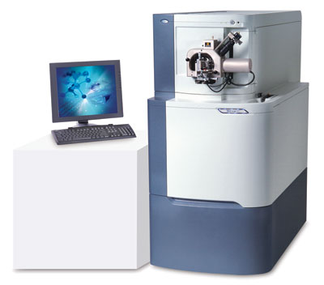
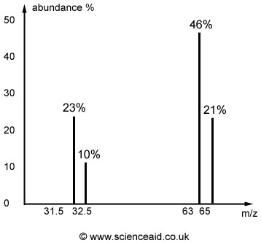
Part 2
Mass Spectrometry

Slide 19
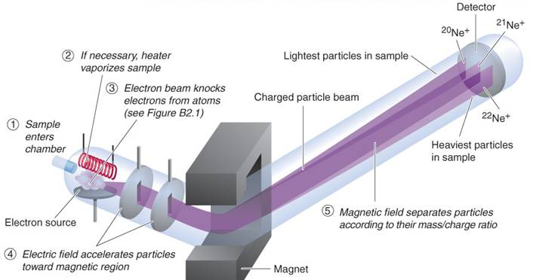
The Mass Spectrometer
Relative atomic masses (among other things we will discuss when we get to organic chemistry) can be determined using this instrument.

Slide 20
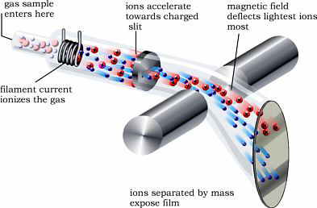
How it works (5 basic steps):
1.
vaporization: if the sample is not already a gas, the sample is heated to this point.

Slide 21
How it works (5 basic steps):
2.
ionization: sample is bombarded with a stream of high energy electrons. In practice, the instrument is set so that only ions with a single positive charge are formed (M⁺).

Slide 22
How it works (5 basic steps):
3.
acceleration: resulting unipositive ions pass through slits in parallel plates under the influence of an electric field.

Slide 23
How it works (5 basic steps):
4.
deflection: ions are then passed over an external magnetic field. The magnetic field causes the ions to be deflected, and the amount of deflections is proportional to the charge/mass ratio. Ions with smaller masses are deflected more than heavier ions. Ions with higher charges are deflected more as they interact more effectively with the magnetic field.
Heavier particles
lighter particles

Slide 24
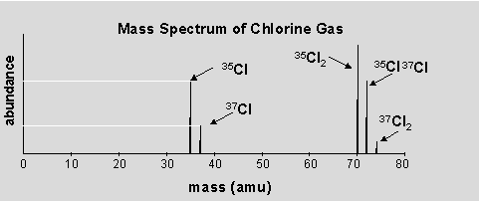
How it works (5 basic steps):
5.
detection: positive ions of a particular mass/charge ratio are detected and a signal is sent to a recorder. The strength of the signal is a measure of the number of ions with that charge/mass ratio that are detected.

Slide 25
Example: Find the relative atomic mass (A_{r}) of naturally occurring lead from the data below. Record your answer to the nearest tenth.
Isotopic mass | Relative abundance | % relative abundance
204 | 0.2 | 2
206 | 2.4 | 2.4
207 | 2.2 | 2.2
208 | 5.2 | 52
$$A_{r}=\frac{\left(2×204\right)+\left(24×206\right)+\left(22×207\right)+\left(52×208\right)}{100}$$
$A_{r}=$207.2
Figure: The Mass Spectrum of Naturally Occurring Lead

Slide 26
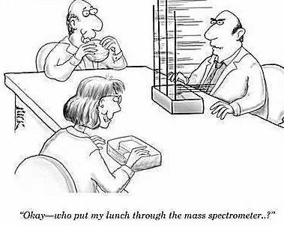

Slide 27
Radioisotopes
Nucleus stability depends upon the balance between the number of protons and neutrons. Nuclei that contain too many or too few neutrons are unstable (radioactive) and change to form more stable nuclei by giving off radiation.

Slide 28
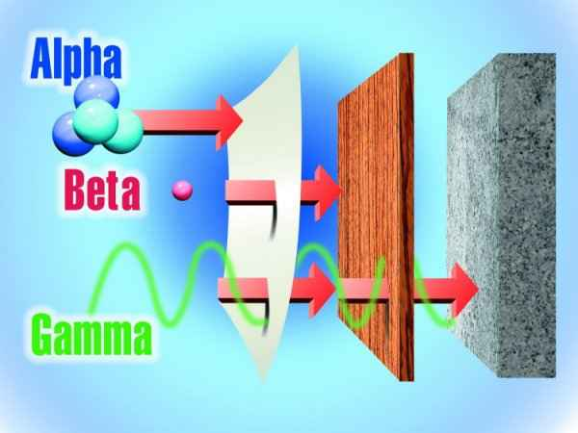
Radioisotopes
Alpha (α): particles (identical to helium nuclei) emitted by nuclei with too many protons.
Beta (β): electrons are ejected (owing to neutron decay) from nuclei with too many neutrons.
Gamma (γ): rays that are a high-energy form of electromagnetic ration.

Slide 29
Uses of radioisotopes
can be used to generate energy in nuclear power plants (fission), sterilize surgical instruments in hospitals, preserve food, detect cracks in structural materials, etc.
While the high energy nature of radioactivity can be used save human life, uncontrolled levels of exposure can have quite the opposite effect.

Slide 30
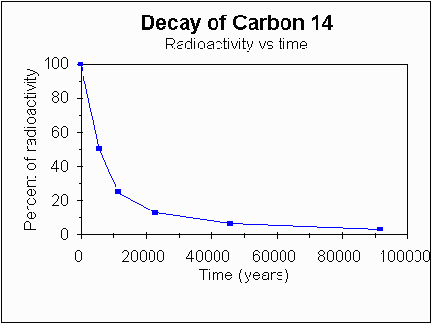
Carbon-14 dating
Decays as (beta emission) at a known rate.
Half life (time it takes for 50% of sample to decay) for C-14 is 5730 years.

Slide 31
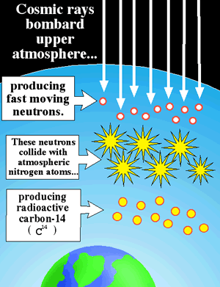
Carbon-14 dating
C-14 continually forms in the upper atmosphere and is in equilibrium with C-12 (concentrations are constant).
As living things function, they constantly recycle carbon, thus maintaining a constant C-14/C-12 ratio.

Slide 32
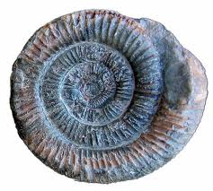
Carbon-14 dating
As living things function, they constantly recycle carbon, thus maintaining a constant C-14/C-12 ratio.
The C-14/C-12 ratio falls by 50% every 5730 years after the death of a living organism.
Measurement of current activity allows us to determine how long ago a fossil was deposited. After 50,000 years, the activity is so low that other radionuclides must be used for accurate fossil dating.

Slide 33
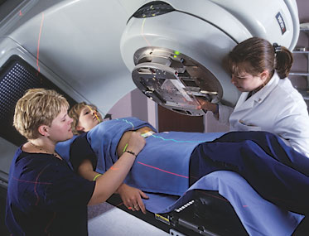
Cobalt-60 used in radiotherapy
Radiotherapy (radiation therapy) targets ionizing radiation at cancer cells, damaging the genetic material of these cells by knowcking off electrons and making it impossible for these cells to grow and divide.
Co-60 is commonly used as it emits very penetrating gamma radiation when its protons an neutrons change their relative positions in the nucleus.
Although radiotherapy damages both cancer and normal cells, the normal cells are able to recover if the treatment is carefully controlled.

Slide 34
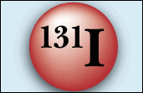
Iodine-131 as a medical tracer
Emitter of both beta and gamma radiation.
Radioisotopes have same chemical properties as any other atom of the same element and so they play the same roll in the body; however, their positions, unlike other isotopes, can be monitored by detecting radiation levels, making them suitable as medical tracers.

Slide 35
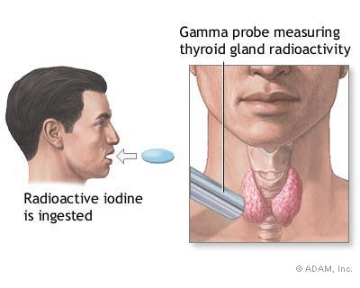
Iodine-131 as a medical tracer
I-131 in the form of sodium iodide can be used to investigate activity of the thyroid gland and to diagnose and treat thyroid cancer.
Half life for I-131 is short, 8 days, so it is quickly eliminated from the body.
Another isotope, I-125 is used in treatment of prostate cancer (half-life=80 days).

Slide 36
Part 3
Emission Spectra

Slide 37
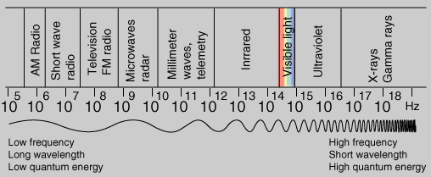
You need to know this (don’t memorize numbers, but you need to know order of things and trends)
R O Y G B I V
microwave
X-ray
radio
gamma
IR
UV

Slide 38
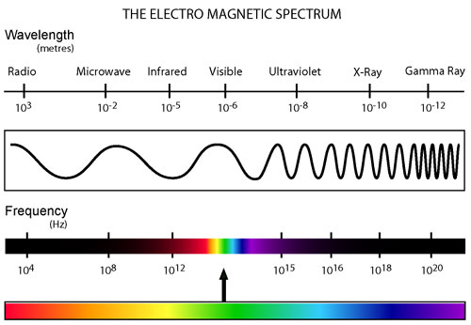
Electromagnetic Radiation
Electromagnetic radiation (radiant energy) is characterized by its wavelength, λ, and frequency, f.

Slide 39
Electromagnetic Radiation
Related by these equations:
where
c = 299 792 458 m/s, or approx.. 3.00 x 10⁸ m s⁻¹
(the speed of light in a vacuum) and
h = 6.626 x 10⁻³⁴ J s (Plank’s constant)

Slide 40
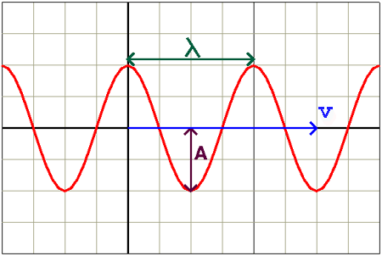
Waves
Wavelength = distance between successive “crests”
Frequency = the # of crests passing a given point per second (unit Hz = s⁻¹)

Slide 41
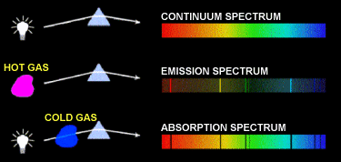
Atomic Emission Spectra
When sunlight or white light is passed through a prism, it gives the continuous spectrum observed in a rainbow.
When energy is supplied to individual elements, they emit a spectrum which only contains emissions at particular wavelengths.

Slide 42
Atomic Emission Spectra
Each element has its own characteristic spectrum known as a line spectrum as it is not continuous.
Example: Hydrogen (H)
NOTE: the line spectrum consists of discrete lines that converge toward the high energy (violet) end of the spectrum. A similar series of lines at higher energies (UV) and several other series of lines at lower energy can be found in the IR region of the spectrum.

Slide 43
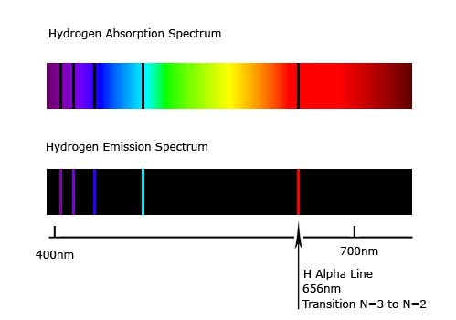

Slide 44
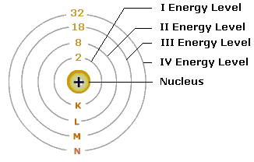
Explanation of emission spectra
Electrons can only exist in certain fixed energy levels.

Slide 45
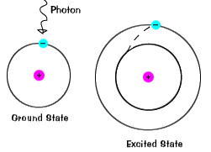
Explanation of emission spectra
When all electrons are in the lowest possible energy levels, an atom is said to be in its GROUND STATE.
When an atom absorbs energy so that its electrons are “boosted” to higher energy levels, the atom is said to be in an EXCITED STATE.

Slide 46
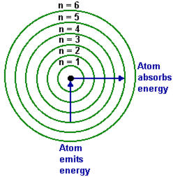
Explanation of emission spectra
When an electron moves from a lower energy level to a higher energy level in an atom, energy of a characteristic frequency (and corresponding wavelength) is absorbed.
When an electron falls from a higher energy level back to the lower energy level, then radiation of the same frequency (and corresponding wavelength) is emitted.

Slide 47
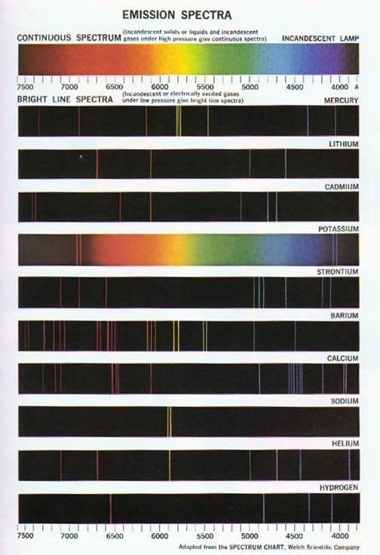
Bright Line Emission Spectrum
The light emitted by an element when its electrons return to a lower energy state can be viewed as a bright line emission spectrum.

Slide 48
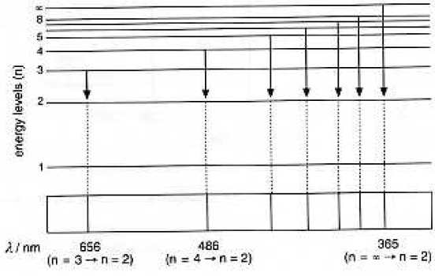
For example: transition to n=2
What portion of the EM spectrum is this?
visible light
Note: the lines in the spectrum converge because the energy levels themselves converge.

Slide 49
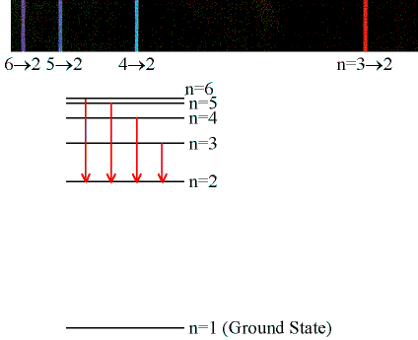

Slide 50
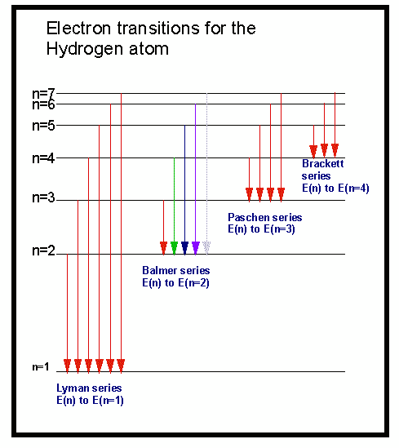
Energy level (n) electrons are returning to… | Part of the spectrum the series of lines will show up in…
n=1
n=2
n=3
UV
visible
IR

Slide 51
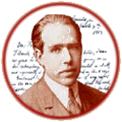
Part 4
Electron Arrangement
“Any one who is not shocked
by Quantum theory does
not understand it.”
Niels Bohr

Slide 52
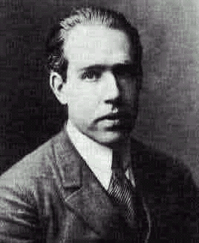
NIELS BOHR
Neils Bohr
(1885 - 1962)
1922 Nobel
In 1913, this Danish scientist suggested that electrons “orbit” the nucleus.
In Bohr’s model, electrons are placed in different energy levels based on their distance from the nucleus.

Slide 53
Electrons are like books in a book case. They can only exist on certain levels.

Slide 54
Only certain “orbits” are allowed

Slide 55
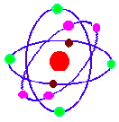
MODERN ATOMIC MODEL
By 1925, Bohr’s model of the atom no longer explained all observations. Bohr was correct about energy levels, but wrong about electron movement.
Electrons occupy the lowest energy levels available.
Energy increases as distance from the nucleus increases.
Electrons move in patterns of “wave functions” around the nucleus.

Slide 56
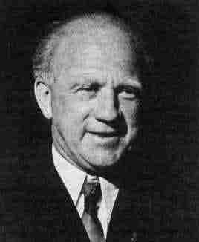
MODERN ATOMIC MODEL
Heisenberg’s Uncertainty Principle:
It has been mathematically proven that it is impossible to know an electron’s momentum and position in space at any moment in time.
As uncertainty of position decreases, uncertainty of momentum increases, and vice versa.
Werner Heisenberg
(1901 - 1976)

Slide 58
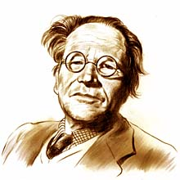
Schrödinger
This is very difficult stuff!
In 1926 Schrodinger proposes an equation that gives the probability of finding an electron at any place in the atom.
Don’t worry, this won’t be on the test.

Slide 59
Evidence from Ionization Energies
Much of our understanding of electron arrangement comes from ionization energy data…

Slide 60
First Ionization Energy

Slide 61
First Ionization Energy
Definition: energy required to remove one electron from an atom in its gaseous state.
+
+ e⁻
Ionization

Slide 62
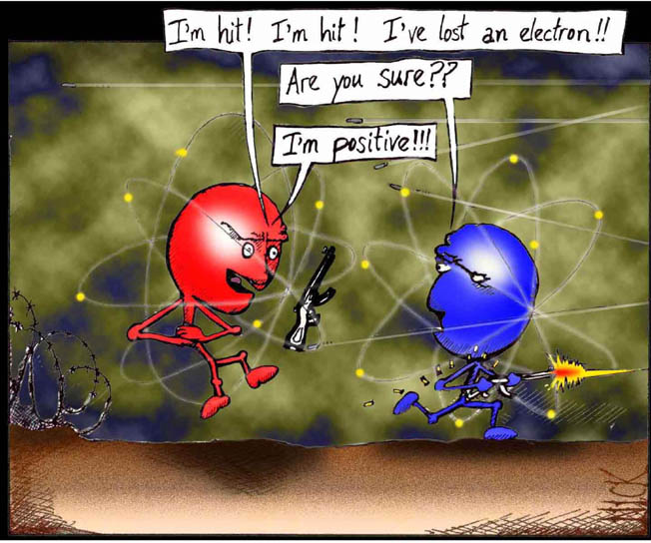
First Ionization Energy

Slide 63
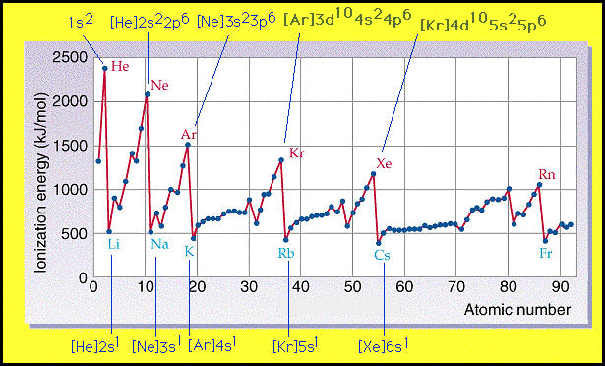
First Ionization Energy

Slide 64
This graph provides evidence that the levels can contain different numbers of electrons before they become full.
Ne
Ar
Li
Na
K
Level | Max # electrons
1 (K shell)
2 (L shell)
3 (M shell)
2
8
8 (or 18)

Slide 65
Second ionization energy
energy required to remove the second electron.

Slide 66
Successive ionization energies…
Al _{(g)} → Al⁺_{(g)} + e⁻
I₁ = 580 kj/mol
Al⁺ _{(g)} → Al²⁺_{(g)} + e⁻
I₂ = 1815 kj/mol
Al²⁺ _{(g)} → Al³⁺_{(g)} + e⁻
I₃ = 2740 kj/mol
Al³⁺ _{(g)} → Al⁴⁺_{(g)} + e⁻
I₄ = 11,600 kj/mol

Slide 67
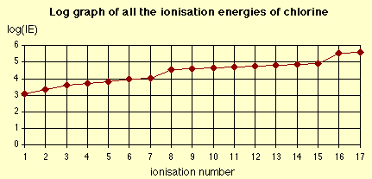
Graph of successive ionization energies
What does this graph show?
As e⁻’s are removed, nucleus holds remaining more tightly (less shielding, outer e⁻’s first)
First “large jump” reveals # valence e⁻’s of element (group)
Does not increase regularly (evidence for sublevels)

Slide 68
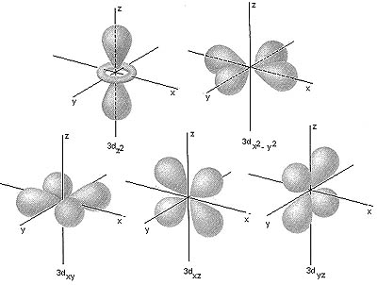
Electron Configurations
The quantum mechanical model of the atom predicts energy levels for electrons; it is concerned with probability, or likelihood, of finding electrons in a certain position.

Slide 69
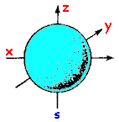
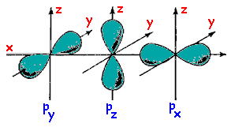
ORBITALS
ORBITAL: the regions in an atom where there is a high probability of finding electrons.
s is the lowest energy orbital, and p is slightly higher
d and f are the next two orbitals. They occupy even higher energy levels and take on more complex shapes than s & p
s orbital
p orbitals

Slide 70
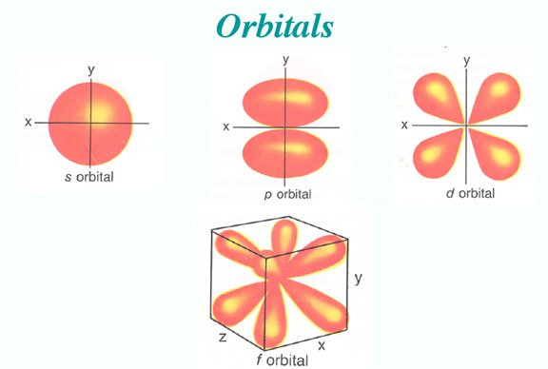
Electron Configurations
Regions where electrons are likely to be found are called orbitals. EACH ORBITAL CAN HOLD UP TO 2 ELECTRONS!

Slide 71
Electron Configurations
In quantum theory, each electron is assigned a set of quantum numbers
analogy: like the mailing address of an electron

Slide 72
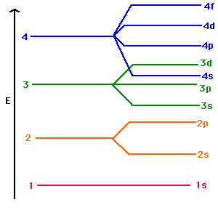
Electron Configurations

Slide 73
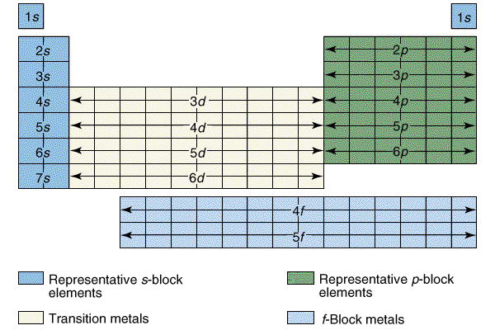
Electron Configurations

Slide 74
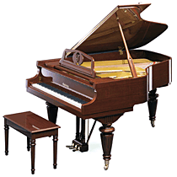
Playing Chopin with Boxing Gloves
“Trying to capture the physicists’ precise mathematical description of the quantum world with our crude words and mental images is like playing Chopin with a boxing glove on one hand and a catcher’s mitt on the other.”
(1996). Johnson, George. On skinning Schrodinger’s Cat.
New York Times.

Slide 75
Principal Quantum Number (n)
Describes the energy level that the electron occupies
n=1, 2, 3, 4
The larger the value of n, the farther away from the nucleus and the higher the energy of the electron.
n = 1
n = 2
n = 3
n = 4

Slide 76
Sublevels (l)
The number of sublevels in each energy level is equal to the quantum number, n, for that energy level.
Sublevels are labeled with a number that is the principal quantum #, and a letter: s, p, d, f (ex: 2 p is the p sublevel in the 2nd energy level)

Slide 77
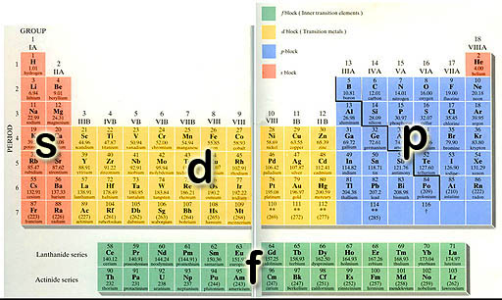

Slide 79
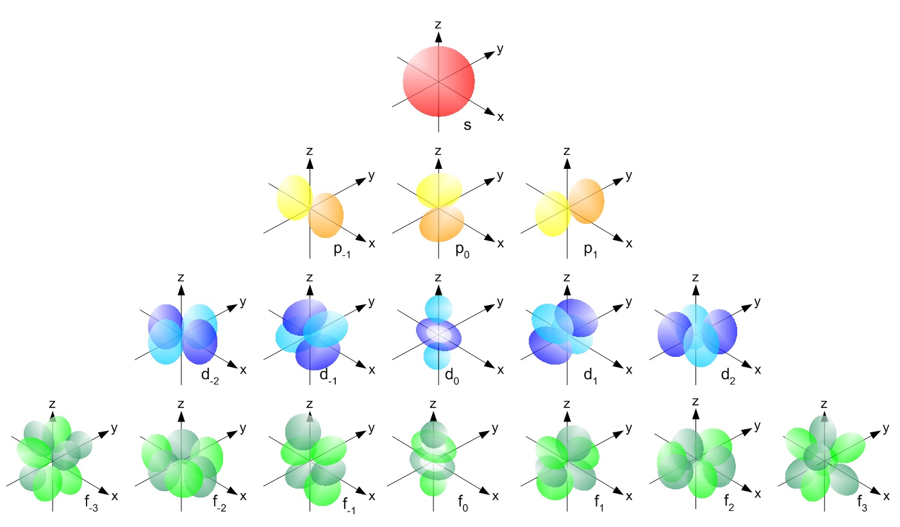

Slide 80
Sublevels (l)
Principal Energy Level | Sublevels | Orbitals
n = 1
1s
one (1s)
n = 2
2s 2p
one (2s) three (2p)
n = 3
3s 3p 3d
one (3s) three (3p) five (3d)
n = 4
4s 4p 4d 4f
one (4s) three (4p) five (4d) seven (4f)

Slide 81
Sublevels (l)
Sublevel | # of orbitals | Max # of electrons
s
1
2
p
3
6
d
5
10
f
7
14

Slide 82
Spin quantum number (m_{s})
Labels the orientation of the electron
Electrons in an orbital spin in opposite directions; these directions are designated as +1/2 and -1/2

Slide 83
Pauli Exclusion Principle
States that no 2 electrons have an identical set of four quantum #’s to ensure that no more than 2 electrons can be found within a particular orbital.

Slide 84
Hund’s Rule
Orbitals of equal energy are each occupied by one electron before any pairing occurs.
Repulsion between electrons in a single orbital is minimized
All electrons in singly occupied orbital must have the same spin.
When 2 electrons occupy an orbital they have opposite spins.

Slide 85
Aufbau Principle
orbitals of lowest energy are filled first (building-up principle).

Slide 86
Orbital Diagrams
Each orbital is represented by a box.
Each electron is represented by an arrow.

Slide 87
Orbital Diagrams
hydrogen
helium
carbon
1s
1s
1s
2s
2p

Slide 88
Complete electron configurations
helium
boron
neon
aluminum
uranium
1s²
1s²2s²2p¹
1s²2s²2p⁶
1s²2s²2p⁶3s²3p¹
1s²2s²2p⁶3s²3p⁶4s²3d¹⁰4p⁶5s²4d¹⁰- 5p⁶6s²4f¹⁴5d¹⁰6p⁶7s²5f⁴

Slide 89
Abbreviated electron arrangements
helium
boron
aluminum
cobalt
uranium
1s²
[He]2s²2p¹
[Ne]3s²3p¹
[Ar]4s²3d⁷
[Rn]7s²5f⁴

Slide 90
IB sometimes uses another form of notation for this…
1s²2s²2p⁶3s²3p¹ becomes…
2e⁻) 8e⁻ ) 3e⁻
Electrons in 1st energy level (shell)
Electrons in 2nd energy level (shell)
Electrons in 3rd energy level (shell)
2.8.3 or 2,8,3

Slide 91
IB will only use this notation for the first 20 elements

Slide 92
Exceptions you should know:
Copper:
Chromium:
1s² 2s² 2p⁶ 3s² 3p⁶4s¹3d¹⁰ or [Ar]4s¹ 3d¹⁰
1s² 2s² 2p⁶ 3s² 3p⁶4s¹3d⁵ or [Ar]4s¹ 3d⁵
Why do these elements do this?
Lower energy arrangement of electrons: this configuration allows for half-filled (less electron repulsion because no pairing in the 3d sublevel) or filled d-sublevel.

Slide 93
Electron configurations of Ions
[He]2s²2p⁶
N³⁻
Se²⁻
Mg²⁺
Al⁶⁺
Cr³⁺
Cu⁺
1s²2s²2p³
= [Ne]
[Kr]
[Ar]3d³
[Ne]
[Ar]3d¹⁰

