Slide 1
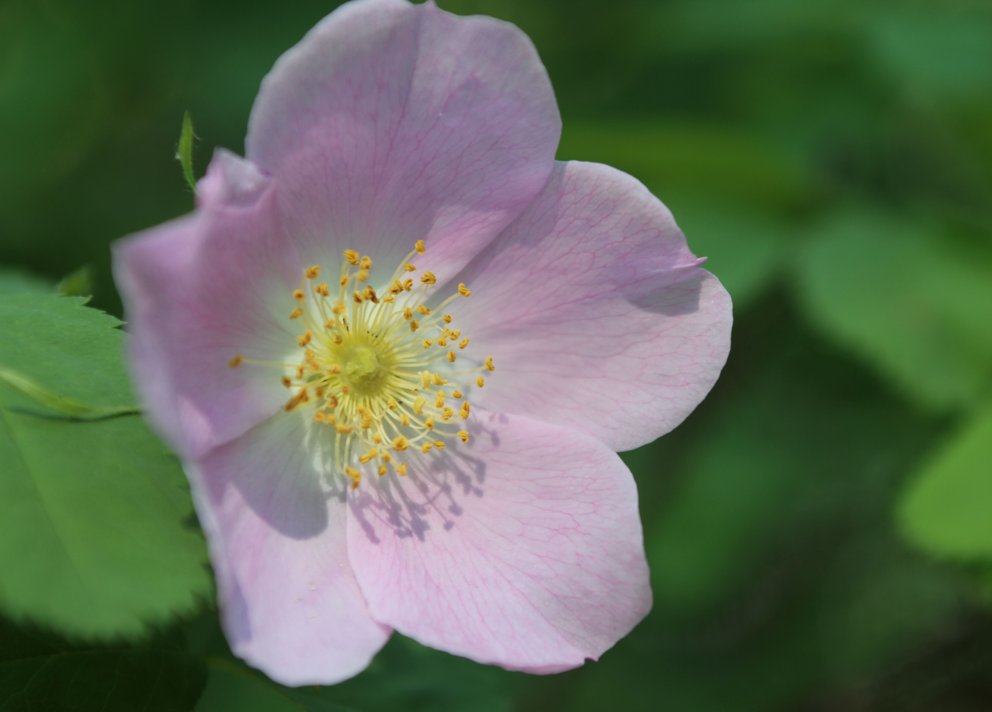
Biology 30 Diploma Review

Slide 2
Contents
Overview of the Biology 30 Diploma Exam
Biology 20 Review
Biology 30 Review
Strategies for the Biology 30 Diploma Exam

Slide 3
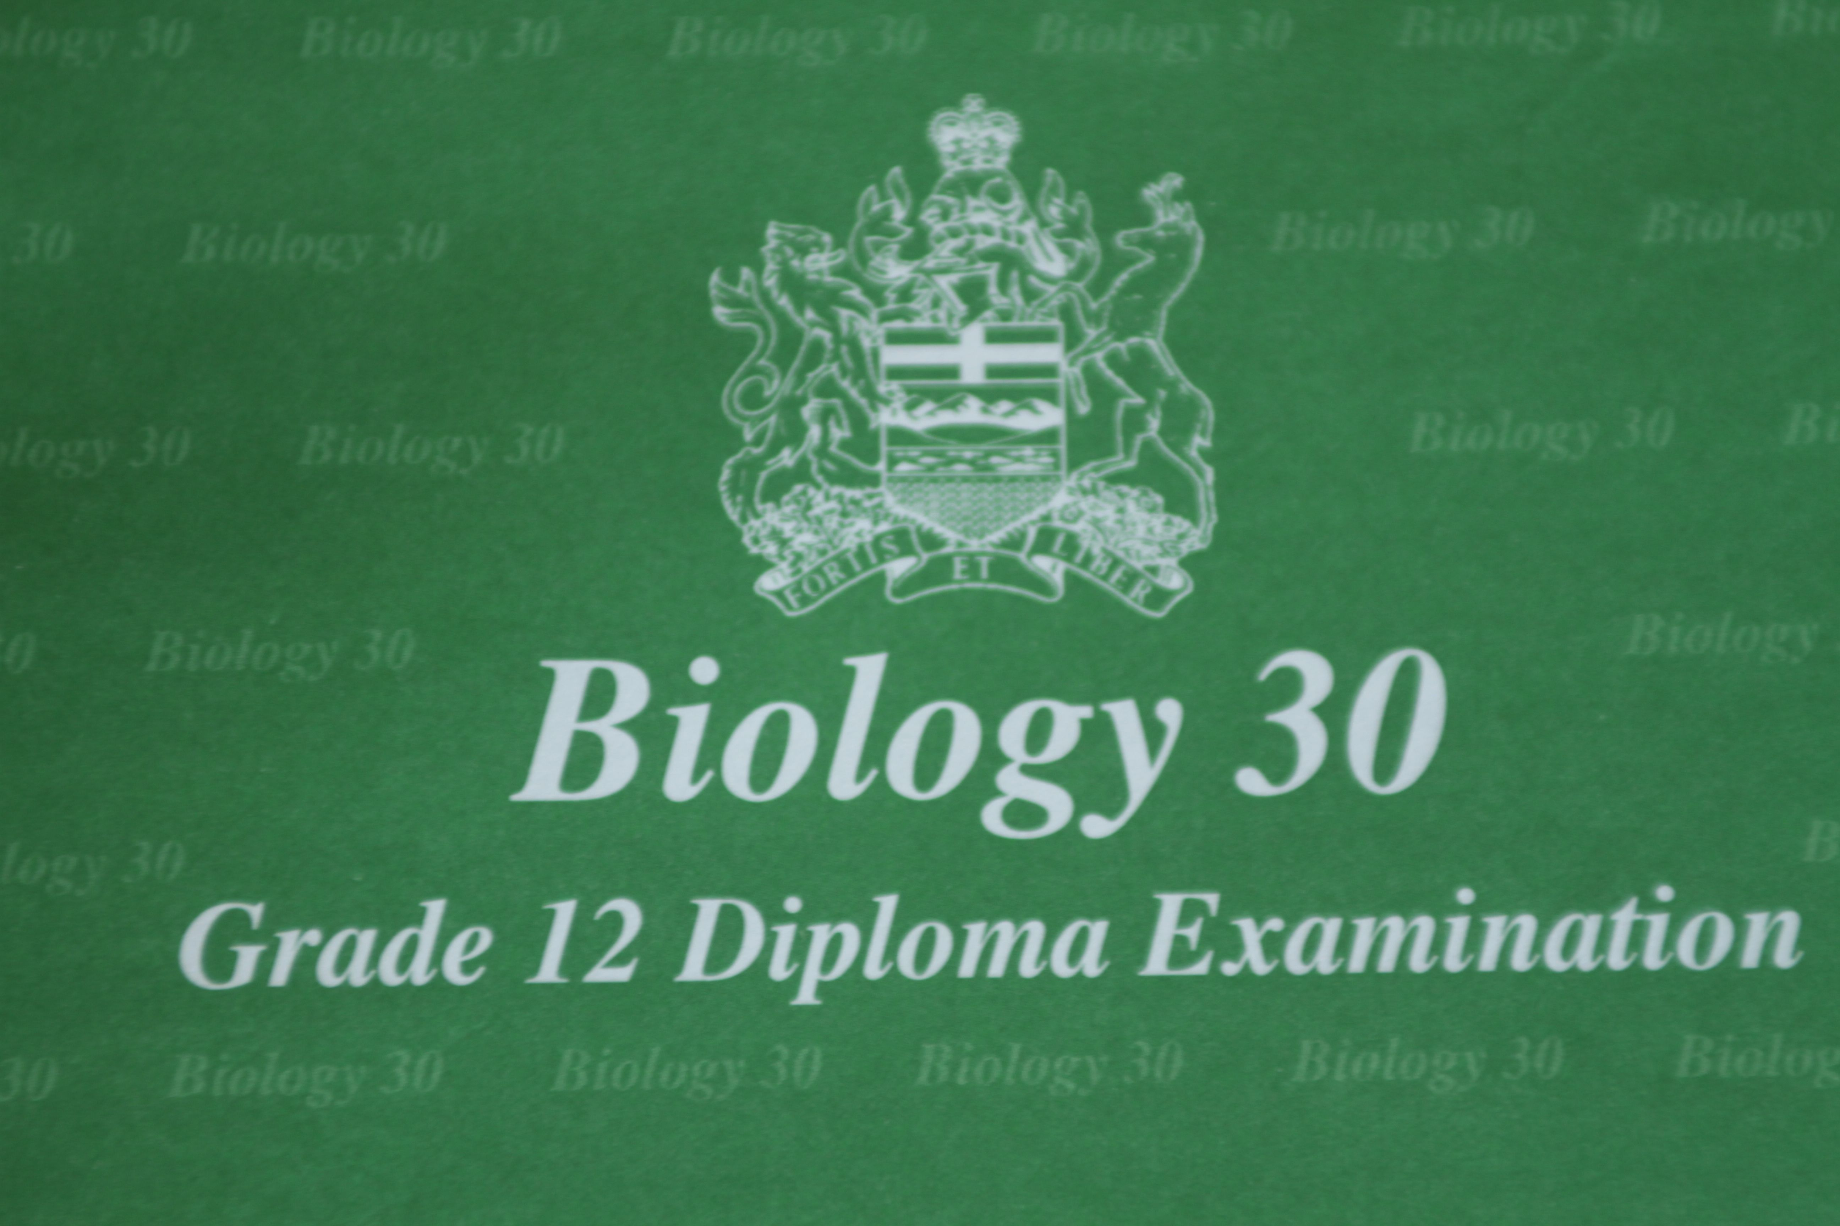
About the Biology 30 Diploma Exam

Slide 4
Biology 30 Diploma Exam
Date:
Time:
Location:

Slide 5
Page 4
About the Biology 30 Diploma Exam
The Alberta Diploma Exam is worth 50% of your biology mark.
Total time allowed—2.5 hrs
48 Multiple choice (MC) worth one mark each
12 Numeric response (NR) worth one mark each

Slide 6
Preparing for the Exam
This booklet is no substitute for hard work during the course. It’s not meant to be a comprehensive study guide. It may, however, contain helpful pointers enabling you to confidently write your Biology 30 Diploma Exam.
Go over as many old diploma exam questions as possible.
Take a diploma review course!

Slide 7
Writing the Exam
Page 5
Get to the exam early. Don’t allow flat tires, bad roads, etc. to make you late. You will not be given extra time and you will not be allowed to write if you are over an hour late.
You are not allowed to ask questions during the exam. If you are unsure about what a question is asking you may NOT ask for help.
Underline/highlight key words as you read a question. This helps you to focus on keywords as you read and since it’s impossible to memorize everything it will be easier to find the information again when you need it.
You are provided with tear out scrap paper at the back of the exams and a formula/data sheet. Tear them out upon starting the exam. You may write on them.
You may be given a formula, experiment, or concept you have not learned in class. You are expected to use the biology you did learn in class and apply it to this new situation.
Don’t spend too much time on one question; come back to it later if necessary.

Slide 8
Warning!
Bring appropriate ID or you will not be allowed to write the exam. Unless you are in a really small school…. Like here…
Official ID
P. Parker

Slide 9
Warning!
If you are found to be in possession of a cell phone during the exam you will be assigned a mark of zero.

Slide 10
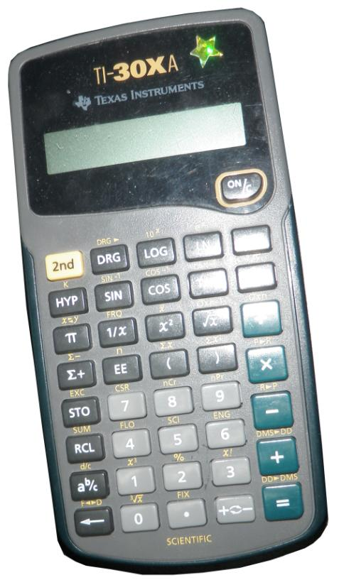
Calculators
• Use a calculator you are familiar with.
• Clear your calculator’s memory before coming to the exam.
• Always check that your calculator is in degree mode after the memory has been cleared.
• Make sure your calculator batteries are new or bring extras.

Slide 11
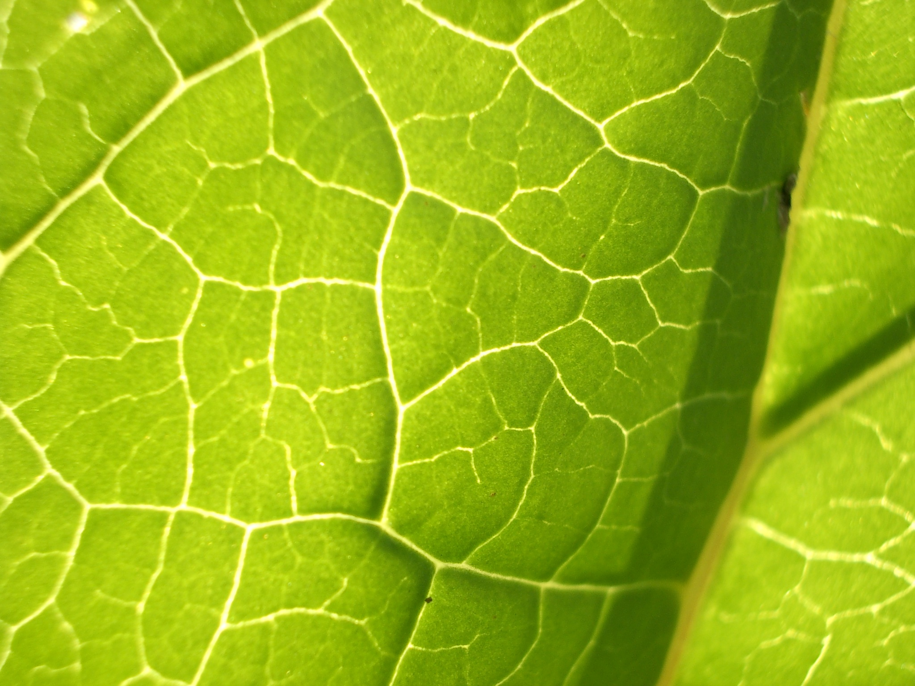
Review of Biology 20

Slide 12
Page 6
Major Points
Be familiar with the key parts of the scientific inquiry process.
Problem—framed as a question that includes both the manipulated and the responding variables being tested.
Hypothesis—gives a possible answer to the problem and explains why that answer is believed to be correct.
Prediction—gives a possible (often numerical) outcome to the experiment.

Slide 13
Design—gives a brief synopsis of what method will be used to solve the problem, differentiates between the experimental group (has the manipulated variable applied to it) and the control group (identical as possible to the manipulated group, except it has a no manipulated variable applied)
defines the variables:
Manipulated – an event that is systematically changed.
Responding – what is measured.
Controlled – all the things that need to be kept the same between the two groups that could affect the outcome of the experiment.
Procedure—the set of instructions needed to perform the experiment
Evidence—all qualitative and quantitative evidence recorded
Analysis—using the data to answer the problem
Conclusion/Evaluation—examining the validity of the analysis, the design, the hypothesis…

Slide 14
Page 6
1. List and define the three types of variables that occur in a scientific investigation.*
Manipulated—an event that is systematically changed.
Responding—what is measured.
Controlled—all the things that need to be kept the same between the two groups that could affect the outcome of the experiment.
What are three characteristics of a hypothesis?
gives an answer
gives an explanation
is testable
*Answers for all questions are on page 45.

Slide 15
3. Explain the difference between the control group and the experimental group.
An experimental group has the manipulated variable applied to it and the control group is identical as possible to the manipulated group, except it has a no manipulated variable applied.

Slide 16
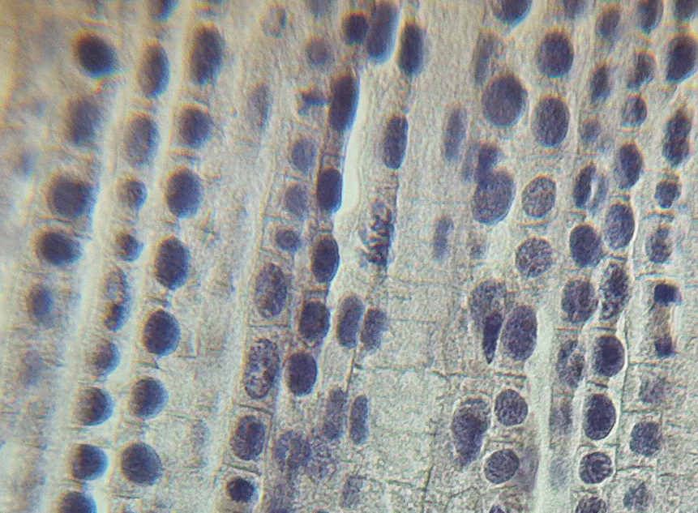
Review the anatomy of a cell and cellular processes.

Slide 17
Fill in the blanks in the chart below. Use the following terms:
nucleus, cell membrane, osmosis, ribosome, mitochondria, vesicles, active transport, centrioles, diffusion
 | DNA found—controls many cellular activities.
 | Phospholipid bilayer that is selectively permeable.
 | Site of protein synthesis.
 | Small membrane bound sacs that stores or transports substances within a cell.
 | Site of cellular respiration.
 | Involved in spindle fibre formation during cell division.
 | Movement of substances from an area of high to low concentration.
 | Movement of water from an area of high to low concentration across a membrane.
 | Movement of substances across a membrane from an area of low to high concentration using ATP.

Slide 18
Fill in the blanks in the chart below. Use the following terms:
nucleus, cell membrane, osmosis, ribosome, mitochondria, vesicles, active transport, centrioles, diffusion
Nucleus | DNA found – controls many cellular activities.
Cell membrane | Phospholipid bilayer that is selectively permeable.
Ribosome | Site of protein synthesis.
Vesicles | Small membrane bound sacs that stores or transports substances within a cell.
Mitochondrion | Site of cellular respiration.
Centrioles | Involved in spindle fibre formation during cell division.
Diffusion | Movement of substances from an area of high to low concentration.
Osmosis | Movement of water from an area of high to low concentration across a membrane.
Active transport | Movement of substances across a membrane from an area of low to high concentration using ATP.

Slide 19
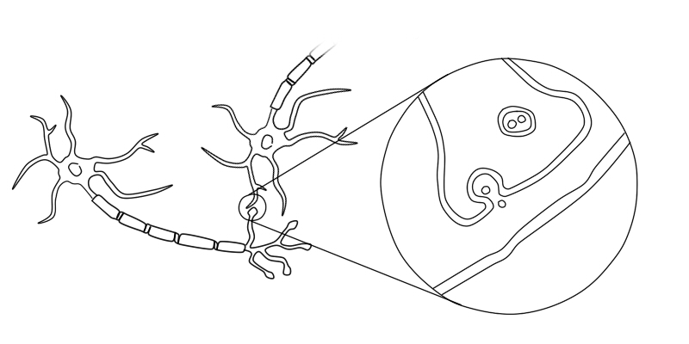
Nervous and Endocrine Systems

Slide 20
The Nervous System
Page 7
Major Points:
Be able to explain how the nervous system controls physiological processes.
Neurons are the functional unit of nervous system that carries the electrical part of the neural message.
nervous system
periferal
central
autonomic— involuntary
somatic-voluntary
spinal
cord
brain
parasynpathetic
sympathetic
sensory
motor

Slide 21
Neurons are the functional unit of the nervous system that carries the electrical part of the neural message.
5. Label the following diagram.
A
Dendrite
G
F
Vesicle
Synapse
Node of ranvier
E
B
C
Cell body
Schwann cell
D
I
Axon
Myelin sheath
J
Endplate
H
Neutrotransmitter
Hint: Mnemonic aid—Axon carries information away from the cell body and both begin with the letter a.

Slide 22
Neural impulse and the action potential: The movement of Na⁺ and K⁺ ions creates a localized electric circuit that stimulates the next section of the neuron until the axon terminals are reached.
Synapse: The physical gap between two neurons that uses neurotransmitters (i.e., acetylcholine) to continue the message to the next neuron by binding to specific receptor sites on the dendrite to create a new action potential.
Reflex arc: Allows some movements to occur rapidly enough to minimize damage to the body (pain reflex) or to allow for quick continuous movement (knee jerk and Achilles reflex during walking). Although the brain is aware of the reflex it is not involved in the decision making.

Slide 23
Page 8
6. The correct order of events in a reflex arc is
A. sensory neuron, sense receptor, interneuron, effector motor, neuron
B. sense receptor, interneuron, sensory neuron, motor neuron, effector
C. sense receptor, sensory neuron, interneuron, motor neuron, effector
D. interneuron, sense receptor, sensory neuron, motor neuron, effector

Slide 24
The Brain: 3 areas:
Hindbrain—composed of cerebellum (balance), pons (information relay area), and medulla oblongata (involuntary actions such as heart rate and breathing)
Midbrain—information relay
Forebrain—mainly the cerebellum, divided into the right and left hemispheres is divided into 4 lobes: frontal (motor control of voluntary movements, intellect and personality), parietal (speech interpretation, touch and temperature), temporal (hearing, visual and verbal memory) and occipital (vision and its interpretation)

Slide 25
Tips
• Stimulus (external or internal) causes sodium ions to enter the neuron and then potassium ions to exit the neuron. The sodium/potassium pump uses ATP to reset the neuron by moving 3Na+ out for every 2K+ that are moved back into the neuron. The neuron cannot be stimulated again until it is reset/polarized.
• Intensity of stimulus is communicated by the frequency of the action potentials (3 per second versus 6 per second) and the number of neurons stimulated.
Action potential size remains constant.
• Under normal conditions the involuntary actions are controlled by the parasympathetic nervous system and it is only under stress that the sympathetic system takes over.

Slide 26
The Senses
Eye
Retina is the receptor for the eye. It converts light energy to neural impulses.
Page 9
Key Parts of Retina
Rods | Cones
Low light intensity | Bright/high light intensity
Black and white | Colour
Peripheral vision | Fine detail—concentrated in fovea centralis
Blind Spot: no rods/cones; where the optic nerve connects the eye to the brain.

Slide 27
Page 9
7. Trace the pathway of light from the moment it enters the eye to where the information is processed.
Cornea→aqueous humour→lens→vitreous humour→retina→optic nerve→occipital lobe.

Slide 28
Ear
The ear enables us to collect sound waves. It is also used to maintain our balance.
Receptor: Organ of Corti that converts mechanical vibrations to neural impulses.
Trace the pathway of sound waves from the moment it enters the ear to where the information is processed.
pinna→auditory canal→tympanic membrane→ossicles→round window→cochlea→organ of corti→auditory nerve→temporal lobe
Tips
All sense receptors for the ear (both balance and hearing) are in the inner ear.
Sound passes from the outer ear to the ossicles of the middle ear and then to the cochlea (inner ear) where the organ of corti is found.

Slide 29
Balance
Static equilibrium | Dynamic equilibrium
head position along a plane | twirling or tumbling motions
in the vestibule | in the Semicircular canals

Slide 30
Balance
Page 10
9. Using the knee jerk reflex, identify the sequence of events involved in this reflex, from the stimulus to the response of the effector.
Rubber mallet hits below knee cap→stretch/pressure sensors in skin stimulated→ sensory neuron→interneuron→motor neuron→lower part of leg jerks upward as muscles are activated.
10. Which of the following rows identifies an effect of Labyrinthitis (an inner eat infection) and the structure that is infected?
Row | Effect of Labyrinthitis | Structure Infected
A. | loss of balance | ossicles
B. | loss of balance | cochlea
C. | loss of hearing | cochlea
D. | loss of hearing | ossicles

Slide 31
Page 10
11. Describe the events of a neural impulse.
Resting/Polarize—high concentration of Na⁺ ions in ECF with a net positive charge and high concentration of K⁺ ions in the cytoplasm of neuron with a net negative charge. Electrical potential difference is negative.
Depolarization—threshold stimulus reached, Na+ ions enter neuron causing electrical potential difference to become positive.
Repolarization—Na⁺ gates close and K⁺ gates open allowing K⁺ ions to exit the neuron, lowering the potential difference back towards that of the resting state.
Refractory—Na⁺/K⁺ pump—for every 1 ATP used 3 Na⁺ exit the neuron and 2K⁺ enter until the neuron is repolarized.

Slide 32
Page 11
Endocrine System
Major Points
The endocrine system is responsible for maintain homeostasis.
It does this through a series of glands that secrete hormones which travel through the blood and affect target sites that have the correct receptors to the specific hormones.
The integration of both systems is clearly seen in the hypothalamus/pituitary area or in the body’s response to stress (neurotransmitter = norepinephrine and adrenal cortex releasing epinephrine).

Slide 33
Page 11
12. Identify the endocrine gland with their associated hormones.
 | Hormone Secreted | Gland
A. | ACTH, TSH, GH, ADH
B. | thyroxine, calcitonin
C. | parathyroid hormone (PTH)
D. | cortisol, aldosterone
E. | epinephrine, norepinephrine
F. | insulin, glucagon

Slide 34
Page 11
12. Identify the endocrine gland with their associated hormones.
 | Hormone Secreted | Gland
A. | ACTH, TSH, GH, ADH | hypothalamus /pituitary complex
B. | thyroxine, calcitonin | thyroid
C. | parathyroid hormone (PTH) | parathyroid
D. | cortisol, aldosterone | adrenal cortex
E. | epinephrine, norepinephrine | adrenal medulla
F. | insulin, glucagon | Islet of Langerhans in pancreas
Hint: Calcitonin lowers calcium, Parathyroid hormone raises calcium levels.

Slide 35
Page 11
Negative Feedback Loops—Negative feedback occurs when the stimulus creates an effect counters the original stimulus and therefore maintains homeostasis. At the minimum a feedback loop should contain:
stimulus
Most feedback loops are negative but a few of them are positive. Positive loops are usually associated with addiction and the role of oxytocin in the birth process.
_
target site &
the effect
gland
hormone

Slide 36
Page 12
Tips
• Practise drawing feedback loops for all the hormones, especially those that work antagonistically: insulin and glucagon, cacitonin and parathyroid hormone.
• Draw feedback loops that include tropic hormone (hormones that target the release of another horomone: ACTH causing the release of cortisol).

Slide 37
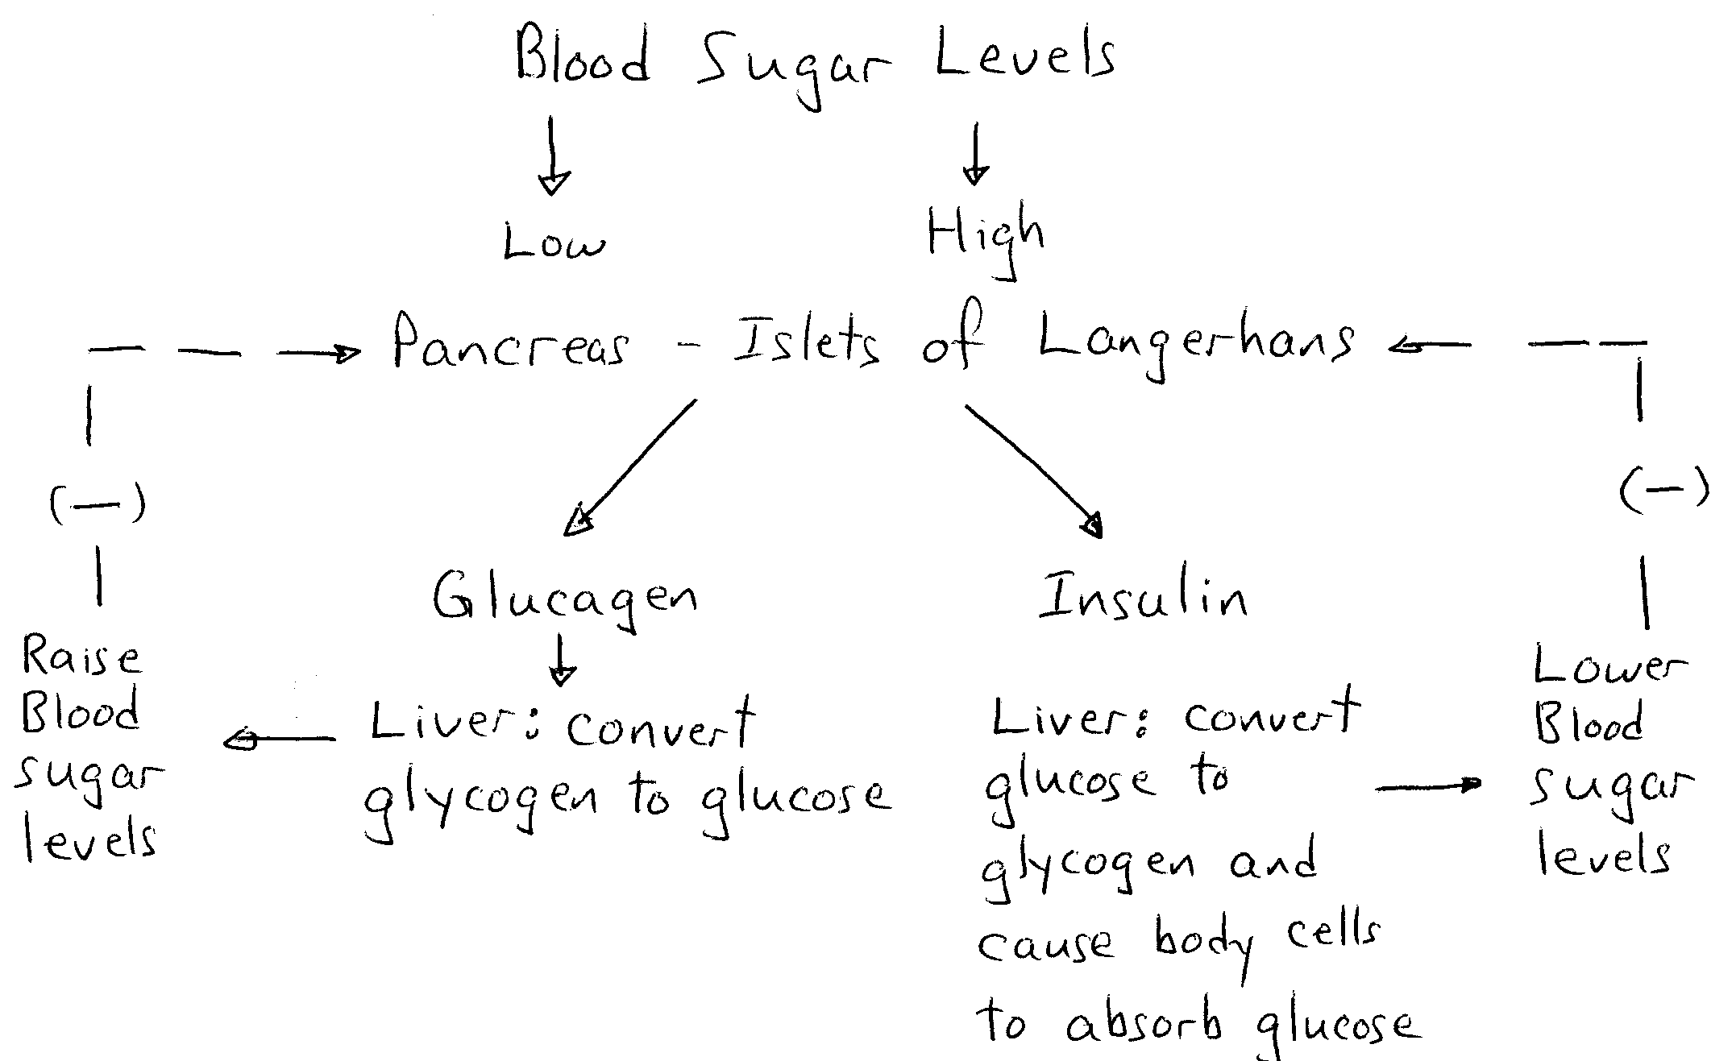
Page 12
13. Draw a feedback loop to show the regulation of blood glucose levels.

Slide 38
Page 12
Use the following information to answer the next two questions.
Ashley has been diagnosed with osteoporosis, a thinning of the bone tissue, that makes bones susceptible to breakage. One of the treatments prescribed is an oral form of a hormone normally made by the body.
14. Which of the following rows identifies the hormone given and the target site of the hormone in the body?
 | i | ii
A. | calcitonin | body cells
B. | calcitonin | body cells
C. | PTH | body cells
D. | PTH | body cells

Slide 39
Page 12
Ashley has been diagnosed with osteoporosis, a thinning of the bone tissue, that makes bones susceptible to breakage. One of the treatments prescribed is an oral form of a hormone normally made by the body.
15. Normally, the body can release the hormone from the ____i____ gland, causing blood calcium levels to ____ii____. The above statement is completed by the information in row…
 | i | ii
A. | parathyroid | decrease
B. | parathyroid | increase
C. | thyroid | increase
D. | thyroid | decrease

Slide 40
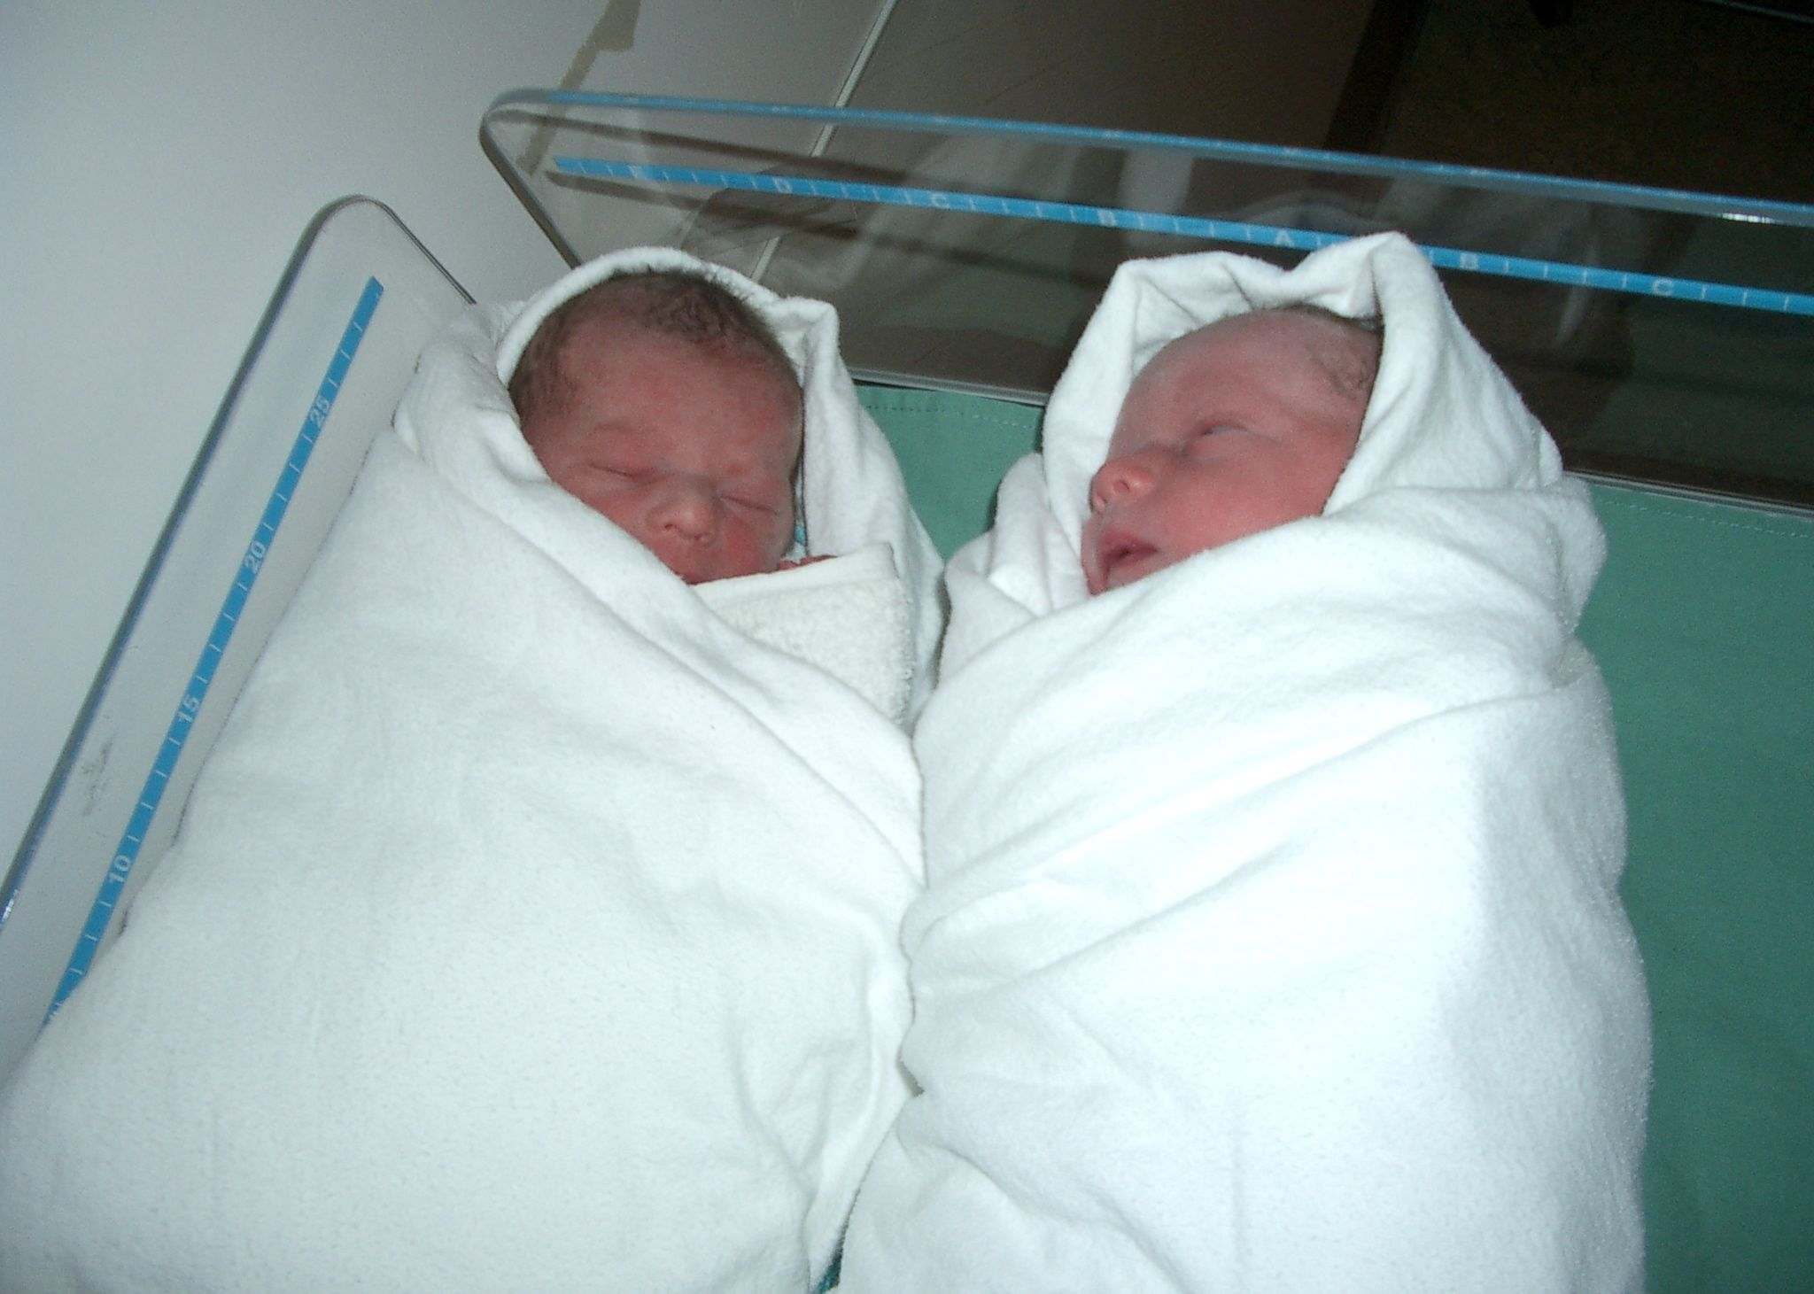
Reproduction

Slide 41
Page 13
Major Points
This unit, in some ways, is a continuation of the role of the endocrine system.
One of the main areas of focus is the role of hormones in sexual maturity, fertility, menstruation, pregnancy and birth.
It is also important to be able to identify the parts and functions of the male and female reproductive anatomy, being able to explain how each part aids in fertility, pregnancy or support of the developing fetus.
16. Without the seminal vesicle secretions, male infertility would increase as semen would lack a source of energy (fructose) needed to survive the journey to the egg. The required source of energy is
A. sucrose
B. fructose
C. carbohydrates
D. ATP

Slide 42
Tips
A common mistake is to confuse sperm with spermatocytes or Sertoli cells with the interstitial cells.
Identity parts of either the ovary or testicular tissues, from drawings or micrographic images.

Slide 43
Page 14
The role of hormones, especially in the female system is a large one. As in the endocrine system it is important to be able to draw feedback loops for all of the hormones involved.
Hormone | Where Hormone is Secreted From | Found In: Male, Female or Both Sexes
GnRH | hypothalamus | both
FSH | anterior pituitary | both
LH | anterior pituitary | both
testosterone | interstitial cells of teste | male
estrogen | maturing follicle, corpus luteum, placenta | female
progesterone | corpus luteum, placenta | female
hGH | chorion | female
prolactin | anterior pituitary | female
oxytocin | posterior pituitary | female

Slide 44
Page 14
Tip In both males and females a common problem is to confuse the roles of both FSH and LH. In males the role of testosterone with FSH or LH is also confused.
Hint: Prolactin stimulates lactation. FSH in males stimulates sperm production and FSH in females stimulates follicle maturation.

Slide 45
Page 14
17. Identify the four phases of the menstrual cycle.
flow, follicular, ovulation and luteal

Slide 46
18. Describe the relative levels of FSH. LH, progesterone and estrogen, and major events that occur in each phase of the menstrual cycle, assuming pregnancy does not occur.
 | FSH | LH | Estrogen | Progesterone | Events
Flow
Follicular
Ovulation
Luteal

Slide 47
18. Describe the relative levels of FSH. LH, progesterone and estrogen, and major events that occur in each phase of the menstrual cycle, assuming pregnancy does not occur.
 | FSH | LH | Estrogen | Progesterone | Events
Flow | Increases | Steady level | Low | Low | Menstruation
Follicular | Steady level | Increase | Increase | Low | Follicle matures, endometrium thickens
Ovulation | Surges | Surges | Increase | Low | Egg is released from mature follicle
Luteal | Lower level | Lowers to steady level | High | High | Ruptured follicle forms corpus luteum, endometrium thickens and vascularizes

Slide 48
If pregnancy does occur fertilization usually occurs in the fallopian tubes.
Implantation of the blastocyst into the endometrial lining of the uterus occurs within two weeks.
Three embryonic membranes develop: chorion (fetal portion of placenta), amnion (amniotic sac) and the allantois (umbilical cord blood vessels).
Gastrulation occurs as the three germ layers, ectoderm, endoderm and mesoderm form, allowing for tissue differentiation to begin.

Slide 49
Tissue Differentiation
Page 15
Ectoderm | epidermis, nervous system, parts of the eye and inner ear
Endoderm | muscles, blood and blood vessels, skeletal structure, reproductive structures
Mesoderm | endocrine glands, lining of reproductive and digestive tracts
The average pregnancy lasts for about 40 weeks that is divided into three trimesters.
First: all the major systems develop; head and limbs begin to develop
Second: baby movements can be felt, sex of fetus visible
Third: time of growth, baby turns to a “head down position” in preparation of birth

Slide 50
During this time the fetus is most adversely susceptible to environmental factors (teratogens) and the lifestyle choices of the mother. Various drugs and microbes can cause life-long problems for the fetus such as neurological/brain damage, low birth weight and limb development abnormalities.
Parturition, or birth, occurs in stages: cervix dilation, rupturing of amniotic sac, uterine contractions due to oxytocin and prostaglandins push the baby out of the body, and expulsion of the placenta (afterbirth).
Tip Students mix up the role of oxytocin (milk release) and prolactin (milk production) after parturition. An easy way to remember: “pro” is in the words prolactin and production.

Slide 51
Page 15
19. Gonorrhea—a sexually transmitted disease—if not treated can travel throughout the female reproductive tract and cause scarring. Infertility can result due to the blockage of the _______i________, preventing ________ii__________. The above statement is completed by the information in row.
Row | i | ii
A. | fallopian tubes | fertilization
B. | fallopian tubes | implantation
C. | ovary | fertilization
D. | ovary | implantation

Slide 52
Page 16
Use the following diagram to answer the following question.
Ovary
D
A
B
C
20. Menopause—the cessation of the menstrual cycle—can lead to uncomfortable symptoms that can be relieved by hormone replacement therapy through the ingestion of synthetic estrogen. The structure normally responsible for production estrogen is
A. | A
B. | B
C. | C
D. | D

Slide 53
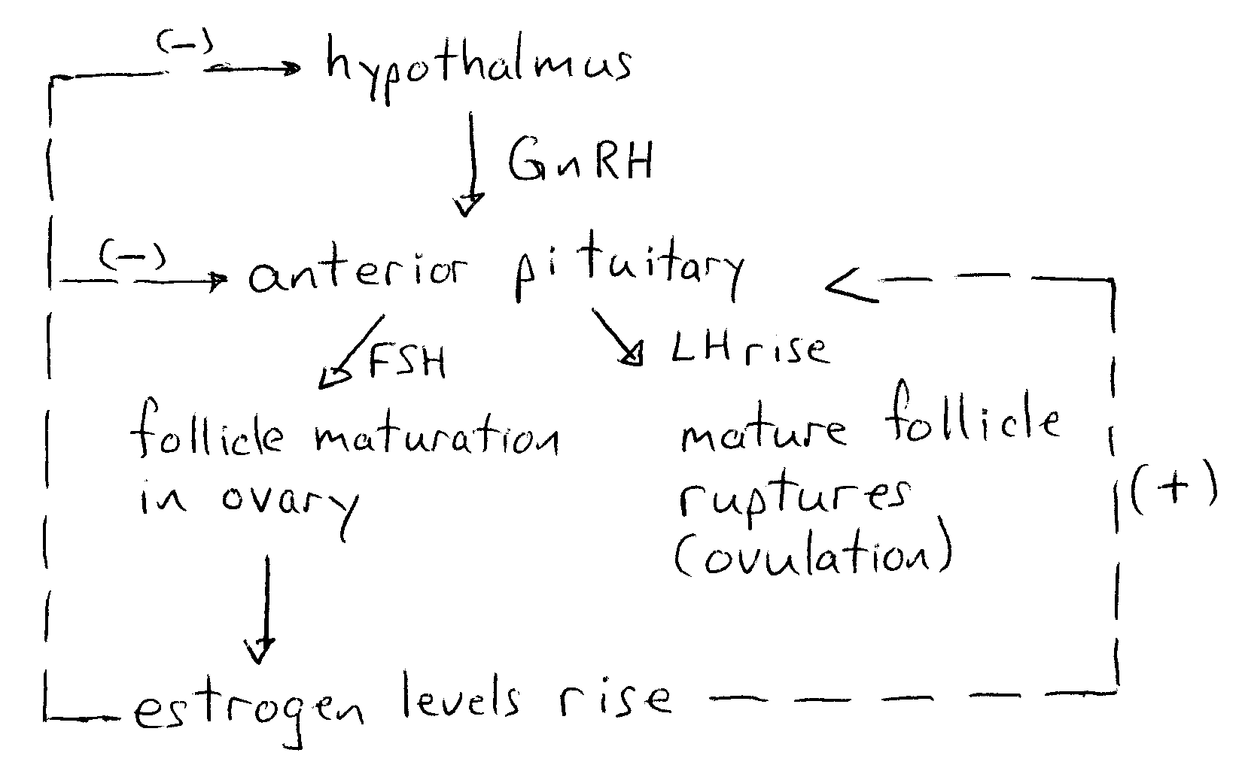
21. Within the menstrual cycle, show both a positive and negative feedback loop in the follicular phase.

Slide 54
Cell Division, Genetics and Molecular Biology
Page 17

Slide 55
Cell Division
Major Points
Homologous Chromosomes—Paired chromosomes (homolog): carry the same genes at the same location. For offspring: one copy of each homolog is from each parent.
Page 17

Slide 56
Homologous Chromosomes—Paired chromosomes (homolog): carry the same genes at the same location. For offspring: one copy of each homolog is from each parent.
Replicated chromosomes: each copy is known as a chromatid or sister chromatid.
Gene: section of a chromosome to make a protein.
Locus: gene location
Centromere: holds chromatids together
Genes may be different forms or alleles.
Note: Sister chromatids may also be referred to as a bivalent.

Slide 57
There are two methods of cell division: mitosis and meiosis.
Mitosis: Creates cells genetically identical (clone) to the original cell; maintains chromosome number.
Meiosis: Creates cells that are not genetically identical to the original cell; halves the chromosome number.
Tip It is important to recognize the stages of both mitosis and meiosis from both images and descriptions. Pay close attention to terms like chromosome versus chromatid; whether or not the chromosomes are replicated or homologs are paired up or not.

Slide 58
Page 18
Phase of Mitosis | Main Events of Phases
Prophase | Chromosomes condense (from distinct visible rod-like structures) with the replicated chomatids held together by the centromere. Spindle fibres form and attach to centromeres and centrioles. Nuclear membrane begins to dissolve.
Metaphase | Chromosomes have aligned themselves at the cell’s equator.
Anaphase | Centromeres divide and the sister chromatids are separated and move to opposite poles of the cell. Chromatids are now referred to as chromosomes.
Telophase | Chromosomes have reached the opposite poles—spindle fibres are broken up. Cell furrow develops in the animal cell and cell plate in the plant cell. Nuclear membrane begins to reform, DNA starts to become uncondensed.
Gap 2 (G2): cell prepares for division
Mitosis
Cytokinesis: Division of cytoplasm
Synthesis (S):
Replication of chromosomes
Gap 1 (G1): cell growth and normal function

Slide 59
Tip Remember that the cell cycle refers to interphase, mitosis and cytokinesis.
Meiosis has two phases, which, between the two, includes one chromosome replication event and two cytokinesis events.
The table below focuses on the differences between mitotic and meiotic phases.

Slide 60
Page 19
Meiosis I—Undergoes the same events as mitotic interphase.
Prophase I | Bivalents line up side by side (synapsis); tetrads formed within the tetrad chromatids exchange alleles (crossing over) Result: genetic diversity increases as sister chromatids are no longer identical
Metaphase II | Tetrads line up along the equatorial plate
Anaphase II | Homologs are separated; the tetrad splits into 2 sets of bivalents.
Telophase II | Same as mitosis excepts the bivalent remain joined by centromeres; Cyctokinesis follows
Prophase II | Same as mitosis
Metaphase II | Bivalents line up at equatorial plate
Anaphase II | The bivalents are split into chromosomes
Telophase II | Same as mitosis; cytokinesis follows
Meiosis II—no interphase occurs
Tip: Meiosis I is also called the reduction division as the original diploid cell has been split into 2 haploid cells because the homologs were separated, even though the bivalents have not yet been divided.

Slide 61
Errors in Mitosis and Meiosis
Mitosis | Meiosis
Cancer is uncontrolled cell division. | Improper separation of chromatids in meiosis can lead to nondisjunction.

Slide 62
22. Contrast the events between mitosis and meiosis.
 | Mitosis | Meiosis
Cytoplasmic division | Once | Twice
Occurs In | Somatic (body) cells | Gonads
Number of cells produced | Two | One in female and four in male
Ploidy of Original Cell | Diploid | Diploid
Chromosome content in products | Same as parental cell | Half of parental cell
Crossing over | No | Yes

Slide 63
23. Somatic cells that were treated with a chemical that prevented spindle fibre formation would not complete the cell cycle because they would stop during…
A. | anaphase
B. | interphase
C. | prophase
D. | metaphase

Slide 64
Page 20
24. Down’s Syndrome (Trisomy 21) is due to an error in ____i___ known as ____ii____. The above statement is completed by the information in row:
Row | i | ii
A. | mitosis | nondisjunction
B. | mitosis | crossing over
C. | meiosis | crossing over
D. | meiosis | nondisjunction

Slide 65
Page 20
DNA and Protein Synthesis
Major Points
DNA (deoxyribonucleic acid) | RNA (ribonucleic acid)
Double stranded helix; each strand bonds in a complimentary (antiparallel) manner. Ladder-like construct. | Single stranded, its nucleotides form in a complimentary manner to DNA
Composed of nucleotides: adenine (A), guanine (G), cytosine (C), thymine (T) | Composed of nucleotides: adenine (A), guanine (G), cytosine (C), uracil (U)
Nucleotide = deoxyribose sugar + phosphate for backbone; ladder rungs = one of A, C,T, or G | Nucleotide = ribose sugar +phosphate for backbone and one nitrogenous base of A, C, U, or G
A bonds with T; C bonds with G | A bonds with U; C bonds with G

Slide 66
DNA replication (S phase of interphase) occurs simultaneously at many sites along a chromosome.
Steps:
1. Semiconservative Replication = “old” strands serve as templates for new DNA strands.
2. DNA helicase breaks the hydrogen bonds holding the nucleotide base pairs together.
3. RNA primers are inserted to act as starting points for DNA synthesis.
4. DNA Polymerase III can “read” the template and continuously adds nucleotides. One strand (leading) is made from a single continuous strand. The other strand (lagging) is made up in small fragments (Okazaki).
5. DNA polymerase I follows polymerase III and replaces primers with DNA nucleotides, leaving small gaps.
6. Ligase joins the gaps together; synthesis is complete.

Slide 67
Protein Synthesis
Page 21
Genes (base pair)
mRNA
Amino acids bonded by a peptide bond to form a protein or polypeptide
Hint: Transcription is from DNA to mRNA.

Slide 68
The DNA does not leave the nucleus (master copy, stays protected). A copy is made called messenger RNA (mRNA). It carries the code from the nucleus to the ribosomes in the cytoplasm where the protein is assembled.
Nucleotides in the mRNA are arranged in a complimentary fashion using the nucleotides on the DNA as a blueprint: DNA: TGGACA becomes mRNA: ACCUGU.
The mRNA attaches itself to the ribosome where it is “read” in a triplet code called a codon. Most amino acids have more than one codon (except methionine and tryptophan) and there are 3 stop codons that signal the end of protein synthesis. There is also an initiator or start codon.
Transfer RNA (tRNA) molecules in the cytoplasm contain an anticodon that is complementary to the mRNA codon. The tRNA picks up amino acids and brings them to the mRNA. The anticodon and codon bind causing the amino acid to be released from the tRNA and to bind to the adjacent amino acid. This process continues until the stop codon is reached and the completed protein is released.

Slide 69
Page 21
Tip Practice moving from: DNA ↔ mRNA ↔ protein
tRNA
DNA | GAATCTCCA
mRNA | CUUAGAGGU
Amino acid sequence | leucine—arginine—glycine
tRNA anticodons | GAA UCU CCA

Slide 70
Errors (copy errors or contact with a mutagen) in the DNA base sequence cause mutations. Only those errors found in gametes can be inherited by the offspring.
There are many ways to manipulate and recombine DNA both within a species and between species through recombinant technology.

Slide 71
Page 22
Technology and its Uses
DNA sequencing | Determine nucleotide order in a DNA molecule for use in the study of evolution, disease, drug synthesis fingerprinting, GMO’s, etc.
PCR—polymerase chain reaction | Replicate small sections of DNA or RNA.
Restriction enzymes | Cut DNA at specific base pair sequence (recognition site).
Ligase | Enzyme that join sections of DNA together.
Recombinant technology | DNA from two sources are cut with a restriction enzyme and joined together with ligase.
Bacterial transformation | Recombinant technology is used to place a gene of interest into a plasmid to study/produce the protein.

Slide 72
25. Contrast DNA with mRNA.
DNA | mRNA
Double stranded | Single stranded
A bonds with T | A bonds with U
Deoxyribose sugar | Ribose sugar
Found only in nucleus | Found in nucleus and cytoplasm

Slide 73
Use the following information to answer the next question.
histidine—threonine—tryptophan—phenylalanine
26. Given the amino acid sequence above, the correct DNA sequence is…
A. | GTA TGC ACC AAA
B. | GTT TGC ACC AAA
C. | GTA TGC TCC AAA
D. | GTT TGA TCC AAA

Slide 74
Use the following information to answer the next question.
Original DNA strand: TAGGGCAGAATC
Mutated strand 1: TAGGGAAGAATC
Mutated strand 2: TAGGGCATTATC
27. Which mutated strand may be more harmful and why?
Original | TAG/GGC/AGA/ATC | AUG/CCG/UCU/UAG
Mutated 1 | TAG/GGA/AGA/ATC | AUG/CCU/UCU/UAG
Mutated 2 | TAG/GGC/ATT/ATC | AUG/CCG/UAA/UAG
Both mutations are point mutations, but strand 1 is a silent mutation because both second codons code for the same amino acid proline so the protein sequence remains unchanged. Strand 2 is harmful in that the third codon changes from serine to a stop codon causing the sequence to end prematurely, thereby changing the protein.

Slide 75
28. Briefly describe the processes involved between DNA, RNA and amino acids in the creation of a protein.
Translation: occurs in the nucleus, a complimentary strand of mRNA is made of the base sequences in the section of DNA coding for the protein. An “A” in DNA is replaced with a “U” in the mRNA.
Transcription: occurs in the cytoplasm, the mRNA attaches to a ribosome where each 3 bases (codon) are read and a tRNA molecule with its matching anticodon ferries the correct amino acid to the ribosome. A peptide bond is formed between the amino acids until the end of the mRNA sequence is reached (stop codon).

Slide 76
Mendelian & Human Genetics
Major Points
Alleles: Possible forms of a gene that can be expressed. Two common types are listed below.
Dominant: symbol = capital letter. Need only one copy of the allele in order to express (observe or measure) the trait.
Recessive: symbol = lower case letter. Need two copies of the allele in order to express the trait.
Homozygous: alleles for a trait are identical—AA or aa.
Heterozygous: hybrid: alleles for a trait are not the same—Aa.
Genotype: The type of alleles an organism has for a trait or traits.
Phenotype: The observable traits or characteristics due to the alleles present in an organism.
Example: Tongue Rolling = trait Alleles: R, r
Dominant phenotype: ability to roll the tongue; genotype: R—(Rr or RR)
Recessive phenotype: cannot roll the tongue; genotype: rr

Slide 77
The Punnett square can be used to determine the inheritance of single traits. It shows all possible outcomes of an offspring, not the amount of offspring per generation. Each inner space represents one probable outcome that is independent to all other probable outcomes.
Single Trait Cross or a Monohybrid Cross
Rr × Rr P₁ = first parental generation
gametes
R
r
gametes
R
RR
Rr
r
Rr
rr

Slide 78
Page 24
29. Calculate the probability of the first child born having the ability to roll the tongue and the second child born not being able to roll the tongue.
3/4 × 1/4 = 3/16 = 0.19
Test Cross: Used to determine the genotype of a dominant trait by crossing the organism with a homozygous recessive and looking at the offspring phenotypes to infer parental genotype.

Slide 79
Tall stem in a plant = T Short stem = t
A plant has tall stems. Illustrate, using a test cross, how the probable genotype of the tall stemmed plant can be determined.
Outcome 1: If tall stemmed is TT
Outcome 2: If tall stemmed is Tt
T
T
T
t
t
TT
TT
t
Tt
Tt
t
Tt
Tt
t
tt
tt

Slide 80
Page 24
Other patterns of inheritance:
Major Points
Incomplete dominance | Two alleles together (hybrid) create an intermediate (blended) phenotype | Flower Colour: BB = blue, RR = red, BR = purple
Codominance | Two alleles are equally dominant and the hybrid produces both phenotypes | Cat Fur Colour: BB = black, TT = tan, BT = patches of black and tan fur
Sex-linked | Alleles are found on the sex chromosome (usually the X) | Traits are seen more often in males (have only one X chromosome.
Multiple alleles | Several alleles are involved and often show dominance in a hierarchy | Eye Colour: C^{br} = brown, C^{g} = green and C^{bl} = blue. Order of dominance: C^{br} < C^{g} < C^{bl}

Slide 81
Dihybrid Cross—when two traits are inherited.
Page 25
Law of Independent Assortment—genes on different chromosomes separate into gametes independently from one another.
For dogs: Coat Colour: B = brown coat, b = white coat
Hair type: W = smooth hair, w = wire hair
A cross between a homozygous brown, smooth coat and a white wire coat.
BBWW × bbww P₁
possible gametes BW, bw
F₁ generation genotype = BbWw (all brown, smooth coat)
P₂ generation = cross 2 F1 organisms = BbWw × BbWw

Slide 82
31. Give the phenotypic ratio of the offspring for the P₂ generation.
Possible gametes (same for each parent): BW, Bw, bW, bw
Male parent
BW
Bw
bW
bw
BW
BBWW
BBWw
BbWw
BbWw
Female parent
Bw
BBWw
BBww
BbWW
Bbww
bW
BbWW
BbWw
bbWW
bbWw
bw
BbWw
BbWw
bbWw
bbww
Tip Recognize some of the common phenotypic ratios when heterozygotes are crossed.

Slide 83
Tip Recognize some of the common phenotypic ratios when heterozygotes are crossed.
Some combinations of heterozygotes mated result in phenotypic ratios different from the expected 9:3:3:1 produced by dihybrid crosses.
Genes on the same chromosomes will not sort independently of each other, and tend to be transmitted together (linked genes).
When crossing-over occurs in prophase I, it can alter gene linkages. Genes near each other on a chromosome almost always end up together after crossing-over.
If two genes are far apart on a chromosome, they are more likely to be affected by crossing-over.
Two genes with a recombinant cross-over value of 5% are much closer together that two genes with a value of 15%.
Cross-over frequencies is related to map distance, or the distance between genes on a chromosome—1% recombinant or cross-over frequency = 1 map distance unit

Slide 84
Use the following information to answer the next question.
Cross over Frequency: D and X 5%
B and E 10%
X and B 5%
D and E 20%
32. Using the above information, create a gene map.
D
X
B
E

Slide 85
Pedigree Analysis
Page 26
A pedigree chart is the usage of family history to study the inheritance of trait.
This pedigree chart represents a typical sex-linked recessive inheritance pattern.
B = normal, b= affected
I-1: X^{B}X^{b}
I-2: X^{B}Y
II-1: X^{B}X^{b} or X^{B}X^{B}
II-2: X^{b}Y
II-3: X^{b}Y
II-4: X^{B}X^{b}
III – 1: X^{b}X^{b}
I – 1
I – 2
II – 1
II – 2
II – 3
II – 4
III – 1

Slide 86
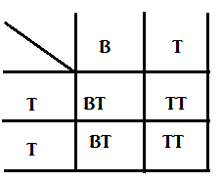
Use the following information to answer the next question.
A small rodent population has three coat colours: homozygous for the B allele = black
homozygous for the T allele = tan
heterozygous = patches of black and tan fur
33. Give the phenotypic and genotypic ratios when black/tan male is crossed with a tan female.
Phenotypic: 50% tan: 50% black/tan
Genotypic: 50% TT: 50% BT

Slide 87
34. A second gene on the X chromosome causes patches of fur to fall out. It is a recessive condition. (N = normal fur, n = patchy fur.) What is the phenotypic ratio if a black carrier female mates with an affected black/tan male?
Male parent
BX^{N}
BY
TX^{N}
TY
BX^{N}
BBX^{N}X^{N}
BBX^{N}Y
BTX^{N}X^{N}
BTX^{N}Y
Female parent
BX^{n}
BBX^{N}X^{n}
BBX^{n}Y
BT^{N}X
BTX^{n}Y

Slide 88
35. What is the most likely mode of inheritance as demonstrated by the following pedigree chart? Give the genotypes of each person. A shaded shape indicates an afflicted person.
Genotypes:
I-1 = DdII-6 = dd
I-2 = ddIII-1 = DD or Dd
II-1 = ddIII-2 = DD or Dd
II-2 = DdIII-3 = dd
II-3 = DdIII-4 = dd
II-4 = DdIII-5 = dd
II-5 = dd

Slide 89
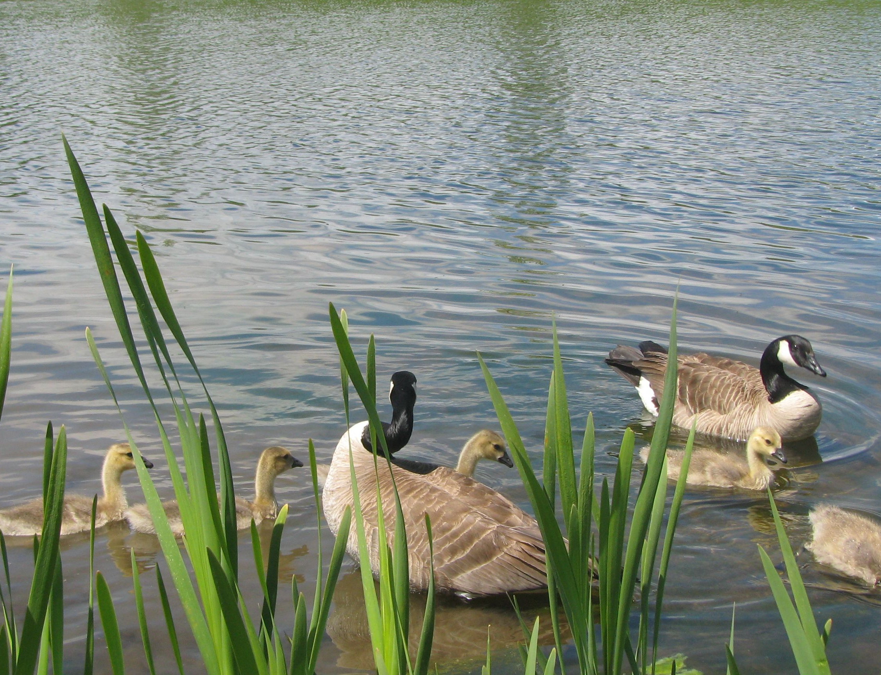
Population and Community Dynamics
Page 28

Slide 90
Page 28
Major Points
Population genetics is the study of the genetic composition of a population. This information can be used to look at the overall diversity of a population. It provides a way to study natural selection and evolution.
Hardy Weinberg Principle provides a mathematical model to measure both allele and genotypic fluctuations. This principle predicts that if certain factors remain constant, the gene pool will maintain a constant composition over many generations.

Slide 91
Factor | Changes to Gene Pool
No mutations occur. | New alleles arise and enter the population.
No gene flow can occur (no migration into or out of the population). | New alleles can be introduced or the loss of alleles can occur.
Random mating must occur (individuals must pair by chance). | If some individuals are more successful in getting a mate then gene frequencies can be changed.
The population must be large. | Genetic drift (changes due to random chance) can cause the allele frequencies to change.
No natural selection. | Certain alleles are selected for while others are not.

Slide 92
Genetic drift—two types:
i. Founder Effect—a small group breaks away from the main group to start a new population, lowering genetic diversity.
ii. Bottleneck Effect—starvation, disease, human activities, or natural disasters can quickly reduce a large population. The survivors only have a subset of the alleles present before the disaster, and therefore, the gene pool loses diversity.
In both of these cases, alleles are lost and some traits become magnified due to interbreeding within the population.

Slide 93
Page 29
There are two formulas to measure gene pool changes.
p² + 2pq + q² = 1
p + q = 1
Where:
p = frequency of allele #1 (often the dominant one)
q = frequency of allele #2 (often the recessive one)
p² = frequency of homozygous allele #1
q² = frequency of homozygous allele #2
2pq = frequency of heterozygotes

Slide 94
Tip Pay attention to what type of frequency you are looking for.
p and q = allele
p² , q², 2pq = genotype
p² + 2pq = phenotypic of trait p if it is dominant
q² = phenotypic of trait q if it is recessive

Slide 95
Page 29
36. In a population of pigs, 80% show the dominant trait of a pink coat colour (C), with a black colour being recessive (c). Calculate the allele and genotypic frequencies.
Let p = pink coat colour and q = black coat colour
p² + 2pq = 0.80 so q² = 0.20
q = √0.20 = 0.45
p = 1 – q = 1 – 0.45 = 0.55
Allelic frequencies: p = black coat = 0.55 = C
q = pink coat = 0.45 = c
Genotypic frequencies: CC = p² = (0.55) ² = 0.30
Cc = 2pq = 2(0.55) (0.45) = 0.50
C = q² = 0.20

Slide 96
Page 30
37. For each scenario, label it as either due to the Founder or Bottleneck Effect.
Scenario 1:
Aboriginal people in North and South America were thought to have arrived after the end of the last ice age. They tended to be mainly type O and Rh positive in the human blood grouping system. There appears to be no natural selection towards any blood type.
Founder Effect
Scenario 2:
The Wood Bison are listed as an endangered species in Canada. They were found in great numbers in the early 1800’s, but nearly 100 years later they were considered to be extremely rare, mainly due to human hunting practices.
Bottleneck Effect

Slide 97
38. Tay Sachs Disease, an autosomal recessive disorder, causes neurological damage that result in death by ages 5–8 years old. The frequency of the Tay Sachs allele is 2% in people of an Eastern European Jewish descent. Calculate the frequency of having the disease and the frequency of being a carrier.
q = 2% = 0.02 so the frequency of having the disease = q² = 0.0004
p = 1 – q = 1 – 0.02 = 0.98, so the frequency of being a carrier = 2 pq = 2(0.98)(0.02) = 0.04

Slide 98
39. Huntington’s Disease is an autosomal dominant disorder that causes a degeneration of the brain tissue so that people afflicted forget how to walk, talk, think and have memory problems. It is eventually fatal. The incidence of those afflicted is 6 in every 100,000. Calculate the allelic frequencies.
p² + 2pq = 6/100,000 = 0.0077 so q² = 0.99
q = √0.99 = 0.99 and p = 1 – q = 1 – .99 = 0.01

Slide 99
40. List the five factors that are needed in order to maintain Hardy–Weinberg equilibrium in a population.
No mutation, no gene flow, random mating, population are large and no natural selection.

Slide 100
Page 31
It is often more useful to compare populations by looking at population density (the number of individuals in a given area or volume).
D = N / A D = N / V
Where:
D = density of organisms (organisms/unit)
N = # of organisms
A = size of area in units or V = volume (aquatic habitats)

Slide 101
Page 31
The size of a population can be affected by the following factors:
1. Natality—number of births.
2. Mortality—number of deaths.
3. Immigration—number of organisms moving into an area.
4. Emigration—number of organisms moving out of an area.
When these factors are combined, three other formulas can be used to study populations.
A. population change:
∆N = (births + immigration) – (deaths + emigration)

Slide 102
B. per capita population growth rate:
(births immigration) – (deaths emigration)
= ∆N/N
cgr =
initial number of organisms
C. growth rate:
gr = ∆N/∆t where t = time

Slide 103
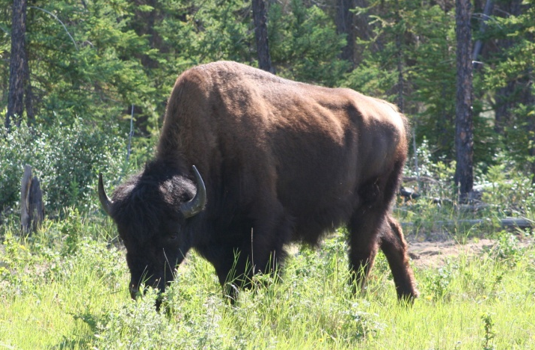
Use the following information to answer the next two questions.
In 2004, a herd of 500 bison in northwestern Canada was studied until 2010. In that time, 300 calves were born, 60 were placed in the herd from a bison farm and 200 died from an outbreak of tuberculosis.
41. Calculate the per capita growth rate. Record your answer as a whole number percentage.
cgr = (births + immigration) – (deaths + emigration) = ∆N/N
initial number of organisms
cgr = (300 + 60) – (200 + 0) = 0.32 bison or an increase of 32%
500

Slide 104
Calculate the growth rate. + ______ bison/year.
(Record your answer to the nearest whole number.)
2 7
gr = ∆N/∆t = 160 bison/6 years = + 27 bison/year
0
0
0
0
1
1
1
1
2
2
2
2
3
3
3
3
4
4
4
4
5
5
5
5
6
6
6
6
7
7
7
7
8
8
8
8
9
9
9
9

Slide 105
Page 32
Biotic potential is another factor that influences the rate of population growth. It is the maximum growth rate under ideal conditions. Its influence depends on a number of factors.
1. Offspring—the maximum number of offspring per birth.
2. Capacity for Survival—the chances of offspring reaching reproductive age.
3. Procreation—the number of times per year an organism reproduces.
4. Maturity—the age at which reproduction begins.
Biotic potential is held in check by environmental resistance—things that inhibit population growth, such as access and availability of food, water, and so forth.

Slide 106
Page 33
Population changes over a time period can be studied by using graphical analysis. There are two types of growth curves—the J-shaped and logistical curve.
Generally, growth begins slowly (lag phase) and then the rate of growth increases (growth or exponential or log phase). However, the growth must eventually slow because there are a maximum number of organisms that an ecosystem can support—its carrying capacity. At this point, the population fluctuates near the carrying capacity. If conditions become more adverse than the population can handle, a death phase can occur until a new carrying capacity is reached or the population dies off.
J-Shaped Curve
Population size
log or growth phase
lag phase
Time

Slide 107
Population changes over a time period can be studied by using graphical analysis. There are two types of growth curves—the J-shaped and logistical curve.
Logistic/S-shaped/sigmoidal growth curve
A population quickly outgrows the carrying capacity of an ecosystem so there is a crash in the population.
These curves are most often associated with organisms that can reproduce very quickly (insects, bacteria).
Stationary/carrying capacity
death phase
Population size
log or growth phase
lag phase
Time

Slide 108
Page 34
Population Types:
K-selected populations: tend to be controlled by density dependent factors (factors that are more prevalent in larger populations, such as limits to food supply, disease, and predation), tend to stay near carrying capacity and tend to exhibit an S-shaped curve.
Other characteristics of K-selected species include:
– late sexual maturation – fewer, larger young
– longer life spans – more parental care
– intense competition for resources – large body size

Slide 109
Population Types:
r-selected populations: tend to be controlled by density independent factors (not affected by population density and include climate changes—storms, floods, and drought), tend to increase population size very rapidly and to exhibit a J-shaped curve.
Other characteristics of r-selected species include:
– early maturation
– numerous, smaller young
– shorter life spans
– less parental care
– smaller body size
– little competition for resources

Slide 110
Tips
Humans are a K–selected species, but due to advances in health and technology, show a J-shaped curve.
Major Points
Relationships between many species living in a common area (community) are studied as the competition between populations is the driving force behind population dynamics.
Intraspecific competition: members of the same species compete for resources such as food, space and mates. Examples: courtship rituals or aggression between males during mating season.
Interspecific competition: between two different species, often times for food/water and space. Examples: predator/prey and producer/consumer interactions.

Slide 111
These are often closely tied to one another (for instance, if a prey population declines, it is likely that the predator species will as well).
Predators are important in ecosystems as they reduce the number of primary consumers that are feeding on producers. Often predators and prey co-evolve in an attempt to gain an upper hand.
Predator and/or prey develop camouflage to escape detection.
Organisms produce physiological adaptations such as plant toxins or spikes to avoid being eaten.
Some animals will engage in mimicry—developing markings similar to that of a poisonous or dangerous animal—to warn away predators.

Slide 112
Page 35
Organisms from two different species live in close relationship in which at least one of them benefits.
1. Commensalism—one benefits, other unaffected (+/0).
2. Parasitism—one benefits, other harmed (+/–).
3. Mutualism—both benefit (+/+).
When a community is disturbed or there is an opportunity for life where none had previously existed, there occurs a series of orderly replacement of one community by another. This series of changes is called “succession.”
Climax communities are eventually formed through this process. These are stable, mature ecosystems. If these changes occur in areas where there was previously no life (such as barren volcanic islands), this is called “primary succession.”
Secondary succession occurs after the partial or complete destruction of a community (areas where life had existed—after a flood or fire).

Slide 113
Stages of Succession
Bare land is formed.
Pioneer species, such as mosses and grasses that are relatively hardy, move in and create shade, thereby reducing soil temperature and rate of water evaporation, while increasing soil fertility.
Small shrubs that tolerate full sunlight move in, stabilizing and enriching the soil. Decay of organisms further enriches soil nutrients.
Small, fast-growing trees replace the shrubs, creating more shade.
A climax community forms, produced from shade-tolerant trees, which have a high sapling survival rate and are stable.

Slide 114
43. How does the amount of biomass and the number of species change in an area that undergoes secondary succession to a climax community?
As succession continues, the biomass steadily increases until a steady mass is reached. The number of species also rises, levels out, but at the climax stage it will have decreased somewhat.
44. This symbiotic relationship between tick and grouse, and the type of factor affecting the grouse population size, can be best described as…
Row | symbiotic relationship | factor
A. | predation | density dependent
B. | predation | density independent
C. | parasitism | density dependent
D. | parasitism | density independent

Slide 115
Page 36
Use the following graph to answer the next two questions.
45. The section of the graph from June to July is most likely due to a…
A. high biotic potential and a high environmental resistance.
B. low biotic potential and a low environmental resistance.
C. low biotic potential and a high environmental resistance.
D. high biotic potential and a low environmental resistance.

Slide 116
Use the following additional information to answer the next question.
The female mosquito lays the eggs in standing water where they can hatch and develop into adults in a few weeks. Adults can live for up to four weeks.
46. The mosquitoes are a ____i____ selected species and they exhibit a ___ii___ growth curve.
Row | i | ii
A. | r | J-shaped
B. | r | logistic
C. | k | J-shaped
D. | k | logistic

Slide 117
Page 37
Additional Questions
When receptors in the semicircular canals are stimulated the area of the brain responsible for interpreting the information is the…
A. Cerebrum. C. parietal lobe.
B. Cerebellum. D. temporal lobe.

Slide 118
Bill was diagnosed with testicular cancer and had surgery to remove the testes. After the surgery Bill received hormone supplements containing…
A. FSH C. Testosterone
B. LH D. inhibin

Slide 119
49. Despite the hormone therapy Bill was now considered to be sterile (inadequate sperm production), mainly due to the removal of…
A. seminiferous tubules that produced sperm.
B. seminiferous tubules that produced testosterone.
C. sertoli cells that produced sperm.
D. sertoli cells that produced testosterone.

Slide 120
Use the following diagram to answer the next question.
Sporophyte (2n)
1
2
zygote
Spores (n)
Male gamete
4
3
Female gamete
Gameophyte (n)
50. The process represented from 1 to 4 is…
A. mitosis, meiosis, mitosis, meiosis
B. mitosis, meiosis, mitosis, mitosis
C. mitosis, meiosis, meiosis, mitosis
D. mitosis, mitosis, meiosis, meiosis

Slide 121
Page 38
Use the following information to answer the next question.
1. Restriction enzymes to cut out the gene and cut the plasmid.
2. DNA ligase to cut out the gene and cut the plasmid.
3. DNA ligase to join the gene and plasmid together.
4. DNA helicase to join the gene and plasmid together.
51. In order to create a recombinant DNA molecule between a human gene and a bacterial plasmid, the following two enzymes needed are numbers…
A. 1 and 4 C. 2 and 3
B. 2 and 4 D. 1 and 3

Slide 122
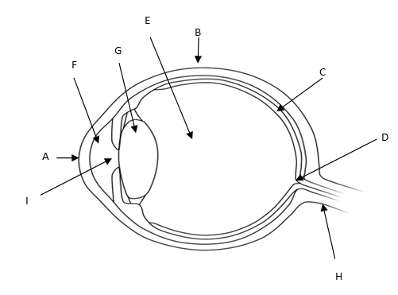
Use the following diagram to answer the next question.
52. The structure labelled ___i___, helps to focus the light onto structure ___ii___, which is where the photoreceptors are located.

Slide 123
Row | i | ii
A. | A | D
B. | A | C
C. | G | C
D. | G | D

Slide 124
Page 39
53. The birth control pill contains high levels of hormones needed to maintain a pregnancy so they “trick” the body into thinking that it is pregnant. Which of the following rows identifies the hormones found in the birth control pill, the type of feedback that occurs and the effect of these hormones on the female body?
Row | Hormones in the Birth Control | Type of Feedback | Effect of the hormones on the female
A. | estrogen and progesterone | positive | Increases FSH and LH production.
B. | estrogen and progesterone | negative | Inhibits FSH and LH production.
C. | FSH and LH | positive | Increases estrogen and progesterone production.
D. | FSH and LH | negative | Inhibits estrogen and progesterone production.

Slide 125
54. Which of the following rows correctly identifies the sequence: DNA, mRNA, tRNA, amino acid?
Row | DNA | mRNA | tRNA | Amino acid
A. | GCT | CGU | GCA | arginine
B. | GCT | CGA | GCU | alanine
C. | GCT | CGA | GCU | arginine
D. | GCT | CGU | GCA | alanine

Slide 126
55. The term below that is a type of genetic drift is…
A. | gene flow
B. | founder effect
C. | random mating
D. | random dispersion

Slide 127
56. Match each of the structures with the appropriate function. A function can be used more than once.
Function: 1 = hearing 2 = static equilibrium 3 = dynamic equilibrium
1
2
1
3
_________ ________ ________ ________
ossicles
vestibule
cochlea
semicircular canals

Slide 128
Page 40
57. Match the label to the correct description.
______________ _____________ _________________ _____________
1
8
9
4
Part of sclera that transmits light
Relays neural impulse to brain
Controls quantity
of light entering eye
Area lacking
photoreceptors

Slide 129
Page 41
Use the following information to answer the next question.
Hormone
1. insulin
2. ADH
3. cortisol
4. aldosterone
Effect on Blood Glucose Levels
5. increase
6. decrease
58. Blood glucose levels can be directly affected by a number of the body’s hormones. From the tables above, choose the information to correctly complete the following information (there can be more than one answer).
Hormone: ________
(Record in the first column)
Effect on blood sugar Levels: ________
(Record in the second column)
Hormone: ________
(Record in the third column)
Effect on blood sugar Levels: ________
(Record in the fourth column)
1635 or 3516

Slide 130
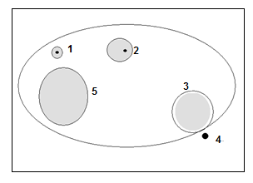
Use the following information to answer the next question.
Diagram of a Female Ovary
59. Match each of the structures with the appropriate name or process. Each number may be used once.
145
______________ _____________ _________________
primary follicle
ovulation
corpus luteum

Slide 131
Page 42
60. Use the list below to answer the next question.
1. Mitosis only.
2. Meiosis only.
3. Both mitosis and meiosis.
_______ Bivalents line up along the equatorial plate (record in the first column).
_______ Reduction division occurs (record in the second column).
_______ Alleles are exchanged between chromatids (record in the third column).
_______ Genetic content is duplicated exactly and divided into two cells (record in the fourth column).
3221

Slide 132
Use the following information to answer the next question.
1. Ligase joins DNA together.
2. Helicase breaks the hydrogen bonds between bases.
3. Nucleotides are added.
4. Primers are added.
61. The order in which DNA is synthesized is: _____, _____,_____, and _____.
2431

Slide 133
Use the following information to answer the next question.
4 and 2 9%
2 and 3 2%
1 and 3 15%
1 and 4 4%
62. The correct order of genes 1 to 4 is: _____, _____, _____, and _____.
1423 or 3241

Slide 134
Page 43
63. Red/green colour-blindness is a sex–linked recessive disorder. What is the probability of a colour-blind male and a carrier female producing a colour-blind female child?
Answer: _________
(Record your answer as a value between 0 and 1 rounded to two decimal places.)
0.25

Slide 135
64. Calculate the recessive allele frequency when the homozygous dominant is expressed 34%, heterozygous is expressed 66%, and the recessive genotype is lethal.
Answer: _________
(Record your answer as a value between 0 and 1 rounded to two decimal places.)
0.42

Slide 136
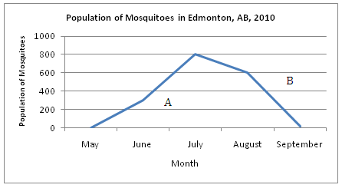
Page 44
Use the following information to answer the next question.
65. Calculate the population density at point B if the area surveyed covered 625 km².
Answer: _________ mosquitoes/km²
(Record your answer as a value rounded to two decimal places.)
0.96

Slide 137
66. Calculate the growth rate of the mosquitoes between point A (June 15) and point B (August 15).
Answer: _________ + mosquitoes/month
150

Slide 138
Strategies for the Biology 30 Diploma Exam

Slide 139
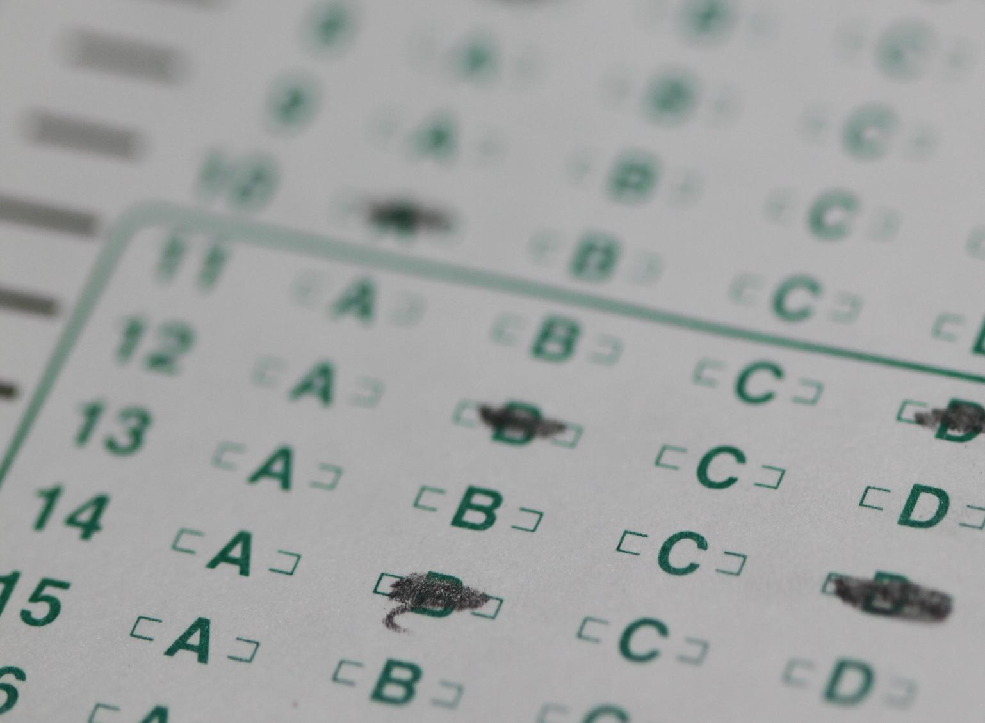
Multiple Choice Strategies

Slide 140
Multiple Choice Strategies
The multiple choice responses have a nearly equal amount of A, B, C and Ds. They make sure no pattern appears; guessing is a 25% proposition.
If you have spent 2–3 minutes and still do not have an answer, go on to the next question and come back to it later.
The text box should be read carefully as it will contain information necessary to answer the question.

Slide 141
Numerical Response Strategies

Slide 142
Three types of numerical response questions will be on the Diploma Exam
Answer from a calculation
Selecting from a list or a diagram
Identification of a sequence of events
The numbers must be correctly entered into the box. The front of the exam has examples if needed. Show your work.
• Record your answer on the answer sheet provided by writing it in the boxes and then filling in the corresponding circles.
• If an answer is a value between 0 and 1 (e.g., 0.25), then be sure to record the 0 before the decimal place.
• Enter the first digit of your answer in the left-hand box and leave any unused boxes blank.

Slide 143
Continue to practice old diploma exam questions and study hard
One must learn by doing the thing, for though you think you know it, you have no certainty until you try.
Aristotle

