Slide 1
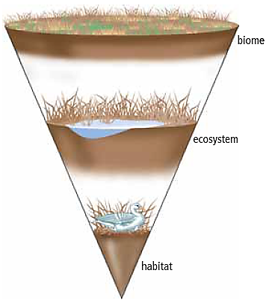
1.1 Biomes
The word “biosphere” refers to the area on and near Earth’s surface where living things exist.
A biome is a region with
similar biotic and abiotic components.
Biotic = living things
(animals, plants, bacteria, etc.)
Abiotic = non-living things
(air, water, soil, etc.)
The Biosphere

Slide 2
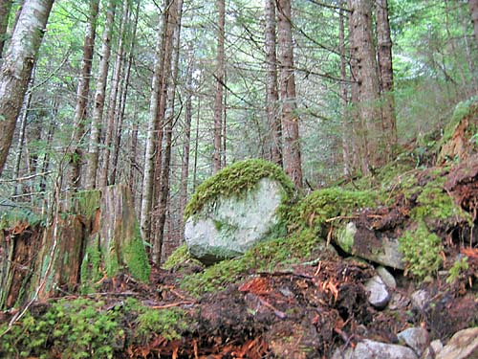
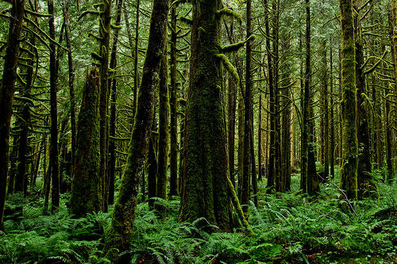
Same biome, different place…
If biotic and abiotic conditions are the same, similar biomes can exist far apart.
A biome in B.C. can be the same as a biome in New Zealand.

Slide 3
Biome Classification
Biomes are classified based on many qualities, such as water availability, temperature, and interactions between biotic and abiotic factors.
Examples of Terrestrial (Land) Biomes:
Boreal forest
Desert
Grassland
permanent ice
temperate deciduous forest
temperate rainforest
tropical rainforest
tundra.

Slide 4
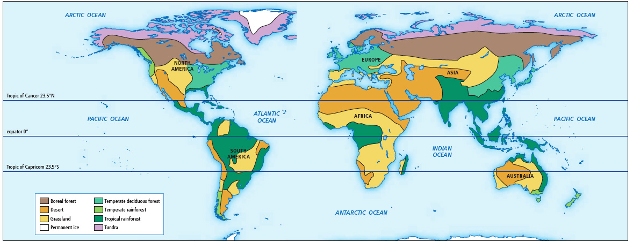
The Distribution of Biomes
Biomes of the World

Slide 5
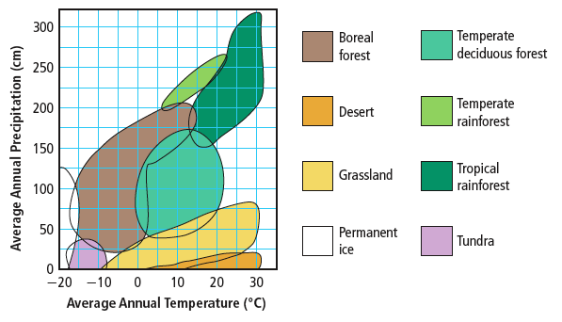
Factors That Influence the Characteristics of Biomes
Certain characteristics help to identify biomes.
Temperature and precipitation are two of the most important abiotic factors.
Other factors include latitude, elevation, and ocean currents.

Slide 6
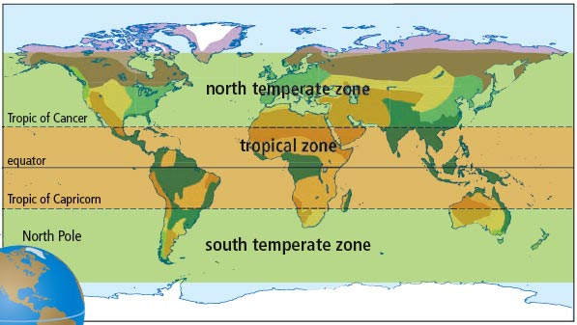
Factors That Influence the Characteristics and Distribution of Biomes (continued)
Latitude is an abiotic factor that influences biomes.
Latitude is the distance north and south from the equator.
Latitude influences both temperature and precipitation.
The tropical zone has very warm temperatures and high precipitation.
The tropical zone receives more direct sunlight than do temperate zones.
Zones of the World

Slide 7
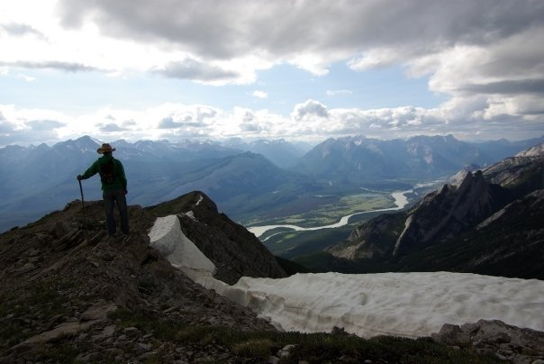
Elevation & Ocean Currents
Elevation also influences biomes.
The atmosphere is thinner at higher elevations, and therefore less heat is retained.
Windward sides of mountains are wet, leeward sides are very dry.
Ocean currents carry
warmth and moisture to
coastal areas.
Where warm currents
meet land, temperate
biomes are found.

Slide 8
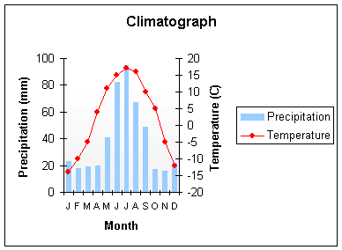
Climatographs
Climate refers to the average pattern of weather conditions of a large region over a period of 30 years or more.
A climatograph shows the average temperature and precipitation for a location over a period of 30 years or more.
Month | Precipitation | Temperature
J | 23 | -14
F | 18 | -10
M | 19 | -5
A | 20 | 4
M | 41 | 11
J | 82 | 15
J | 95 | 17
A | 67 | 16
S | 49 | 10
O | 17 | 5
N | 16 | -5
D | 22 | -12

Slide 9
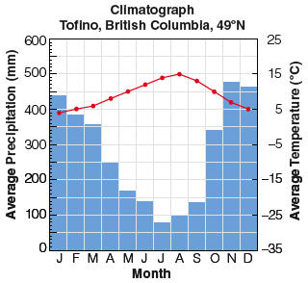
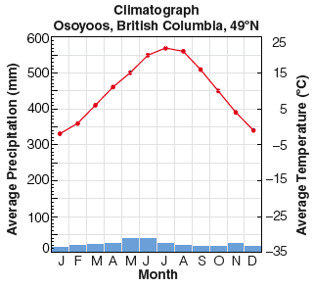
Climatographs
Biomes are often defined using information in climatographs.
Examine the differences between the climatographs for Tofino and Osoyoos

Slide 10
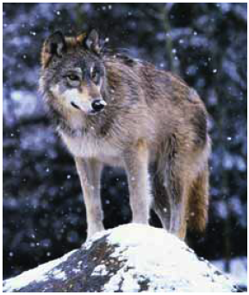
Adaptations and Biomes
Biomes are often identified with characteristic biotic factors,
such as a cactus in the desert or a caribou on the tundra.
Many of these characteristic factors have special adaptations for that biome.
An adaptation is a characteristic that allows an organism to better survive and reproduce.
There are three types of adaptations an
organism can have.
Let’s use the wolf to look at all three

Slide 11
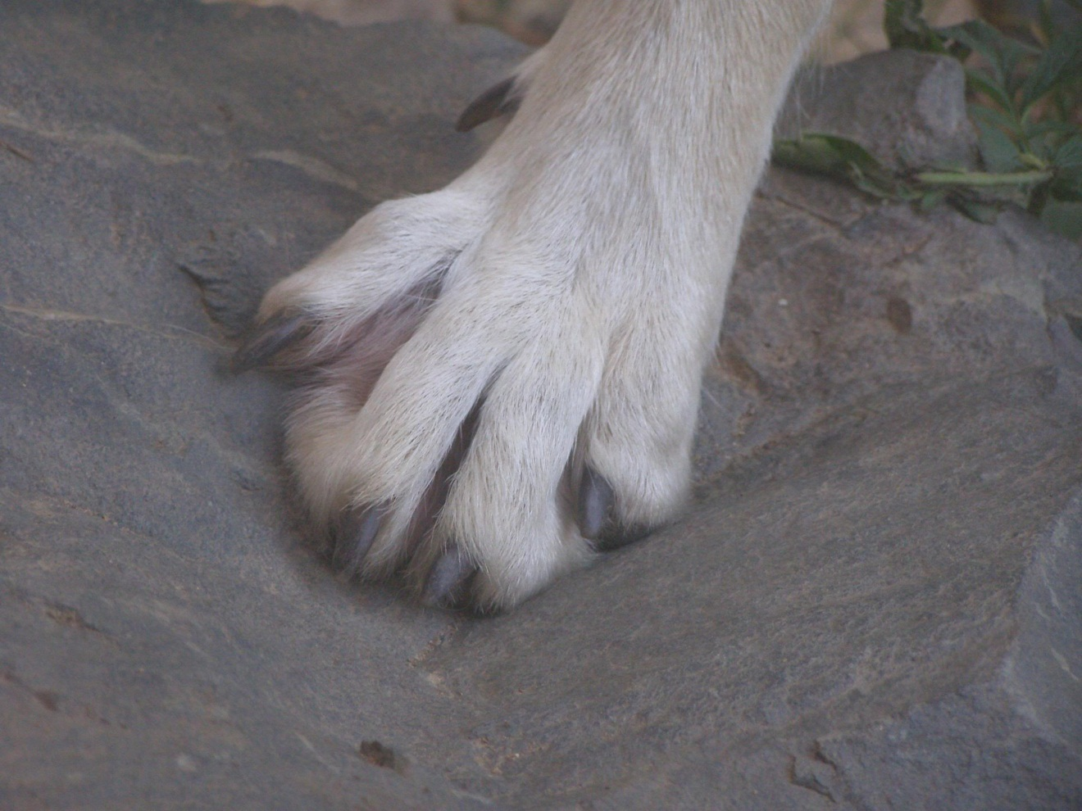
Structural adaptation
A physical feature that helps an organism survive
A wolf has large
paws to help it run
in snow.

Slide 12
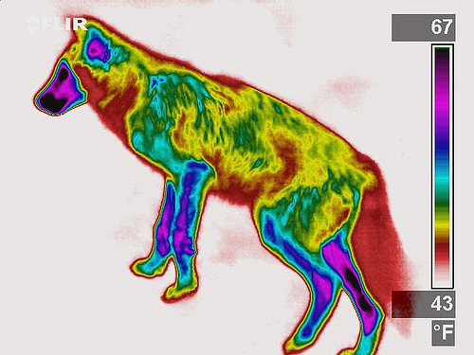
Physiological adaptation
A physical or chemical event inside the body of an organism that allows it to survive
A wolf maintains
a constant body
temperature.

Slide 13
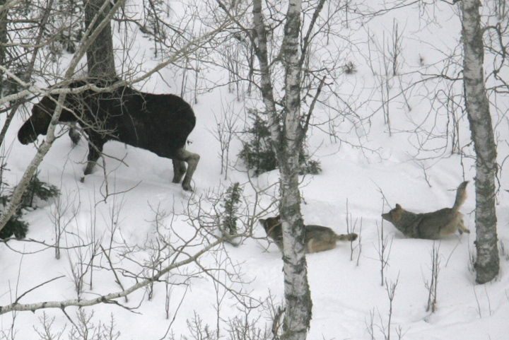
Behavioural adaptation
A behaviour that helps an organism to survive
Wolves hunt in
packs to
capture large
Prey like the
moose.

Slide 14
Behavioural adaptation

Slide 15
Behavioural adaptation

Slide 16
Behavioural adaptation

Slide 17
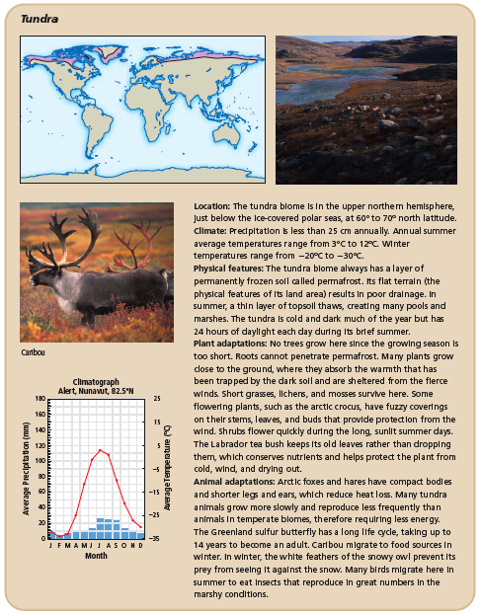
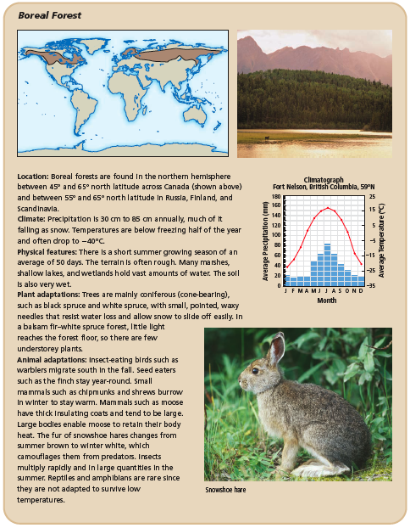
A Survey of Biomes: Tundra and Boreal Forest

Slide 18
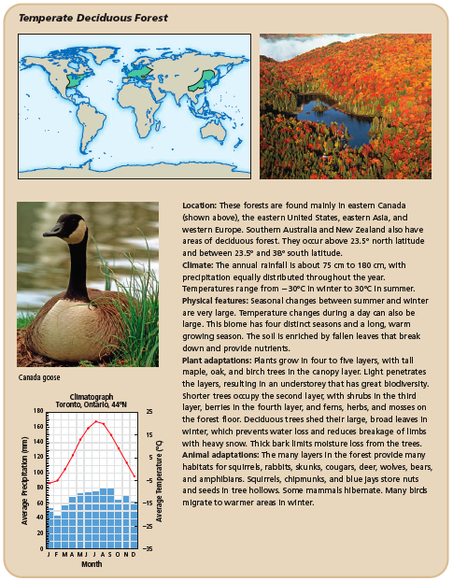
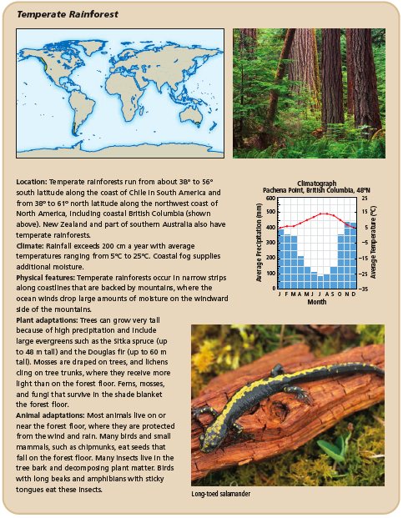
A Survey of Biomes: Temperate Deciduous Forest and Temperate Rainforest

Slide 19
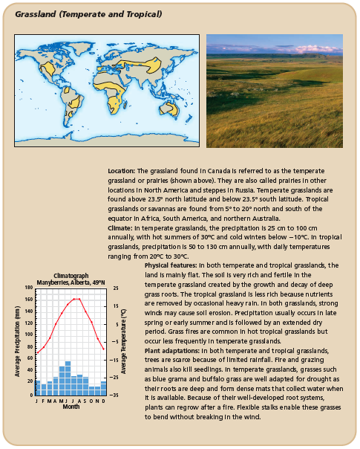
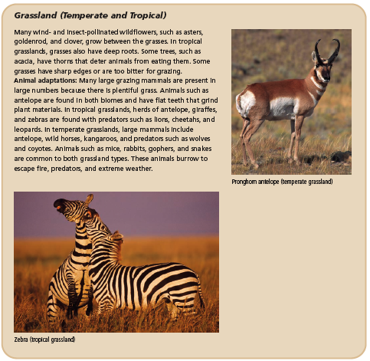
A Survey of Biomes: Grassland (Temperate and Tropical)

Slide 20
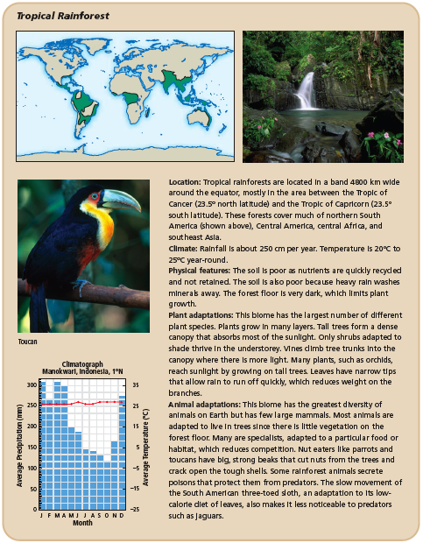
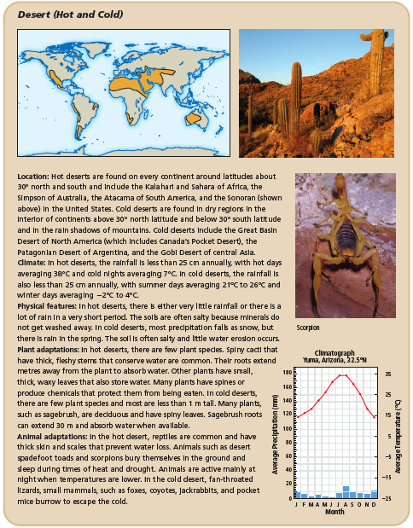
A Survey of Biomes: Tropical Rainforest and Desert (Hot and Cold)

Slide 21
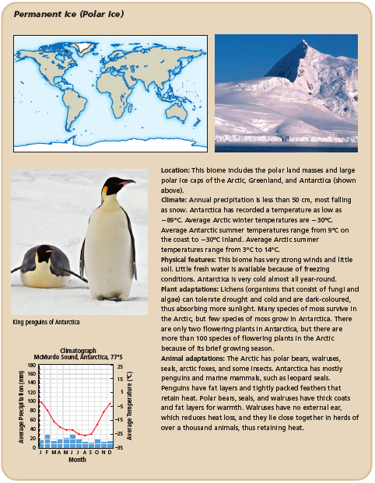
A Survey of Biomes: Permanent Ice (Polar Ice)

