Slide 1
Mass Spectrometry IR & NMR Spectroscopy
High School Chemistry
brought to you by:
Notes:
Welcome from ChemCatalyst.co.uk!

Slide 2
Information for the teacher:
Mastery learning – builds on the concept of developing automatic fluency in your learners. We drive cars on auto-pilot so lets aim to for our students to work in chemistry with the same level of autonomy. New material is present in smaller chunks than we are used to with frequent practice and mastery of small sections before we move on.
There should be lots of practice as you go so please include and stop this presentation and get your students to do your own worksheets and homeworks as well as the problems included in the slides as you progress – have extra sheets or extension activities available for those who work more quickly and try to only move on once everyone in the class is getting over 80% of the problems correct – if not return and reteach – it will save you time in the long run!
Each lesson or at the end of a new section develop a habit of reviewing previous learning and linking new ideas back to previous content.
These PowerPoints cover a broad range of chemistry and although aimed at Grade 11 may be appropriate for classes in Grades 10 and 12 also.
The notes section of each slide provides links back to mastery learning ideas to provide the teacher with an rationale of what this slide is aiming to achieve or test and provide ideas for the teacher as to what content they might want to augment that slide with.
The notes section also includes explanation of more complex problems where appropriate and questions for the teacher to consider as their students progress.
Please visit ChemCatalyst.co.uk for more information
Notes:
More information on Mastery Learning can be found here:
https://www.aft.org//sites/default/files/periodicals/Rosenshine.pdf

Slide 3
Mass spectrometry IR & NMR Spectroscopy
High School Chemistry
Notes:
Welcome from ChemCatalyst.co.uk!
This presentation is designed to support the teaching of high school chemistry.

Slide 4
Expected learning gains
Describe and understand different analytical techniques to be able to analyse the different results they produce
Use the MS data to determine the relative molecular mass of the unknown substance and the presence of certain functional groups
Use the ¹³C-NMR to determine the number of carbon environments
Use the ¹H-NMR to determine the number of hydrogen environments
Understand and interpret IR spectra to help identify unknown substances
Notes:
Expected learning gains
Deep understanding of…
Technical proficiency in…
Mastery of…
Fluency in…

Slide 5
Starter 1: Identification
Substance X decolourises bromine water and reacts with PCl₅ producing steamy white acidic fumes
If the molecular formula of X is C₄H₈O suggest two possible structural isomers
Notes:
1. There are several hydroxy alkenes which answer this question.
Make connections from previous learning to new content

Slide 6
Mass Spectrometry
High School Chemistry

Slide 8
Overview of Mass Spectrometry https://youtu.be/mBT73Pesiog
LINK
Notes:
https://www.youtube.com/watch?v=J-wao0O0_qM
Embedded video may or may not working depending on your version of PowerPoint and Google’s current security measures on YouTube.
Guided Practice – step by step
Explanations
(Do not rush through guided practice)

Slide 9
Mass Spectrometry
The sample is vaporised, ionised, accelerated and then deflected
The peaks occur at different mass:charge ratios (m/z)
The charge is often +1 but the x-axis really only measures the mass of the different fragments
e.g. a fragment of 28 with a +1 charge is 28/1 = 28
A fragment of 56 with a 2+ charge would also show up at 28 on the m/z scale
It is used to find different isotopes and therefore the relative atomic mass of an element
It can also be used to identify the relative molecular mass of compounds
Notes:
Guided Practice – step by step
Explanations, deconstruction
(Do not rush through guided practice)

Slide 10
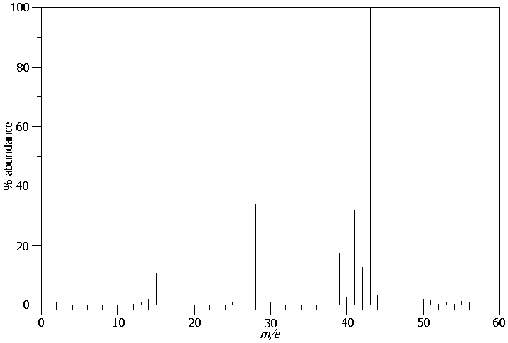
Example:butane
Butane C₄H₁₀ M_{r} = 58
Base
Peak
(most abundant)
Butane loses one electron and forms a positive ion
The peak with the highest m/z value shows the relative molecular mass of the compound
This is called the molecular ion peak
Relative intensity (%)
m/z
The molecular ion peak is indicated using the symbol M+
Notes:
Guided Practice – step by step
Explanations, deconstruction, worked examples
(Do not rush through guided practice)

Slide 11
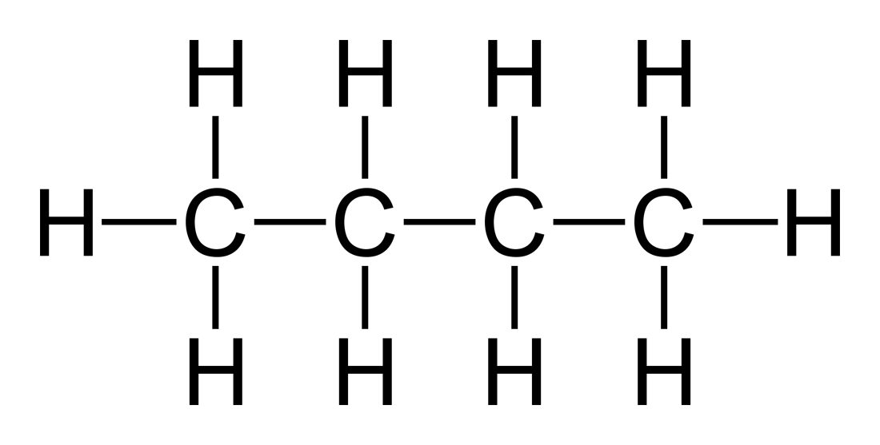
A free radical? How would I get one of those?
High energy electron
Notes:
Guided Practice – step by step
Explanations
(Do not rush through guided practice)

Slide 12
A free radical? How would I get one of those?
Radical fragment - UNDETECTED
Cation fragment - DETECTED
Notes:
Guided Practice – step by step
Explanations, deconstruction
(Do not rush through guided practice)

Slide 13
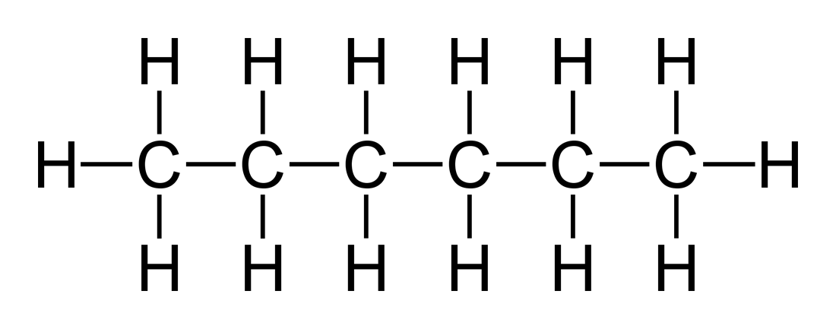
Labelling the fragments
What fragments are likely to be responsible for peaks at 15, 29 and 43 in a sample of hexane?
Notes:
Practice to fluency - CH3+ C2H5+ C3H7+
Shallow 🡪 deep understanding (e.g. building up in small chunks)
Guided 🡪 independent practice (e.g. teacher moves to assist those who need additional support)
Worked examples🡪 problem solving 🡪 interleaving/varying
80% success before moving on 🡪 live marking, regular retrieval tests, Q + A can all be used to determine this level of attainment.
Do I need to re-teach? What will those who are over 80% do? e.g. Spaced practice of previously covered work

Slide 14
Butane Fragments
58 = CH₃CH₂CH₂CH₃⁺
43 = CH₃CH₂CH₂⁺ (base peak)
29 = CH₃CH₂⁺
15 = CH₃⁺
Relative intensity (%)
m/z
Notes:
Guided Practice – step by step
Explanations, deconstruction
(Do not rush through guided practice)

Slide 15
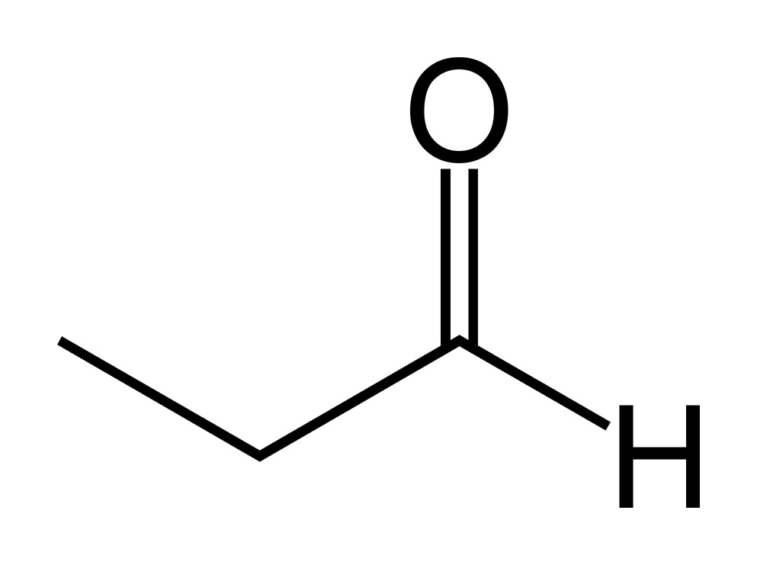
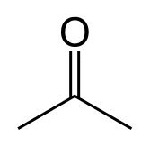
M_{r} = 58
Propanal vs. Propanone
Notes:
-----
By Fvasconcellos - Vector version of File:Acetone-2D-skeletal.png by Ben Mills, Public Domain, https://commons.wikimedia.org/w/index.php?curid=8118967

Slide 16
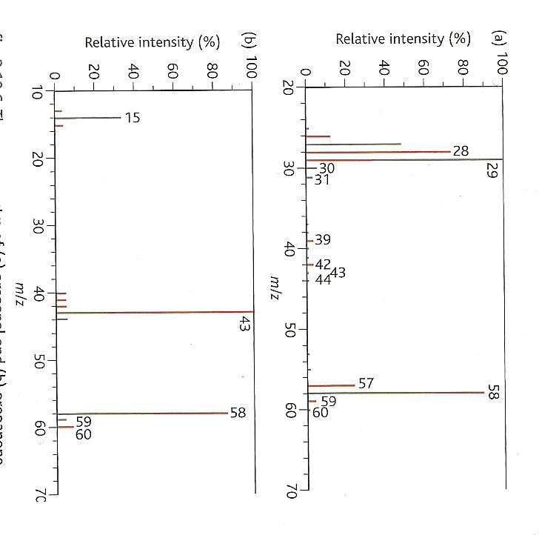
Which is
which?
This is a simplified spectra
In reality many rearrangements and new molecules are formed in the fragmentation process
You could find any small neutral molecule containing only carbon, hydrogen or oxygen
Notes:
Guided Practice – step by step
Explanations, deconstruction, worked examples
(Do not rush through guided practice)

Slide 17
Propanal vs. Propanone
Things to notice:
The top diagram
The peak at 58: the molecular ion peak
The peak at 57 could indicate the hydrogen has been lost in fragmentation CH₃CH₂CO⁺
A strong peak at 29 shows either lose of CHO or CH₃CH_{2.}
These structures could only exist in propanal
Notes:
Guided Practice – step by step
Explanations, deconstruction, worked examples
(Do not rush through guided practice)

Slide 18
Propanal vs. Propanone
Things to notice:
The bottom diagram
Also has a peak at 58: the molecular ion peak
There is a base peak at 43 and another strong peak at 15.
43 corresponds to CH₃CO⁺ and 15 is the rest of the molecule ie CH₃⁺
Notes:
Guided Practice – step by step
Explanations, deconstruction, worked examples
(Do not rush through guided practice)

Slide 19
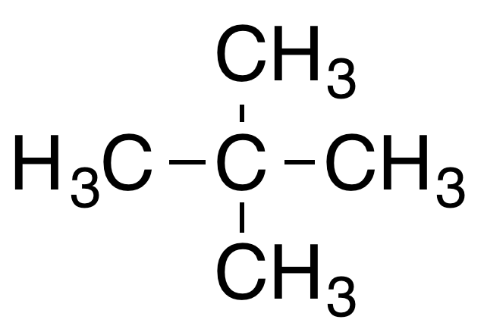
Dimethylpropane (poi)
Why is the peak for (CH₃)₃C⁺ much stronger than the peak for CH₃⁺ in the mass spectra of dimethylpropane?
Notes:
Can students conceptualise their understanding?
The tertiary carbocation is stabilised more successfully by the surrounding methyl groups making it a much more energetically favourable fragment
Connections, expansions, extended abstract thinking
(What resources are available for further student exploration?)
--------------
By DMacks (talk) - Own work, Public Domain, https://commons.wikimedia.org/w/index.php?curid=540017

Slide 20
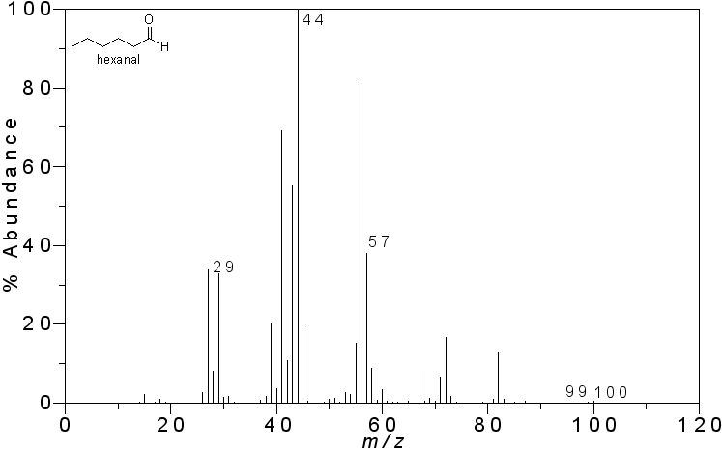
What molecule?
Which straight chain aldehyde has this spectra?
Notes:
Check for understanding - hexanal
Hinge questions, connect, expand, summarise
--------------
By Vladislav Andriashvili - Own work, CC BY-SA 3.0, https://commons.wikimedia.org/w/index.php?curid=26954052

Slide 21
Analysis using mass spectra
The mass spectrometer is normally used with infrared spectroscopy and NMR spectroscopy to identify an unknown substance
This is because you don’t always get all the pieces of the puzzle you need from just a mass spectrum
You can also find other peaks caused by fragmentation
Remember only positive ions (cation fragments) are detected by the machine anions and free radicals are not
Notes:
Guided Practice – step by step
Explanations
(Do not rush through guided practice)

Slide 22
IR spectroscopy
High School Chemistry
Notes:
Additional resources on RSC Learn Chemistry
http://www.rsc.org/learn-chemistry/resource/res00000281/introduction-to-spectroscopy

Slide 23
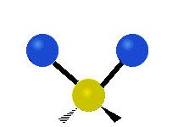
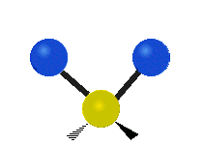
Moving bonds
The bonds which hold atoms in molecules together are not static they vibrate
These vibrations could be in the form of stretching (symmetrical and asymmetrical), bending, rocking, twisting or even wagging!
Notes:
Guided Practice – step by step
Explanations, modelling, deconstruction, worked examples
(Do not rush through guided practice)
----
By No machine-readable author provided. Tiago Becerra Paolini assumed (based on copyright claims). - No machine-readable source provided. Own work assumed (based on copyright claims)., Public Domain, https://commons.wikimedia.org/w/index.php?curid=600624
By No machine-readable author provided. Tiago Becerra Paolini assumed (based on copyright claims). - No machine-readable source provided. Own work assumed (based on copyright claims)., Public Domain, https://commons.wikimedia.org/w/index.php?curid=600621
By No machine-readable author provided. Tiago Becerra Paolini assumed (based on copyright claims). - No machine-readable source provided. Own work assumed (based on copyright claims)., Public Domain, https://commons.wikimedia.org/w/index.php?curid=600634
By No machine-readable author provided. Tiago Becerra Paolini assumed (based on copyright claims). - No machine-readable source provided. Own work assumed (based on copyright claims)., Public Domain, https://commons.wikimedia.org/w/index.php?curid=600663
By No machine-readable author provided. Tiago Becerra Paolini assumed (based on copyright claims). - No machine-readable source provided. Own work assumed (based on copyright claims)., Public Domain, https://commons.wikimedia.org/w/index.php?curid=600657

Slide 24
Absorption
The vibrations are stimulated when the bond absorbs electromagnetic radiation of a certain frequency
The EM radiation is in the infra red (IR) region of the spectrum and corresponds to a particular vibration
RSC Infrared spectroscopy (IR)
Notes:
Guided Practice – step by step
Explanations, modelling, deconstruction, worked examples
(Do not rush through guided practice) ----

Slide 25
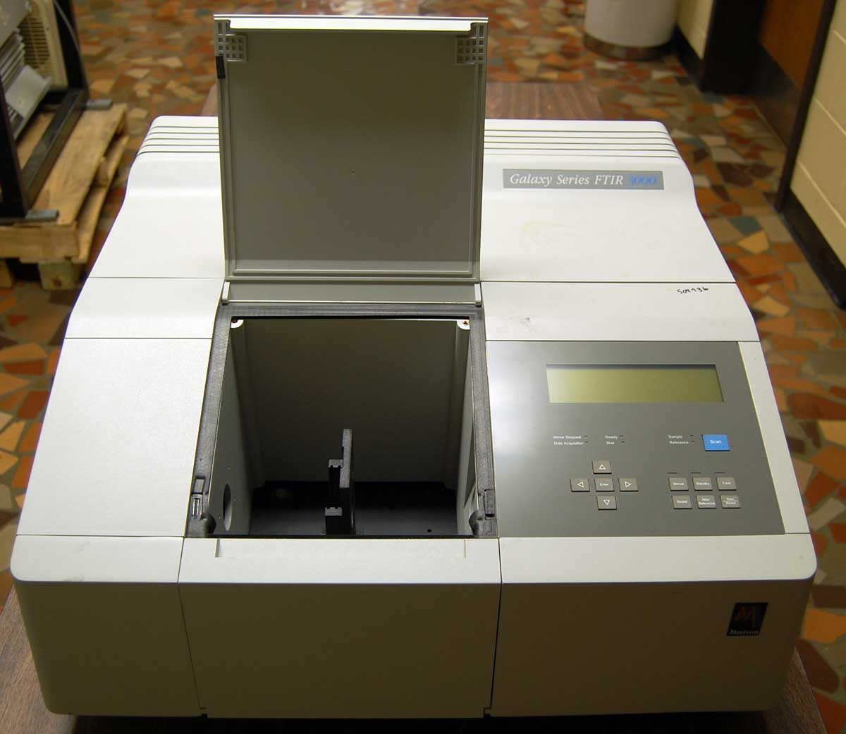
How it works: summary
The machine fires IR radiation at the sample
The frequency of IR radiation is gradually increased
The sample absorbs the energy at different levels depending on the bonds which are present
The machine converts the frequency into a wavenumber and a spectra of the sample is produced
Notes:
Guided Practice – step by step
Explanations, modelling, deconstruction, worked examples
(Do not rush through guided practice)
----
Von Kkmurray - Eigenes Werk, CC BY-SA 3.0, https://commons.wikimedia.org/w/index.php?curid=5066300

Slide 26
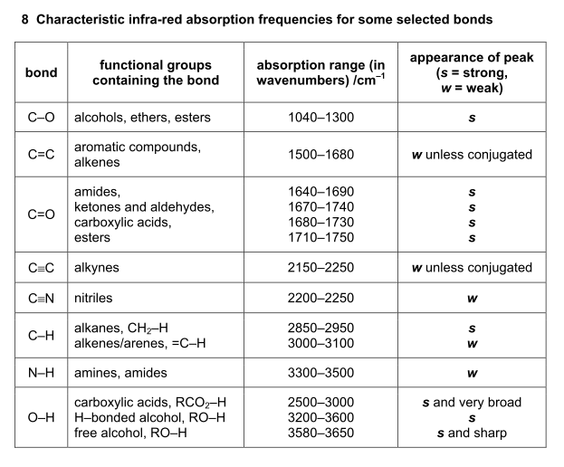
Data Booklet
Data books in chemistry contain information on many different reactions and properties the following is an example
Here is an example
Notes:
Guided Practice – step by step
Explanations, modelling, deconstruction, worked examples
(Do not rush through guided practice)

Slide 27
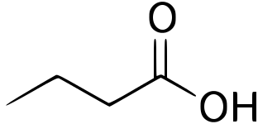
100
50
0
Transmittance %
3000 2000 1500 1000 500
Wavenumber ⁻¹
Here is the spectra for butanoic acid
Notes:
Guided Practice – step by step
Explanations, modelling, deconstruction, worked examples
(Do not rush through guided practice)
----
By Ljfa-ag - Own work, CC BY-SA 3.0, https://commons.wikimedia.org/w/index.php?curid=3531319

Slide 28
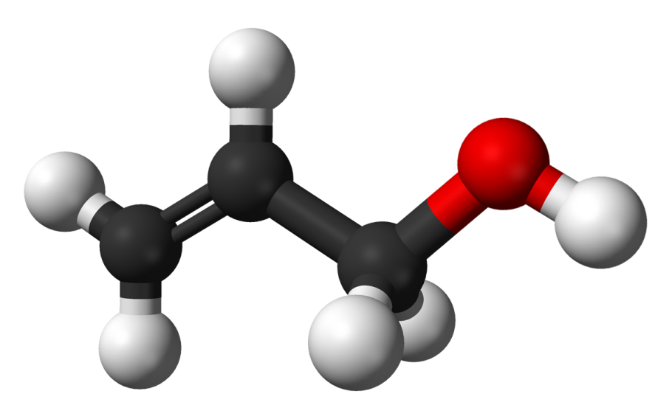
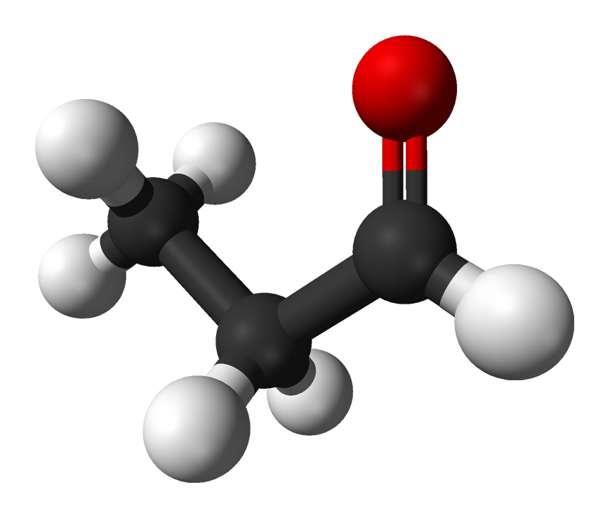
Data Booklet
You use the IR spectra to help you identify a compound it won’t be the only piece of information you know
e.g. C₃H₆O could be propanal or 3-propenol
IR spectroscopy can help you work out which is which
Notes:
Guided Practice – step by step
Explanations, modelling, deconstruction, worked examples
(Do not rush through guided practice)
----
By Ben Mills and Jynto - Derivative of File:Allyl-chloride-3D-balls.png and File:Methanol-alternative-3D-balls.png, Public Domain, https://commons.wikimedia.org/w/index.php?curid=9402787
By Kemikungen - Own work, Public Domain, https://commons.wikimedia.org/w/index.php?curid=8452426

Slide 29
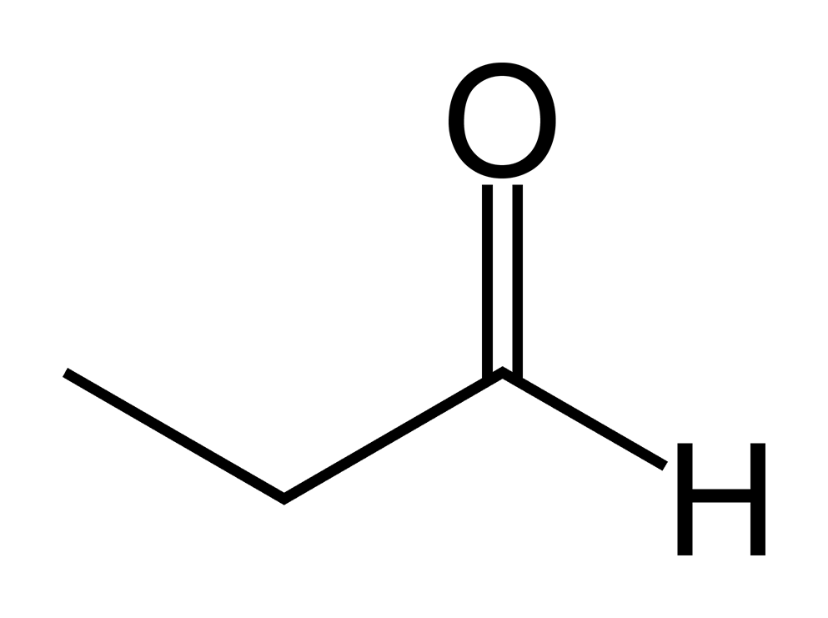
The examples in the tests will often be simplified
100
50
0
Transmittance %
3000 2000 1500 1000 500
Wavenumber ⁻¹
Here is the spectra for propanal
Notes:
Guided Practice – step by step
Explanations, modelling, deconstruction, worked examples
(Do not rush through guided practice)
----
By Benjah-bmm27 - Own work, Public Domain, https://commons.wikimedia.org/w/index.php?curid=686830

Slide 30
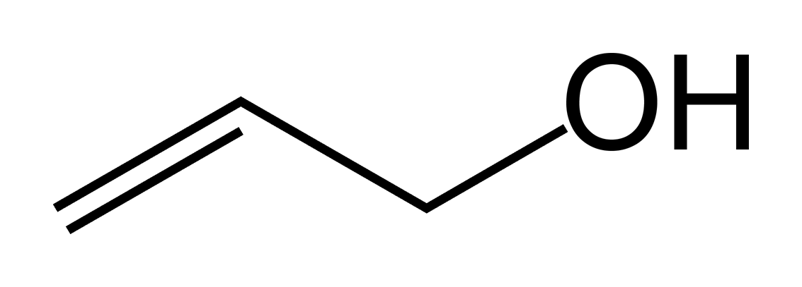
Here is the spectra for 3-propenol
100
50
0
Transmittance %
3000 2000 1500 1000 500
Wavenumber ⁻¹
It can be hard to read but usually there will be one peak you are sure about and will help you answer the question
Notes:
Guided Practice – step by step
Explanations, modelling, deconstruction, worked examples
(Do not rush through guided practice)
----
By No machine-readable author provided. Benjah-bmm27 assumed (based on copyright claims). - No machine-readable source provided. Own work assumed (based on copyright claims)., Public Domain, https://commons.wikimedia.org/w/index.php?curid=621813

Slide 31
What is the substance?
100
50
0
Transmittance %
3000 2000 1500 1000 500
Wavenumber ⁻¹
Propanone
Propan-1-ol
Propanoic acid
Propanal
Notes:
Practice to fluency = 3
Shallow 🡪 deep understanding
Guided 🡪 independent practice
Worked examples🡪 problem solving 🡪 interleaving/varying
80% success before moving on 🡪 live marking, regular retrieval quizzes
Do I need to re-teach?
Spaced practice

Slide 32
Check for understanding
100
50
0
Transmittance %
3000 2000 1500 1000 500
Wavenumber ⁻¹
Which spectra RED or BLACK shows the presence of a nitrile group?
Notes:
Defend, disagree, summarise

Slide 33
NMR Spectroscopy
High School Chemistry

Slide 34
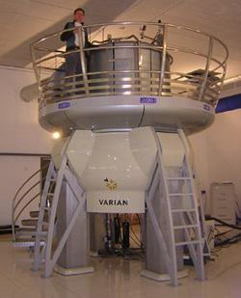
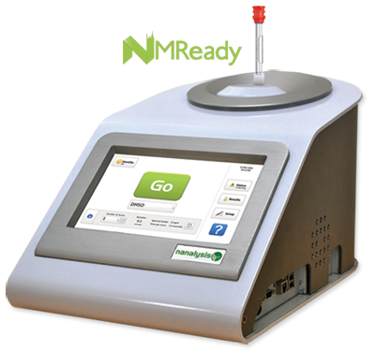
NMR Spectroscopy
The nucleus’ of carbon and hydrogen atoms have magnetic properties
Chemists use this property to determine information about the structure and chemical environment of molecules which contain the carbon and hydrogen atoms
NMR stands for
nuclear
magnetic
resonance
NMR spectrometers can be small benchtop sized devices or much larger
Notes:
Guided Practice – step by step
Explanations, deconstruction
(Do not rush through guided practice)
--------------------------
http://www.nmrtubes.com/images/nmready.png
By MartinSaunders at English Wikipedia - Transferred from en.wikipedia to Commons by Jacopo Werther., Public Domain, https://commons.wikimedia.org/w/index.php?curid=4859697

Slide 35
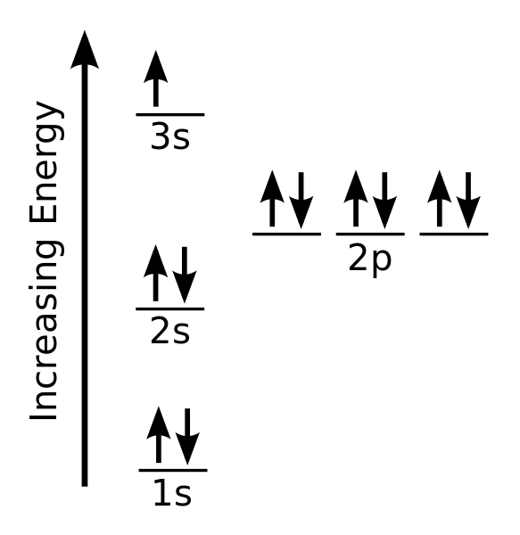
Nuclear magnetic resonance
Nuclear magnetic resonance is a physical phenomenon where the nucleons of an atom absorb electromagnetic radiation which changes their quantum property of spin
We have seen this spin idea before with electrons when drawing diagrams for electronic configuration
Notes:
Guided Practice – step by step
Explanations, deconstruction
(Do not rush through guided practice)
--------------------------
By CK-12 Foundation (raster), Adrignola (vector) - File:High School Chemistry.pdf, page 365, Public Domain, https://commons.wikimedia.org/w/index.php?curid=16806413

Slide 36
Nuclear magnetic resonance
An external magnetic field is applied to the sample and a specific radio wave frequency in the electromagnetic spectrum causes the protons in a nucleus to absorb energy and ‘flip’ to their resonance condition
This flipping is measuring by the device and is seen as a peak on the NMR spectra
The peak can be analysed to tell us information about the structure of the molecule
Notes:
Guided Practice – step by step
Explanations, deconstruction
(Do not rush through guided practice)
--------------------------

Slide 37
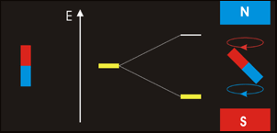
Splitting of nuclei spin states
Nuclei behave like they have their own magnetic moments
In an external magnetic field there is a high-energy state and a low-energy state depending on the relative orientations of the magnet to the external field
Notes:
Guided Practice – step by step
Explanations, deconstruction
(Do not rush through guided practice)
--------------------------
By Darekk2 - Own work, CC BY-SA 3.0, https://commons.wikimedia.org/w/index.php?curid=20398517
https://en.wikipedia.org/wiki/Nuclear_magnetic_resonance#/media/File:NMR_EPR.gif

Slide 38
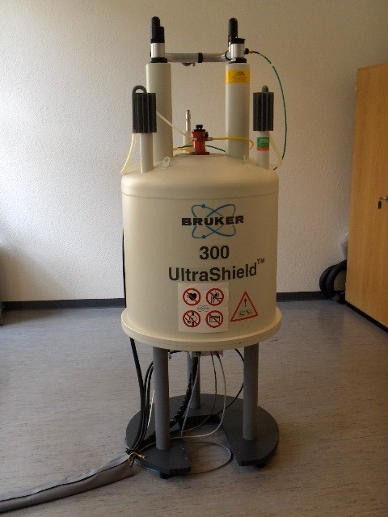
The surrounding environment 1
The electrons of other atoms in the surrounding environment of the atom reduce the affect of the external magnetic field
The bonding electrons are further or closer to the carbon depending on relative electronegativities
Hence an isolated proton for example would need a different strength of magnetic field to cause the proton to flip into its resonance condition than a similar proton bonded to another atom
Notes:
Guided Practice – step by step
Explanations
(Do not rush through guided practice)
--------------------------
By Andel Früh & Andreas Maccagnan - Own work, CC BY-SA 3.0, https://commons.wikimedia.org/w/index.php?curid=927647

Slide 39
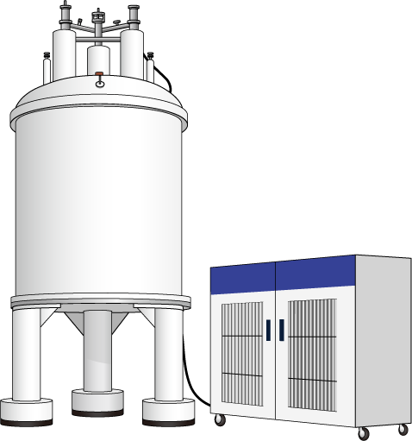
The surrounding environment 2
For the nucleon to flip there must be exactly the right combination of external magnetic field and radio frequency for the resonance condition
Historically all NMR machines varied the magnetic field and kept the frequency of the radio waves constant but some newer models fix the magnetic field and vary the frequency of the radio
Notes:
Guided Practice – step by step
Explanations
(Do not rush through guided practice)
--------------------------
By Database Center for Life Science (DBCLS), CC BY 3.0, https://commons.wikimedia.org/w/index.php?curid=27719573

Slide 40
¹H-NMR
In the same way as a nucleus of carbon-13, hydrogen nuclei (a single proton) are affected by a magnetic field
The magnetic spin can align with a magnetic field or against it in a higher energy state
The difference in energy between the two states once again corresponds to the energy of a specific radio frequency
The size of energy gap between the two alignments depends on the environment of the hydrogen atom
Notes:
Guided Practice – step by step
Explanations, deconstruction
(Do not rush through guided practice)
--------------------------

Slide 41
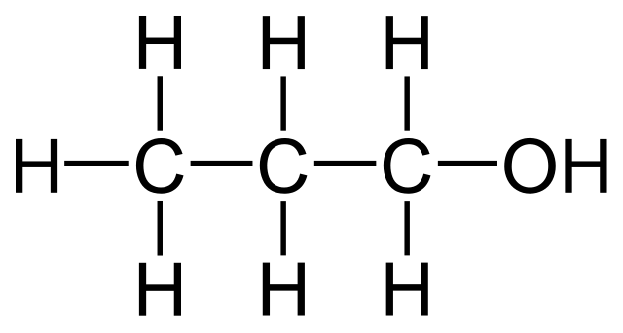
¹H-NMR Propan-1-ol
In this ¹H-NMR we can see four peaks
Is this what we would expect?
The structure of propan-1-ol is:
(2)
(3)
A low resolution spectra
(1)
(2)
8 7 6 5 4 3 2 1 0
δ ppm
Hydrogen nuclei exist in four separate environments
Notes:
Guided Practice – step by step
Explanations, deconstruction, worked examples
(Do not rush through guided practice)
--------------------------

Slide 42
¹H-NMR Propan-1-ol
In this low resolution spectra the area under the peak can be used to tell you how many hydrogen nuclei exist in a given environment
(2)
(3)
A low resolution spectra
(1)
(2)
8 7 6 5 4 3 2 1 0
δ ppm
(2), (1), (2) and (3) are relative areas and again are in line with our structure
areas not to scale
Notes:
Guided Practice – step by step
Explanations, deconstruction, worked examples
(Do not rush through guided practice)
--------------------------

Slide 43
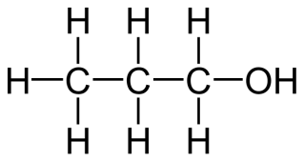
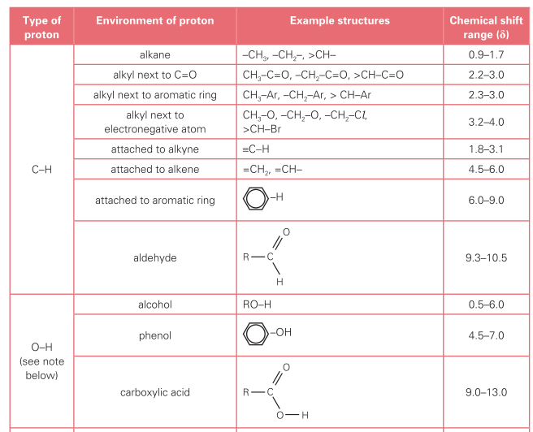
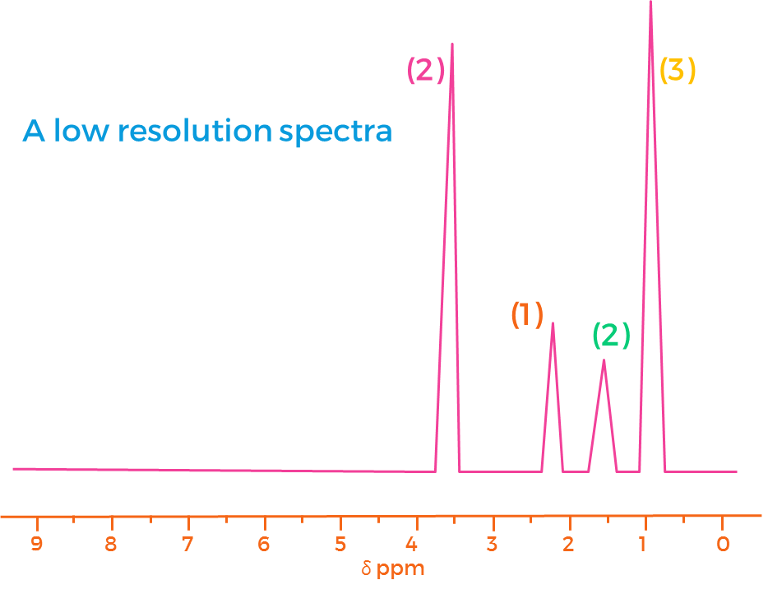
¹H-NMR Propan-1-ol
Data booklet values help to confirm the analysis
Notes:
Guided Practice – step by step
Explanations, deconstruction, worked examples
(Do not rush through guided practice)
--------------------------

Slide 44
¹H-NMR Propanal and Propanone
If these two molecules were examined independently how many peaks would they each have and what would be the ratio of those peaks in each individual molecule?
Notes:
Propanone would have only one peak
Propanal would have 3 peaks with an area ratio of 3:2:1
Practice to fluency
Shallow 🡪 deep understanding (e.g. building up in small chunks)
Guided 🡪 independent practice (e.g. teacher moves to assist those who need additional support)
Worked examples🡪 problem solving 🡪 interleaving/varying
80% success before moving on 🡪 live marking, regular retrieval tests, Q + A can all be used to determine this level of attainment.
Do I need to re-teach? What will those who are over 80% do? e.g. Spaced practice of previously covered work
--------------------------

Slide 45
¹H-NMR Propan-1-ol
At a higher resolution we can observe that the peaks are split
The amount of splitting of each signal peak depends on the number of hydrogens attached to the carbon atom/s next in the chain
Hydrogen atoms on the same carbon are equivalent and don’t affect each other
(2)
(3)
A high resolution spectra
(1)
(2)
8 7 6 5 4 3 2 1 0
δ ppm
Splitting occurs because of spin-spin coupling
This is university chemistry but essentially slightly different magnetic environments exist for that specific proton due to interaction with other neighbouring protons
Notes:
Guided Practice – step by step
Explanations, deconstruction, worked examples
(Do not rush through guided practice)
--------------------------

Slide 46
Naming split signals
We classify the number of peaks a signal has with the following names:
Singlet
0 hydrogen neighbours = 1 peak
Doublet
1 hydrogen neighbour = 2 peaks
Triplet
2 hydrogen neighbours = 3 peaks
Quartet
3 hydrogen neighbours = 4 peaks
Quintet (Pentet)
4 hydrogen neighbours = 5 peaks
Sextet
5 hydrogen neighbours = 6 peaks
Septet
6 hydrogen neighbours = 7 peaks
}
multiplets
Notes:
Guided Practice – step by step
Explanations, deconstruction
(Do not rush through guided practice)
--------------------------

Slide 47
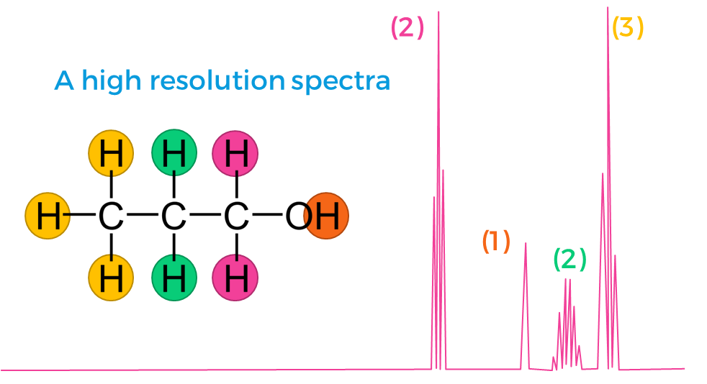
¹H-NMR Propan-1-ol
If a proton has n neighbours
(protons attached to adjacent carbons)
It will split into n+1 lines
n = 2, n+1 = 3, triplet
n = 2, n+1 = 3, triplet
-OH groups are always singlets
n = 5, n+1 = 6, sextet
Notes:
Guided Practice – step by step
Explanations, deconstruction, worked examples
(Do not rush through guided practice)
--------------------------

Slide 48
-OH and –NH bonds
The hydrogen on the -OH or –NH always forms a singlet
They do not interact with other hydrogens to produce any splitting in their peak or the peaks of neighbouring hydrogens
D₂O is used to eliminate the peak from –OH and –NH bonds and allow more accurate analysis
Introducing D₂O causes hydrogens on the –OH and -NH in the compound to be replaced by deuterium due to proton exchange in the alcohol and amino groups
Peaks created by –OD and –ND bonds appear in a different region of the spectra and are not displayed
Notes:
Guided Practice – step by step
Explanations
(Do not rush through guided practice)
--------------------------

Slide 49
Spectra Examples
Follow the link for collections of spectra for different molecules
Examples
Notes:
Can students conceptualise their understanding?
Connections, expansions, extended abstract thinking
(What resources are available for further student exploration?)

Slide 50
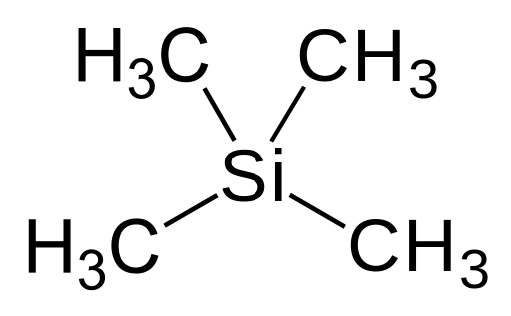
Creating a baseline
In order to compare peaks tetramethylsilane is used as an internal standard for calibrating chemical shift for ¹H and ¹³C NMR
All four carbons atoms and all twelve hydrogen atoms (relative to each other) in a tetramethylsilane molecule are equivalent so a strong peak is created
Notes:
Guided Practice – step by step
Explanations, deconstruction
(Do not rush through guided practice)
--------------------------
By Jynto (talk) - Own workThe source code of this SVG is valid.This vector image was created with Inkscape., Public Domain, https://commons.wikimedia.org/w/index.php?curid=25260110

Slide 51
Creating a baseline
The peak appears to the far right of the spectra due to the silicon atom
The electrons in the C-Si bond are closest here to the carbon atom and hence shield it the most effectively from the magnetic field meaning a very large magnetic field (hence far right) is needed to create the resonance condition in the carbon atoms in ¹³C-NMR
For ¹H-NMR twelve hydrogens creates a strong singlet which can be easily identified
All other chemical shifts are determined relative to this peak
Notes:
Guided Practice – step by step
Explanations, deconstruction
(Do not rush through guided practice)
--------------------------
By Jynto (talk) - Own workThe source code of this SVG is valid.This vector image was created with Inkscape., Public Domain, https://commons.wikimedia.org/w/index.php?curid=25260110

Slide 52
More chemical shift detail
The peak created by TMS is often omitted from spectra
The horizontal scale is the chemical shift measured in parts per million
A peak to the left of the TMS peak is downfield
100ppm is more downfield than 40ppm
180 160 140 120 100 80 60 40 20 0
δ ppm
Assuming the device varies magnetic field, a peak at 80 means that the carbon atoms causing the peak need a magnetic field 80 millionths less than the field needed by the TMS to create a resonance condition
Notes:
Guided Practice – step by step
Explanations, deconstruction
(Do not rush through guided practice)
--------------------------
By NEUROtiker ⇌ - Own work, Public Domain, https://commons.wikimedia.org/w/index.php?curid=7171157

Slide 53
Varying frequency or field
If the NMR device varies the magnetic field
TMS will need the highest external magnetic field to reach the resonance condition
The delta shift value indicates a magnetic field millionths less than that of TMS to achieve a resonance condition
If the NMR device varies the frequency of electromagnetic wave
TMS will need the lowest frequency (energy) to reach the resonance condition as the energy gap between normal and resonance states is smallest in TMS
The delta shift value indicates a frequency millionths more than that of TMS to achieve a resonance condition
Notes:
Guided Practice – step by step – arguably too much detail but included for the sake of students looking to read chemistry at college (unhide if needed)
Explanations, deconstruction
(Do not rush through guided practice)
--------------------------

Slide 54
Solvents
Solid molecules need to be dissolved into solution for the NMR to be run
Deuterated solvents such as CDCl₃ are used
The hydrogen atom in this chloroform molecule has been replaced with an atom of deuterium, an isotope of hydrogen
As such it doesn’t have any hydrogen to interfere with a ¹H-NMR spectra
It does have carbon atoms but CDCl₃ creates an easily identifiable peak which can be easily discounted when analysing the spectra for ¹³C-NMR
Notes:
Guided Practice – step by step
Explanations
(Do not rush through guided practice)
--------------------------

Slide 55
Summary: Proton Nuclear Magnetic Resonance (NMR)
LINK
Notes:
Guided Practice – step by step https://www.youtube.com/watch?v=uNM801B9Y84
Explanations, modelling
(Do not rush through guided practice)
Embedded video may or may not working depending on your version of PowerPoint and Google’s current security measures on YouTube.
--------------------------

