Slide 1
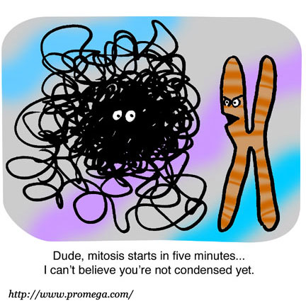
Cellular Reproduction Mitosis and Meiosis

Slide 2
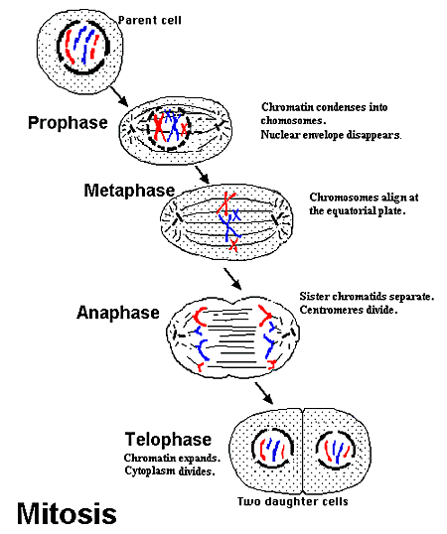
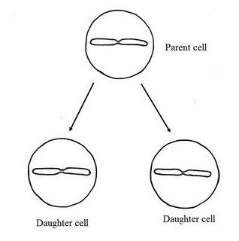
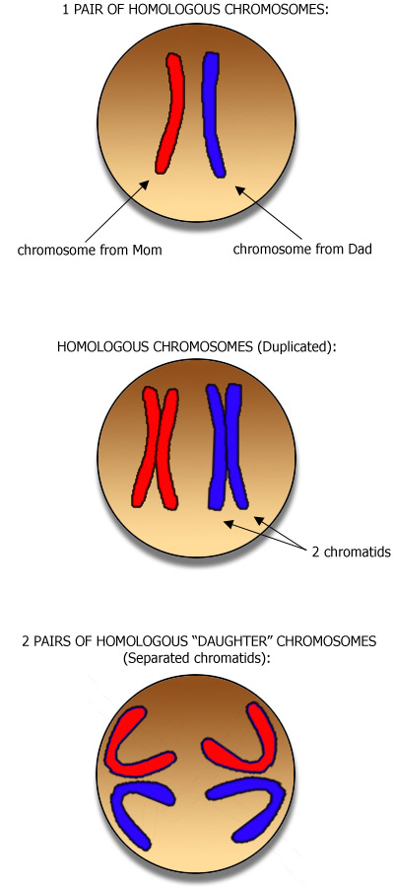
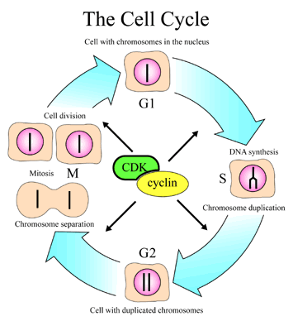
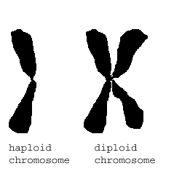
Mitosis

Slide 3
Stages of Cell Cycle
Interphase (most of cells life spent in this stage) There are three phases:
G1 – growth 1 – all matter is growing during this phase
S – synthesis phase – this is where the DNA is duplicated
G2 – growth 2 – this is where cell replenish energy lost during growth and replication

Slide 4
Mitosis
Prophase:
Chromatin condenses into tightly packed Chromosomes
Nuclear membrane breaks down – release chromosomes into cytoplasm
Centrioles move to opposite poles
Spindle fibers form

Slide 5
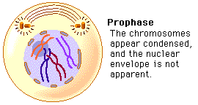
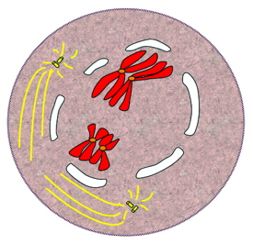
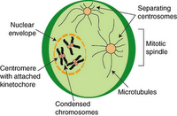
Prophase

Slide 6
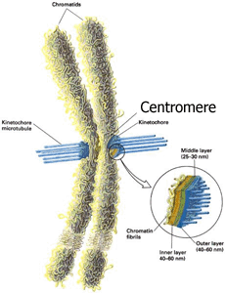
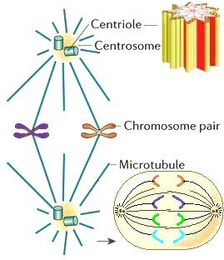
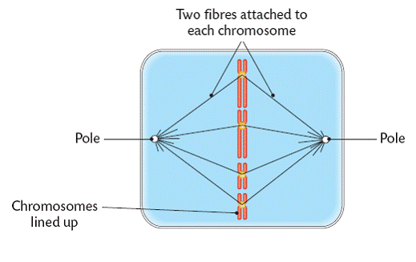
Centromere, centrioles and Spindle Fibers

Slide 7
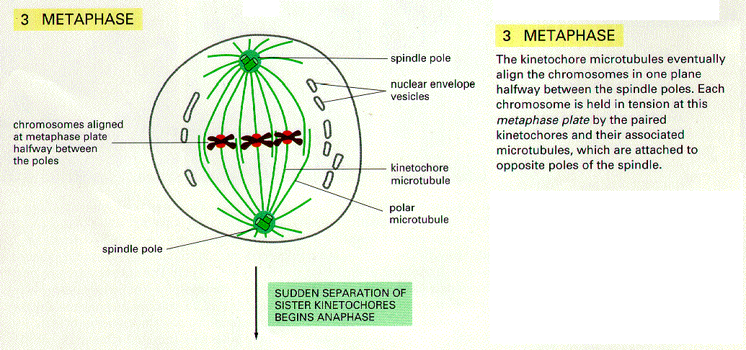
Metaphase
Spindle fibers guide the chromosomes to line up on the equatorial plate

Slide 8
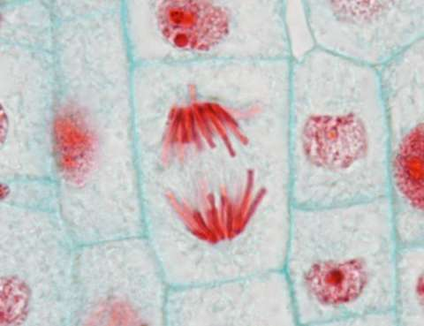
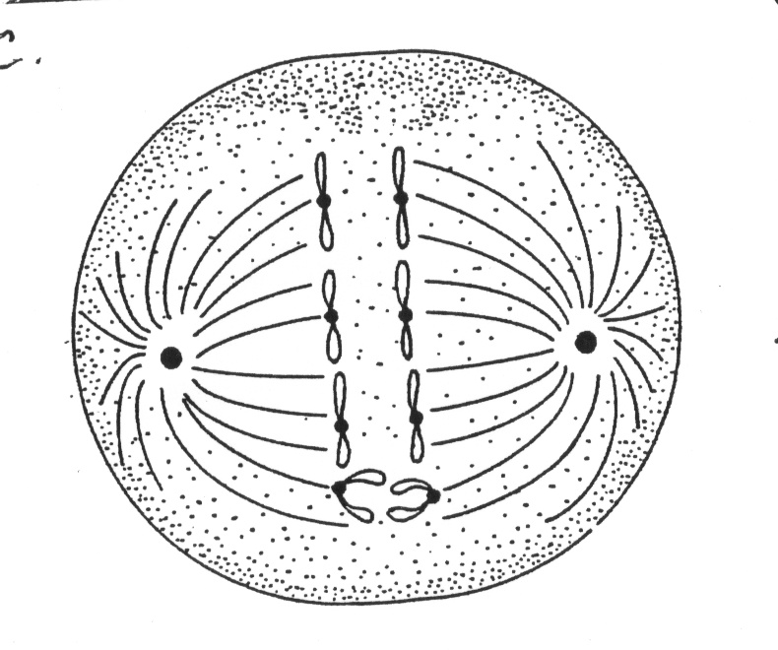
Anaphase
Centromere splits and sister chromatids split apart and move towards the poles

Slide 9
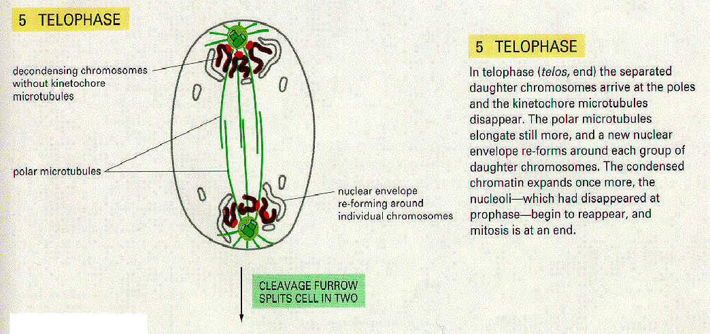
Telophase
Chromatids start to unwind and become chromatin
Nuclear membrane forms

Slide 10
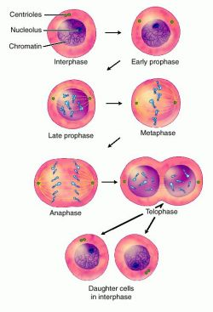
Mitosis - summary
Happens in somatic cells
The daughter cells are exact replicates of parent cell
Each cell has a “start” and “stop” signals to prevent out of control division
Crash Course

Slide 11
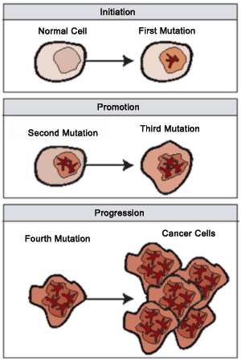
Cancer
Considered to be non-regulated mitosis
The cells spend little to no time in Interphase and just rapidly divide
Video

Slide 12
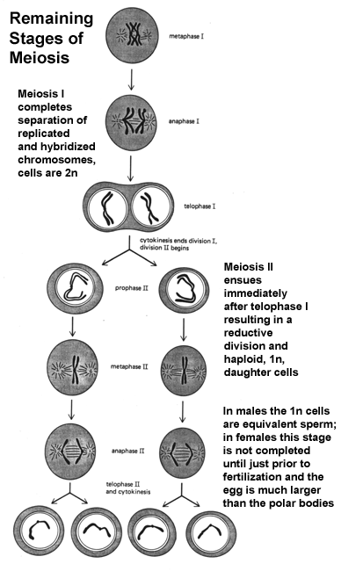
Meiosis
Only in germ cells (gametes)
Go through interphase just like mitosis
Have two stages
Meiosis I
Meiosis II

Slide 13
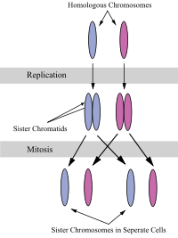
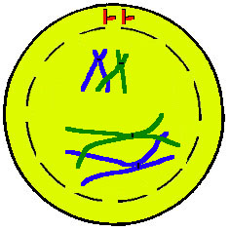
Prophase I
Synapsis – each pair of matching chromosomes line up side by side
Each pair made up of four chromatids called a tetrad

Slide 14
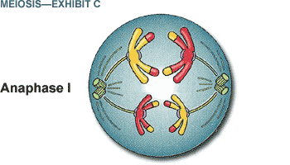
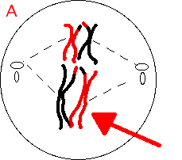
Metaphase 1 and Anaphase 1
Each pair of chromosomes line up beside each other on the equatorial plate
A spindle fiber attaches to the centromere
Spindle fibers shorten pulling on pair of sister chromatids to each pole

Slide 15
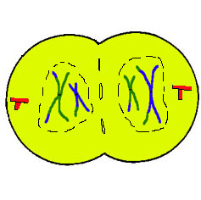
Telophase 1
Some cell move from anaphase I to prophase II
In telophase 1 – chromosomes begin to unwind, spindle fibers disappear, cytoplasm divided, and two cells are formed.
These cell are haploid of the parent cell as they only have half of the genetic information.

Slide 16
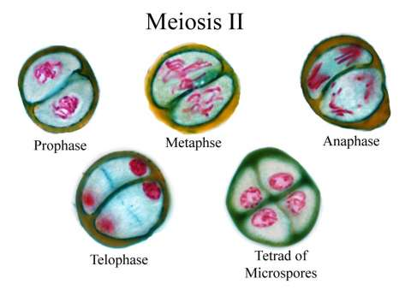
Meiosis II
Just like mitosis
Each cell entering meiosis II is a haploid consisting of a replicated chromosome by the end of this stage each daughter cell will be a single haploid.
Meiosis Crash Course

Slide 17
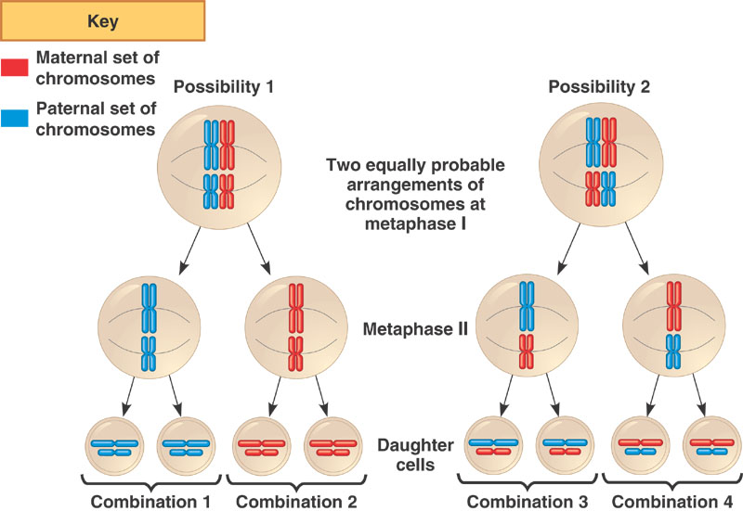
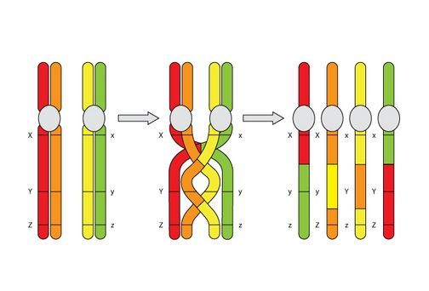
How do we get such genetic variation?
Independent assortment
Crossing Over

Slide 18
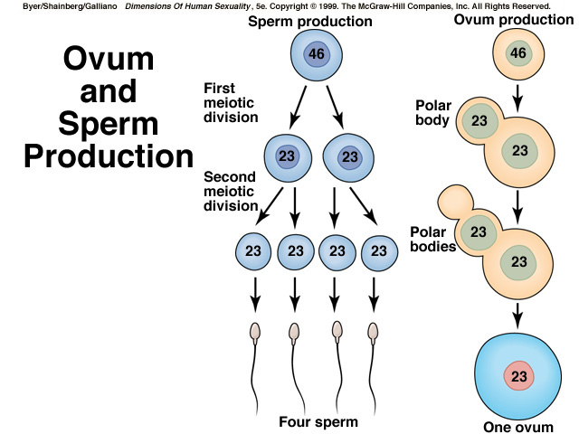
Gametes
Spermatogenesis
Oogensis

Slide 19
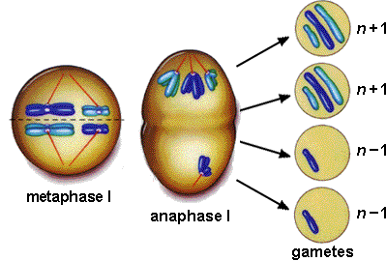
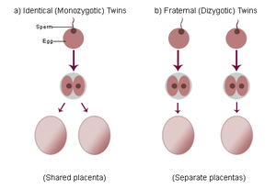
Twins
Fraternal (not identical) – two eggs fertilized
Paternal (identical) – one egg fertilized, but during division of early embryonic development result into two separate cells
Non disjunction

Slide 20
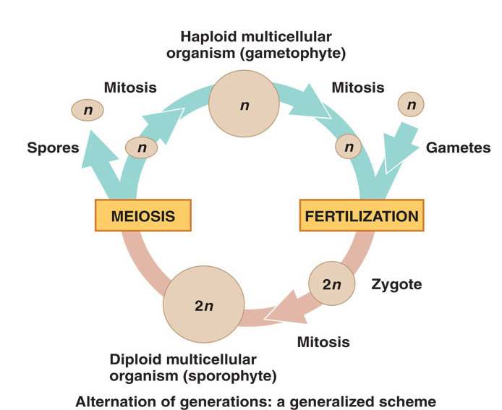
Life Cycles

Slide 21
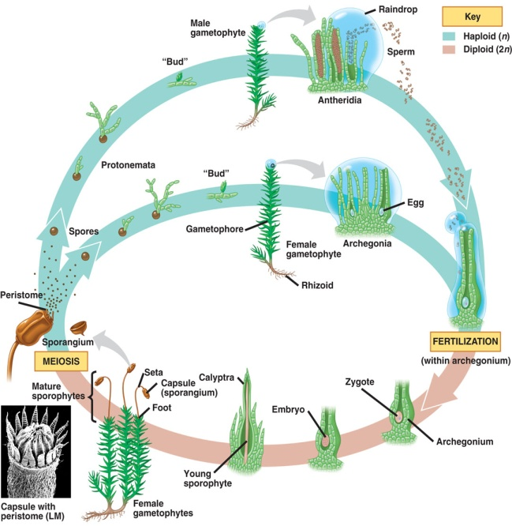
Non-Vascular Plants:
Crash Course
Moss example detail:
Moss have multi-cellular haploid and diploid stages
Meiosis produces spores (N, haploid), which grow into a whole haploid body called the gametophyte
The gametophyte produces gametes (sperm + eggs) by mitosis
Fertilization or Syngamy produces the zygote, “the baby” (2N, diploid)
The zygote grows into the sporophyte stage (2N, diploid), which undergoes meiosis...

